Slide 1
E-commerce Customer Insights Dashboard
Power BI Analysis using Olist Dataset
Prepared by: Yogita Hindlekar

Slide 2
Key Business Metrics
Repeat Purchase Rate: **3.08%** (very low)
Repeat Orders: 3,067
Total Orders: 99K
Customers Analyzed: 96K+

Slide 3
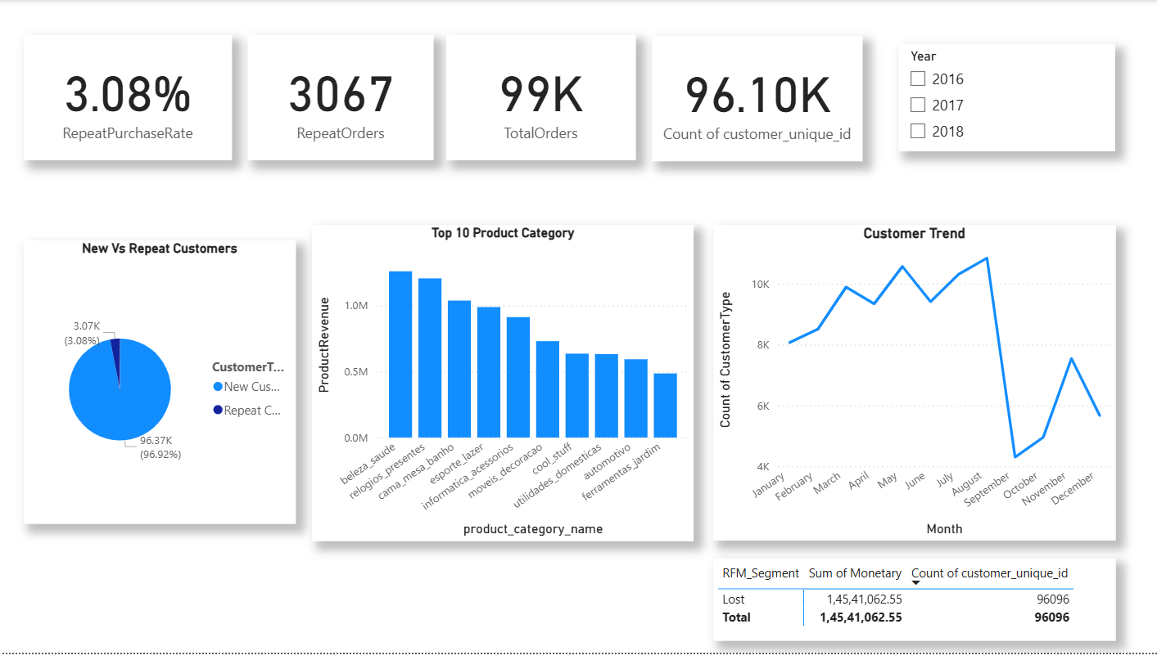

Slide 4
Customer Behavior Insights
97% of customers purchase only once → Low loyalty
Only 3% customers are repeat buyers
Action: Need loyalty programs, personalized offers, and retention campaigns

Slide 5
Order Trends
Monthly trend shows peak around Aug–Sep
Drop in orders after September (seasonal effect)
Action: Boost off-season campaigns to stabilize demand

Slide 6
Product Insights
Top revenue categories: Beauty & Health, Watches, Electronics
Lower revenue categories: Home & garden, automotive
Action: Focus promotions on top products; bundle low performers with high sellers

Slide 7
Customer Segmentation (RFM)
Majority of customers are classified as 'Lost'
Few Champions or Loyal Customers
Action: Implement re-engagement campaigns for lost customers

Slide 8
Key Recommendations
1. Improve customer retention with loyalty programs
2. Target seasonal campaigns around August–September
3. Diversify revenue beyond top categories
4. Focus on reactivating 'Lost' customers
5. Invest in personalized marketing and offers

Slide 9
THANK YOU !

