Slide 1
HR Analytics – Employee Attrition Insights
Tools: Excel + Python (Pandas, Matplotlib, Scikit-learn)
Prepared by: Yogita Hindlekar

Slide 2
Project Overview
Objective: Analyze employee attrition to identify key drivers and retention strategies.
Dataset: IBM HR Analytics Employee Attrition (1470 records).
Tools: Python (pandas, seaborn, scikit-learn), Excel Dashboard.
Model: Logistic Regression for attrition prediction.
Outcome: Insights on factors influencing employee turnover.

Slide 3
Attrition by Department
• Sales Department: 20.6% attrition (highest)
• Human Resources: 19%
• Research & Development: 13.8%
👉 Action: Focus retention and engagement initiatives in Sales and HR teams.

Slide 4
Attrition by Age Group
18–25 years: 39% attrition (highest)
26–35 years: 20%
Above 45 years: below 11%
👉 Action: Implement mentorship and early-career development programs to retain young talent.

Slide 5
Salary and Job Satisfaction
• Low-income employees: 29% attrition
• High-income employees: <11% attrition
• Job Satisfaction Rating 1: 22.8% attrition
• Rating 4: 11.3% attrition
👉 Action: Review pay scales and conduct engagement programs to improve job satisfaction.

Slide 6
Overtime and Attrition
• Employees working overtime: 30.5% attrition
• Employees not doing overtime: 10.4% attrition
👉 Action: Manage workload, promote work-life balance, and monitor overtime hours.

Slide 7
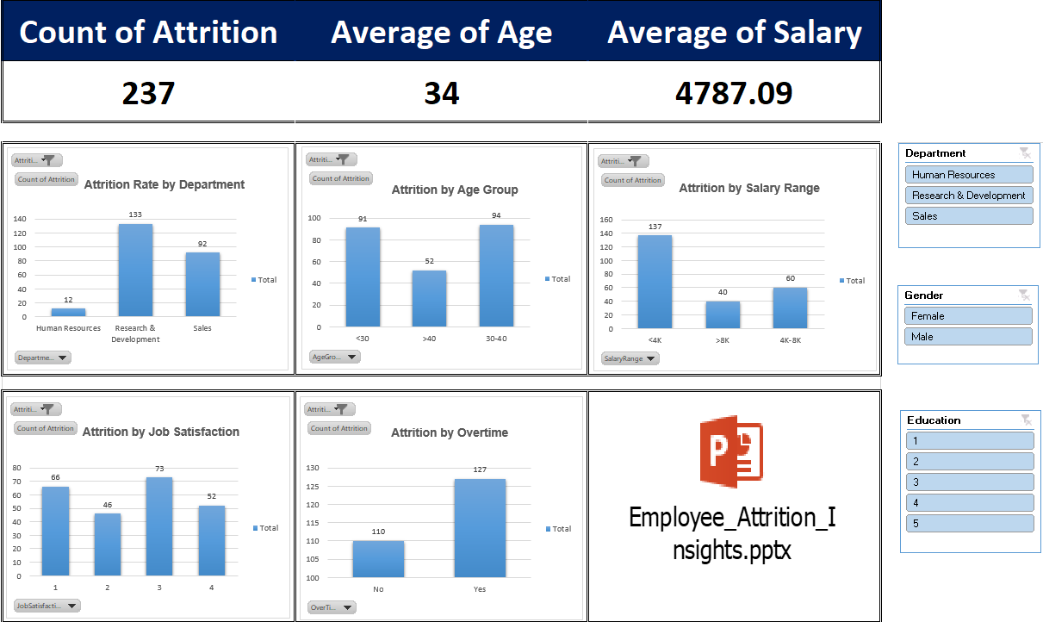

Slide 8
Summary & Recommendations
• Overall attrition rate ≈ 16%.
• Major risk groups: Sales, young employees, low salary, low satisfaction, overtime workers.
Recommendations:
1. Launch early-career retention programs.
2. Improve compensation structure.
3. Conduct regular satisfaction & engagement surveys.
4. Reduce overtime dependency.
5. Provide career growth opportunities in Sales & HR.

