Slide 1
CipherCop Hackathon 2025
Yogeshwar Bugide
Ashok Reddy
Palla Nagender
Ratnadeep

Slide 2
Tracing illegal Crypto currency Transactions
Understanding Techniques & Challenges

Slide 3
What is Crypto Currency
Crypto currency is a type of digital or virtual money that uses cryptography (advanced encryption) to secure transactions.
🔑 Key Features
Decentralized – No central authority (like banks or governments) controls it. Most run on block chain (a distributed ledger).
Secure – Transactions are encrypted and verified by network participants (miners/validators).
Transparent – All transactions are recorded on the block chain and can be viewed publicly.
Borderless – Can be sent/received anywhere in the world, 24/7.
Limited Supply – Many have a fixed supply (e.g., Bitcoin: 21 million max), making them resistant to inflation.
Examples of Cryto
Bitcoin (BTC): First and most widely used.
Ethereum (ETH): Smart contracts and decentralized apps.
Ripple (XRP), Litecoin (LTC), Monero (XMR), Dogecoin (DOGE) etc.

Slide 4

Crypto Currency - TRANSACTION
{
"inputs": [
{
"prev_tx": "abcd1234...",
"output_index": 0,
"signature": "YogeshPrivateKeySignature"
}
],
"outputs": [
{
"address": "GeethaBitcoinAddress",
"value": 10.0
},
{
"address": "YogeshChangeAddress",
"value": 2.5
}
],
"fee": 0.0005
}

Slide 5
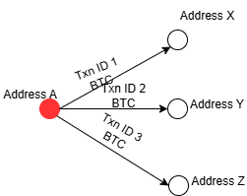
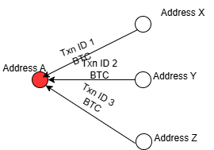
Key Techniques TO TRACE ILLEGAL TRANSACTIONS
• Since many of the crypto are public , we can get the transaction details from Blockchain.com API , Block Cypher API, Block chair API, Ether scan API
• Detecting mixers/tumblers – obfuscation services.
• Chain hopping – cross-chain transfers.
• Peel chains – gradual fund transfers.
• Transaction graph analysis.
• Cluster analysis – grouping related addresses.
FAN OUT
FAN IN

Slide 6
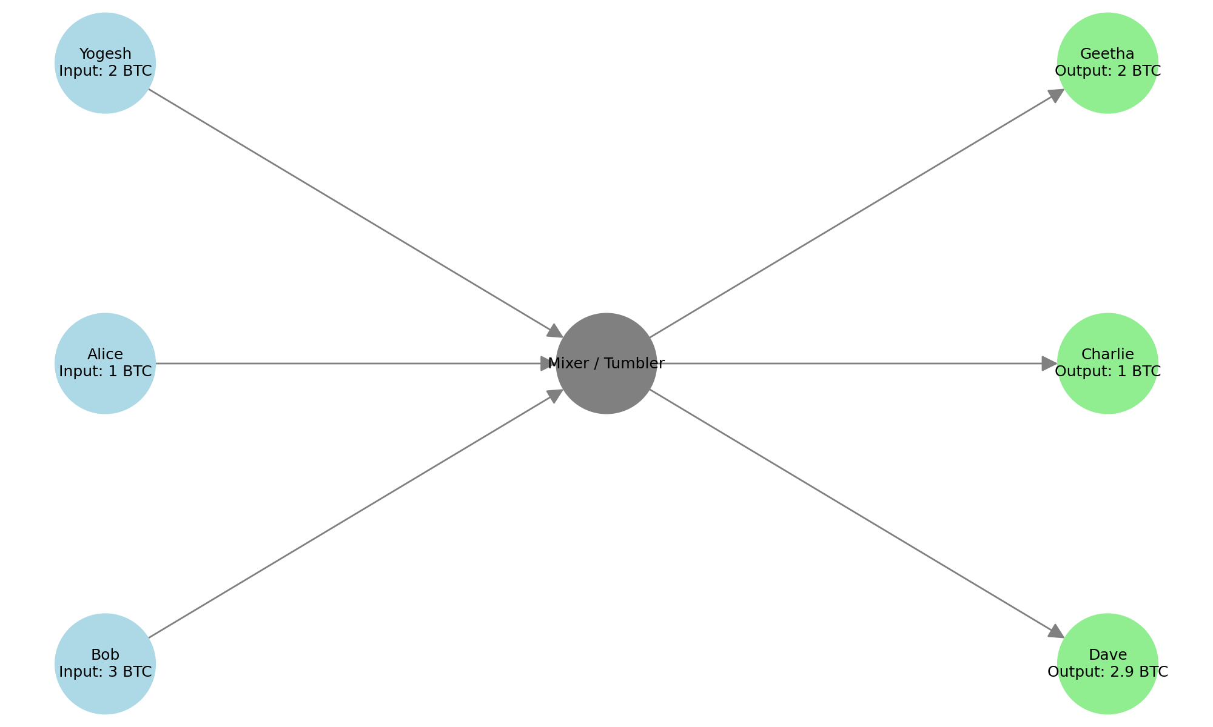
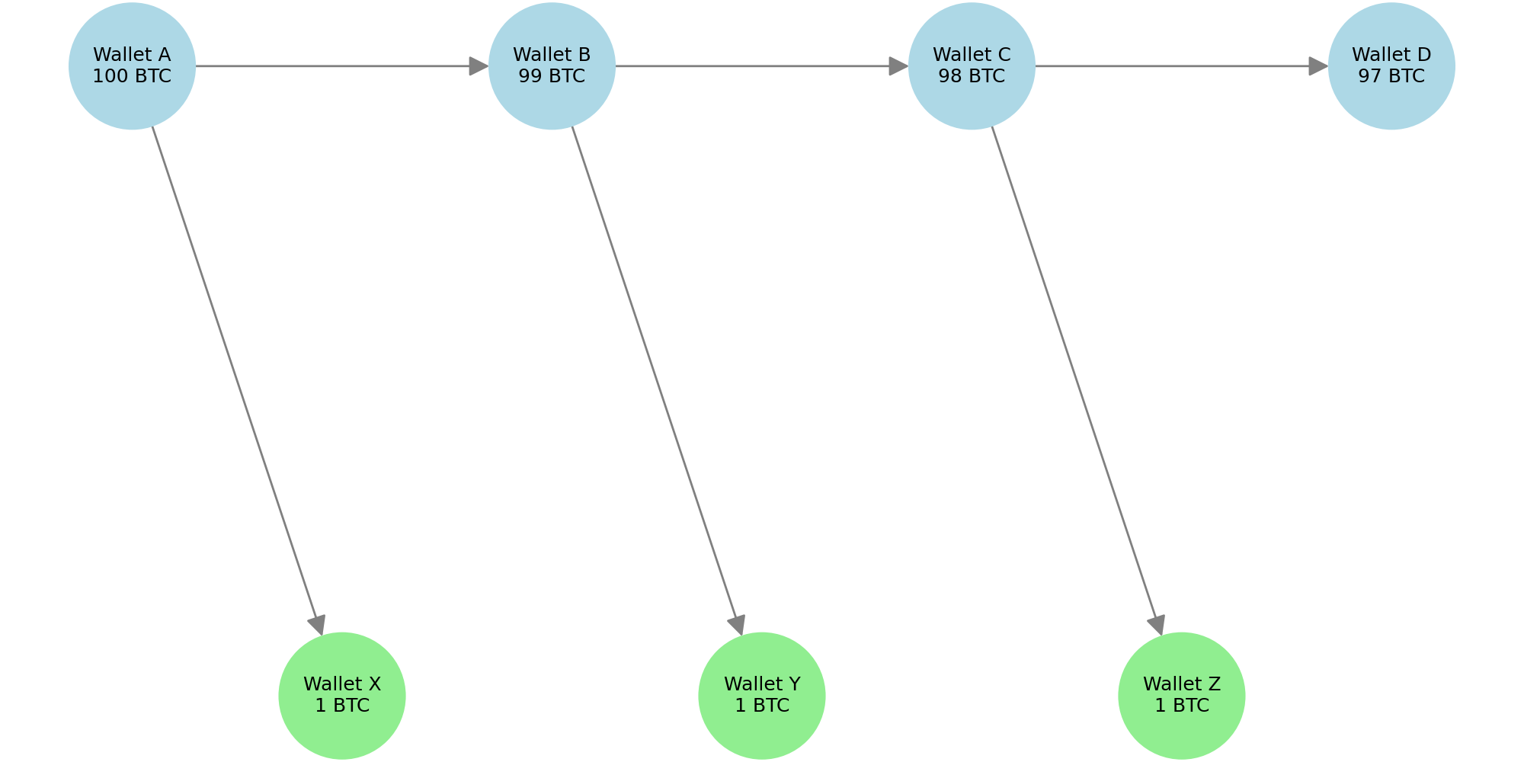
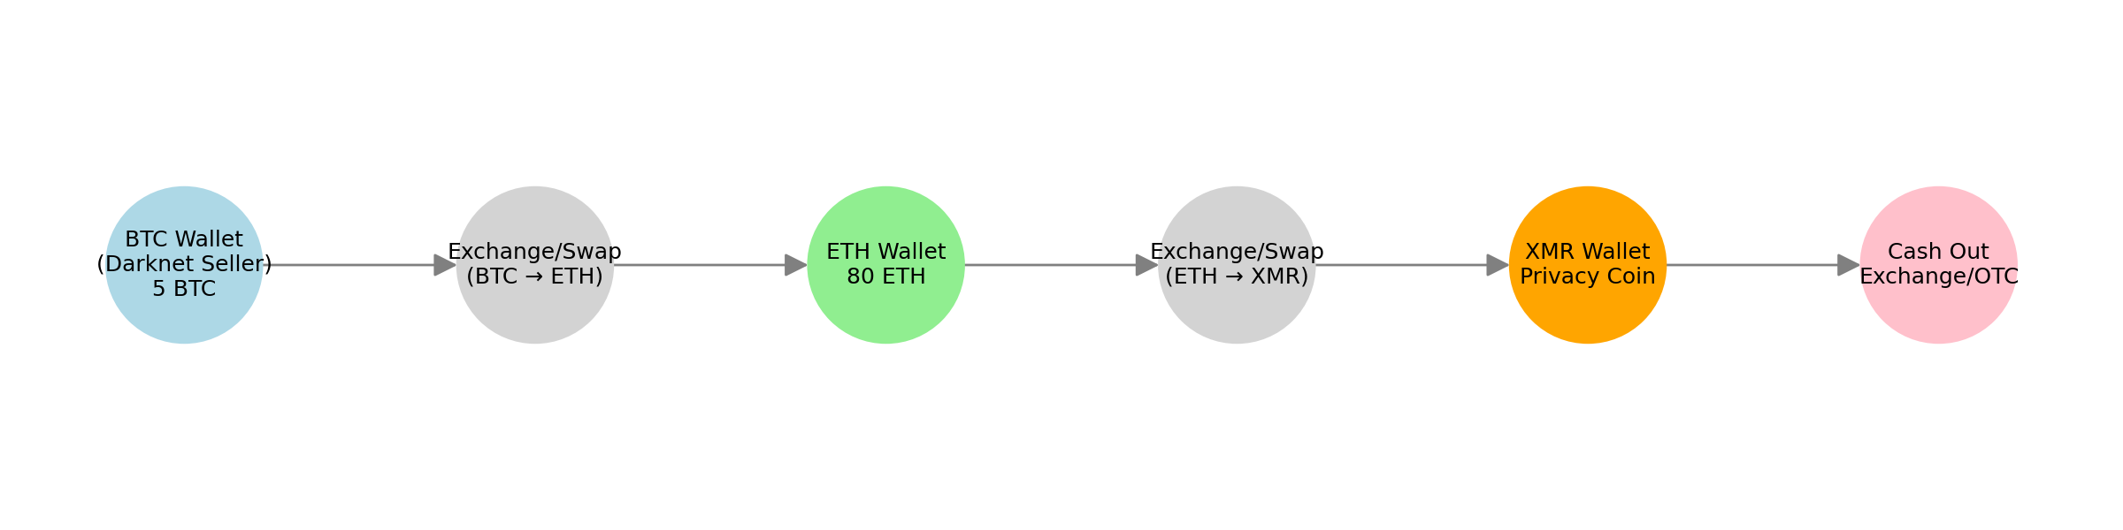
Mixers/tumblers
Peel Chain Pattern
Chain Hopping

Slide 7
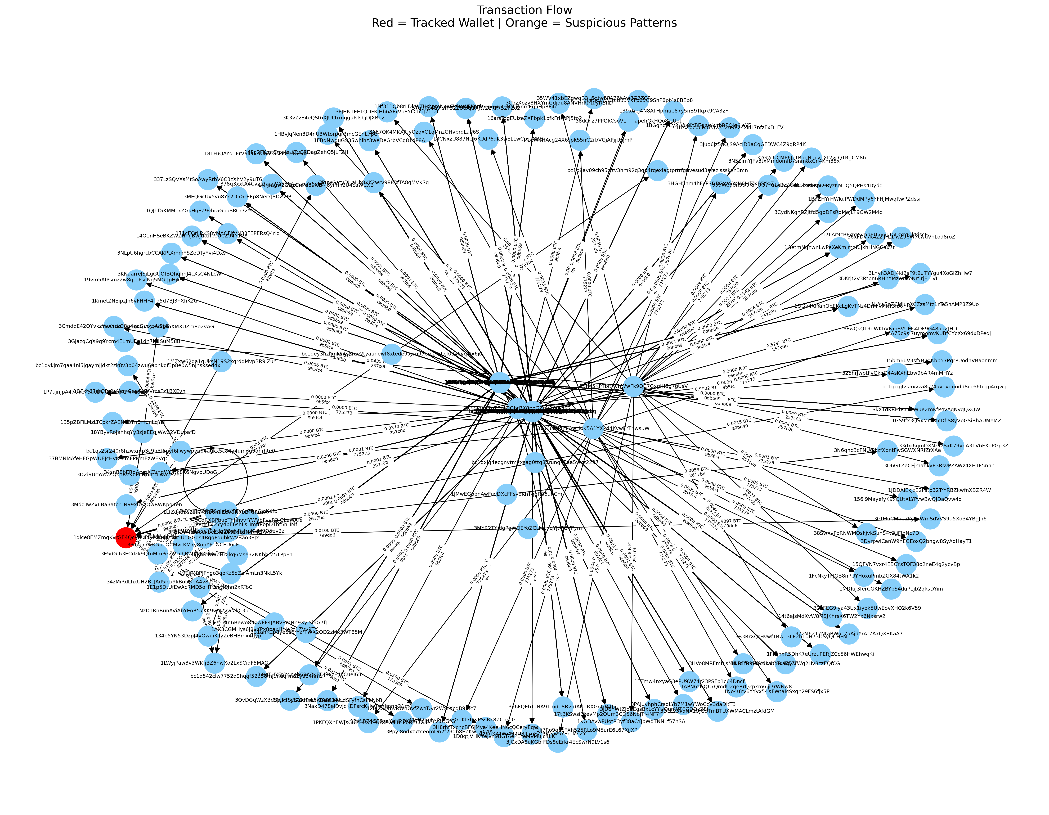
Technicacchnicalhnical approachch
• We need to monitor the transactions continuously from public API’s
• With the help of Python programming and Plotting libraries and Network Graphs we can successfully convert the transactions into Graphs to identify illegal patterns

Slide 8
Conclusion & Future Outlook
• Crypto tracing is essential for financial crime prevention.
• Advances in AI and blockchain analytics improve detection.
• Stronger regulations and global cooperation are key.

