Slide 1
S.Yogul Kishore
211521104187
Wine Grading using AI
3/21/2024 Annual Review

Slide 2
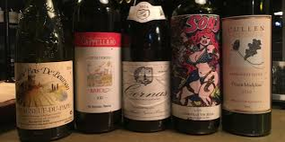
Wine Grading using AI
3/21/2024 Annual Review

Slide 3


AGENDA
PROBLEM STATEMENT
PROJECT OVERVIEW
WHO ARE END USERS?
SOLUTION AND ITS VALUR PROPORTIONS
OBJECTIVES
DATA DESCRIPTION
MODELLING
RESULTS
REFERENCES
3/21/2024 Annual Review

Slide 4

PROBLEM STATEMENT
In industries, understanding the demands of wine safety testing can be a complex task for the laboratory with numerous analytes and residues to monitor.
But, our application's prediction, provide ideal solutions for the analysis of wine, which will make this whole process efficient and cheaper with less human interaction.
3/21/2024 Annual Review

Slide 5

PROJECT OVERVIEW
About wine:
Wine is a beverage made from fermented grape and other fruit juices with lower amount of alcohol content.
Quality of wine is graded based on the taste of wine and vintage. This process is time taking, costly and not efficient.
A wine itself includes different parameters like fixed acidity, volatile acidity, citric acid, residual sugar, chlorides, free sulphur dioxide, total sulphur dioxide, density, pH,sulphates, alcohol and quality.
3/21/2024 Annual Review

Slide 6

WHO ARE THE END USERS?
Winemakers: Winemakers can use quality prediction models to optimize their production processes, improve the quality of their wines, and make informed decisions about harvesting, fermentation, aging, and blending.
Wine consumers: Wine enthusiasts and consumers may use quality prediction tools to make informed purchasing decisions, select wines that match their preferences, and explore new varieties or regions.
Wine retailers: Retailers can utilize quality prediction models to recommend wines to customers, manage inventory effectively, and ensure the quality of the wines they sell.
Restaurants and sommeliers: Restaurants and sommeliers can benefit from wine quality prediction models to curate wine lists, offer personalized recommendations to patrons, and ensure consistency in the wines they serve.
3/21/2024 Annual Review

Slide 7

YOUR SOLUTION AND ITS VALUE PROPOSITION
Precision and Accuracy: Our model employs advanced machine learning algorithms trained on comprehensive wine datasets, ensuring precise and reliable predictions for informed decision-making.
Optimized Production: Winemakers utilize our solution to optimize production processes, adjusting factors like harvesting time and fermentation techniques for enhanced quality and consistency.
Improved Consumer Experience: Consumers receive personalized wine recommendations based on their preferences, enriching their exploration of high-quality wines tailored to their palate.
3/21/2024 Annual Review

Slide 8

THE WOW IN YOUR SOLUTION
"The wow in your wine quality testing project lies in its ability to accurately predict wine quality using cutting-edge machine learning algorithms. By leveraging comprehensive datasets and sophisticated analysis techniques, your solution offers unparalleled precision and reliability in assessing wine quality. This means winemakers can make informed decisions to optimize their production processes, resulting in consistently high-quality wines. Additionally, the personalized recommendations provided to consumers enhance their wine exploration experience, ensuring they discover wines perfectly suited to their preferences and taste profiles. Overall, the wow factor of your solution lies in its transformative impact on both winemaking practices and consumer satisfaction."
3/21/2024 Annual Review
8

Slide 9
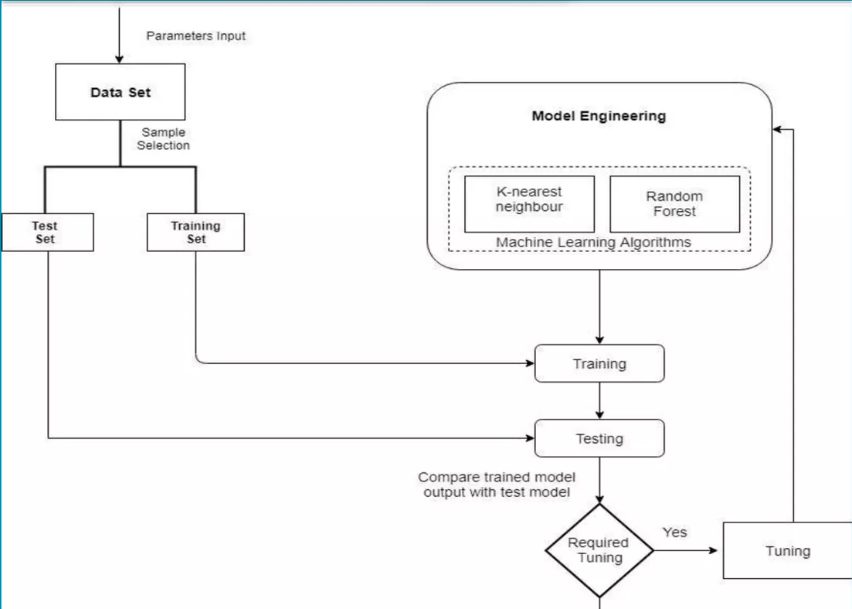
MODELLING
Teams cam add wireframes
3/21/2024 Annual Review
9

Slide 10
RESULTS
Data Collection: Compile a dataset with wine attributes like acidity, residual sugar, pH level, alcohol content, and quality ratings (subjective or objective).
Data Preprocessing: Cleanse the dataset by addressing missing values, outliers, and inconsistencies. Normalize or scale features for improved model performance.
Feature Selection/Engineering: Identify relevant features through methods like correlation analysis, principal component analysis (PCA), or domain knowledge-driven engineering.
Model Selection: Choose a suitable machine learning algorithm (e.g., linear regression, decision trees, random forests, SVM, gradient boosting, or neural networks) for wine quality prediction.
Demo Link
3/21/2024 Annual Review
10

