Slide 1

Dandelion Consulting
Conjoint Analysis Of
EarlyRiders’ Toy Horse
Group P
Section: 13B
Case 4: Toy Horse Case
Date: Dec 6th, 2021
Group P members: Maheen Ansari, Yufeng He, Chenxi Hu, Lili Wang, Qi Zhang

Slide 2



Summary (Key Insights & Recommendation)
Key Insights
Recommendation
Conjoint Analysis
Four attributes: price, height, motion, and style
Competitor’s response is strong and effective enough to get market share back
Best product profile for EarlyRider
Launch P4 (119.99, 26 inches, Bouncing , Racing) and P6 (119.99, 18 inches, Rocking Racing)
Maintain profile 4 and 6 even if after competitors' response
Notes:
After running the simulation and comparing the P4,P6 is the best- this is what maximizes the companys profitability
Even if competitor lowers their price – EarlyRider should maintain profile 4 and 6 to be consistent.
Priori segmentation – good approach to understand our segment and as result maximize profit.

Slide 3

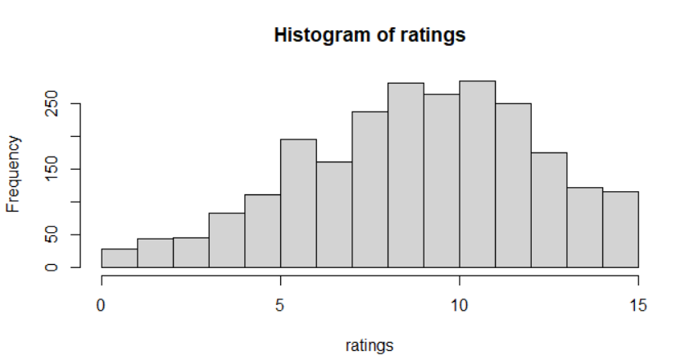
Conjoint Analysis
Why is Conjoint Analysis
Product Profiles
Sample Data visualization
Analysis Goal
Product revitalization
Increase market share
Long-Run Profitability
Tool
Conjoint Analysis
Quantify consumer preferences
Survey Data
Sample size: 200
Method
A priori segmentation
Post-hoc segmentation
 | Price | Size | Motion | Style
0 | 139.99 | 18” | Bouncing | Racing
1 | 119.99 | 26” | Rocking | Glamour
63%
37%
48%
52%
Notes:
What is conjoint analysis? Model displaying consumer preferences, allowing prediction of how consumers would choose between products and services that are or may become available on the market. In our case it is most suited analysis since it gives us better insight on what kids prefer in terms of toys. This allows company to make better decision on how to change up their strategy to attract more consumers or give competition to rival companies.

Slide 4

A Priori Segmentation: Demographic information
Demographic Variable
Subgroup of Age
Findings
Gender
Age = 0 (2)
Gender and Age segmentation are insignificant on style
Coefficient | P-Value
price:gender | 0.85651
size:gender | 0.03783 *
motion:gender | 0.14016
style:gender | 0.69041
Coefficient | P-Value
Price | < 2e-16 ***
Size | 0.403
Motion | < 2e-16 ***
Style | 2.08e-06 ***
Gender segmentation is insignificant
Age segmentation is significant
Age
Age =1 (3-4)
Interactions | P-Value
price:age | 0.0462 *
size:age | < 2e-16 ***
motion:age | < 2e-16 ***
style:age | 0.3795
Interactions | P-Value
Price | < 2e-16 ***
size | < 2e-16 ***
Motion | 1.90e-06 ***
style | 8.73e-06 ***
Subgroup of age as the result of a priori segmentation
Notes:
Whereas gender is found not significant in priori segmentation, age is distinguished to be significant in the segmentation.

Slide 5
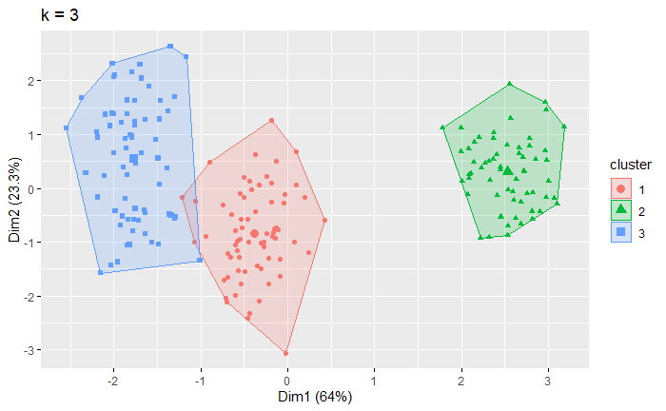
Post-hoc Segmentation: Cluster Analysis
Optimal number of Cluster is 3
Cluster Segmentation Percentages

Slide 6
Ideal product profile in Priori & Post Segmentation
A Priori Segmentation
Post-hoc Segmentation
Price
Size
Motion
Styling
Price
Size
Motion
Styling
Product profiles:
2 yrs: P6
3-4 yrs: P4
Product profiles:
Segment 1: P9
Segment 2: P11
Segment 3: P5

Slide 7
Market Simulation
Toy Horse Market Share
Methodology:
Simulate market share into 5 scenarios
Profile 5 & 13 is status-quo market
Profile 4 & 6 is priori segmentation
Profile 5 & 11 & 9 is post- hoc analysis
Scenario 3: 5 & 9
Scenario 4: 5 & 11
Scenario 5: 11& 9
Finding:
Scenario 2 with Profile 4 & 6 steal the most of competitor’s share. It increase market share to 92%
Scenario 2 is the best option
Notes:
Scenario 4 proves that the result of a priori segmentation: P6 for 2-year-old children, and P4 for 3–4 years old children, is the best guidance for new product launch

Slide 8
Scenario 2: Launch Profile 4 and 6
By launching profile 4 and profile 6
the market share of EarlyRiders is estimated to increase from 32.9% to 92.1%
Status quo Market Share
Scenario 2 (before competitor’s response)
Notes:
Scenario 4 will make EarlyRiders dominate the toy horse market

Slide 9
No competitive response to the launch of P4 & 6
EarlyRiders’ product:
Profile 4: 26” Bouncing Racing horse at 119.99
Profile 6: 18” Rocking Racing horse at 119.99
Competitors’ product:
Profile 7: 26” Rocking Racing horse at 139.99
Finding:
EarlyRiders will make huge profit if the competitor does not response to the launch of P4 & 6
Total profit of EarlyRiders in the first 2 years will be $ 311,454
Notes:
EarlyRiders will make huge profit if the competitor does not response to the launch of P4 & 6

Slide 10
Scenario 2 is still the best option with response
Findings
Market Share
Assume the competitor will only response when their market share is smaller than 50% (scenario 2,3)
Competitor is likely to response by lowing the price, which is use profile 8 to replace profile 7
Profile 8:
26” Rocking Racing horse at 119.99
Notes:
Even if the competitor response to the threat from EarlyRiders, Scenario 2 is still the best option

Slide 11
Scenario 2 is still the best option with response
Competitor’ s response is strong and effective enough to get market share back. However, in scenario 2, EarlyRiders still holds 67% market share.
Before Competitor’s response
After Competitor’s response
Notes:
Scenario 2 will make EarlyRiders still keep a large share after the competitor lower their price

Slide 12
Profitability of Scenario 2 in the short-run
Competitor response, change the market share of P4 & 6
Competitor response, change the market share of P4 & 6
Assume competitor will response in the 2nd year
Assume competitor will response in the 3rd year
Notes:
EarlyRiders can still make considerable profit after the competitor’s response by holding profile 4 &6

Slide 13
Profitability of Scenario 2 in the long-run
Assume competitor will response in the 2nd year
The profit in Year 10: $ 309,147

Slide 14
Conclusion
Market Segmentation
Market Simulation
Product Profile
Priori Segmentation
Market Share
Profile 4
Age Segmentation
Product Profile 4 & 6
119.99 & 26 inches
Competitor’s Response
Bouncing & Racing
Post-hoc Segmentation
Profitability
Profile 6
3 cluster segmentation
Product Profile 5 & 9 & 11
Short Run
119.99 & 18 inches
Long Run
Rocking & Racing
Notes:
EarlyRiders can still make considerable profit after the competitor’s response by holding profile 4 &6

Slide 15
THANKS
For Watching
Dandelion Consulting

Slide 16
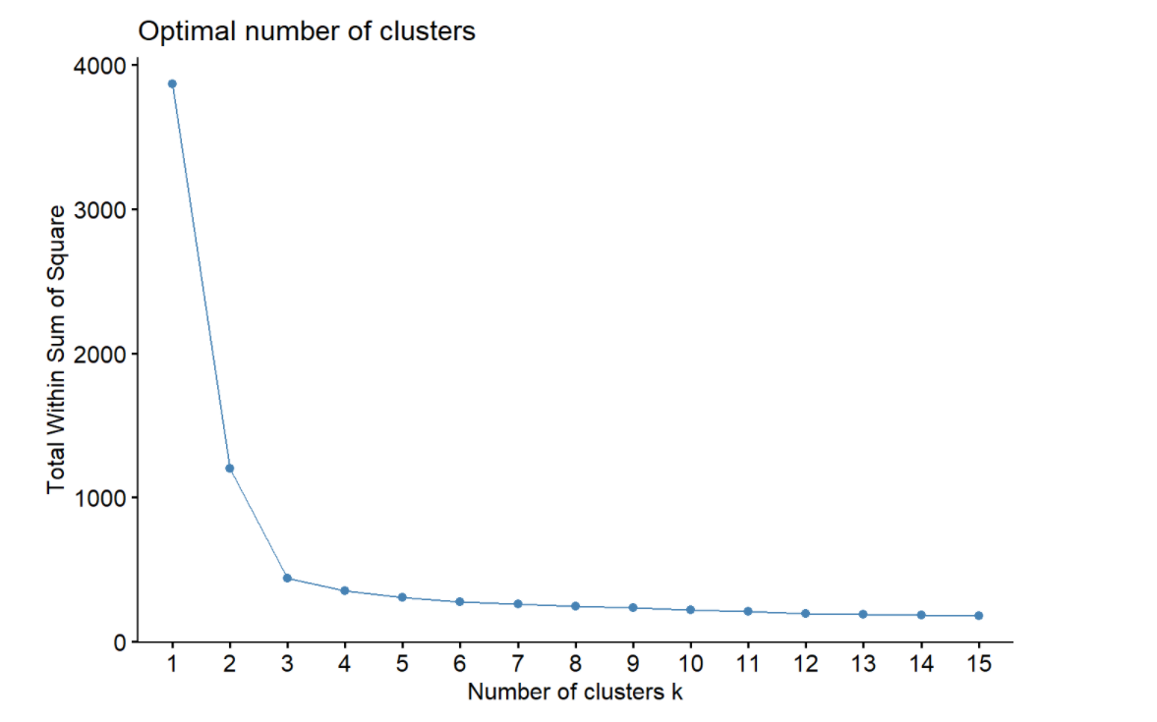
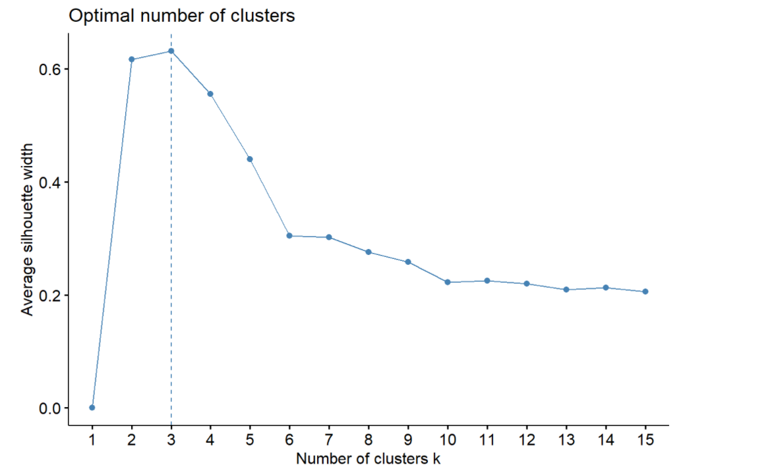
Appendix
Optimal number of Clusters

Slide 17
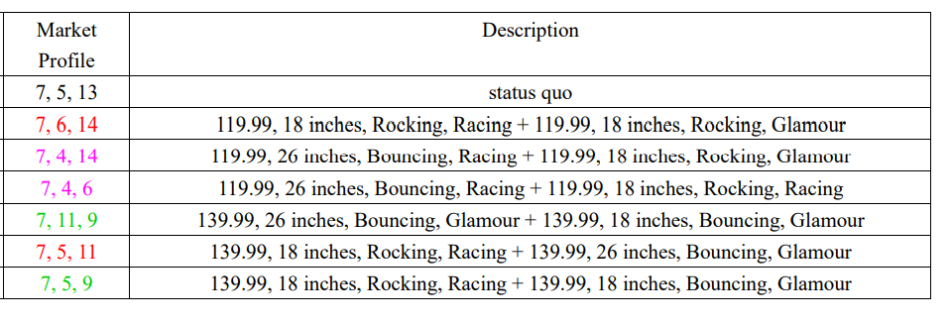
Appendix
Market profile of all scenarios

Slide 18
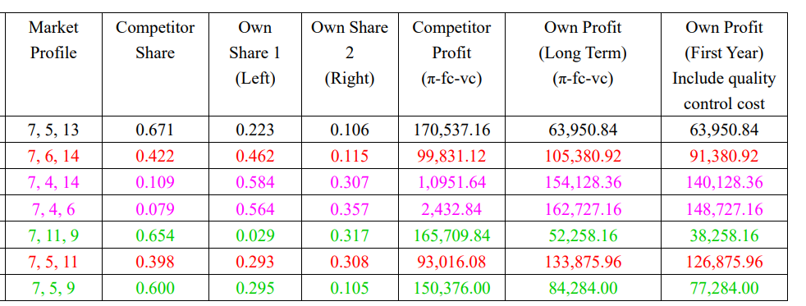
Appendix
Market profile of all scenarios

Slide 19
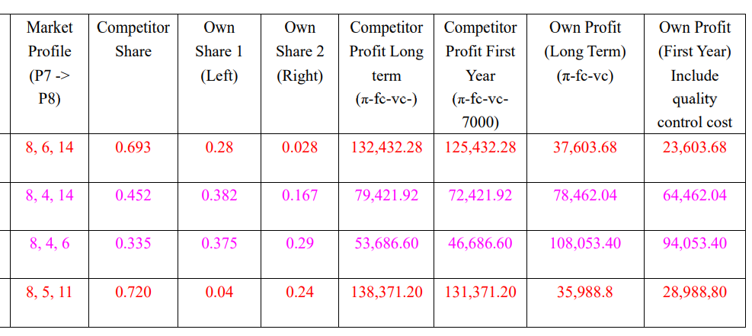
Appendix
Market profile of all scenarios
—— AFTER Competitor’s response

