Slide 1
CIS 423 – SPRING B | FINAL PROJECT
DECISION SUPPORT SYSTEM
for HELOC Case
April 28th, 2022
Members: Shiwei Chen, Yicheng Gao, Aijia Li, Lili Wang, Tianyao Xin

Slide 2
Content
Giving an overview of our project and system
CASE OBJECTIVES
DATA DESCRIPTION MODEL SELECTION
INTERACTION INTERFACE LESSONS LEARNED
Data
Models
Decision
Making

Slide 3
Case Objectives
Understanding business intuitive behind models
PREDICTIVE MODEL
A data-driven credit risk model in Python
Predict probabilities of default of borrowers.
INTERACTIVE INTERFACE
Build an interactive interface to sales representatives
Input features, outputs decisions and reasons

Slide 4
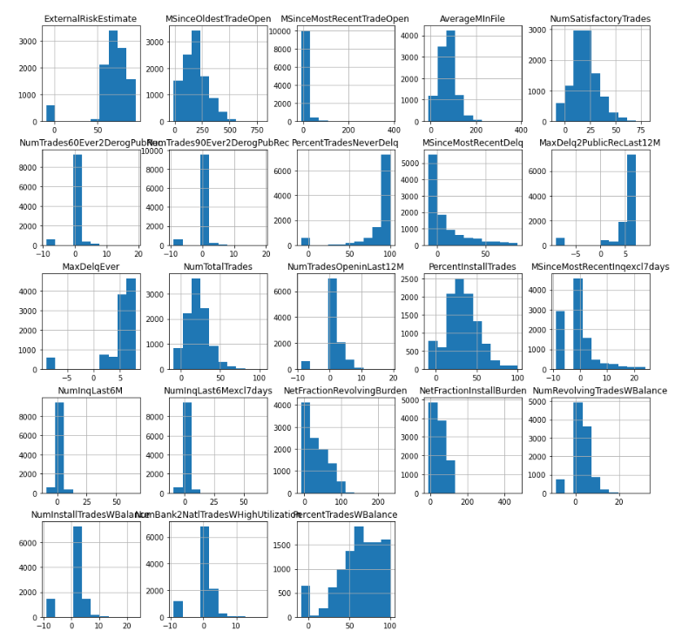
Data Description
Transforming features for better model performance
DATA PROFILE
Data size: 10,459 observations
Feature: 23 features
Measure banking activities of applicants
TRANSFORMATIONS
Process the missing value == 34 variables
Generate the dummy variable for risk performance
Target = 0, "Good"
Target = 1, "Bad"

Slide 5
Model Selection -- characteristics
Understanding models to capture features’ information
 | Decision Tree | Random Forest | LGBM | Logistic
Basic logic | Split a population of data into smaller segments | Bagging and ensemble learning techniques | Histogram-based algorithm | Stochastic gradient descent
Overfitting | More prone to | More prone to | Less prone to | Less prone to
Noise influence | Very sensitive | Not sensitive | Not sensitive | Not sensitive
Data requirement | Low | Low | Low | High
Time consumption | Long | Medium | Short | Short
Interpretation | Medium | Hard | Medium | Easy
Limitation | Instable model; High variance; Fail to perform equally well on new data. | Training time and computational resources grow with the number of trees created. | Generate a very complex tree; Overfitting on small datasets. | Requires a large data set; Sensitive to outliers; Requires each training example to be independent.
Advantage | Less affected by missing values. | Less affected by the introduction of new data points. | Lower memory usage; Performs equally well on large datasets with less training time. | Easily updated to reflect new data; Outputs well-calibrated probabilities along with classification results.

Slide 6
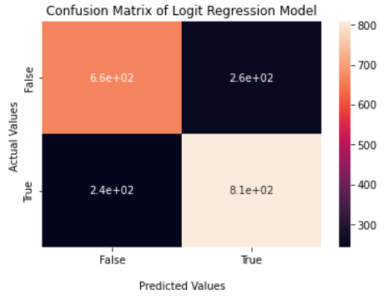
Model Selection -- requirements
Accuracy and two types of error are our benchmarks
IMPORTANT METRICS
False Negative:If the model has predicted the client will repay the loan but he has defaulted.
False Psitive: If the model has predicted the client will default but he can pay the loan, the bank will loss in return interest.
Model | ROC-AUC | Cross-Validation Accuracy
Decision Tree | 0.78 | 0.713
Random Forest | 0.80 | 0.728
LGBM | 0.81 | 0.735
Logit Regression | 0.81 | 0.738

Slide 7
Interaction Interface
The system generates simple outputs for decision making
Process
Inputs
Output
Overall Score
Probability of risk performance
Similar Candidates
Features of existing / potential borrowers
Logit Regression

Slide 8
Lessons Learned
LIMITED EFFECT OF FEATURE ENGINEERING
Many variables in the dataset are closely related, with strong correlations. Transforming or even deleting some variables cannot affect the output to a great extent.
TRADE OFF OF MODEL SELECTION
Both False Negative and False Positive cases should be taken into account. The former can avoid bad debts, and the latter is to avoid a situation where the expected rate of return and market share declines due to being too conservative in daily operations.
REASON FOR HIGH-RISK SCORE IN RESULT
The Logit Regression Model fails to pinpoint the primary factors leading to high risk when providing high risk probability predictions. We provide a reference for why applicants are considered high risk by looking for similar cases.
Notes:
mention: we did not use demographic features to segment
although C has willingness to pay. but when 8 and 7 are both available, C will choose 8, the cheaper one.

