Slide 1
Tender Compliance Agent
Public bids are rejected on paperwork before anyone reads them.
This agent finds the gaps first.
AGENTS FOR HUMANS · PROFESSIONAL AGENTS TRACK · BUILT WITH THE STRANDS AGENTS SDK
Notes:
20 s. Say what it is before saying why it should exist.
"This is a compliance agent for public tenders. You give it the buyer's
consultation file and the list of papers your company holds, and it tells you
what is missing, what expires too soon, and what a human still has to look at."

Slide 2
A bid dies on the paperwork
€100 bn
of French public contracts a year, roughly — and a bid can be thrown out before anyone reads it. Not on price. Not on technique. Because an attestation expired three days before the deadline, or a form was missing.
« Les candidatures incomplètes ou demeurées incomplètes à la suite d'une demande de compléments sont éliminées. »
RÈGLEMENT DE LA CONSULTATION — ANTAI, ARTICLE IV.9
The buyer has that checklist. The bidder does not.
A small firm without a bid office is assembling forty documents across several open tenders, from a folder nobody has re-read since the last one.
Notes:
35 s. The quotation is the strongest thing on the slide because it is not your
claim — it is the buyer's own wording, in the file itself.

Slide 3
A Professional Agent
It does one job inside somebody's working day: the person assembling a bid, before they submit it.
Not an assistant, and it does not chat. It reads a document, checks every claim against it, and produces a compliance matrix.
The model observes. The code decides.
Everything after this slide is a proof of that one sentence.
Notes:
20 s. Say the rule slowly. It is the thesis of the whole submission, and every
later beat exists to prove it.

Slide 4
Four verdicts, because there are four actions
COVERED
a document in your library answers it
MISSING
nothing does
EXPIRES TOO SOON
it answers today, and not on the submission date
TO REVIEW
a human has to look
And two counts, not one: an incomplete candidature is eliminated, an irregular offre may be invited to correct itself.
The same missing paper ends the bid in one case and is recoverable in the other.
Notes:
20 s. Do not read the table aloud — it reads itself. Spend the words on the two
piles, which is the part nobody expects.

Slide 5
Real files, and one honest fabrication
rc_ANTAI_2026.pdf
French · 34 pages
Ministry of the Interior. 27 pages store part of their text as images.
rc_2026SDCRH05.pdf
French · 14 pages
DGAC. The negative control: nothing hidden.
itt_EP_COMM_2026.pdf
English · 16 pages
European Parliament. A turnover floor of EUR 175 000.
itt_EFSA_2023.pdf
English · 5 pages
EFSA — and one requirement of it is in French.
All four are published by public buyers and downloadable by anyone, without registration.
The evidence library is fabricated, and the repository says so. Publishing which of a real company's certificates have lapsed is not something a demonstration gets to do.
Notes:
25 s. The last sentence buys more credibility than anything else in the video.
Say it, and do not hurry it.

Slide 6
▶ Live, in both languages
DGAC, French — 17 s. European Parliament, English — 35 s.
Nothing here is replayed.
CUT THIS SLIDE IN THE EDIT — IT MARKS WHERE THE SCREEN RECORDING GOES
Notes:
65 s of screen recording, two runs. `python demo/walkthrough.py` drives both.
RUN 1 — DGAC, French, 17 s:
python -X utf8 -m tender_compliance samples/real_dce/rc_2026SDCRH05.pdf
--pages 5-6 --today 2026-08-23 --html out/dgac.html
Talk over it. Then open out/dgac.html, stop talking, and let them read the
'-9 d' row. One sentence after: the requirement stays French because the tender
is French and the code checks the quotation against the page it cites — the
English sits beside it, never instead of it.
RUN 2 — European Parliament, English, 35 s:
python -X utf8 -m tender_compliance samples/real_dce/itt_EP_COMM_2026.pdf
--today 2026-08-23
READ THE BANNER OFF THE SCREEN; the count moves on every run (39 requirements,
8 covered, 31 fatal on 2026-09-04). Then point at what is NOT there: no
translation lines anywhere. The tool worked out that this document needs none.

Slide 7
What the real files gave back
−9 d
An insurance certificate valid today and expired on the day bids are due. Nobody catches that by reading — it is a subtraction.
27 / 34
Pages of the ANTAI file storing part of their text as images. So the tool refuses to call anything absent, and names the pages to open by hand.
1 of 4
Requirements in the “English” EFSA pack that are written in French — found on the first run of a real document.
Every count moves between runs. Every quotation, and every verdict computed from it, does not.
Notes:
25 s. If ANTAI is not in your take, drop its line and keep the other two. The
EFSA one is the most surprising and the cheapest to say.

Slide 8
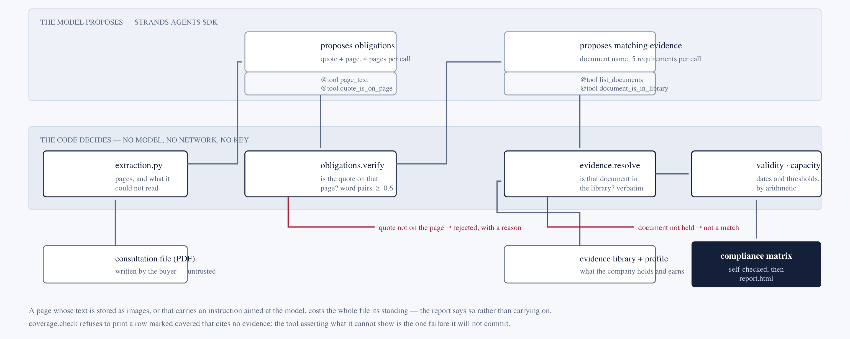
How it does it
Both agents are Strands agents, and both are given tools — page_text, quote_is_on_page, list_documents, document_is_in_library. A tool the agent never calls changes nothing: the verification runs either way.
Notes:
35 s, over the diagram. This slide answers judging criterion 1.
"Two bands. The model proposes on top, twice — the obligations in the text, then
which document might answer each one. It decides nothing. Everything below is
deterministic. A quote that is not on the page it cites is rejected, with a
reason. A document that is not in the library, verbatim, is not a match. Dates
and thresholds are arithmetic and never reach the model at all."
Then the tools, off the strip at the bottom. If ten seconds are spare: "the
English translation is the one thing on the page a model wrote and nothing
verified — so it is the one thing that decides nothing."

Slide 9
Who it is for
The person assembling the bid: a small firm without a bid office, a subcontractor, a first-time bidder.
The buyer already has this checklist. The bidder does not. Getting it wrong costs a contract that was winnable on the merits — which is why the tool would rather say “check this” than say “covered”.
It does not write your bid, and it does not tell you that you are compliant.
It finds the gaps and shows you where to look.
Notes:
20 s. Saying plainly what it does not do reads as confidence, not as a caveat.
Do not soften it.

Slide 10
Recorded, and deliberately not built
One requirement with several satisfaction paths — matching the alternatives rather than only flagging them.
Requirements the buyer can obtain itself from an official register, legitimately absent from any folder.
Groups of operators: the checklist multiplies per member while the capacity thresholds are assessed on the group as a whole.
Each one is in samples/real_requirements.json with the sentence that revealed it. Not one was visible from the specification — they came out of reading real documents.
Notes:
15 s. First slide to cut if you are over time — it is in the Devpost text and in
the repository.

Slide 11
Public bids are rejected on paperwork
before anyone reads them.
This agent finds the gaps first.
github.com/Yoh5/tender-compliance-agent
Notes:
10 s. Leave the URL on screen for a beat after you stop talking, then end. No
thank-you slide.

