Slide 1

UML PROJECT
Yohan Saba Karim Bouaza Quentin Fourie Romain Castellari

Slide 2
Diagrams presentation

Slide 3
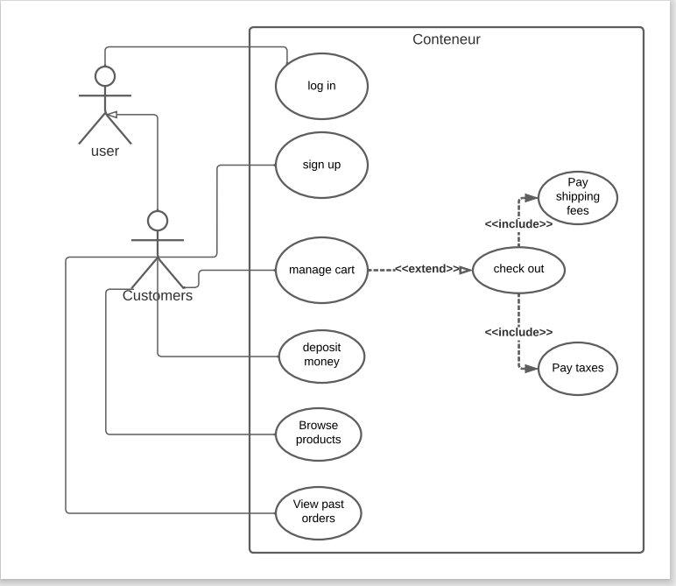

Slide 4
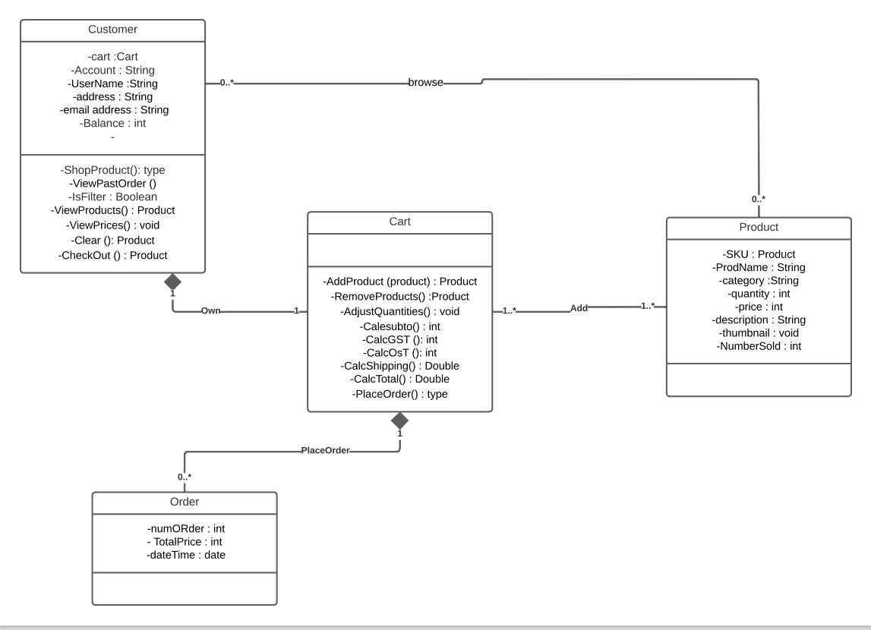

Slide 5
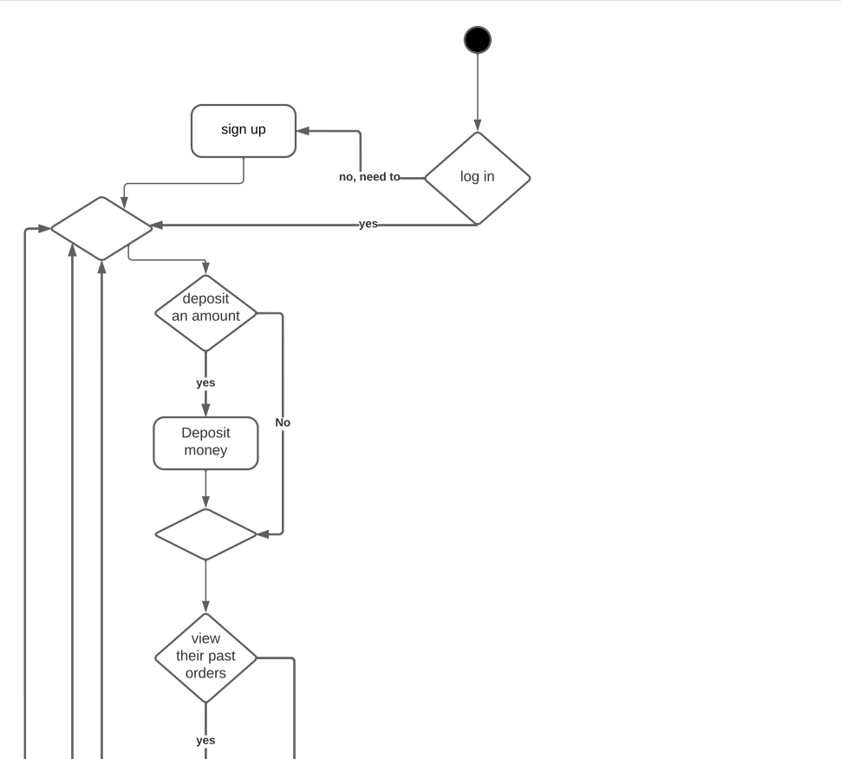

Slide 6
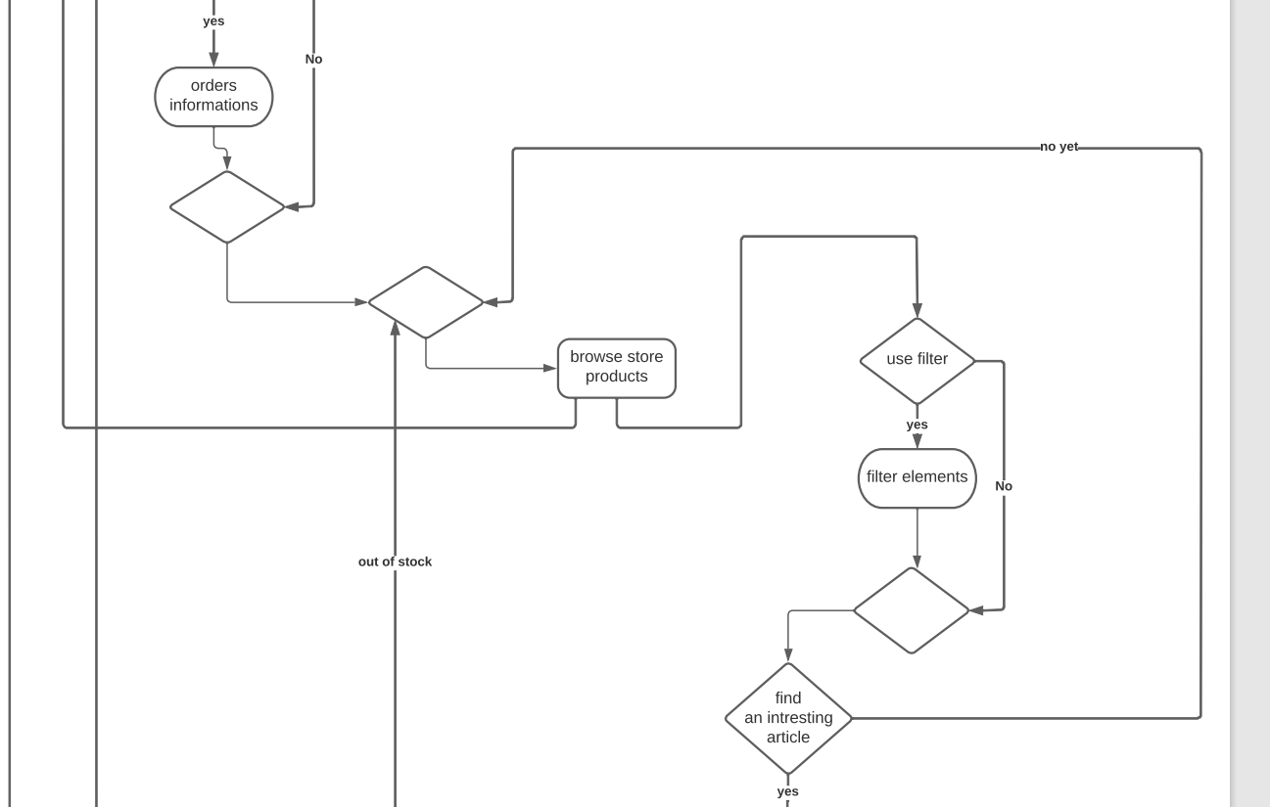

Slide 7
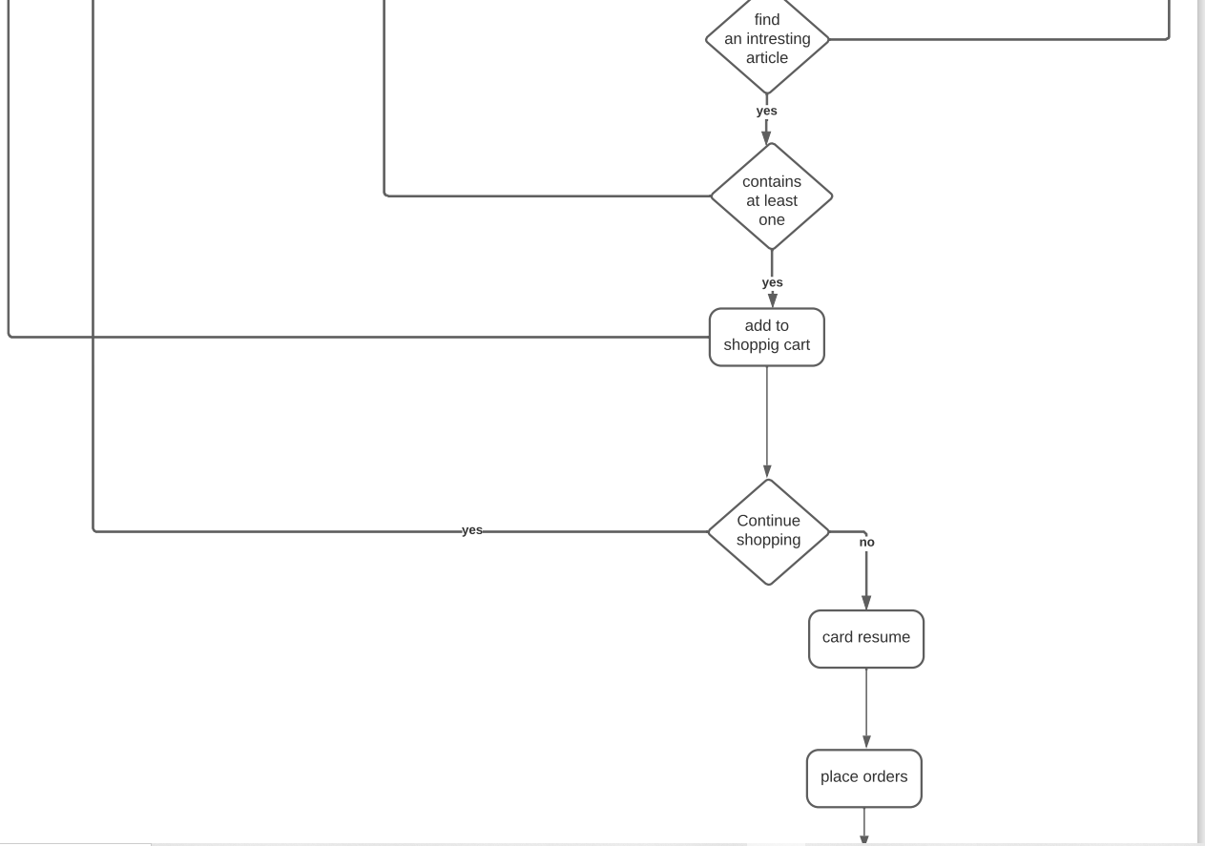
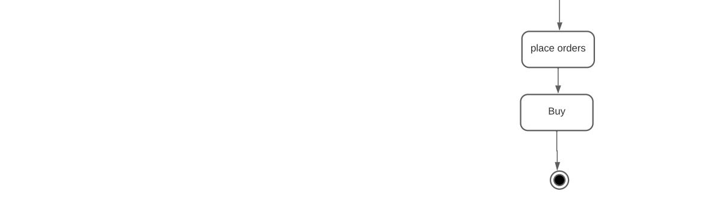

Slide 8
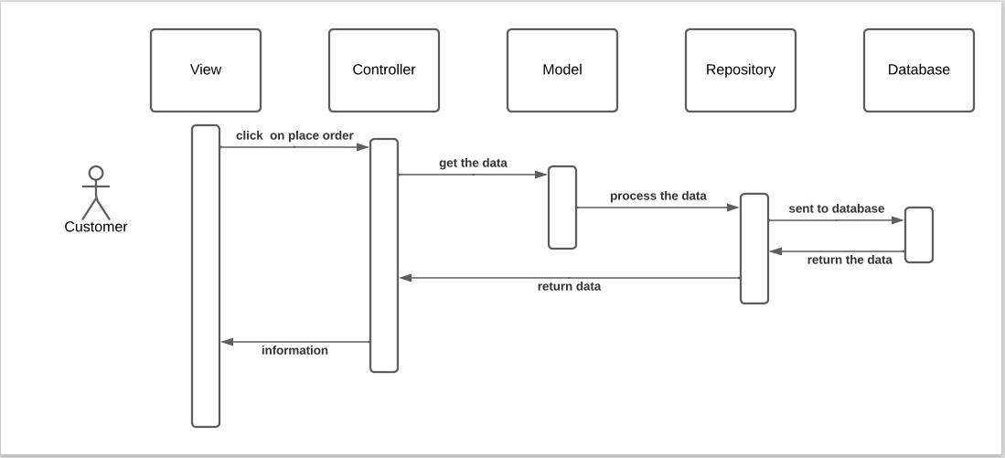

Slide 9
Login and Register
Implementation KeyParts

Slide 10
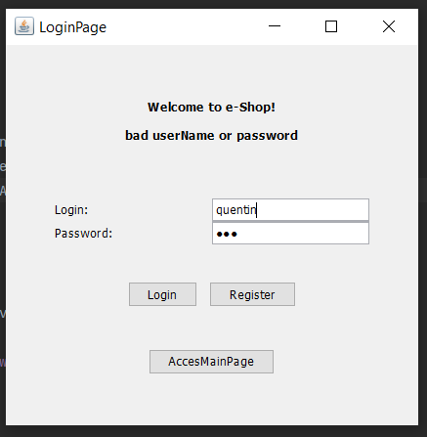
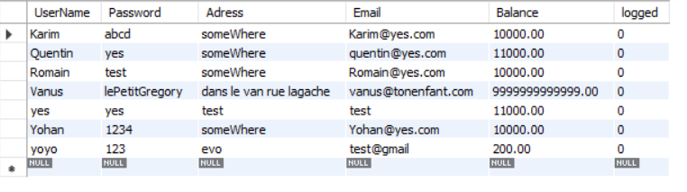
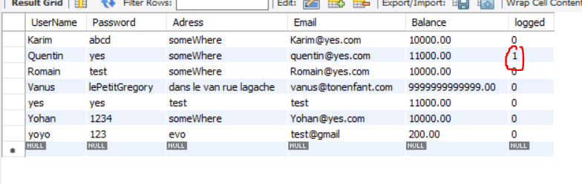
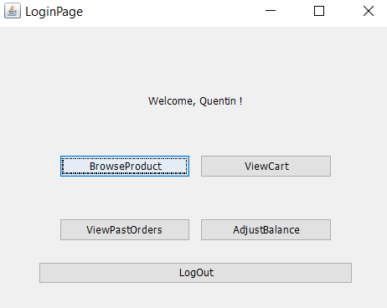

Slide 11
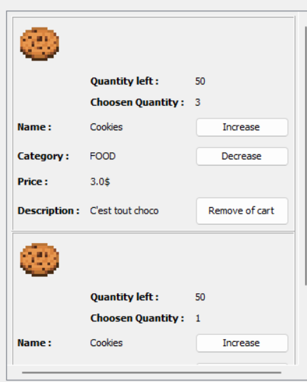
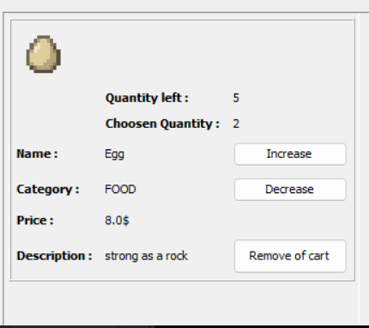

Slide 12
Navigation Page
Implementation KeyParts

Slide 13
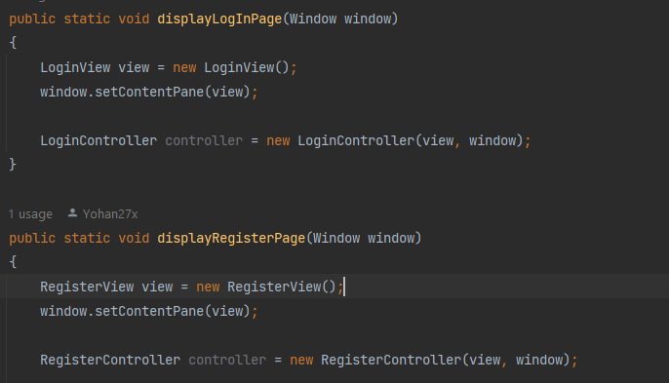
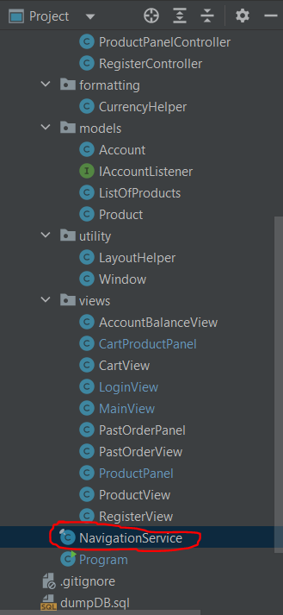
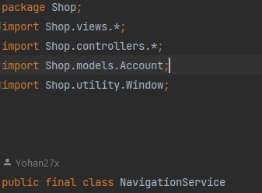
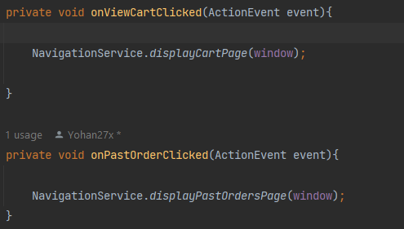
. Navigate between pages without opening each time a completely new window
…

Slide 14
ListOfProducts
Implementation KeyParts

Slide 15
. Bridge between DataBase and Java to retrieve data
DataBase
. Different ways to fill a list : - list.fillCart(), - list.fillStoreProducts()
ListOfProducts
CartProductsList
StoreAvailableProductsList

Slide 16
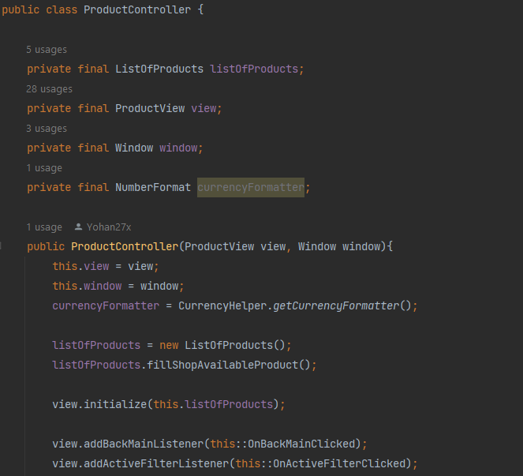
. Fill the list the right away and give it to the view

Slide 17
MVC Design, High level / Low level
Implementation KeyParts

Slide 18
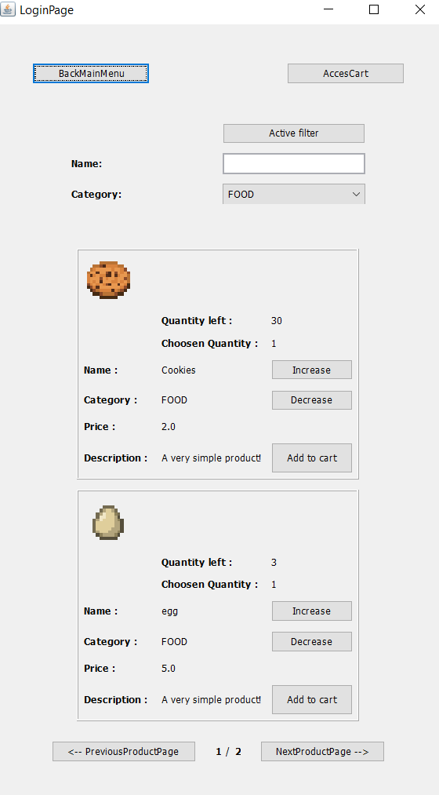
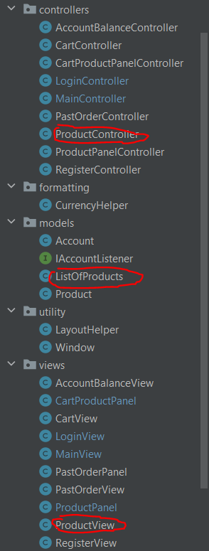
MODEL / VIEW / CONTROLLER HIGH LEVEL

Slide 19
MODEL / VIEW / CONTROLLER LOW LEVEL
MODEL
VIEW
CONTROLLER
MODEL
VIEW
CONTROLLER
. Allow to acces to unique AddToCart, increase and decrease buttons.
. -> Decrease coupling + increase cohesion

Slide 20
Implementation KeyParts
BrowseProducts

Slide 21
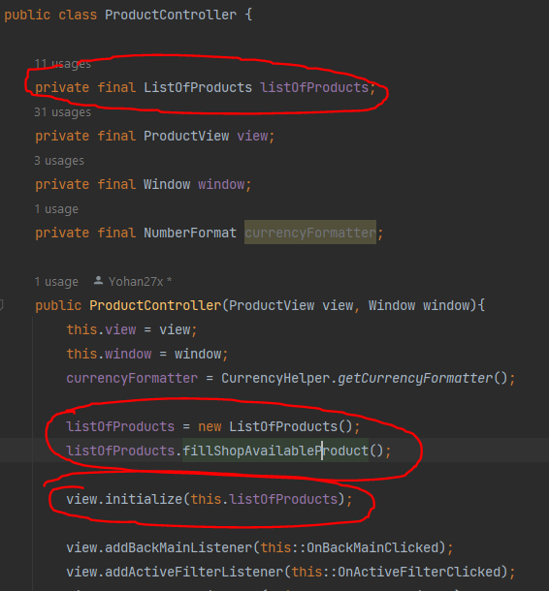
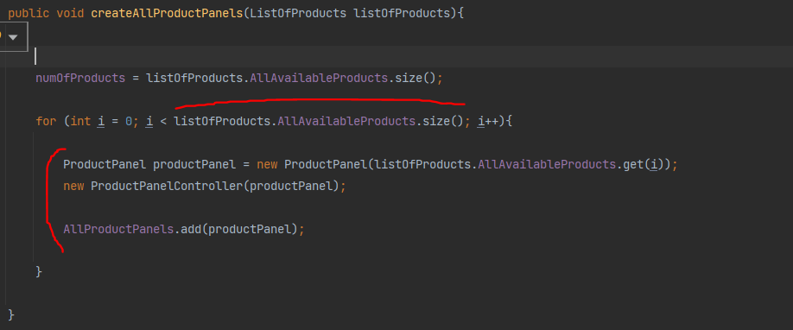
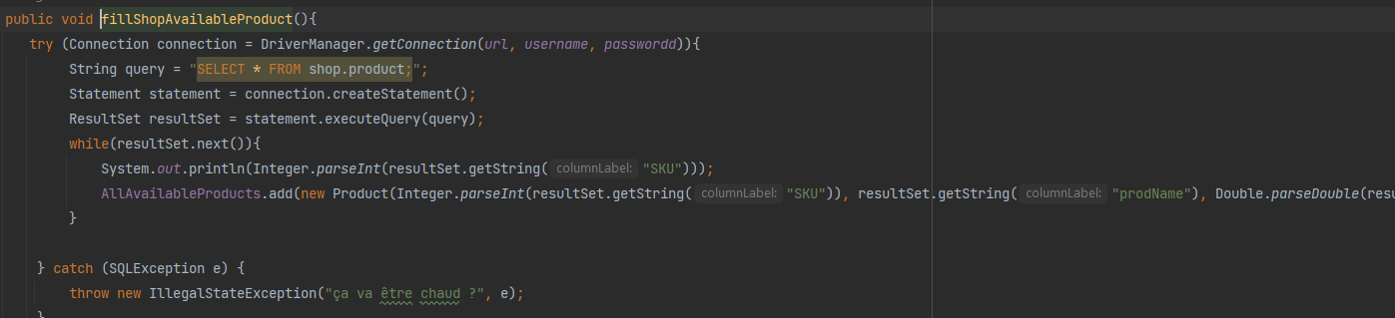
. Initializing the list of product in the controller who then give it the to his browseProductView,

Slide 22
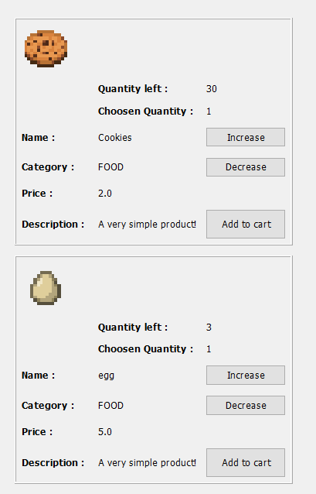
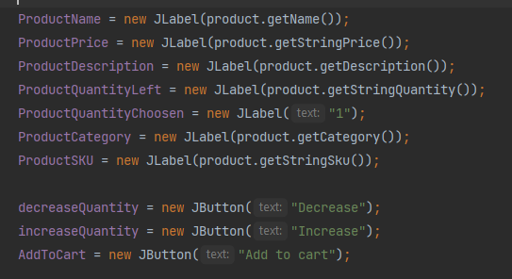
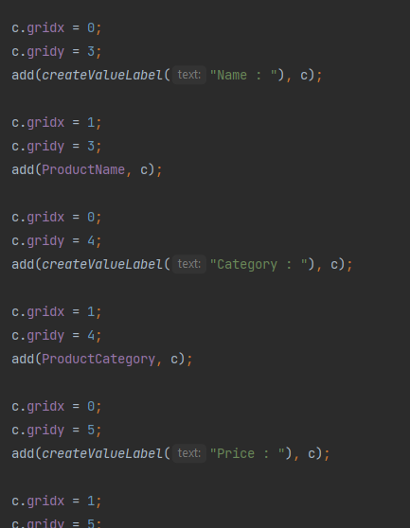
- retrieve and store product data to display them
- Create the layout of the panel using a gridBagLayout

Slide 23
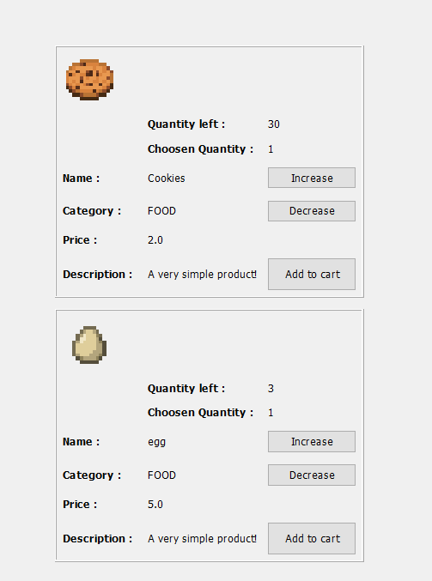
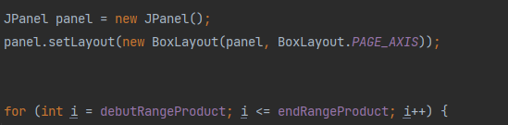
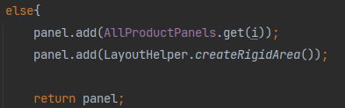

Slide 24
Cart
Implementation KeyParts

Slide 25
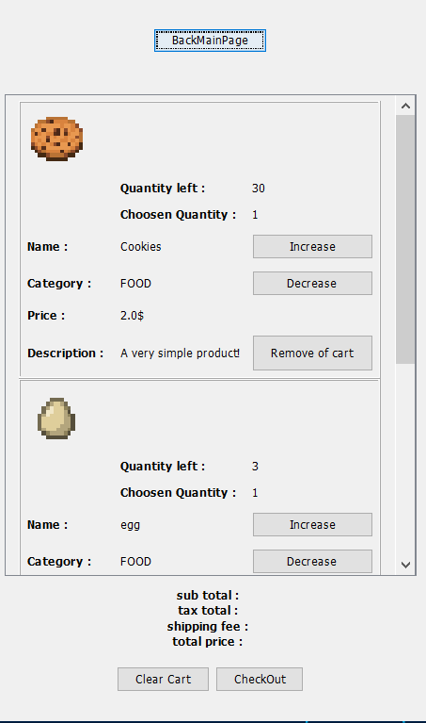
. Same code logic as BrowseproductView with lowerLevel MVC
. Using this time a ScrollPane instead of the page system we did, why ?
. User Friendly choice.

Slide 26
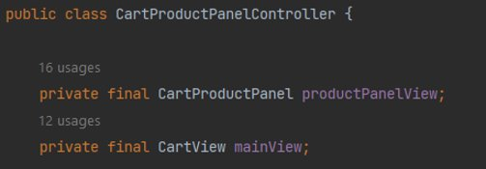
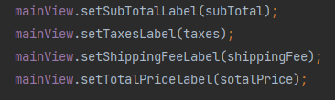
. 1 controller --> 2 views !

Slide 27
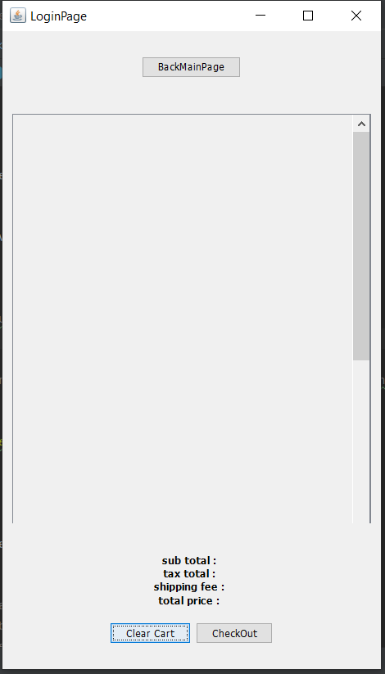
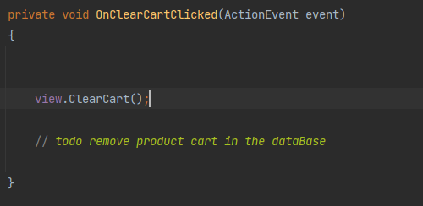
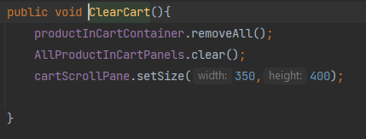
. Clear the cart

Slide 28
What we've learn :
. Create Diagram -> better mental model of the project before starting coding
. Handle a projet by starting with few given needs and finishing it with some code
. Manage a code with different independent part, make them all work together
. Better understand of java langage and Swing
. Use in practice a little of some software engineering principles

