Slide 1

Minecart
Bouaza Karim
Saba Yohan
Fourie Quenin
Castellari Romain

Slide 2




Introduction

Slide 3

Minecart : User’s point of view

Slide 4
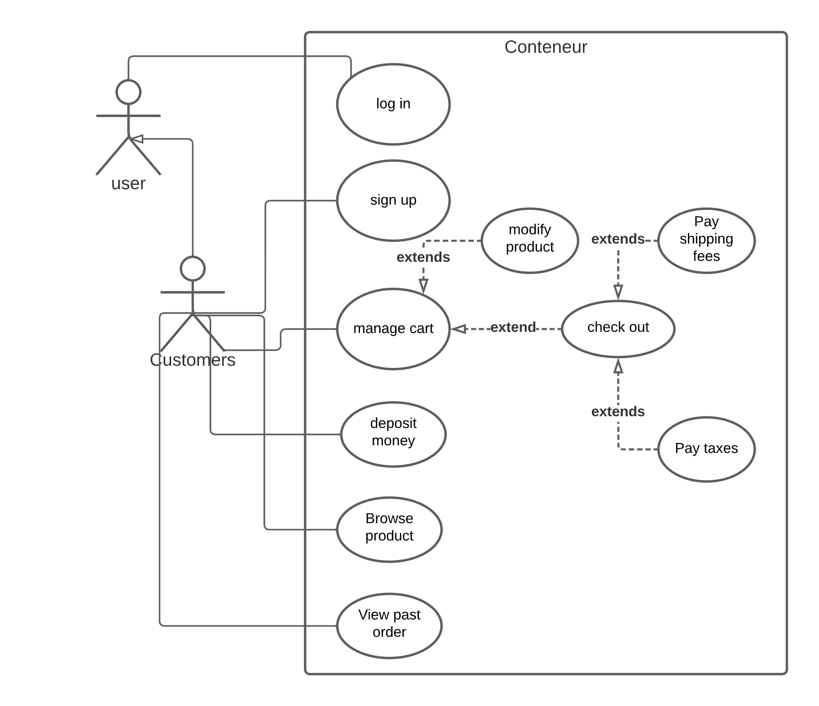
Use Case Diagram

Slide 5
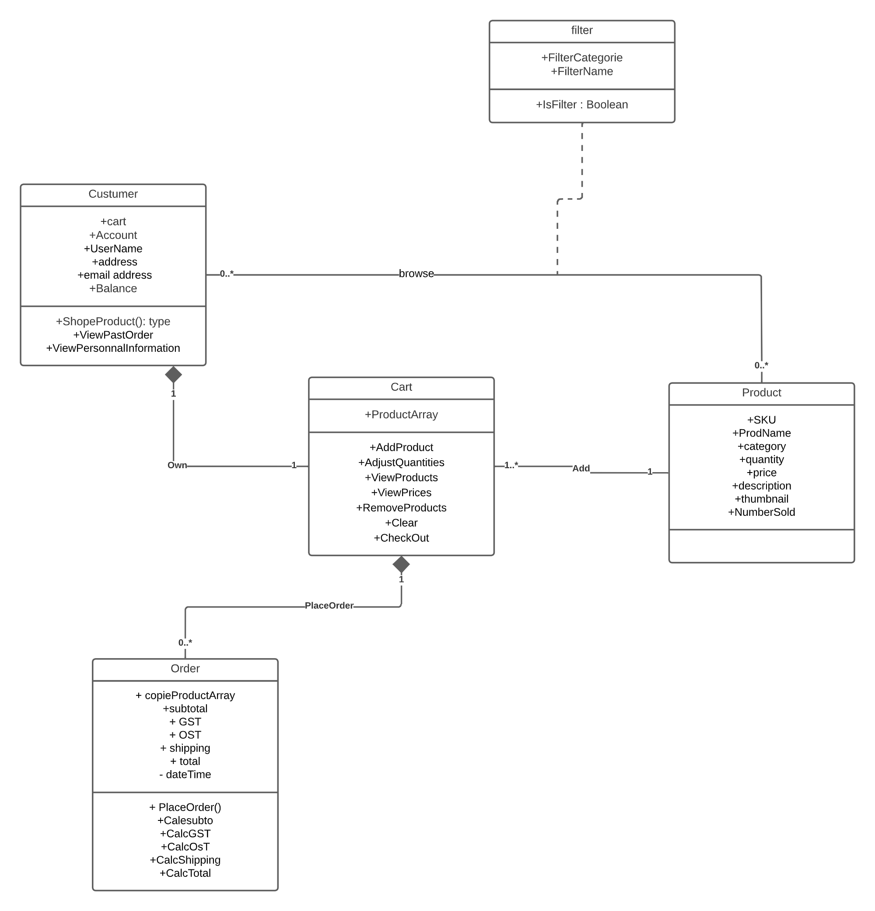
Class Diagram

Slide 6
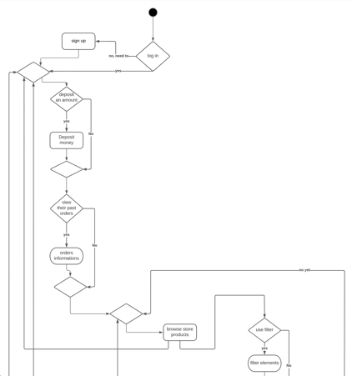
Activity Diagram

Slide 7
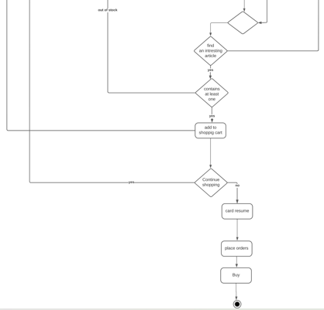
Activity Diagram

Slide 8
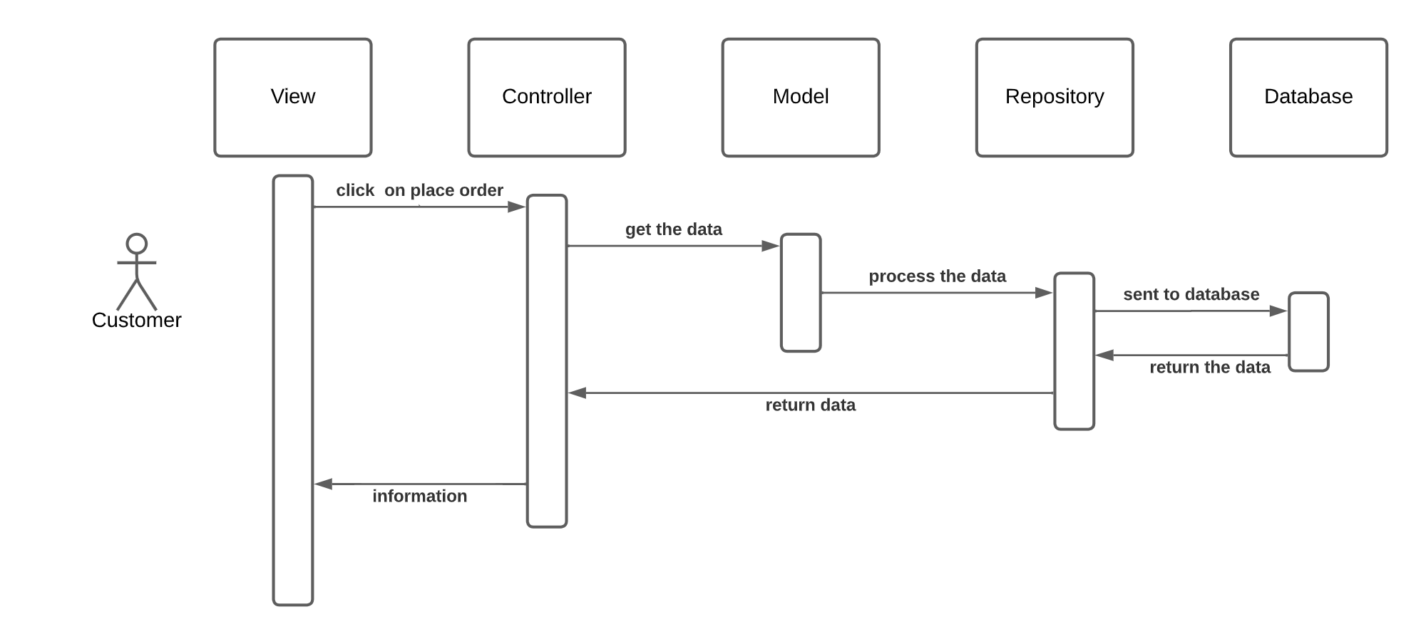
Sequence Diagram

Slide 9
Organisation

Slide 10
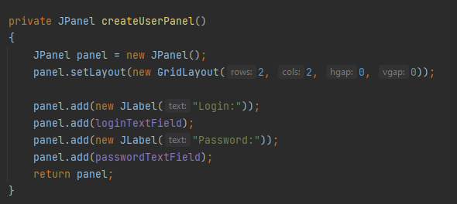
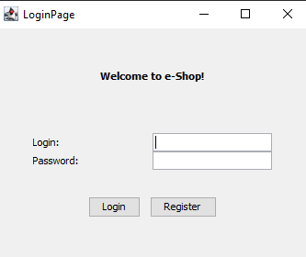
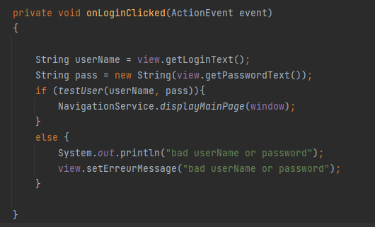
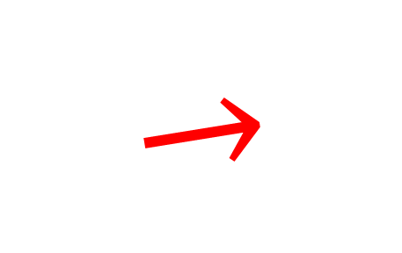
LOGIN AND REGISTER PAGE
LoginRegister
$$→$$
LoginView

Slide 11
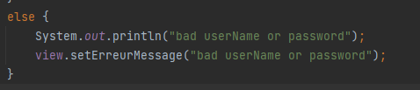
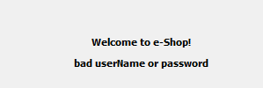
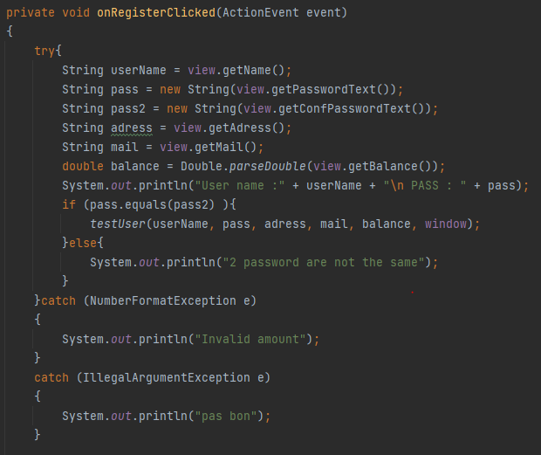
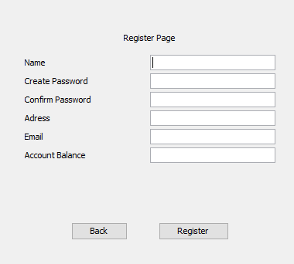


Login and register page
$$→$$
$$→$$

Slide 12
Connection with the database

Slide 13
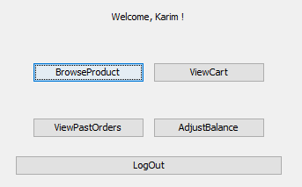
HOME PAGE
5 posibilities :
Browse a product
View Cart
View the past orders
Adjust balance
Log out (to anothor account for example)

Slide 14
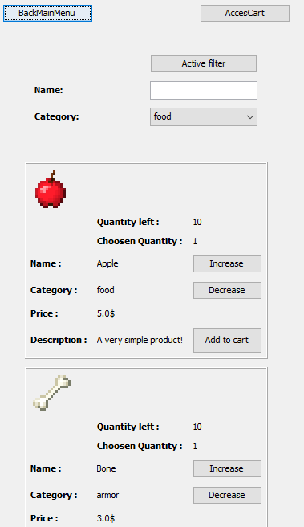
Browse product
Add product to cart with choosen my quantity
Use filter
Access to cart
Return to menu
Change page

Slide 15
*code example*

Slide 16
Connection with the data base

Slide 17
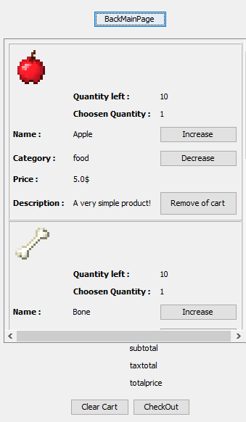
Cart Page
Modify the quantities
Remove to cart
Clear the cart
Check out

Slide 18
*code example*

Slide 19
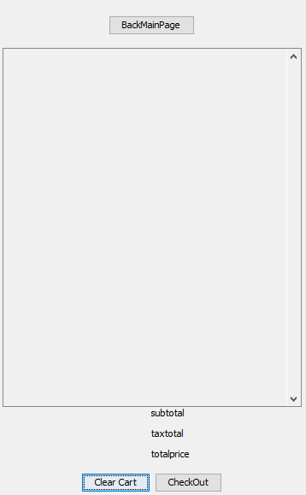
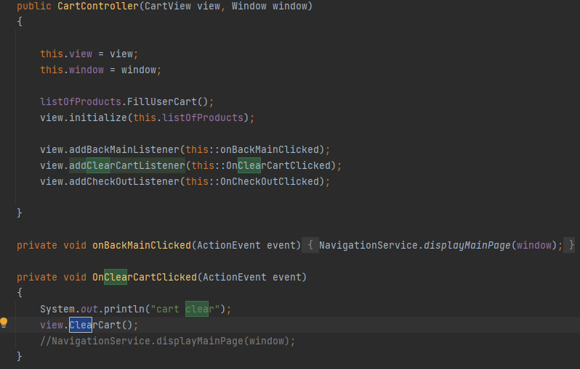

Clear cart
$$→$$

Slide 20
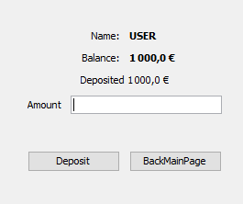
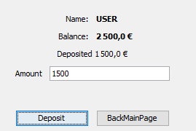
Adjust Balance

Slide 21
*View past order*

Slide 22
Code partie avec les problèmes :

Slide 23
Nos problèmes et nos amelioration/ apprentissage

Slide 24

Questions

