Slide 1
CACFAR

Slide 2
Step by step
Write sample in the WRITE ADDRESS position of the BRAM
If WRITE ADDRESS is lower to 12, or memory is not filled, do nothing. If one of both is true, then read the value of the corresponding cell under test.
Make the average of the window around cut
Make the product by alpha
Compare with cut and make a decision
Incremental CUT ADDRESS and WRITE ADDRESS

Slide 3
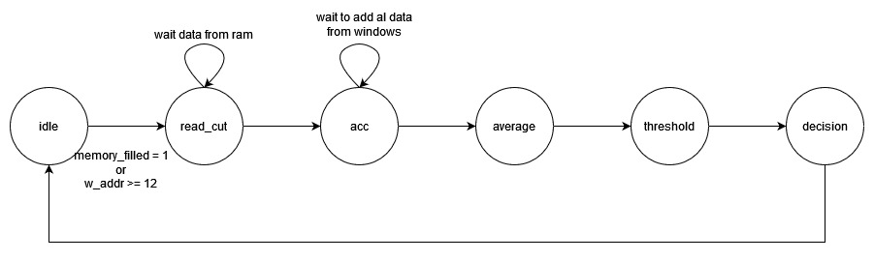
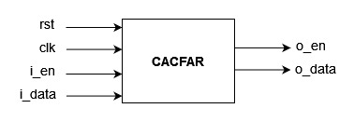
FSM and BLOCK DIAGRAM

Slide 4
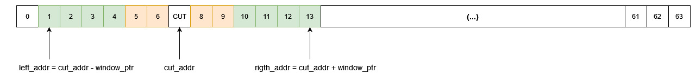
POINTERS
cut_addr is the index of the current cell under test
right_addr and left_addr are the pointers to the cells within left and rigth window
Window pointer is incremented until it reaches the higher position

Slide 5
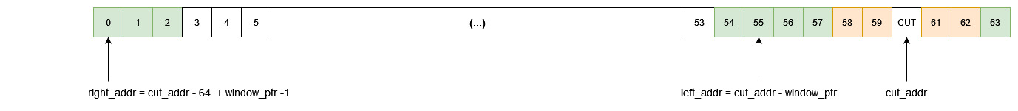
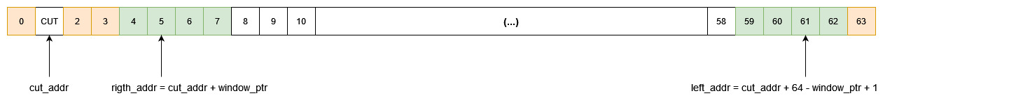
POINTERS – CORNER CASES
There are 2 corner cases: lower bound and upper bound of ram
Both cases are solved by wrapping the address

