Slide 1


Know It CDAC- ACTS, Pune
A Presentation on “Build-Mart”

Slide 2
1.Project Introduction:
Buildmart - Your One-Stop Construction Solution
Welcome to the world of Buildmart, where construction dreams are turned into reality! Buildmart is a comprehensive and innovative construction project aimed at revolutionizing the way we approach and execute construction projects. Whether you're envisioning a residential masterpiece, a commercial complex, or an industrial facility, Buildmart is your ultimate one-stop solution for all things construction.

Slide 3
1.1 Project Background :
There is no computerized system for the vendors and service providers to sell their construction materials and provide services. The traditional system of purchasing construction equipment has certain limitations or faults compared to e-commerce.
Here are some common faults associated with the traditional system:
Limited Access
Limited Product Information
Lack of Price Transparency
Inconvenience for Comparison Shopping

Slide 4
1.2 Goals of the project :-
To develop and deploy a comprehensive e-commerce platform for construction materials that caters to the needs of Individual customers, construction material vendor, and service providers, creating a thriving marketplace that facilitates seamless interactions and transactions within the construction industry. To solve the problems in traditional system and provide all the services at one place so that customer can easily avail the services
1.3 Customers and Stakeholders:-
Customers : -
Construction material vendors who want to sell their materials.
Construction related work service providers who want to provide their services.
Individual customers want to buy the materials and services.
Construction companies want to buy materials and services in large scale

Slide 5
Stakeholders : -
Individual Customers
Construction Company
Construction material vendors
Construction workers (labours)

Slide 6
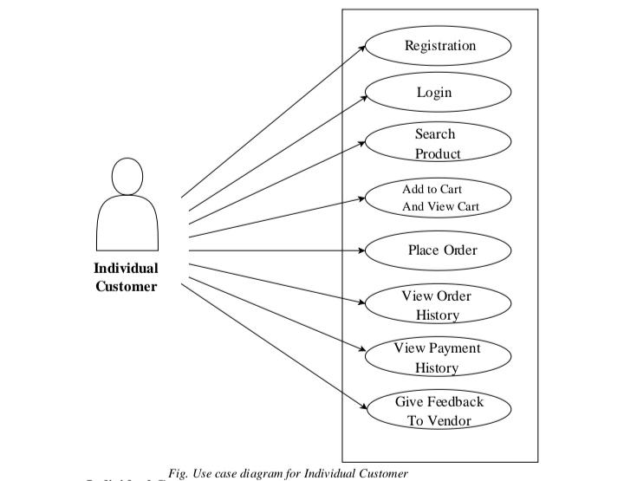
Individual Customers

Slide 7
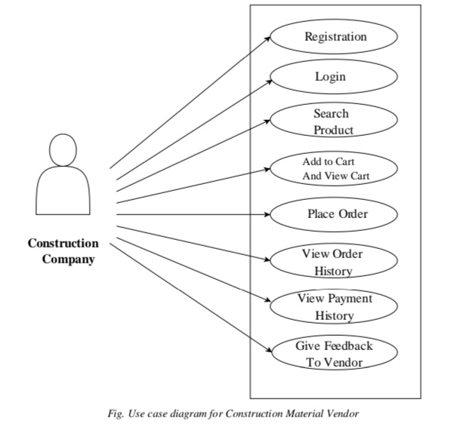
Construction Company

Slide 8
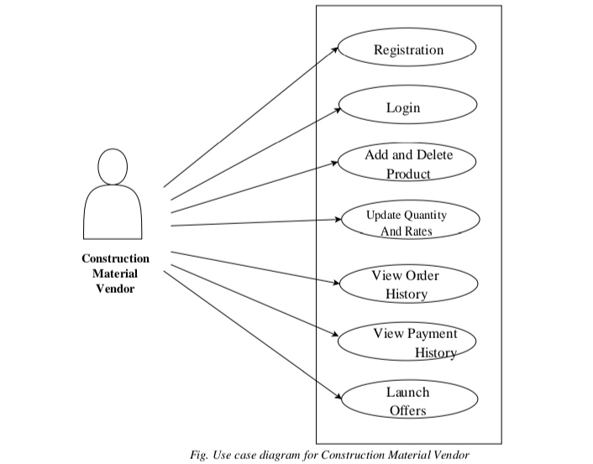
Construction Material Vendors

Slide 9
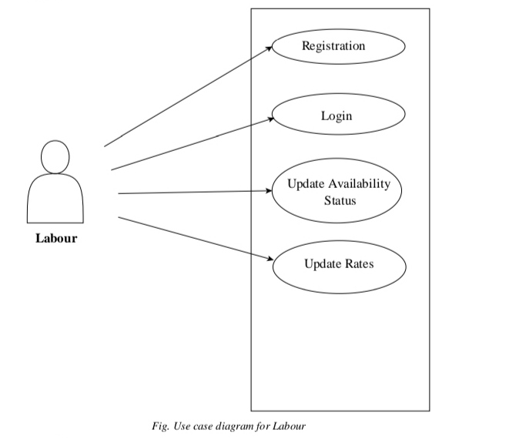
Construction workers (Labours)

Slide 10
Project Architecture
Used For Used For
User Interfacing 1. Server Side Validation
Basic Data Validation 2. Response Handling
3. Business Logic Used For
4. Database Operations 1. Permanent Storage
2.Database Level Validations
3. Database Access Using Stored Procedures
Technology Used
HTML, CSS
JavaScript, jQuery Technology Used
React JS 1. Spring Boot
JSON 2. Hibernate Technology Used
1. MySQL
Front End Layer
Server Layer
Database Layer

Slide 11
Technology Platform Used For Project :
Technologies used :
HTML, CSS, JavaScript, jQuery, ReactJS, JSON, Spring boot, Hibernate, MySQL
Reason :
Html, CSS and JavaScript are used for frontend part for static web pages.
React JS is used for rendering the dynamic web pages and to create a single page application where only particular part of web page is rendered without altering complete web page.
Spring boot is used for server side processing wherein in connection with database is established from server and required data is manipulated and sent to client side.

Slide 12
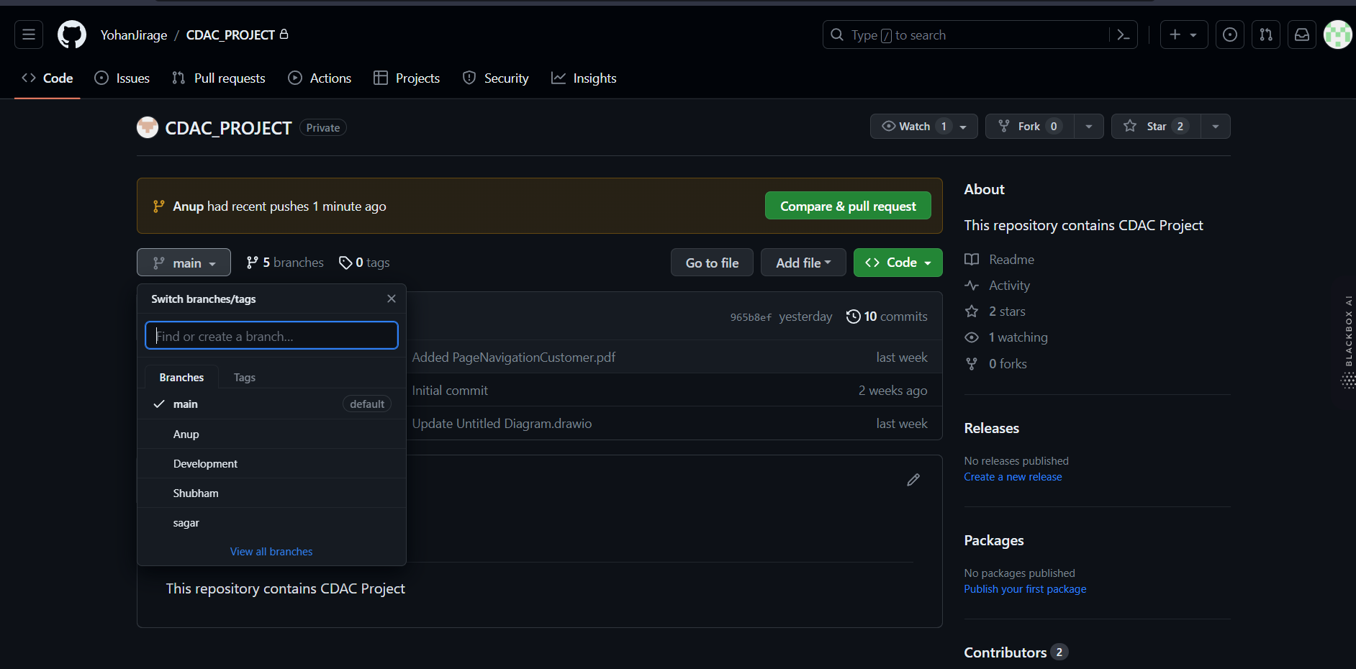
GitHub Repository
GitHub link : https://github.com/YohanJirage/CDAC_PROJECT.git

Slide 13
Division of work within team:
Anup Patil : Implemented the Admin use cases.
Sagar Patil: Implemented the Customer and construction company use cases.
Yohan Jirage : Implemented construction vendor use cases.
Shubham Swami : Implemented Construction Worker(Labour) use cases.
Stages at which Coordination was needed :
Most of the coordination was needed when complete UI needed to be rendered using React,
Every one worked together for designing the database

Slide 14
Future scope:
Incorporating sustainable and eco-friendly materials
enhancing online presence and e-commerce capabilities
embracing smart home technologies and focusing on exceptional customer service to stay competitive in the evolving construction and home improvement market.
should make sure customer service is really great to do well in the changing market.
BuildMart has the opportunity to expand its range of products, so people can find even more things they need for construction and improving their homes.

Slide 15
Conclusion :
Challenges you faced :
There were many challenges that we faced like finding a write path to start with, exploring the technologies beyond the horizon of our course Etc.
Things Learnt :
We have learnt to efficiently distribute the task within the team. We have learnt to combine all the dynamic stack of technologies together to create a fully functional software.
Overall Experience :
Overall experience was very practical oriented and highly knowledgeable.

Slide 16
Thank You….

