Slide 1
Doom 3 Bfg Concrete Architecture
Basement Gurus
Isaac Chan
Daniel Elmer
Matthew Sherar
Yohanna Gadelrab
Dylan Liu
Kainoa Llyod

Slide 2
Overview
Introduction
Derivation Process
Updated Conceptual Architecture
Concrete Architecture
Dependencies
Reflexion Analysis
Alternatives
Game Logic Subsystem
Sequence Diagram
Concurrency
Limitations
Lessons Learned
Summary

Slide 3
Introduction
Concrete Architecture
Object Oriented Layered Architecture
Subsystem: Game Logic Subsystem
Reflexion Analysis of concrete vs game architecture

Slide 4
Derivation Process
Conceptual Architecture as a basis
Analysis of source code using Understand
Identified subsystems and decided on Game Logic subsystem
Analyzed discrepancies

Slide 5
Updated Conceptual Architecture

Slide 6
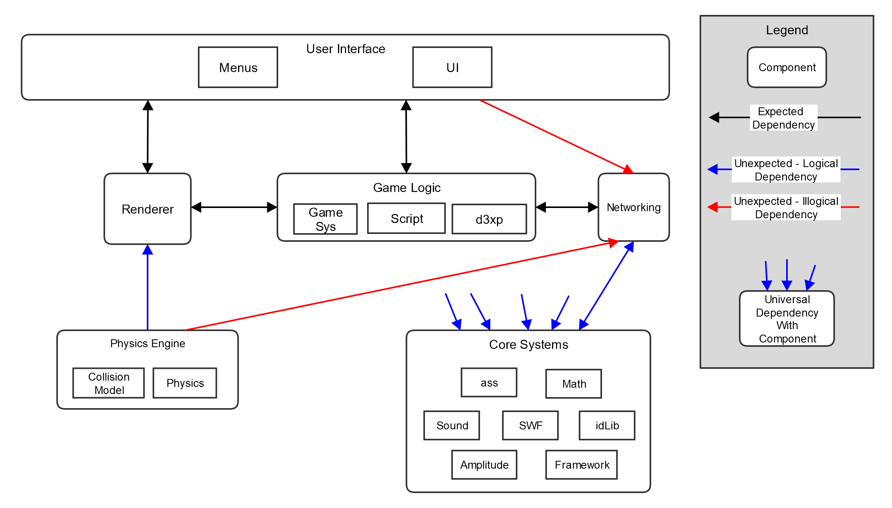
Concrete Architecture

Slide 7
Unexpected Dependencies
Logical:
Universal bidirectional dependency with Core System
Bidirectional dependency between Networking and Core System
Unidirectional dependency between Physics and Renderer
Illogical:
Dependencies between the UI, Renderer, and Physics subsystems and Networking

Slide 8
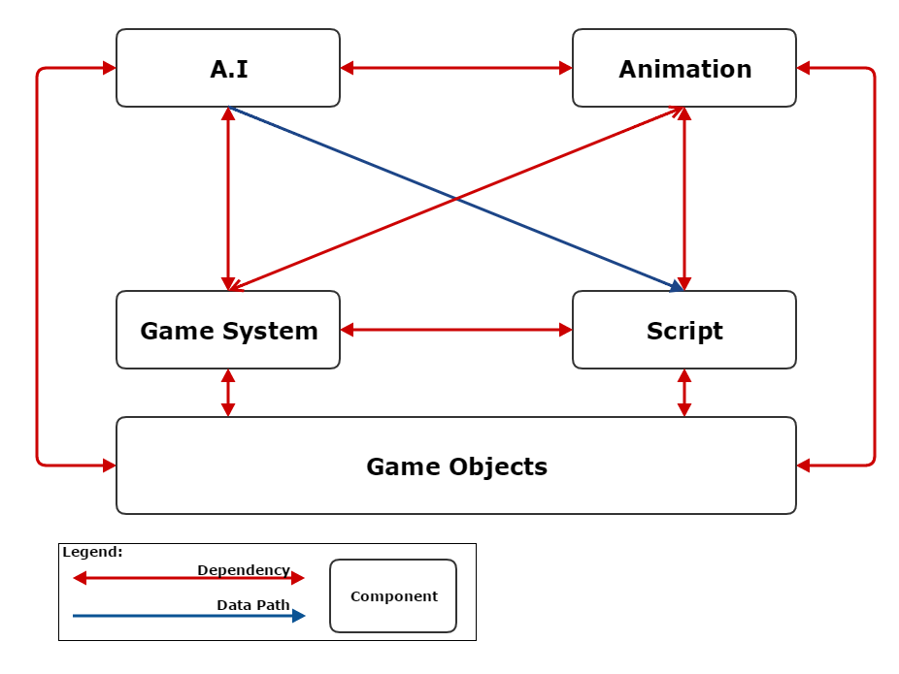
Internal Dependencies

Slide 9
Reflexion Analysis

Slide 10
Alternative Architectures
Initially had platform independence layer
Initially had game assets as it’s own component
Tried including idLib in Game Logic (precompiled.h includes many files found in Game Logic Component)
Tried gamesys in core systems but too tightly coupled with other game logic components

Slide 11
Subsystem

Slide 12
Sequence Diagram
Player Shooting

Slide 13
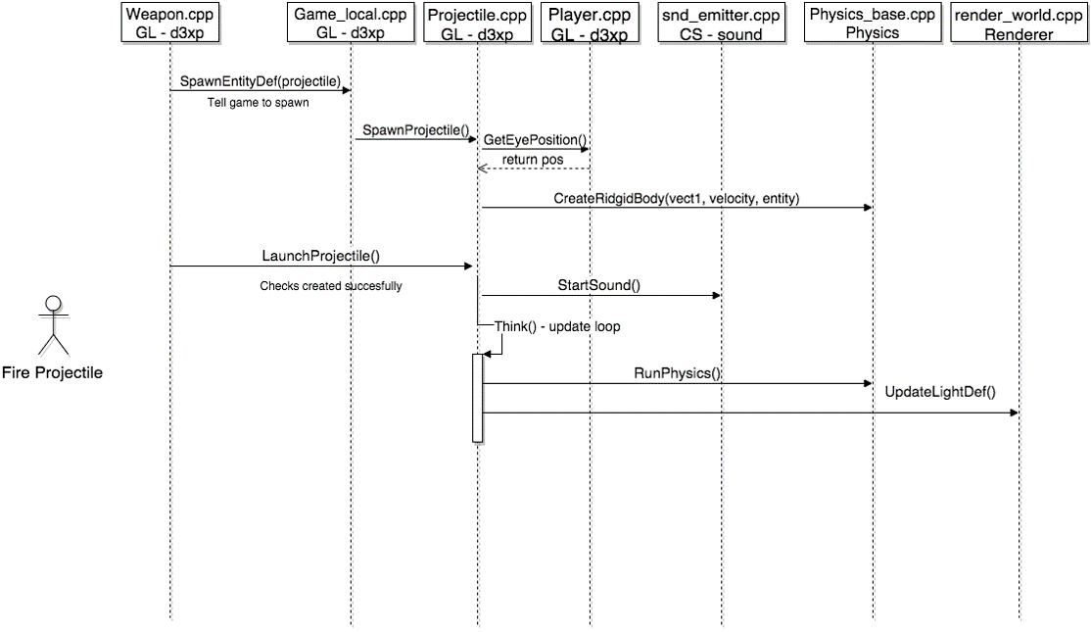

Slide 14
Concurrency
Follows the conceptual triple-threaded multi-threading model with support from Worker threads.
Code responsible for maintaining multi-threading exists in the Core System under idLib\sys.
Core System is called by all subsystems – multi-threading is ubiquitous in the program.

Slide 15
Limitations
Knowledge of the Understand program
Understand Crashing

Slide 16
Lessons Learned
Use a program to determine dependencies
Unexpected dependencies

Slide 17
Summary
DOOM 3 BFG uses an Object Oriented Layered Architecture
Game logic subsystem uses an Object Oriented Architecture
Major changes in our conceptual architecture
A few unexpected dependencies
Learned how to accurately derive a concrete architecture

