Slide 1
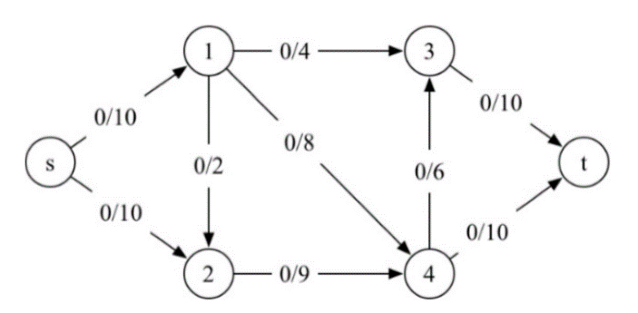




$G$:
1
0/4
3
0/10
$G_{f}$:
1
4
3
10
2/10
0/8
10
Flow value = 2
s
2/2
0/6
t
s
2
8
6
t
0/10
2
2/9
4
2/10
10
2
9
4
10
$G$:
1
4/4
3
4/10
$G_{f}$:
2
1
4
3
6/10
8
10
s
2/2
0/8
0/6
t
s
2
8
6
t
Flow value = 6
0/10
2/10
10
8
2
2/9
4
2
7
4
2
6
2
$G$:
1
4/4
3
4/10
$G_{f}$:
1
4
3
4
10/10
4
6
s
2/2
4/8
0/6
t
s
2
8
6
t
Flow value = 10
0/10
6/10
10
8
2
2/9
4
2
7
4
2
$G$:
$G_{f}$:
2
4
10/10
1
4/4
3
4/10
10
1
4
3
6
6/8
4
Flow value = 12
s
0/2
0/6
t
s
2
4
6
t
2/10
8/10
10
4
2
2/9
4
2
7
4
6
$G$:
$G_{f}$:
2
1
4/4
3
4/10
1
4
3
4
10/10
10
6
6
s
0/2
6/8
0/6
t
s
2
2
6
t
Flow value = 14
4/10
10/10
8
2
2
4/9
4
2
2
7
4
8
2
$G$:
1
4/4
3
9/10
$G_{f}$:
1
4
3
4
10/10
10
6
6
s
0/2
6/8
5/6
t
s
2
2
6
t
Flow value = 19
9/10
2
4
10/10
6
2
4
10
9/9
4
5
4
$G_{f}$:
1
4
3
9
No augmenting path,
Here we terminate.
10
6
1
s
2
2
1
5
t
Max flow value = 19
1
2
4
10
9
5

