Slide 1
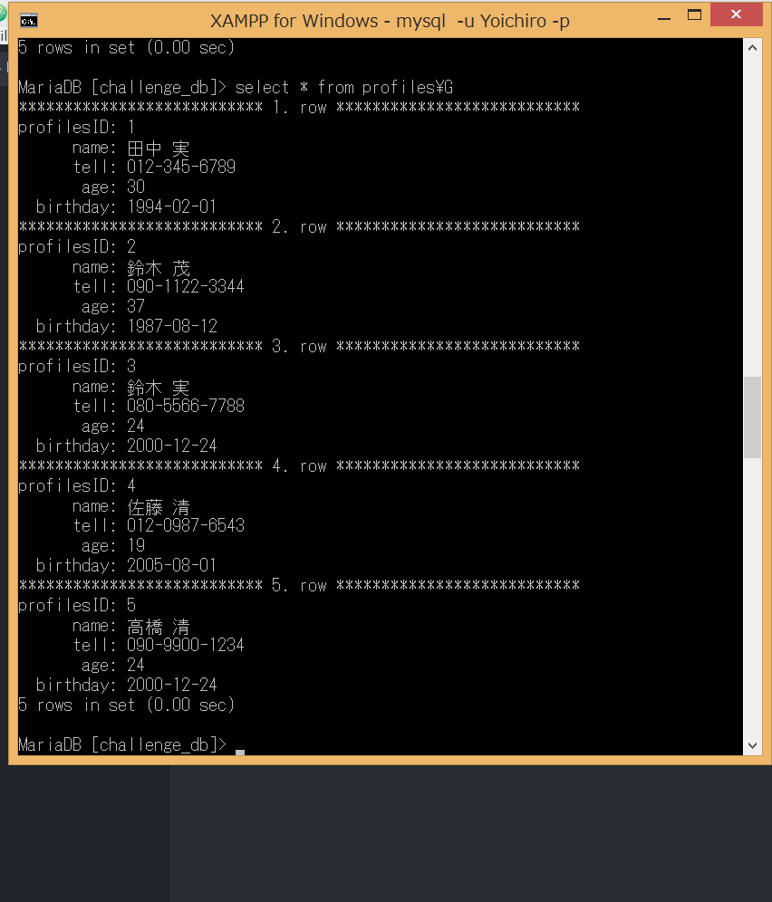
1

Slide 2
１コマンド(INSERT)
insert into profiles values(1, ‘田中 実’, ‘012-345-6789’, 30, ‘1994-02-01’);
insert into profiles values(2, ‘鈴木 茂‘, ‘090-1122-3344’, 37, ‘1987-08-12’);
insert into profiles values(3, ‘鈴木 実’, ‘080-5566-7788’, 24, ‘2000-12-24’);
insert into profiles values(4, ‘佐藤 清’, ‘012-0987-6543’, 19, ‘2005-08-01’);
insert into profiles values(5, ’高橋 清’, ‘090-9900-1234’, 24, ‘2000-12-24’);

Slide 3
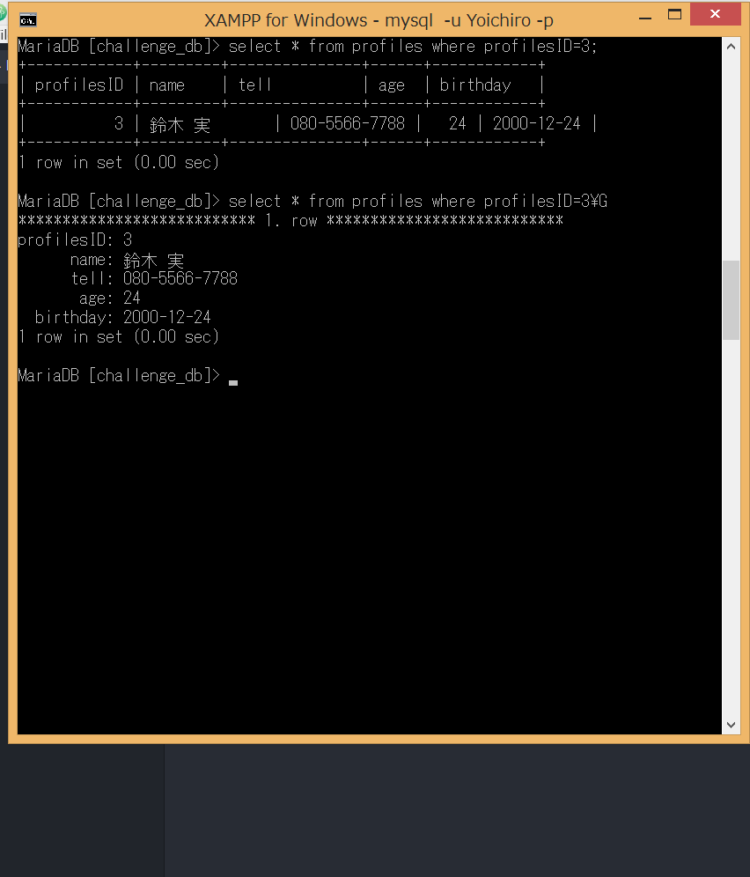
2

Slide 4
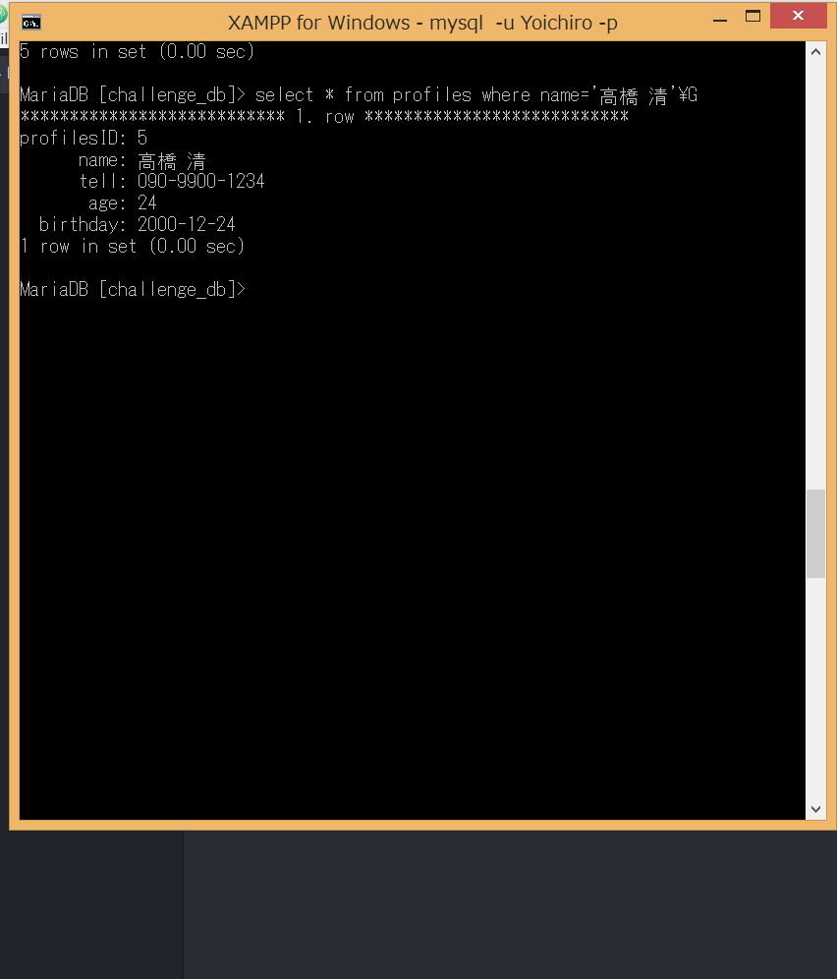
3

Slide 5
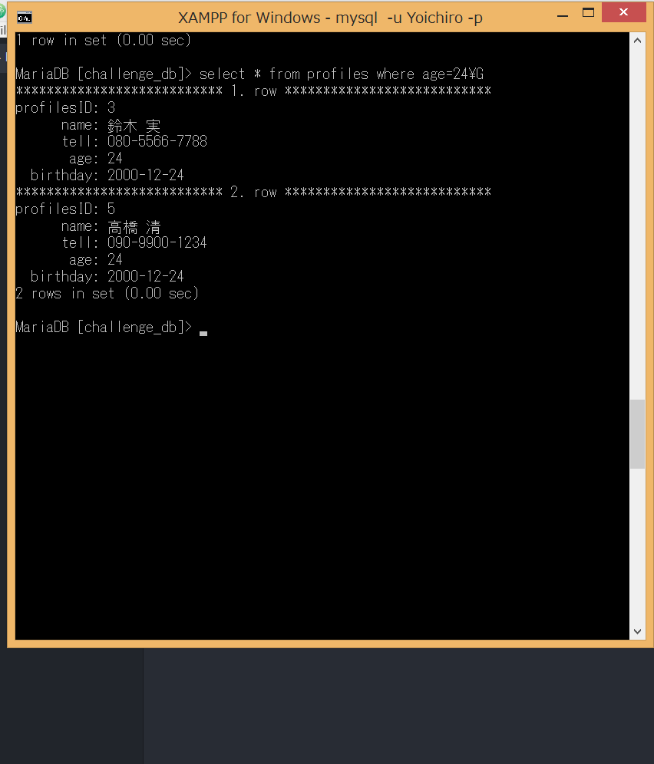
4

Slide 6
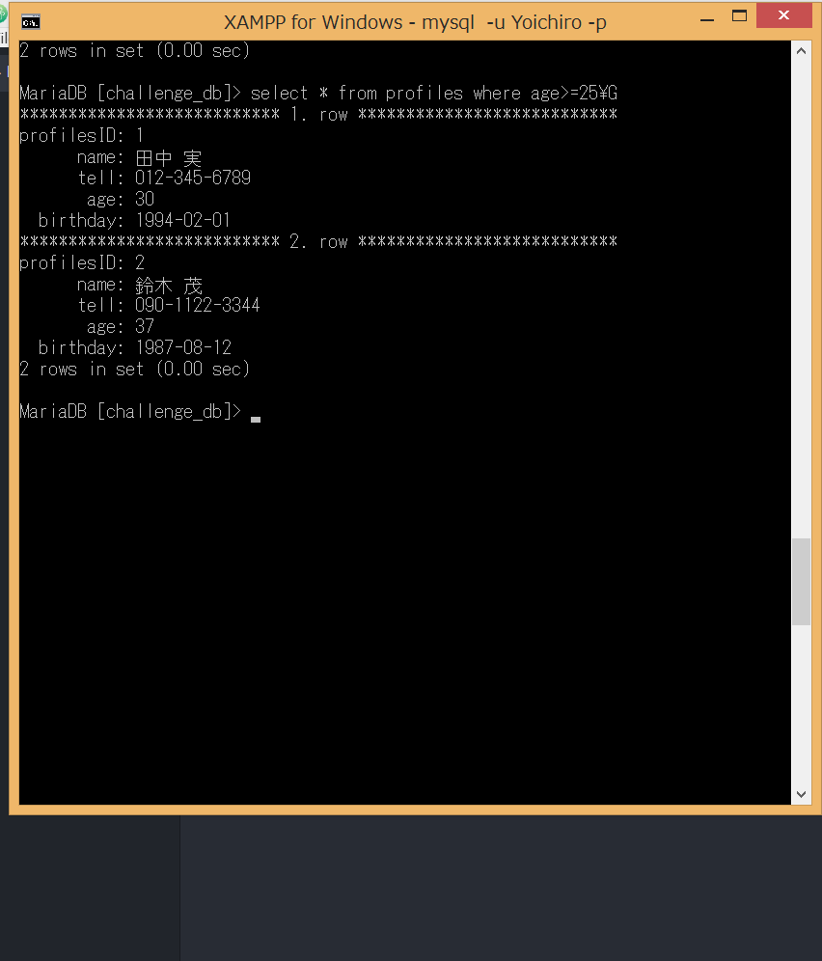
5

Slide 7
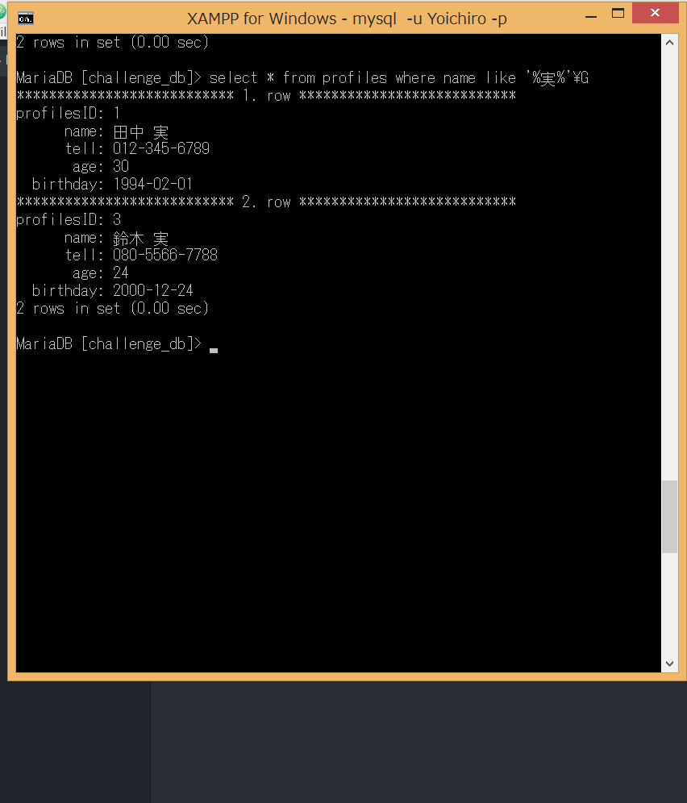
6

Slide 8
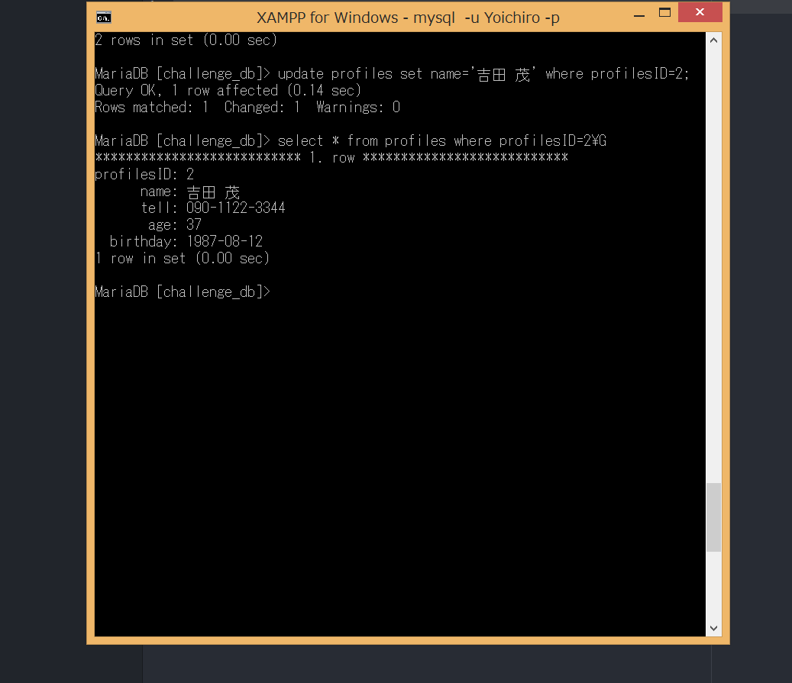
7

Slide 9
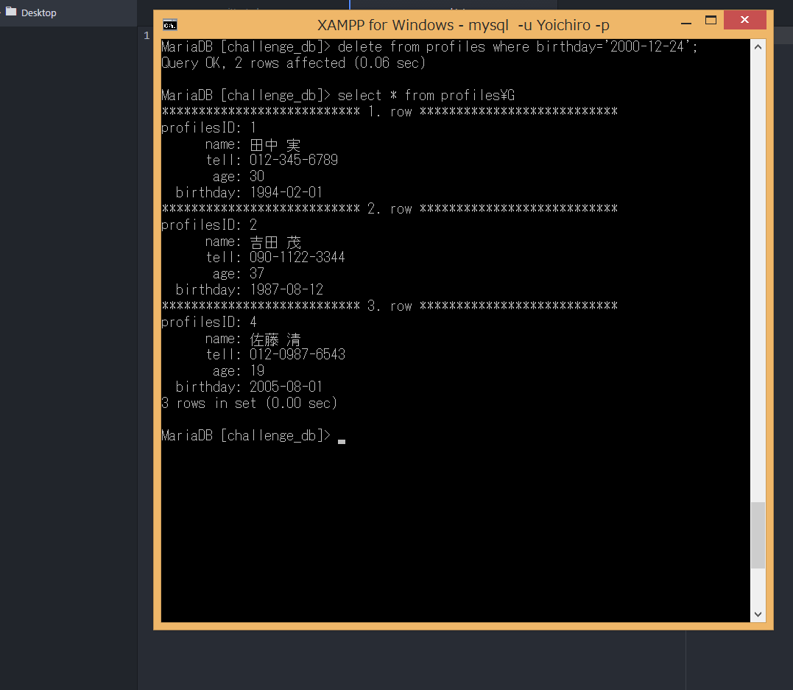
8

