Slide 1
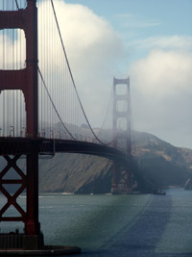
Tour San Francisco
Popular tourist attractions

Slide 2
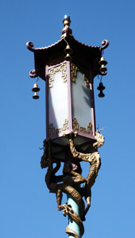
Chinatown

Slide 3
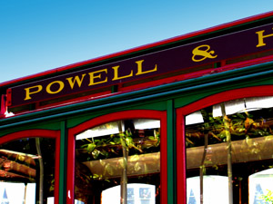
Cable cars

Slide 4
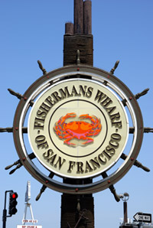
Fisherman’s Wharf

Slide 5
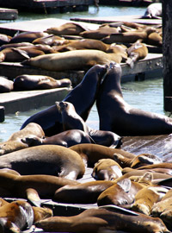
Pier 39

