Slide 1
Nested Patient, Intervention, and Outcome Labeling from medical literature
Sabin Devkota
NLP class project
Nov 28, 2018

Slide 2
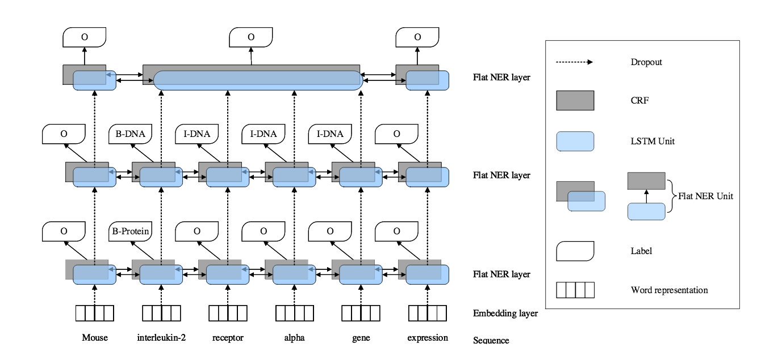
Nested Named Entity Recognition
Ju etal. , A Neural Layered Model for Nested Named Entity Recognition
https://github.com/meizhiju/layered-bilstm-crf

Slide 3
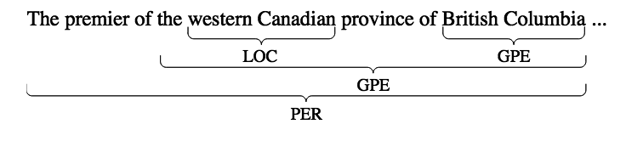
Nested Named Entity Recognition
Each flat NER layer is a bi-lstm using char and word Embedding with CRF labeling on top (Lample etal. 2016)
Starts from inner entities detection
Merges (i.e. averages) the hidden output (i.e. contextual representation) of tokens from previous layer and feeds into the next layer
Ends when no outer entities found

Slide 4
Our Approach
Start by detecting outer entities (p,i,o) spans
Feed the contextual representation when detecting detailed labeling e.g. (age, sample size etc)
Merges (i.e. averages) the contextual representation from the first layer (i.e. PIO detection) and uses it for second layer (i.e. detailed tags)

Slide 5
Motivation
Cohen’t K between annotators is higher for outer labelling (~0.71) compared to detailed labeling (~0.5)
There is less noise in outer label training sample
Baseline model performs better on outer labels (F-score = 0.79) compared to detailed labeling (F-score = 0.26)

Slide 6
Our Approach
Merges the contextual representation from the first layer (i.e. PIO detection) and uses it for second layer (i.e. detailed tags)
Implemented using dynet
https://github.com/devkotasabin/EBMNLP/tree/master/nlp_project

Slide 7
Results
 | Precision | Recall | F1-Score
PIO tagging (LSTM-CRF) - Baseline | 0.72 | 0.68 | 0.79
Detailed labeling (Stanford NER detector) - Baseline | 0.56 | 0.18 | 0.26
Nested NER Juetal. 2018, Baseline | 0.33 | .15 | 0.2
Nested NER with reverse ordering | 0.30 | 0.1 | 0.15
Our approach (reverse order) | 0.48 | 0.54 | 0.50

