Slide 1

IILM UNIVERSITY
School of Computer Science & Engineering
SOFTWARE DEVELOPMENT INTERNSHIP
Internship Report
A 1-month web-based software project built with Python and Django
at Cognifyz IT Solutions Pvt. Ltd.
Yojit Bhatt
Roll No: 2410031104 | B.Tech CSE, Batch 2024-28
15 June 2026 - 15 July 2026

Slide 2
OVERVIEW
What This Report Covers
01
Introduction
02
Organization Profile
03
Problem Statement
04
Objectives & Scope
05
Technologies & Tools
06
System Architecture
07
Methodology
08
Outcomes & Certificate
Cognifyz IT Solutions | Software Development Internship
2

Slide 3
CHAPTER 4.1
Introduction
This report summarizes the work carried out during the 1-Month Software Development Internship at Cognifyz IT Solutions Pvt. Ltd., from 15/06/2026 to 15/07/2026.
1M
1 Month
The program built a strong foundation in software development practices and gave hands-on exposure to building a real-world, web-based application, ending with a generic web-based project in Python and Django.
Duration
PY
It covered the complete software development lifecycle, from requirement analysis and setup to coding, testing and deployment, bridging academic learning with industry-oriented skills.
Python + Django
Core stack
Cognifyz IT Solutions | Software Development Internship
3

Slide 4
CHAPTER 4.2
Organization Profile
Cognifyz IT Solutions is an IT solutions and technology training organization offering internship and training programs that combine practical, project-based assignments with mentorship.
Cognifyz IT Solutions Pvt. Ltd.
“Where Data Meets Intelligence”
HEADQUARTERS
Interns receive a verifiable internship completion certificate from the organization after successfully completing their assigned duration and deliverables.
Warora, Chandrapur, India
CERTIFICATION
ISO 9001:2015 certified
REGISTRATION
Weekly modules pair conceptual learning with hands-on assignments, closely simulating an industry training environment.
MSME registered
✓
FOCUS AREAS
Software development, data analytics
Cognifyz IT Solutions | Software Development Internship
4

Slide 5
CHAPTER 4.3
Problem Statement
Beginners in software development often struggle to turn theoretical knowledge into a complete, deployable web application. The internship addressed two concrete problems:
01
02
Static, unscalable data handling
Gap between learning and practice
Managing and presenting information through static or ad-hoc means is inefficient. A dynamic, database-backed web application can store, process and present data through a structured interface.
New developers need exposure to the full web-development workflow, from designing the data model to building backend logic and a usable front end, best learned through an applied mini-project.
Cognifyz IT Solutions | Software Development Internship
5

Slide 6
CHAPTER 4.4 AND 4.5
Objectives & Scope
OBJECTIVES
SCOPE
Build a strong foundation in Python programming
Included
+ Data model design and Django MVT backend logic
Learn Django's Model-View-Template (MVT) architecture
+ Relational database integration
+ Front-end templates for user interaction
Design and integrate a relational database (SQLite / MySQL)
+ Local functional testing
Implement a web application with full CRUD functionality
Not included
- Large-scale production deployment
Use Git and GitHub for version control
- Load and performance testing
- Third-party payment or cloud-hosting integration
Cognifyz IT Solutions | Software Development Internship
6

Slide 7
CHAPTER 4.6
Technologies & Tools Used
PY
DJ
</>
Python 3
Django
HTML / CSS
Core programming language
Web framework (MVT architecture)
Front-end with Django templates
DB
GIT
IDE
SQLite / MySQL
Git & GitHub
VS Code / PyCharm
Relational database
Version control
Development environment
Cognifyz IT Solutions | Software Development Internship
7

Slide 8
CHAPTER 4.7
System Architecture: Django MVT
URL Routing
Maps incoming request URLs to the appropriate view functions
Model
Defines data structures via the Django ORM, mapped to database tables
View
Business logic that processes requests and prepares data
Template
Renders dynamic HTML pages with Django's templating engine
Database
Stores persistent application data, accessed through the ORM
Cognifyz IT Solutions | Software Development Internship
8

Slide 9
CHAPTER 4.8
Methodology: A 4-Week Journey
1
2
3
4
WEEK 1
WEEK 2
WEEK 3
WEEK 4
Python & Web Fundamentals
Django & Database Integration
Views, Templates & Front End
Final Project
Environment setup, Python syntax, control structures, functions, intro to Django
MVT architecture, models and migrations, database setup, Django Admin
URL routing, view logic, HTML/CSS templates, CRUD functionality
Applying Weeks 1-3 to design, build, test and present the complete project
Cognifyz IT Solutions | Software Development Internship
9

Slide 10
CHAPTER 4.9
Expected Outcomes
Solid working knowledge of Python and the Django framework
Practical skill integrating a relational database with a web app
✓
✓
A functional web application demonstrating CRUD operations
Better problem-solving, debugging and documentation skills
✓
✓
Exposure to an industry-style internship workflow
A verifiable completion certificate from Cognifyz IT Solutions
✓
✓
Cognifyz IT Solutions | Software Development Internship
10

Slide 11
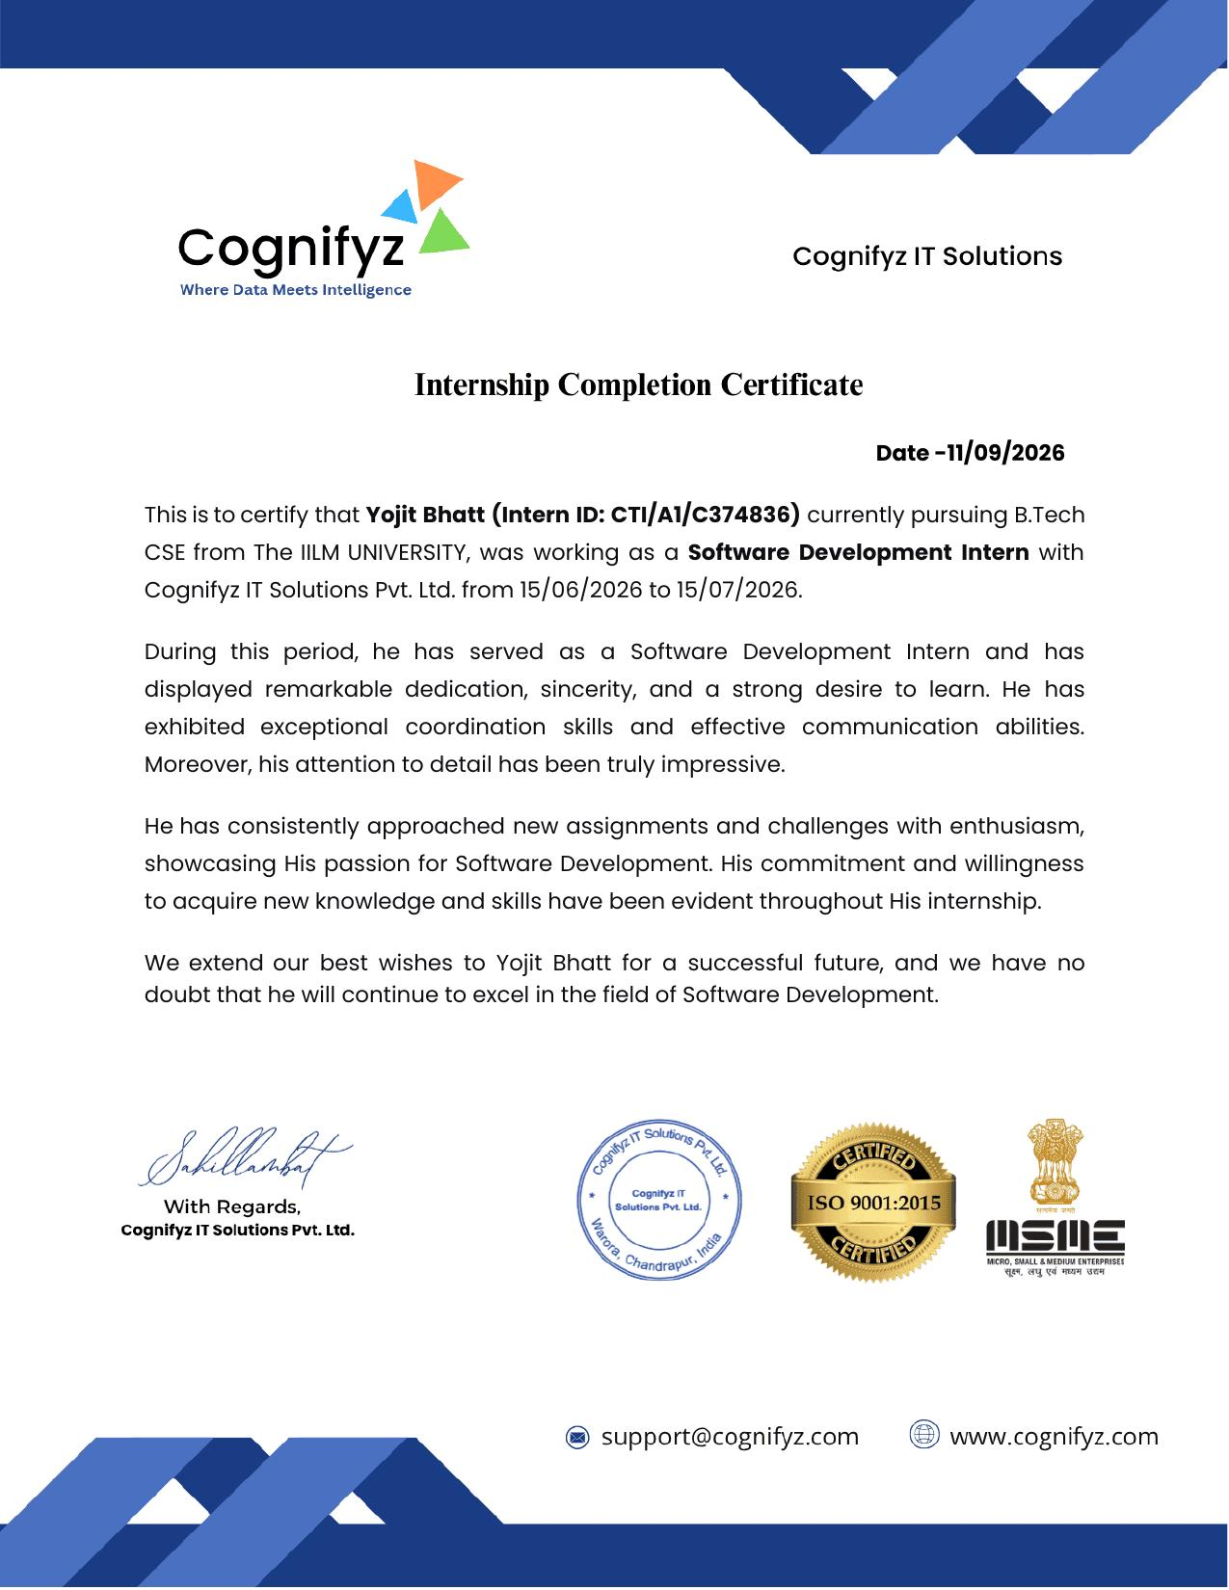
CHAPTER 4.10
Certificate of Completion

Slide 12
Thank You
Yojit Bhatt | Roll No: 2410031104 | B.Tech CSE, IILM University
Software Development Intern, Cognifyz IT Solutions Pvt. Ltd.

