Slide 1
Evaluating Aircraft Risk
Identifying Low-Risk Aircraft for Purchase

Slide 2
Summary
Commercial aviation, while a high-cost venture, is considered to have relatively low risk. This report highlights key factors for the aviation industry to evaluate before making purchasing decisions for airplanes intended for both commercial and private use. The findings emphasize the crucial need to prioritize safety to prevent accidents, injuries, and loss of life.

Slide 3
Outline
Business Problem
Data
Methods
Results
Conclusions

Slide 4
Business Problem
The company Lacks detailed knowledge about the potential risks associated with Aircraft, which would imply safety and operational efficiency. The task at hand is to assess and identify which aircraft presents the lowest risk. The Analysis will then be translated into clear, actionable insights to assist in making informed and strategic purchasing decisions

Slide 5
Data
By investigating Aviation Accident data, the focus was to evaluate the different risks associated with Aircraft accidents and draw our attention to Airplanes that are not built by amateurs and only classified under Accidents in the Investigation Type. 1 - Risk Factors include: Aircraft Damage, Weather conditions a Models, Manufacturer, Injury severity etc. 2 – Aircraft Performance: Models and make that are associated with fewer incidents, minimal damage, low injury counts.

Slide 6
Methods
Estimating Rate of injuries associated with each Aircraft model and Aircraft Make is a good indicator of determining the safety of the aircraft based on the safety of the passengers. This helps to guide on the % of accidents that result in injuries, uninjured, fatal, minor and serious injuries.
This is calculated by finding the ratio of Total_injuries / Total_Events

Slide 7
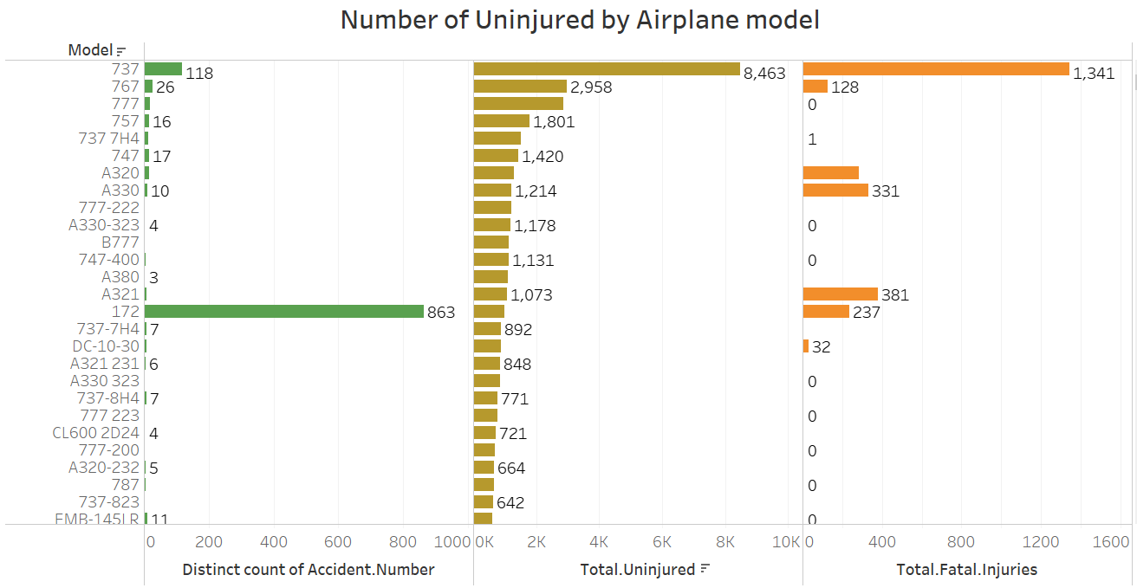
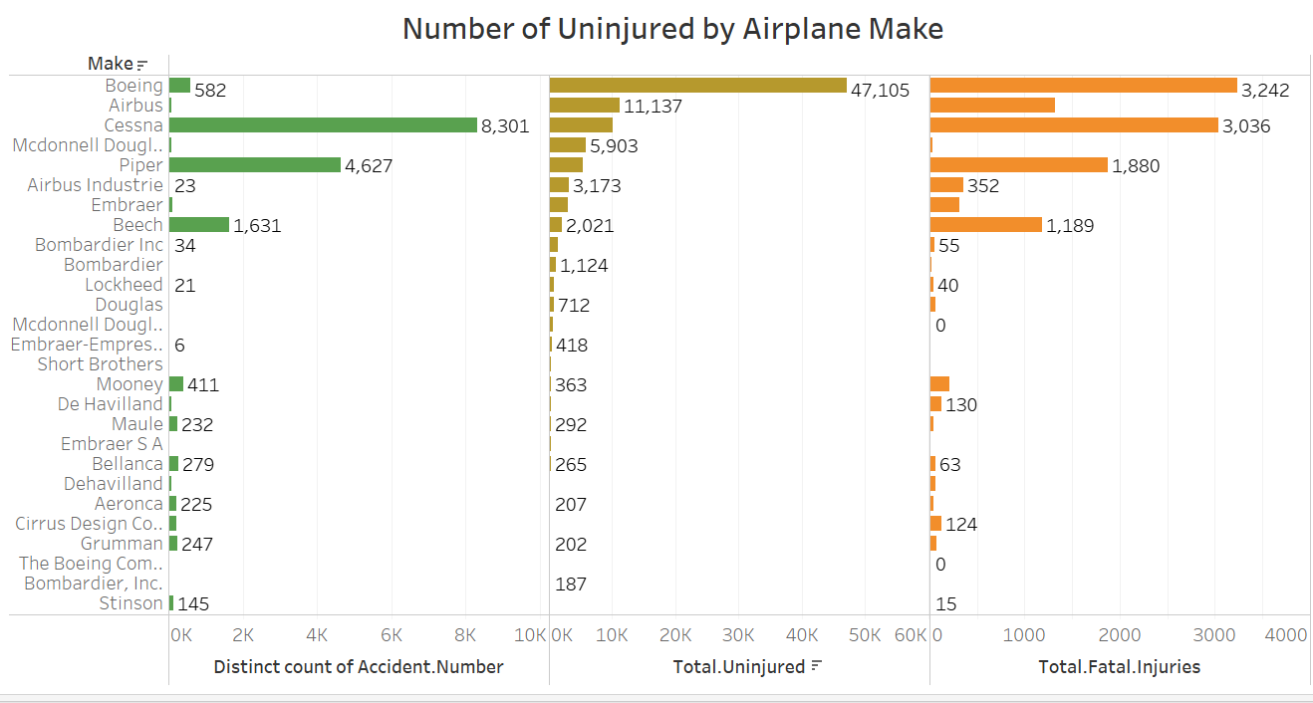
Results
Below are the safest Aircraft models based on the total number of passengers who remained uninjured considering the accident events that accoured. 737 being the safest model and Boeing being the safest Manufacturer of Airplane.

Slide 8
Conclusions
Recommendations:
1 - Avoid Amateur-built aircraft as these correlate with high-risk.
2 – Boeing should be given priority as a top manufacturer and specifically Boeing 777 should be the Airplane model of choice as they have the highest rate of uninjured passengers after an Accident has occurred.
3 – Models 737, 767, A330-323 have high uninjured rates under the weather VMC as visibility is clear.
Future Recommendations/further Analysis
It would be good to know the Flight Hours Each Airplane has.

Slide 9
Thank You!
Email: ronngwang@gmail.com
GitHub: @YokRonn
LinkedIn: linkedin.com/in/username/

