Slide 1

Department of Computer Science and Engineering Project Review 14.06.2022
Title of the Project
BREAST CANCER CLASSIFICATION USING DEEP LEARNING
Reg .No. | Name of the student
1905034 | NIDIN S
1905046 | SANJAY PRATAP T K
1905062 | YOKESH. R.S
2005201 | ABUTHAGEER S
Guided by:
Dr. S P Abirami
Assistant professor,CSE

Slide 2
Outline
Abstract
Introduction
Problem Statement
Objective
Google Trend Analysis
Literature Survey
Existing System
Proposed Work
Implementation
Conclusion
References

Slide 3
Abstract
Globally, breast cancer is the most common cancer among women, and the most likely cause of female cancer deaths as per statistical analysis given by WHO. High-income countries (HICs) have made the most progress in improving breast cancer outcomes. Between 1990 and 2014, breast cancer death rates dropped by 34% in the US attributable to the combination of improved earlier detection and effective adjuvant therapies. By contrast, breast cancer is an increasingly urgent problem in low- and middle-income countries (LMICs), where historically low incidence rates have been rising by up to 5% per year. In view of earlier detection of breast cancer, the research aims in developing a classification model using CNN. The model primarily uses Wisconsin Dataset for training the model and classifies the cancer tissues. The accuracy of the model is evaluated and found to be better compared to other existing models. The system could be further improved in integrating the image inputs to the optimized features.

Slide 4
Introduction
Breast Cancer is the most affected disease between women all over the world. All most 25% of all cancers with an estimated 1.67 million new cancer cases diagnosed in 2012 and its incidence is increasing day by days. It is also said that Breast cancer is the second leading cause of death for women worldwide.
Early detection of cancer can reduce the risk of deaths for cancer patients. To increase the survival rate the early diagnosis of breast cancer and a trustworthy detection model is required.
The goal of the research is to identify and classify Malignant and Benign patients by proposing a simple and efficient model for early detection of breast cancer with minimal error percentage.
This model uses an Artificial neural network and produces Accuracy of 98% and f1 score as 98% - Benign and 97% - Malignant .

Slide 5
Problem statement
The effects of bosom cancer around the world is miserable. Building a trustworthy detection and diagnosis of breast cancer at the earliest is required.

Slide 6
Objective
The goal of the research is to identify and classify Malignant and Benign patients by proposing a simple and efficient model for early detection of breast cancer .
We want to reduce the error rates with maximum accuracy.
CNN models are used to classify the Breast cancer classification

Slide 7
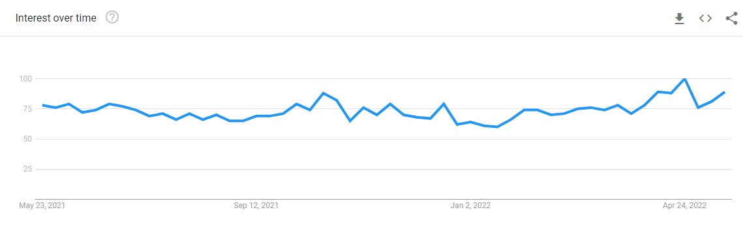
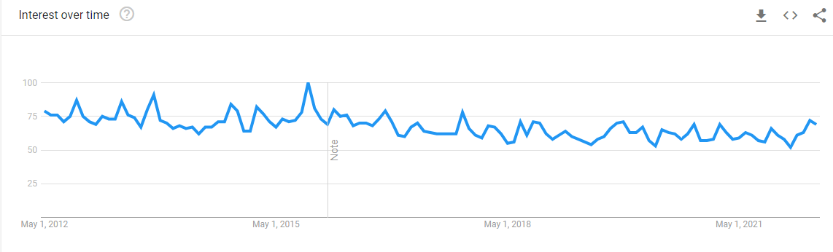
Google Trend Analysis

Slide 8
Literature Survey

Slide 9
Paper 1
Title of the Paper
Moh’d Rasoul Al-hadidi, Abdulsalam Alarabeyyat, Mohannad Alhanahnah Breast Cancer Detection using K-nearest Neighbor Machine Learning Algorithm 2016 9th International Conference on Developments in eSystems Engineering.

Slide 10
Paper 1
Parameters considered | Methodology used | Algorithms used if any | Limitations | Are you going to over come this?? (yes or no)
Hidden layers, neurons in the second layer, neurals in the first layer | Image processing Machine learning. | Back propagation neural network Logistic regression | Uses mammographic datasets.(quite slow and less acurrate) | yes

Slide 11
Paper 2
Title of the Paper
Efficient Approaches for Accuracy Improvement of Breast Cancer Classification Using Wisconsin Database. Shajib Ghosh ,Jubaer Hossain,Dr. Shaikh Anowarul Fattah,Dr. Celia Shahnaz ,Asir Intisar Khan,2017 IEEE Region 10 Humanitarian Technology Conference (R10-HTC)21 - 23 Dec 2017, Dhaka, Bangladesh[2]
Available: 10.1117/1.JMI.5.3.034501
[Accessed 2018].

Slide 12
Paper 2
Methodology used | Algorithms used if any | Limitations | Are you going to over come this?? (yes or no)
Image processing Deep learning | Partial occlusion Sequential CNN, VGG 16, ResNet-50, Xception, DenseNet-121, Inception v3 | Only binary stage classification is done | Yes
Model’s Region of interest | Grad-CAM (Gradient- Weighted Class activation mapping) | Dataset contains some over stained and damaged images

Slide 13
Paper 3
Title of the Paper
G. Shekar, S. Revathy and E. K. Goud, "Malaria Detection using Deep Learning," 2020 4th International Conference on Trends in Electronics and Informatics (ICOEI)(48184), 2020, pp. 746-750
Available: 10.1109/ICOEI48184.2020.9143023
[Accessed 2020].

Slide 14
Paper 3
Parameters considered | Methodology used | Algorithms used if any | Limitations | Are you going to over come this?? (yes or no)
Diagnosis, Texture mean , Area mean, concavity mean, | Deep learning | Neural network algorithm | Too slow in processing huge dataset | yes
symmetry mean, Smoothness worst, concavity worst, symmetry mean, fractal dimension worst

Slide 15
Paper 4
Title of the Paper
Abbas, S.S., Dijkstra, T.M.H. “Detection and stage classification of Plasmodium falciparum from images of Giemsa stained thin blood films using random forest classifiers.” Diagn Pathol 15, 130 (2020).
Available: https://doi.org/10.1186/s13000-020-01040-9
[Accessed 2020]

Slide 16
Paper 4
Methodology used | Algorithms used if any | Limitations | Are you going to over come this?? (yes or no)
Image preprocessing Image segmentation | Gaussian blur Pixel classification | 6- stage classification accuracy is 58.8%
Classification | Random Forest

Slide 17
Paper 5
Title of the Paper
Marada Amrutha Reddy, Ganti Sai Siva Rama Krishna, Teki Tanoj Kumar, “Malaria Cell-Image Classification using InceptionV3 and SVM ”, International Journal of Engineering Research & Technology (IJERT) ISSN: 2278-0181 Vol. 10 Issue 08, August-2021
Available: https://www.ijert.org/malaria-cell-image-classification-using-inceptionv3-and-svm
[Accessed Aug 8, 2021].

Slide 18
Paper 5
Methodology used | Algorithms used if any | Limitations | Are you going to over come this?? (yes or no)
Preprocessing Data Augmentation | ImageDataGenerator from Keras | The model wont be able to distinguish between parasites, impurities and artefacts.
Feature Extraction Optimization | Binary cross-entropy function Adaptive learning rate optimization – Adam | Smaller input for VGG-16 and VGG-19 might yield better accuracy.

Slide 19
Existing system
The existing system for Breast cancer Classification include just only the predictor using the simple learning algorithms and have ended up with good accuracy, on the other hand with few input as training images and with is insufficient to really prove a given data benign or malignant and less accuracy.

Slide 20
Proposed work
Our model uses EfficientNet b7 as a base model for training and testing the data, which are most advanced model developed with CNN and really a good model for classification using image datasets. The model uses 780 image datasets including benign, malignant and normal for training the model gives best result for further classification on input of any histopathological image.

Slide 21
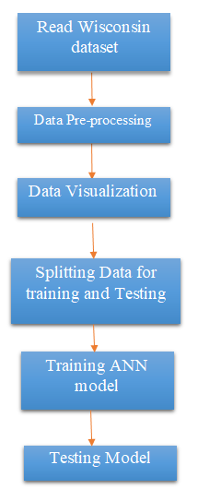
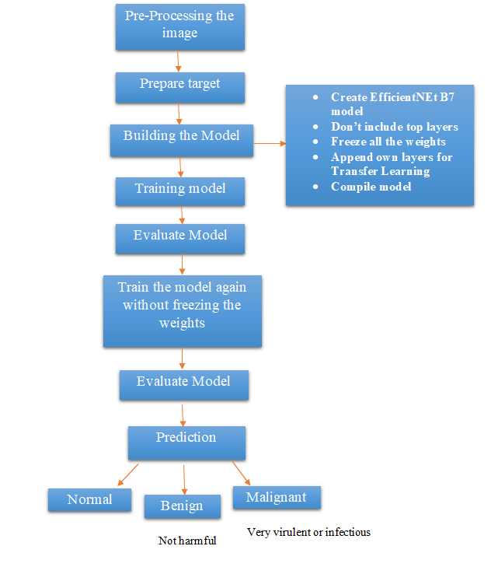
Flow Diagram

Slide 22
Implementation
Dividing the dataset:
The dataset that is used in the ANN model is WISCONSIN dataset and the histopathological images of malignant, benign and normal classes are given as input to the EfficientNet B7 model for classification.
The Wisconsin dataset is first divided into 70 % for training the ANN model and the remaining 30% for testing or validating the model. The WISCONSIN dataset consists of 33 features and 569 rows of data.

Slide 23
Implementation
(ii) Pre-processing the dataset:
The two unwanted features of the WISCONSIN dataset namely the ‘id’,’Unnamed’ columns are removed from the dataset. The diagnosis class feature is encoded with 0 for Benign and 1 for Malignant. MinMaxScaler() is imported from sklearn library and the data is scaled in the particular common range of values.
And for the images the mask images removed from the dataset ,which are unnecessary and the total image size reduces to 780.Whenever the image is passed into the trained model we divide the pixel of each image by 224x224 to reduce the image size , indeed reducing the image size.

Slide 24
Implementation
(iii) Build and train the model:
The CNN network consists a set of customized layers such as conv2D, max-pooling layer, activation layer, dropout layer, dense layer. The augmented images were fed to the network which in turn returns the feature learnt from the image to the output layer which detects the diseases present in the particular leaf.
(iv) Output:
The ANN which is trained using the WISCONSIN dataset gives the accuracy and the predicts for any input value of the same features that is used to train the model. And the EfficientNet B7 model which is trained with the image dataset gives the prediction either of three classes Benign or Malignant or Normal for any histopathological image given as input.

Slide 25
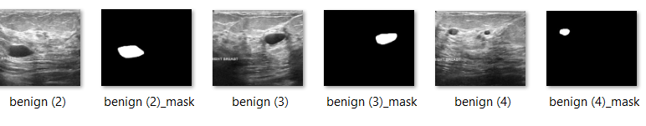
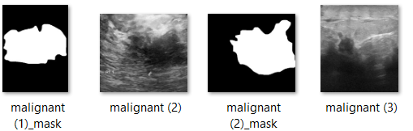
Dataset sample
Benign Cells
Malignant Cells

Slide 26
Custom CNN model
The custom CNN model has three convolution-pooling layers where various number of filters of different size are used.
After each layer, batch normalization step is applied to reduce the overfitting issue then flatten, dense layers.
Adam optimizer function is used for training process. Adam is an optimization algorithm that can be used instead of the classical stochastic gradient descent procedure to update network weights iterative based in training data.
Sparse categorical entropy is used as the loss function to compute the loss value of the custom CNN model.

Slide 27
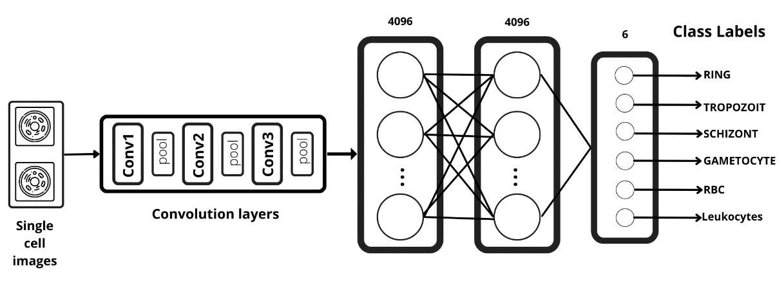
Custom CNN model

Slide 28
CONCLUSION
The project uses a deep learning technique convolutional neural system in that, a latest model of EfficientNet B7 which is trained of using the image datasets and another model of Artificial neural Network that is trained using the Wisconsin dataset.
Both the models can be used for classification of breast cancer. The given datasets is properly pre-processed and used for training and testing the model.

Slide 29
Reference
[1] Moh’d Rasoul Al-hadidi, Abdulsalam Alarabeyyat, Mohannad Alhanahnah Breast Cancer Detection using K-nearest Neighbor Machine Learning Algorithm 2016 9th International Conference on Developments in eSystems Engineering.
[2] Shajib Ghosh, Jubaer Hossain , Dr. Shaikh Anowarul Fattah, Dr. Celia Shahnaz , Asir Intisar Khan Efficient Approaches for Accuracy Improvement of Breast Cancer Classification Using Wisconsin Database 2017 IEEE Region 10 Humanitarian Technology Conference (R10-HTC) 21 - 23 Dec 2017, Dhaka, Bangladesh.
[3] Naresh Khuriwal , Dr Nidhi Mishra Breast Cancer Diagnosis Using Deep Learning Algorithm International Conference on Advances in Computing, Communication Control and Networking (ICACCCN2018).

Slide 30
References
[4] Nur Syahmi Ismail , Cheab Sovuthy Breast Cancer Detection Based on Deep Learning Technique Universiti Teknologi PETRONAS Bandar Seri Iskandar, 31750 Tronoh, Perak, Malaysia.
[5] Hari Krishna Timmana, Rajabhushanam C Breast Malignant Detection using Deep Learning Model Proceedings of the International Conference on Smart Electronics and Communication (ICOSEC 2020) IEEE Xplore Part Number: CFP20V90-ART; ISBN: 978-1-7281-5461-9.
[6] Ramik Rawal , BREAST CANCER PREDICTION USING MACHINE LEARNING 2020 JETIR May 2020, Volume 7, Issue 5.

Slide 31
Thank you

