Slide 1

Department of Computer Science and Engineering Project Review-1,2 18.10.2022
Design and Development of Deep-Learning Enabled Audio Spoof Detector
Reg .No. | Name of the student
1905015 | Gourav Gopal
1905031 | Nalin Suriya S
1905060 | Vishal Karthik S
1905062 | Yokesh R S
Guided By:
Dr.M. Mohanapriya M.E., Ph.D.
Associate Professor,
Department of CSE,
Coimbatore Institute of Technology,
Coimbatore

Slide 2
Problem Statement
The increase in the advancement of audio editing softwares , provide an easy way to the accessibility of voice controlled authentication systems which makes the Voice controlled devices(VCD) vulnerable for audio spoof attacks.
Audio spoof attack is the manipulation of genuine signal through recording or modifying to trick an audio verification system.

Slide 3
Objective
To develop a Deep-Learning Enabled Audio Spoof Detector which uses Recurrent Neural Networks(RNN) and Long Short Term Memory(LSTM) to classify human voice from recorded voices.
The proposed model will defend from the following attacks:
Replay attack
Voice conversion attack

Slide 4
Abstract
Authentication has become very important aspect of our day today lives starting from normal lock screen pin to human retina based authentication systems.
One among those popular and complex authentication systems are the audio based authentication systems where in people use certain words to unlock devices and objects like mobiles, doors etc.,
Audio Authentication generally involves authentication based on words and voices.

Slide 5
Abstract
Issue in the existing system is that the system verifies and extracts the features of words and voices but it does not classify human voice and recorded human voices.
The above issue can be overcome by using models like RNN and LSTM for classification.

Slide 6

Introduction
Development of VCD’s, have boosted the realization of smart homes, voice-controlled authentication systems etc.,.
These VCDs are vulnerable to different spoofing attacks .

Slide 7
Introduction
Audio Authentication is becoming very essential part of our lives. Audio Authentication spoofing is becoming an issue.
High-quality audio recorders enables bypassing this audio authentication system by just recording the human voice and reusing them for accessing the same system.
Thus, there exists a need to develop a voice anti-spoofing framework capable of detecting multiple audio spoofing attacks.

Slide 8
Proposed Methodology
Audio files are visualized and converted as spectrograms.
With these spectrograms, the inputs are classified into actual voice and recorded voice.
The proposed system uses machine learning models such as LSTM and RNN.

Slide 9
Literature Survey

Slide 10
PAPER 1- Fusion of BiLSTM and GMM-UBM Systems for Audio Spoofing Detection
AUTHORS- Ivan Rakhmanenko , Alexander Shelupanov , Evgeny Kostyunchenko
Published In: International Journal of Advanced Trends in Computer Science and Engineering – August 2019
Methodology | Anti-spoofing system using constant Q cepstral coefficients (CQCC) features and bidirectional long-short term memory (BiLSTM) networks for genuine/spoof audio classification. Fusion of BiLSTM and GMM-UBM system to improve results.
Algorithm Used | Gaussian mixture model(GMM) – universal background model(UBM) fusion system is used. BiLSTM network model is used for audio spoof detection.
Advantages | Uses time domain dependency relation in audio and gives better results. Uses fusion mechanism to improve accuracy.
Disadvantages | It doesn’t provide classification model for classification of various attacks.

Slide 11
PAPER 2- Improving anti-spoofing with octave spectrum and short-term spectral statistics information
AUTHORS- Jichen Yang , Rohan Kumar Das
Published In: 2020 – Elsevier Limited – Applied Acoustics
Methodology | To combine linear power spectrum and octave power spectrum and to produce a n hypothesis which utilizes the complementary information obtained from octave power spectrum to linear power spectrum.
Algorithm Used | Convolutional Neural Network – CNN Recurrent Neural Network - RNN ResNet Gaussian Mixture Modeling – GMM Deep Neural Network - DNN
Advantages | The systems combines linear power spectrum and Octave power spectrum to produce better to form better novel feature eCQCC indeed produces good results. Works for Synthetic and Playback Spoof attacks.
Disadvantages | Does not prove to be much effective in classification of audio spoofed data.

Slide 12
PAPER 3- Spoofed Speech Detection with Weighted Phase Features and Convolutional Networks.
AUTHORS - Gökay DISKEN
Published In: Archives of Acoustics, 2022
Methodology | Frame-wise weighted magnitude spectrum for effective detection of replay attacks. Frame-wise weighted cosine normalized phase features as feature extraction. CNN classifier to detect spoofing attacks using the extracted features.
Algorithm Used | Deep Neural Network – DNN Gaussian Mixture Modeling – GMM. Convolutional Neural Network - CNN
Advantages | Frame –wise weighted magnitude spectrum results in more effective method for spoof detection. Discusses various Attacks like synthetic , replay attacks and S10.
Disadvantages | Takes much computational cost for training.

Slide 13
PAPER 4 - Detection of Various Speech Forgery Operations Based on Recurrent Neural Network
AUTHORS - Diqun Yan and Tingting Wu
Published In: Springer Nature Singapore PVT LTD, 2020
Methodology | Spoof Forensic Method based on Recurrent Neural Network for the detection of various audio forgery operations. The model is trained using the TIMIT and UME datasets and then the model is tested within the dataset for intra-database evaluation and the model also does cros-database evaluatiom.
Algorithm Used | Feature extraction techniques like Mel-Frequency Cepstrum Coefficients(MFCC), Linear frequency Cepstrum Coefficients (LFCC). Recurrent Neural Network (RNN) is used.
Advantages | Feature extraction techniques like MFCC and LFCC are used to extract audio features.. In this work, RNN is used as it can capture the correlation between the frames in a speech recognition application. Hence it is considered better than CNN as it does not capture the sequential correlation well..
Disadvantages | The cross-database evaluation accuracy could be improved in this model.

Slide 14
PAPER 5 - Fake Audio Speech Detection.
AUTHORS - Shilpa Lunagaria, Mr. Chandresh Parekh
Published In: June 2020 , International Journal of Innovative Research in Technology.
Methodology | A model is built and used to identify whether an audio is real or fake. Uses visual representations of audio clips in the model known as spectrograms, ie raw audio is converted into mel-frequency spectrograms. ASVSpoof 2019 Dataset.
Algorithm Used | Deep Learning model and python libraries like Numpy, Pandas and Librosa are used for audio analysis. Sigmoid activation function and gets binary output ie 1 for Real voice and 0 for Fake voice.
Advantages | The real and fake voices can be identified. The accuracies obtained for training, validation are considerably high(99%, 95% respectively).
Disadvantages | This work only focuses on deep fake audio forgery and it doesnt detect or identify other audio forgery operations. The testing accuracy in this model could be improved with better algorithms (just 85% accuracy).

Slide 15
PAPER 6 – Deep Learning based DFWF Model for Audio Spoofing Attack Detection
AUTHORS – Kottilingam Kottursamy
Published In: Journal of Artificial Intelligence and Capsule Networks Sepetember 2020
Methodology | Continuous Learning using dynamic neural network based on DWDF method. positive sample alignment (PSA) and learning without forgetting (LwF).
Algorithm Used | Deep Neural Networks based on DWDF Knowledge Distillation loss to retain the memory loss. PSA and Lwf.
Advantages | Overcomes the demerit of loss of previous data by introduction of knowledge Distillation loss.
Disadvantages | Poor performance in detection of unseen data. Requires both original and new data. Storage of data.

Slide 16
PAPER 7 – Voice spoofing countermeasure for voice replay attacks using deep learning.
AUTHORS - Jincheng Zhou, Tao Hai1, Dayang N. A. Jawawi, Dan Wang, Ebuka Ibeke and Cresantus Biamba
Published In: Journal of Cloud Computing : Advances, Systems and applications (2022)
Methodology | Audio signals are decomposed and two features of 7, 7-dim, i.e., MFCCs and GTCCs are obtained. Bi-directional long short-term memory network as a deep learning classifier.
Algorithm Used | Mel‑Frequency cepstrum coefficient MFCC & Gammatone cepstral coefficients (GTCC) for feature Extraction. BiLSTM for classification.
Advantages | Avoids replay attacks in ASV. Voice biometrics. More accurate with the method of Speech Decomposition.
Disadvantages | Does not discuss about many audio spoof attacks , focuses on Replay attacks only.

Slide 17
PAPER 8-LSTM and CNN based ensemble approach for spoof detection task in automatic speaker verification systems
AUTHORS- Mohit Dua, Chhavi Jain, Sushil Kumar
Published In: Journal of Ambient Intelligence and Humanized Computing (2022)
Methodology | An audio spoof detection system which uses deep learning algorithms to detect various attacks created by synthesis or conversion of speech. ASV spoof dataset 2015,2019 is used.
Algorithm Used | Feature extraction techniques MFCC, Inverse MFCC,Constant Q cepstral coefficients Recurrent neual network LSTM, spatial CNN, temporal convolution CNN Ensemble method is used.
Advantages | Various feature extraction techniques are used which extracts audio quality features. LSTM models are used which increases performance. Ensemble method is used to get a consolidated decision from models.
Disadvantages | Performance on combined dataset is low. Deep CNN can be used to improve performance.

Slide 18
Dataset
ASV SPOOF DATASET-2019
ASV Spoof dataset contains two types of Audio files
Physical Access - Bonafide utterances are made in a real, physical space in which spoofing attacks are captured and then replayed within the same physical space using replay devices of varying quality.
Logical Access - Bonafide and spoofed utterances generated using text-to-speech (TTS) and voice conversion (VC) algorithms are communicated across telephony and VoIP networks with various coding and transmission effects.
Physical and Logical access has 50000 audio files that are recorded and classified into two classes
Bonafide
Spoofed

Slide 19
Dataset
The dataset includes genuine and spoofed speech from 20 speakers (8 male, 12 female).Each spoofed utterance is generated according to one of 2 voice conversion and 3 speech synthesis algorithms.
The voice conversion systems include those based on (i) neural-network-based and (ii)transfer-function-based methods.
The speech synthesis systems were implemented with (i) waveform concatenation, (ii) neural-network-based parametric speech synthesis using source-filter vocoders and (iii) neural-network-based parametric speech synthesis using Wavenet.

Slide 20
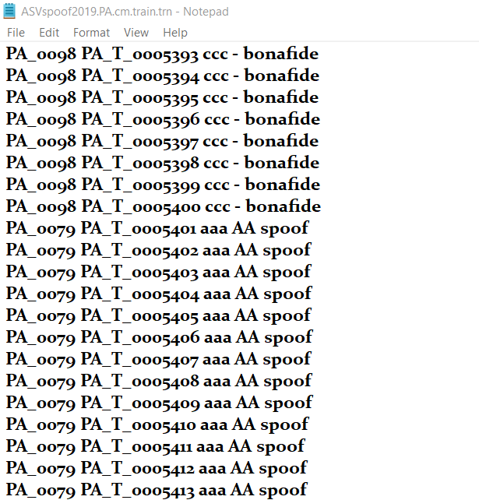
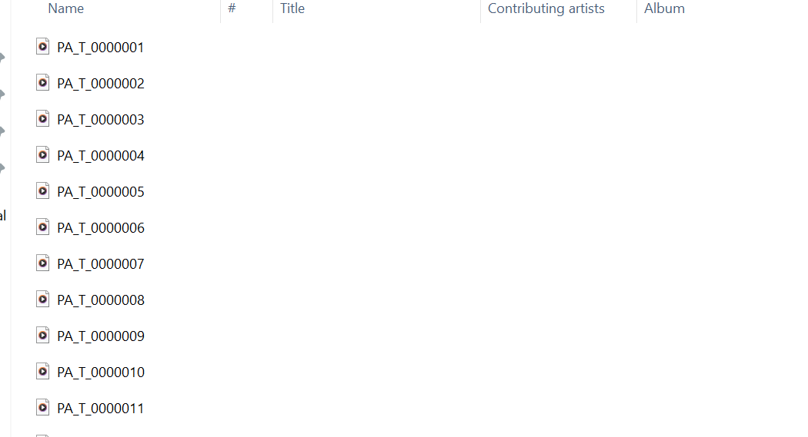
Dataset

Slide 21
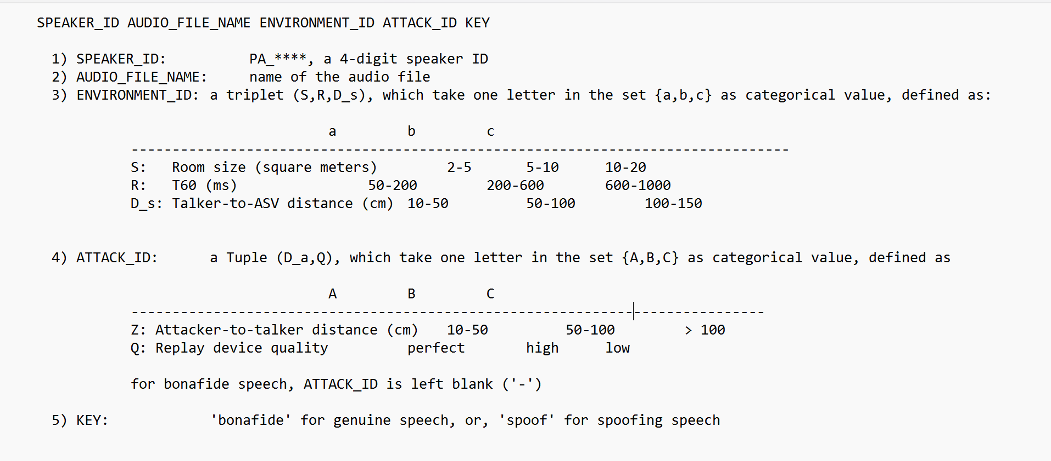
Dataset Description

Slide 22
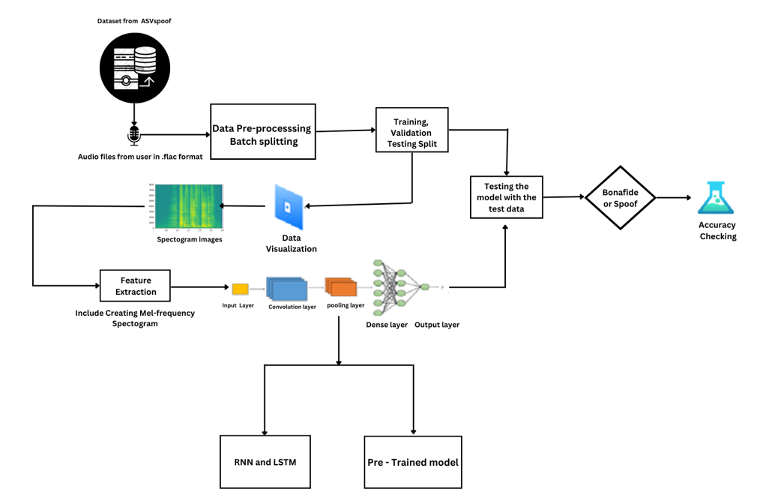
Architecture

Slide 23
Project Modules
Module 1:
Data collection- ASV spoof Dataset collection and Dataset Loading.
Module 2:
Data visualization.
Data pre-processing.
Feature extraction.

Slide 24
Project Modules
Module 3:
Creation of Deep learning models based on RNN,
LSTM.
Audio classification using RNN and LSTM is to be done and comparison of models to be performed.
Module 4:
Parameter Tuning - Trying out different parameters like activation functions, pooling methods and features to improve performance.
Ensemble methods - Usage of ensemble methods to further improve performance.

Slide 25
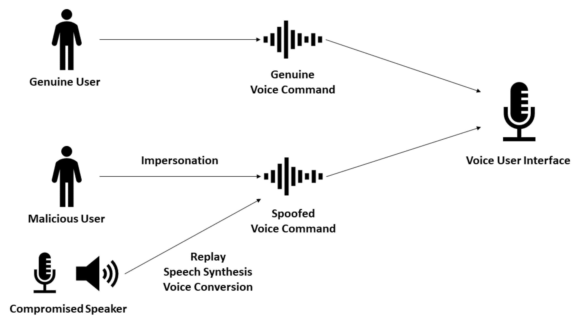

Project Modules
Module 5:
Integration to an IOT system and using it as an audio verification system.
Genuine

Slide 26
Works completed
ASV Spoof 2019 dataset is taken and dataset preparation is done.
Logical access and Physical access audio files are combined to generate a dataset which contains two different situations.
Dataset is loaded as batches using tensorflow module.
Data is splitted into training, testing, validation batches.
Spectrograms are generated using Librosa, Matplotlib module for data visualization.

Slide 27
Works yet to be completed
Data augmentation is to be performed to generate new set of data with variations.(in module 2)
Module 3
Module 4
Module 5

Slide 28
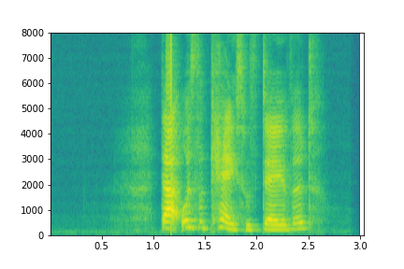
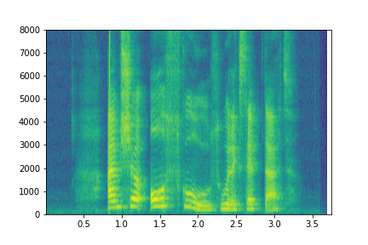
Spectrograms
Bonafide
Spoofed

Slide 29
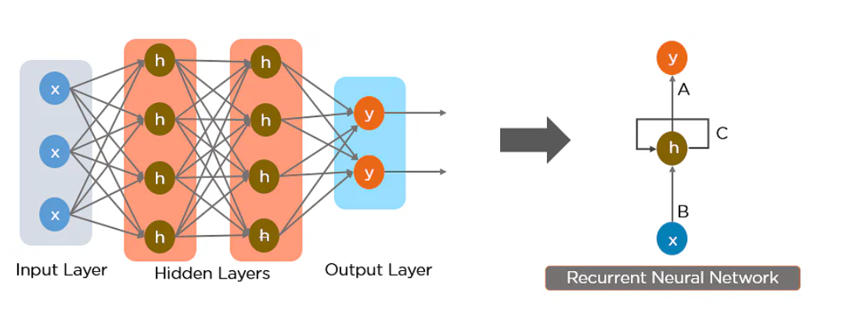
Algorithms to be used
Recurrent Neural Network:
RNN works on the principle of saving the output of a particular layer and feeding this back to the input in order to predict the output of the layer.

Slide 30
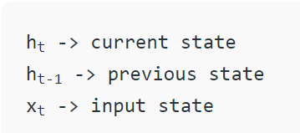

Algorithms to be used
RNN is proposed because normal feed forward neural network:
It cannot handle sequential data like audio files.
It cannot memorize previous inputs.
Formula for calculating current state:
Disadvantages:
Gradient vanishing and exploding problems.
Training an RNN is a very difficult task.
It cannot process very long sequences if using tanh or relu as an activation function.

Slide 31
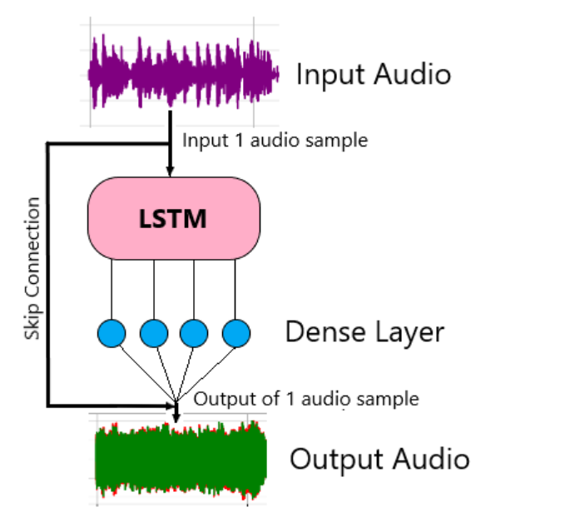
Algorithms to be used
Long Short Term Memory Networks:
Long Short Term Memory networks(LSTM) – are a special kind of RNN, capable of learning long-term dependencies.
LSTMs provides a large range of parameters such as learning rates, and input and output biases. no need for fine adjustments. The complexity to update each weight is reduced to O(1) with LSTMs, similar to that of Back Propagation Through Time (BPTT), which is an advantage.

Slide 32
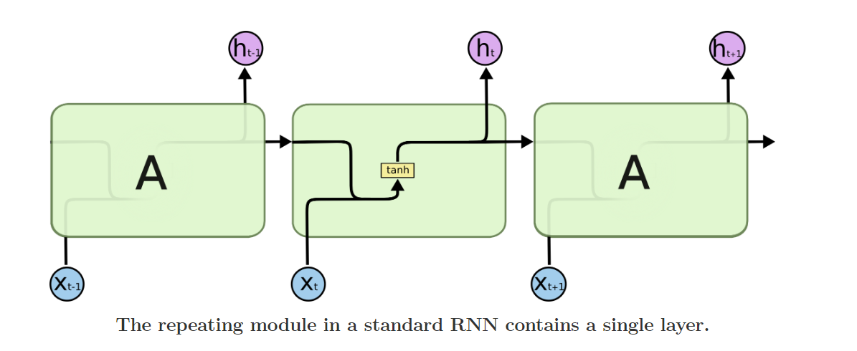
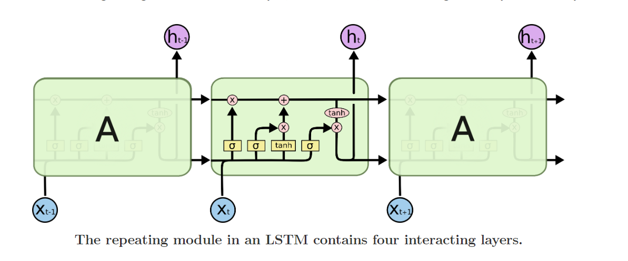

Slide 33
Outcome
The proposed model can be integrated into any IOT devices or VCD’s for added security measures.
This project can also be used in various different areas, starting from mobile unlocking system to car door unlocking system.
This Deep Learning model can be deployed and used alongside the audio authentication system to classify recorded voices from human voices.

Slide 34
References
Dua, M., Jain, C. & Kumar, S. LSTM and CNN based ensemble approach for spoof detection task in automatic speaker verification systems. J Ambient Intell Human Comput 13, 1985–2000 (2022). https://doi.org/10.1007/s12652-021-02960-0
Yamagishi, Junichi; Todisco, Massimiliano; Sahidullah, Md; Delgado, Héctor; Wang, Xin; Evans, Nicolas; Kinnunen, Tomi; Lee, Kong Aik; Vestman, Ville; Nautsch, Andreas. (2019). ASVspoof 2019: The 3rd Automatic Speaker Verification Spoofing and Countermeasures Challenge database, [sound]. University of Edinburgh. The Centre for Speech Technology Research (CSTR). https://doi.org/10.7488/ds/2555.
https://www.simplilearn.com/tutorials/deep-learning-tutorial/rnn
https://colah.github.io/posts/2015-08-Understanding-LSTMs/
Sak, H., Senior, A.W., & Beaufays, F. (2014). Long short-term memory recurrent neural network architectures for large scale acoustic modeling. INTERSPEECH.
Ankur, Tanjemoon & Kundu, Bipasha & Foysal, Md & Ortiz, Bengie & Chong, Jo. (2022). LSTM-Based COVID-19 Detection Method Using Coughing. 10.21203/rs.3.rs-2106413/v1.
Akyol K, Şen B. Automatic Detection of Covid-19 with Bidirectional LSTM Network Using Deep Features Extracted from Chest X-ray Images. Interdiscip Sci. 2022 Mar;14(1):89-100. doi: 10.1007/s12539-021-00463-2. Epub 2021 Jul 27. PMID: 34313974; PMCID: PMC8313418.

Slide 35
References
Ivan Rakhmanenko Fusion of BiLSTM and GMM-UBM Systems for Audio Spoofing Detection August 2019 International Journal of Advanced Trends in Computer Science and Engineering 6(4):1741-1746.
Jichen Yang, Rohan Kumar Das,Improving anti-spoofing with octave spectrum and short-term spectral statistics information,Applied Acoustics,Volume 157,2020,107017,ISSN 0003-682X,
https://ijirt.org/master/publishedpaper/IJIRT149877_PAPER.pdf
Mittal, Aakshi & Dua, Mohit. (2022). Automatic speaker verification systems and spoof detection techniques: review and analysis. International Journal of Speech Technology. 25. 10.1007/s10772-021-09876-2.
https://irojournals.com/aicn/article/pdf/4/3/4
https://journals.pan.pl/dlibra/publication/141648/edition/123487/content/archives-of-acoustics-2022-vol-47-no-2-spoofed-speech-detection-with-weighted-phase-features-and-convolutional-networks-br-disken-gokay?language=en
Zhou, J., Hai, T., Jawawi, D.N.A. et al. Voice spoofing countermeasure for voice replay attacks using deep learning. J Cloud Comp 11, 51 (2022). https://doi.org/10.1186/s13677-022-00306-5

Slide 36
Thank you!

