Slide 1

Department of Computer Science and Engineering Project Review-External VIVA
15.05.2023
Audio Spoof Detection Integrated with a Home Automation System using IOT
Reg .No. | Name of the student
1905015 | Gourav Gopal
1905031 | Nalin Suriya S
1905060 | Vishal Karthik S
1905062 | Yokesh R S
Guided By:
Dr.M. Mohanapriya M.E., Ph.D.
Associate Professor,
Department of CSE,
Coimbatore Institute of Technology,
Coimbatore

Slide 2
Objective
To develop a Home automation system using IOT integrated with Audio Spoof Detector to prevent from the following audio spoof attacks like:
Replay attack.
Voice Conversion attack.

Slide 3
Abstract
Authentication has become very important aspect of our day today lives starting from normal lock screen pin to human retina based authentication systems.
One among those popular and complex authentication systems are the audio based authentication systems where in people use certain words to unlock electronic devices as well as IOT devices like mobiles, home automation systems etc.,
Audio Authentication generally involves authentication based on words and voices.

Slide 4

Introduction
Development of VCD’s, have boosted the realization of smart homes, voice-controlled authentication systems etc.,.
These VCDs are vulnerable to different spoofing attacks .

Slide 5
Introduction
Audio Authentication is becoming very essential part of our lives. Audio Authentication spoofing is becoming an issue.
High-quality audio recorders enables bypassing this audio authentication system by just recording the human voice and reusing them for accessing the same system.
Thus, there exists a need to develop a voice anti-spoofing framework capable of detecting multiple audio spoofing attacks.

Slide 6
Introduction
The increase in the advancement of audio editing softwares, provide an easy way to the accessibility of voice controlled authentication systems which makes the Voice controlled devices(VCD) like Home Automation systems vulnerable to audio spoof attacks.

Slide 7
Literature Survey

Slide 8
PAPER 1- Fusion of BiLSTM and GMM-UBM Systems for Audio Spoofing Detection
AUTHORS- Ivan Rakhmanenko , Alexander Shelupanov , Evgeny Kostyunchenko
Published In: International Journal of Advanced Trends in Computer Science and Engineering – August 2019
Methodology | Anti-spoofing system using constant Q cepstral coefficients (CQCC) features and bidirectional long-short term memory (BiLSTM) networks for genuine/spoof audio classification. Fusion of BiLSTM and GMM-UBM system to improve results.
Algorithm Used | Gaussian mixture model(GMM) – universal background model(UBM) fusion system is used. BiLSTM network model is used for audio spoof detection.
Advantages | Uses time domain dependency relation in audio and gives better results. Uses fusion mechanism to improve accuracy.
Disadvantages | It doesn’t provide classification model for classification of various attacks.

Slide 9
PAPER 2 – Voice spoofing countermeasure for voice replay attacks using deep learning.
AUTHORS - Jincheng Zhou, Tao Hai1, Dayang N. A. Jawawi, Dan Wang, Ebuka Ibeke and Cresantus Biamba
Published In: Journal of Cloud Computing : Advances, Systems and applications (2022)
Methodology | Audio signals are decomposed and two features of 7, 7-dim, i.e., MFCCs and GTCCs are obtained. Bi-directional long short-term memory network as a deep learning classifier.
Algorithm Used | Mel‑Frequency cepstrum coefficient MFCC & Gammatone cepstral coefficients (GTCC) for feature Extraction. BiLSTM for classification.
Advantages | Avoids replay attacks in ASV. Voice biometrics. More accurate with the method of Speech Decomposition.
Disadvantages | Does not discuss about many audio spoof attacks , focuses on Replay attacks only.

Slide 10
PAPER 3- Voice-Based Human Identification using Machine Learning.
AUTHORS- Baha A. Alsaify, Hadeel S. Abu Arja, Baskal Y. Maayah, Masa M. Al-Taweel, Rami Alazrai, Mohammad I. Daoud.
Published In: 13th International Conference on Information and Communication Systems (ICICS) , 2022
Methodology | Voice identification of 150 speakers were performed. Dataset contains 3000 data samples. MFCCs are used to extract the features. Simple machine learning algorithms are used to identify voice samples.
Algorithm Used | MFCC is used for feature extraction. Support Vector Machine and Random Forest are used for classification.
Advantages | As simple machine learning algorithms are used, hence it is power efficient.
Disadvantages | Deep Learning models can be used to improve the accuracy even further.

Slide 11
PAPER 4 - IoT based speech recognition system.
AUTHORS - Kishore Kumar Sethy, L. M. Varalakshmi, Rajkumar E.
Published In: AIP Conference Proceedings 2393, 020096, 2022
Methodology | Low-cost speech recognition system using ESP-32 as the wireless option. Simple machine learning algorithms used for speech recognition
Algorithm Used | Support vector machine (SVM) Natural Language Processing (NLP)
Advantages | ESP-32 Wifi mouse is efficient for data transmission. Raspberry pi Iot system is powerful.
Disadvantages | Raspberry pi based Iot system is not cost effective

Slide 12
PAPER 5 - Fake Audio Speech Detection.
AUTHORS - Shilpa Lunagaria, Mr. Chandresh Parekh
Published In: June 2020 , International Journal of Innovative Research in Technology.
Methodology | A model is built and used to identify whether an audio is real or fake. Uses visual representations of audio clips in the model known as spectrograms, ie raw audio is converted into mel-frequency spectrograms. ASVSpoof 2019 Dataset.
Algorithm Used | Deep Learning model and python libraries like Numpy, Pandas and Librosa are used for audio analysis. Sigmoid activation function and gets binary output ie 1 for Real voice and 0 for Fake voice.
Advantages | The real and fake voices can be identified. The accuracies obtained for training, validation are considerably high(99%, 95% respectively).
Disadvantages | This work only focuses on deep fake audio forgery and it doesnt detect or identify other audio forgery operations. The testing accuracy in this model could be improved with better algorithms (just 85% accuracy).

Slide 13
PAPER 6 - Comparison of VQ and GMM for Text Independent Speaker Identification System for The Bengali Language
AUTHORS - Md Mahadi Hasan Nahid , Md Ashraful , Islam , Md Saiful Islam
Published In: International Journal of Computer Applications · September 2019
Methodology | Performs a comparative study of VQ and GMM to identify the speaker who speaks in Bengali accent. Extract features using Mel Frequency Cepstral Coefficients (MFCC) and Liner Predictive Coding Coefficients (LPCC) for feature extraction These extracted features are then sent to the Convolutional Neural Network as input and then are classified as either synthetic or replay attacks.
Algorithm Used | Deep Learning model and python libraries like Numpy, Pandas and Librosa are used for audio analysis. Sigmoid activation function and gets binary output ie 1 for Real voice and 0 for Fake voice. Mel Frequency Cepstral Coefficients (MFCC) and Liner Predictive Coding Coefficients (LPCC) for feature extraction.
Advantages | The method GMM+LPCC and VQ+LPCC are very fast. The method (GMM+LPCC) gives tremendous improvement over the method (GMM+MFCC), and it can detect the correct speaker from much shorter speech samples.
Disadvantages | Method like VQ+MFCC is highly accurate but slow and it can be applied in security purpose where the number of users is limited.

Slide 14
Dataset
ASV SPOOF DATASET-2019
ASV Spoof dataset contains two types of Audio files
Physical Access - Bonafide utterances are made in a real, physical space in which spoofing attacks are captured and then replayed within the same physical space using replay devices of varying quality.
Logical Access - Bonafide and spoofed utterances generated using text-to-speech (TTS) and voice conversion (VC) algorithms are communicated across telephony and VoIP networks with various coding and transmission effects.
Physical and Logical access has 50000 audio files that are recorded and classified into two classes
Bonafide
Spoofed

Slide 15
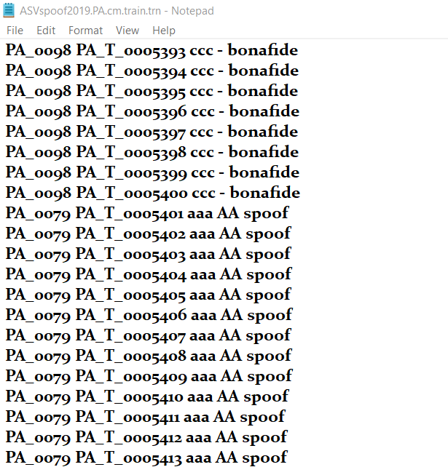
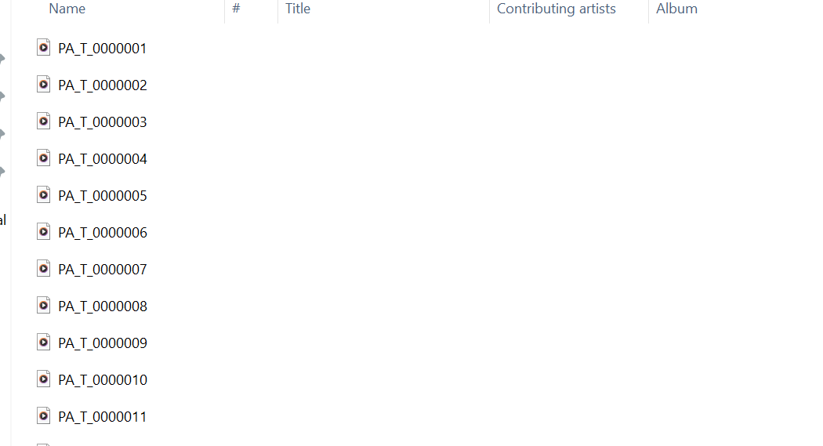
Dataset

Slide 16
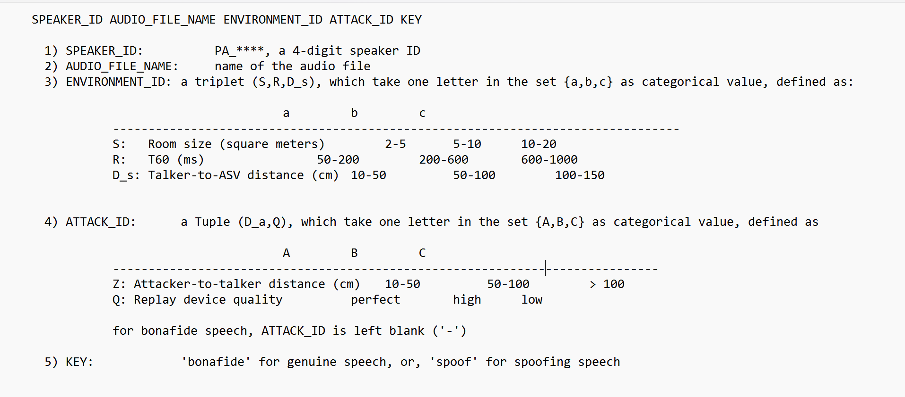
Dataset Description

Slide 17
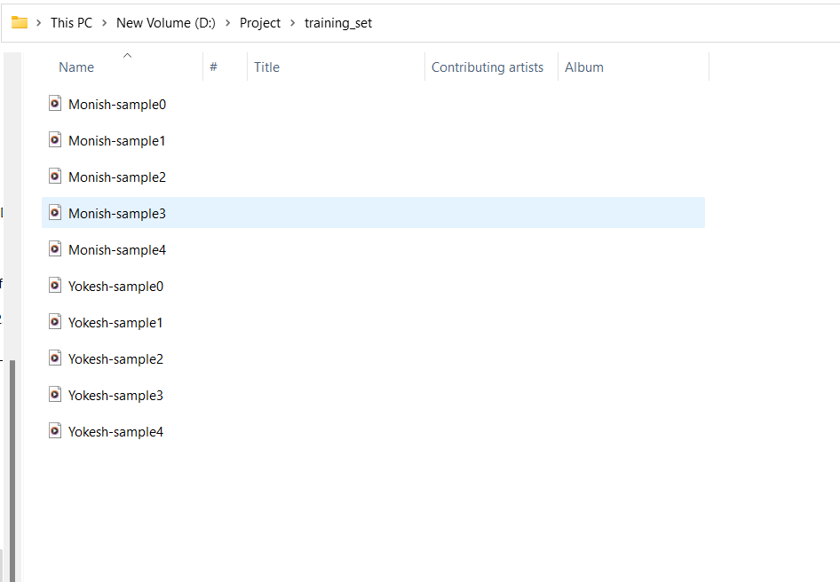
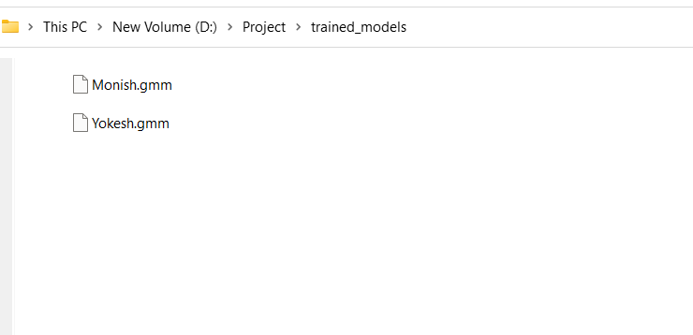
Dataset GMM dataset:

Slide 18
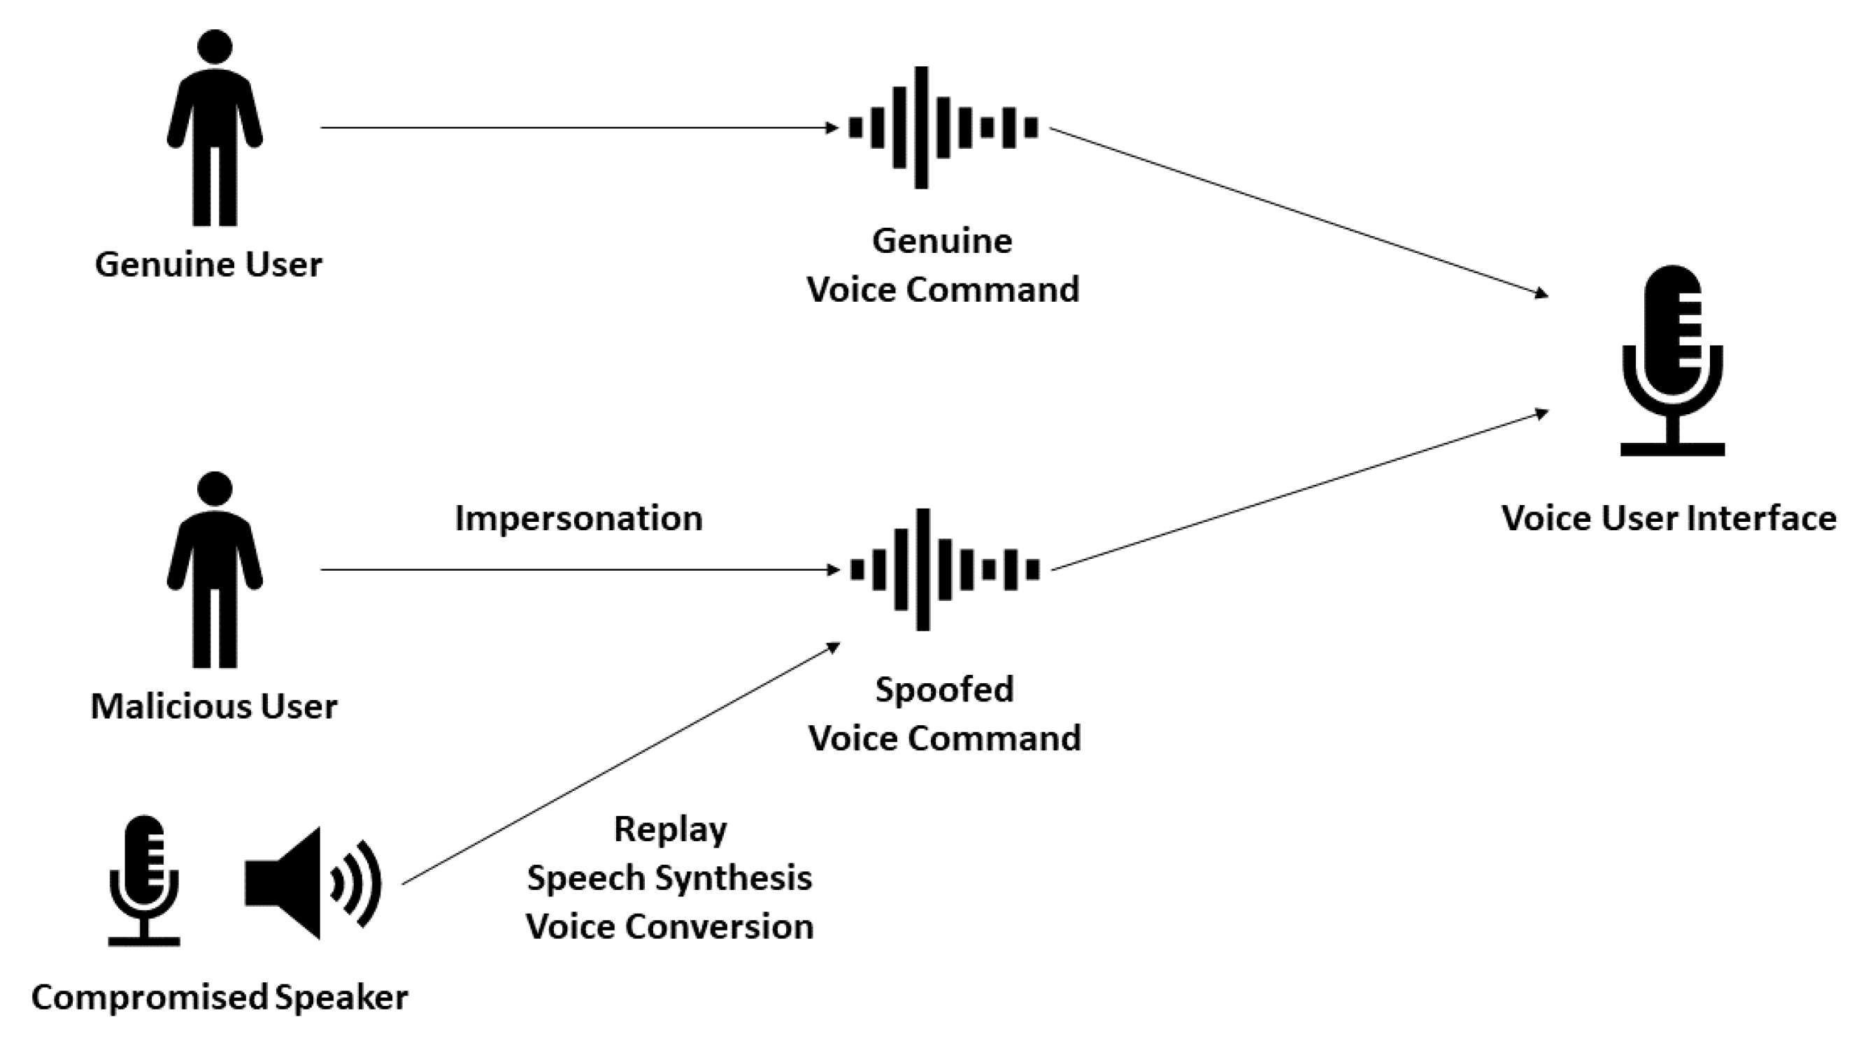

Project Modules
Module 5:
Integration to an IOT system and using it as an audio verification system.
Genuine

Slide 19
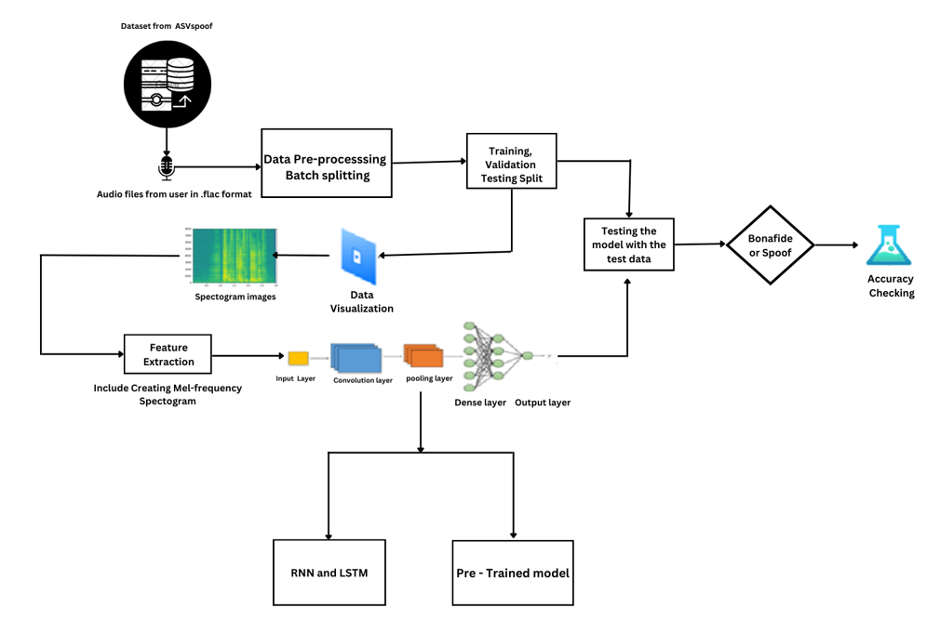
Architecture

Slide 20
Modules
Legit Audio
Authorized User
Audio Spoof Detector
Speaker Identification
IoT System

Slide 21
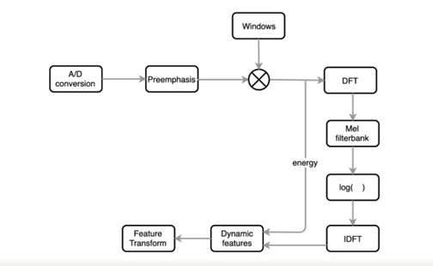
Algorithms used
Mel Frequency Cepstral Coefficients(MFCCs):
MFCC is the widely used technique for extracting the features from the audio signal.
Mel-frequency cepstral coefficients (MFCC) which have 39 features. The feature count is small enough to force us to learn the information of the audio. 12 parameters are related to the amplitude of frequencies. It provides us enough frequency channels to analyze the audio.

Slide 22
Algorithms used
BiDirectional LSTM:
Unlike standard LSTM, the input flows in both directions, and it’s capable of utilizing information from both sides. It’s also a powerful tool for modeling the sequential dependencies between words and phrases in both directions of the sequence.
BiLSTM adds one more LSTM layer, which reverses the direction of information flow.

Slide 23
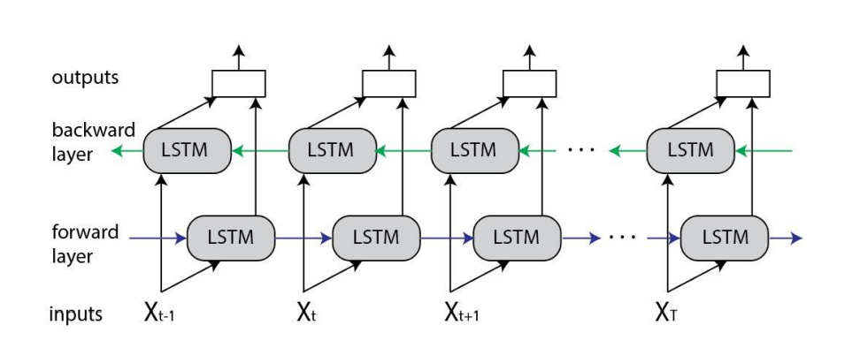

Slide 24
Algorithms Used
GMM :
The Gaussian mixture model (GMM) is a parametric classifier , used in classifying different audio classes. It is an intuitive approach when the model consists of several Gaussian components, which can be seen to model audio features.
The basis for using GMM is that the probability distribution of feature vectors extracted from a class can be modeled and compared for identification.

Slide 25
IoT Components to be used
Arduino UNO board
LED lights
Servo motor
Connecting wires
Bread Board

Slide 26
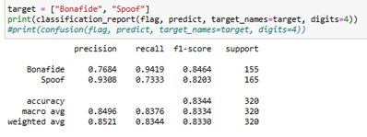
Results
Classification Report

Slide 27
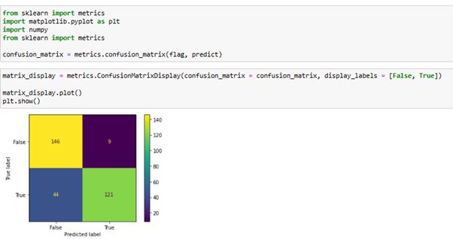
Results
Confusion Matrix

Slide 28
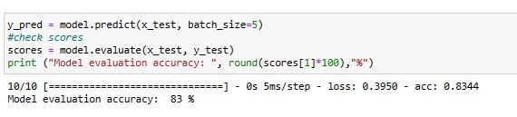
Results
Model testing

Slide 29
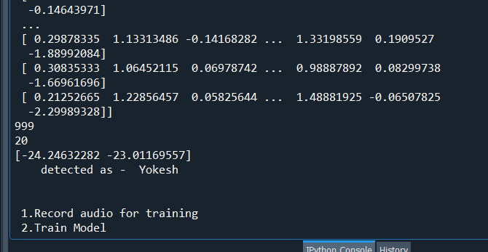
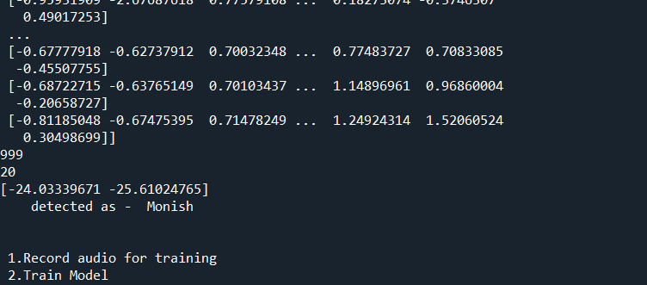
Results
Speaker Identification Testing

Slide 30
Conclusion
The proposed system can classify human voices from recorded voices. The proposed system also defends from replay attacks and voice conversion attacks.
The accuracy obtained for the proposed system is 85%.
The proposed speaker identification system(integrated with IoT) is tested against three unknown and one known user, it performs as expected.

Slide 31
References
Dua, M., Jain, C. & Kumar, S. LSTM and CNN based ensemble approach for spoof detection task in automatic speaker verification systems. J Ambient Intell Human Comput 13, 1985–2000 (2022). https://doi.org/10.1007/s12652-021-02960-0
Yamagishi, Junichi; Todisco, Massimiliano; Sahidullah, Md; Delgado, Héctor; Wang, Xin; Evans, Nicolas; Kinnunen, Tomi; Lee, Kong Aik; Vestman, Ville; Nautsch, Andreas. (2019). ASVspoof 2019: The 3rd Automatic Speaker Verification Spoofing and Countermeasures Challenge database, [sound]. University of Edinburgh. The Centre for Speech Technology Research (CSTR). https://doi.org/10.7488/ds/2555.
https://www.simplilearn.com/tutorials/deep-learning-tutorial/rnn
https://colah.github.io/posts/2015-08-Understanding-LSTMs/
Sak, H., Senior, A.W., & Beaufays, F. (2014). Long short-term memory recurrent neural network architectures for large scale acoustic modeling. INTERSPEECH.
Ankur, Tanjemoon & Kundu, Bipasha & Foysal, Md & Ortiz, Bengie & Chong, Jo. (2022). LSTM-Based COVID-19 Detection Method Using Coughing. 10.21203/rs.3.rs-2106413/v1.
Akyol K, Şen B. Automatic Detection of Covid-19 with Bidirectional LSTM Network Using Deep Features Extracted from Chest X-ray Images. Interdiscip Sci. 2022 Mar;14(1):89-100. doi: 10.1007/s12539-021-00463-2. Epub 2021 Jul 27. PMID: 34313974; PMCID: PMC8313418.

Slide 32
References
Ivan Rakhmanenko Fusion of BiLSTM and GMM-UBM Systems for Audio Spoofing Detection August 2019 International Journal of Advanced Trends in Computer Science and Engineering 6(4):1741-1746.
Jichen Yang, Rohan Kumar Das,Improving anti-spoofing with octave spectrum and short-term spectral statistics information,Applied Acoustics,Volume 157,2020,107017,ISSN 0003-682X,
https://ijirt.org/master/publishedpaper/IJIRT149877_PAPER.pdf
Mittal, Aakshi & Dua, Mohit. (2022). Automatic speaker verification systems and spoof detection techniques: review and analysis. International Journal of Speech Technology. 25. 10.1007/s10772-021-09876-2.
https://irojournals.com/aicn/article/pdf/4/3/4
https://journals.pan.pl/dlibra/publication/141648/edition/123487/content/archives-of-acoustics-2022-vol-47-no-2-spoofed-speech-detection-with-weighted-phase-features-and-convolutional-networks-br-disken-gokay?language=en
Zhou, J., Hai, T., Jawawi, D.N.A. et al. Voice spoofing countermeasure for voice replay attacks using deep learning. J Cloud Comp 11, 51 (2022). https://doi.org/10.1186/s13677-022-00306-5
Ivan Rakhmanenko Fusion of BiLSTM and GMM-UBM Systems for Audio Spoofing Detection August 2019 International Journal of Advanced Trends in Computer Science and Engineering 6(4):1741-1746.
Zhou, J., Hai, T., Jawawi, D.N.A. et al. Voice spoofing countermeasure for voice replay attacks using deep learning. J Cloud Comp 11, 51 (2022). https://doi.org/10.1186/s13677-022-00306-5
Alsaify, Baha & Abu Arja, Hadeel & Maayah, Baskal & Altaweel, Masa & Alazrai, Rami & Daoud, Mohammad. (2022). Voice-Based Human Identification using Machine Learning. 205-208. 10.1109/ICICS55353.2022.9811154.
AIP Conference Proceedings 2393, 020096 (2022); https://doi.org/10.1063/5.0074140 Published Online: 19 May 2022

Slide 33
Thank you!

