Slide 1
Jewelry Online Store
Website Source Code using HTML, CSS & Java
N Ragul
Batch - 2024-2027
Department – BCA
S.K.P Arts and Science College

Slide 2
Introduction
• Online shopping trend in jewelry
• Why digital jewelry store?
• Project aim: Easy online jewelry purchase

Slide 3
Objectives
• User-friendly jewelry shopping experience
• Interactive cart & checkout system
• Elegant UI with attractive design
• Secure payment input form

Slide 4
Technologies Used
• HTML → Structure
• CSS → Styling & Layout
• JavaScript → Dynamic functionality

Slide 5
Website Layout
• Header (Logo + Navigation)
• Hero Banner (Background Image + Title)
• Products Section
• Shopping Cart Section
• Checkout Form
• Order Confirmation Page
• Footer

Slide 6
Header Section
• Contains store title & navigation links
• CSS styling with golden theme (#b8860b)
• Navigation → Home, Products, About, Contact

Slide 7
Hero Banner
• Background image (bgbanner.jpg)
• Text overlay → Shine with Elegance ✨
• CSS: Centered text + text shadow effect

Slide 8
Products Section
• Displayed in grid layout
• Each product has:
- Image
- Title
- Price
- Add to Cart button

Slide 9
Product Examples
• Diamond Ring – $499
• Gold Necklace – $799
• Silver Bracelet – $199
• Pearl Earrings – $299

Slide 10
Cart Section
• Dynamic cart list
• Shows product name + price
• Displays total amount
• Proceed to Checkout button

Slide 11
Checkout Page
• Collects customer details:
- Name, Email, Address
- Card Number, Expiry Date, CVV
• Button: Pay Now

Slide 12
Order Confirmation Page
• Displays:
- Order Confirmed ✅
- Customer Name
- Total Paid
- Shipping Address
- Continue Shopping button

Slide 13
CSS Styling
• Colors: Gold (#b8860b), White, Black
• Hover Effects on buttons
• Grid Layout for responsiveness
• Rounded corners + shadows for modern design

Slide 14
JavaScript Functions
• addToCart() → Adds product
• displayCart() → Updates cart display
• goToCheckout() → Switches to checkout page
• submitOrder() → Processes order & shows confirmation
• continueShopping() → Back to product page

Slide 15
Code Snippet – Cart Function
function addToCart(product, price) {
cart.push({ product, price });
total += price;
displayCart();
}

Slide 16
Code Snippet – Checkout
function goToCheckout() {
if (cart.length === 0) {
alert('Your cart is empty!');
return;
}
document.querySelector('.products').style.display = 'none';
document.querySelector('.cart').style.display = 'none';
document.getElementById('checkout-section').style.display = 'grid';
}

Slide 17
Code Snippet – Order Confirmation
function submitOrder(event) {
event.preventDefault();
let name = document.getElementById('name').value;
let address = document.getElementById('address').value;
document.getElementById('confirm-name').textContent = name;
document.getElementById('confirm-total').textContent = total;
document.getElementById('confirm-address').textContent = address;
}

Slide 18
Features
• Attractive UI with jewelry theme
• Dynamic cart system
• Checkout & Payment form
• Order confirmation with details
• Responsive design

Slide 19
Advantages
• Easy jewelry shopping experience
• Saves time & effort
• Modern look and feel
• Secure checkout process

Slide 20
Limitations
• Payment not connected to real gateway
• Limited product set
• No backend database (all in browser)

Slide 21
Future Enhancements
• Add real payment gateway (PayPal, Razorpay)
• Integrate with database (MySQL, Firebase)
• User login & profile management
• Order history tracking
• Advanced product filters

Slide 22
Real-World Applications
• Can be extended as an e-commerce platform
• Jewelry brands can showcase collections online
• Customers can explore before visiting physical stores

Slide 23
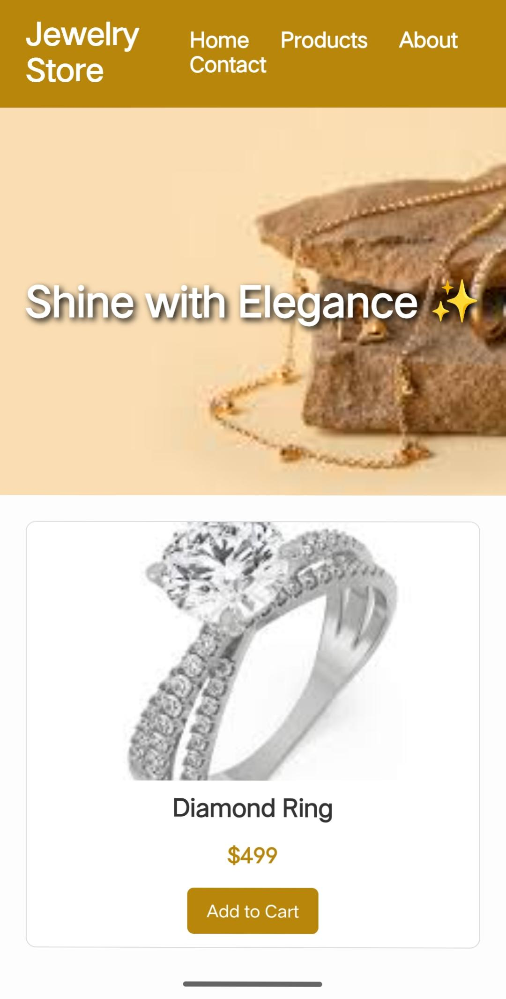
Screenshots – Home Page

Slide 24
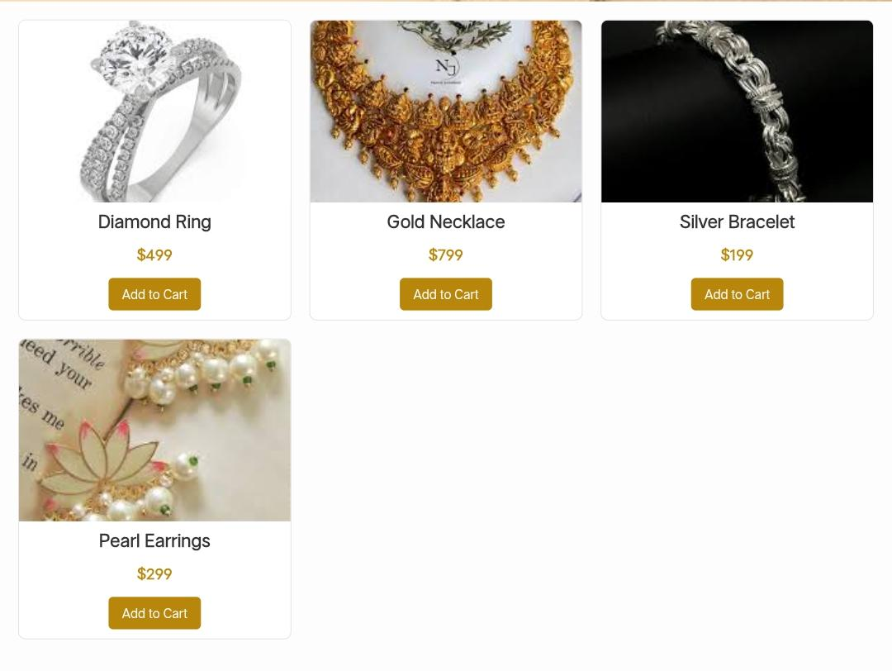
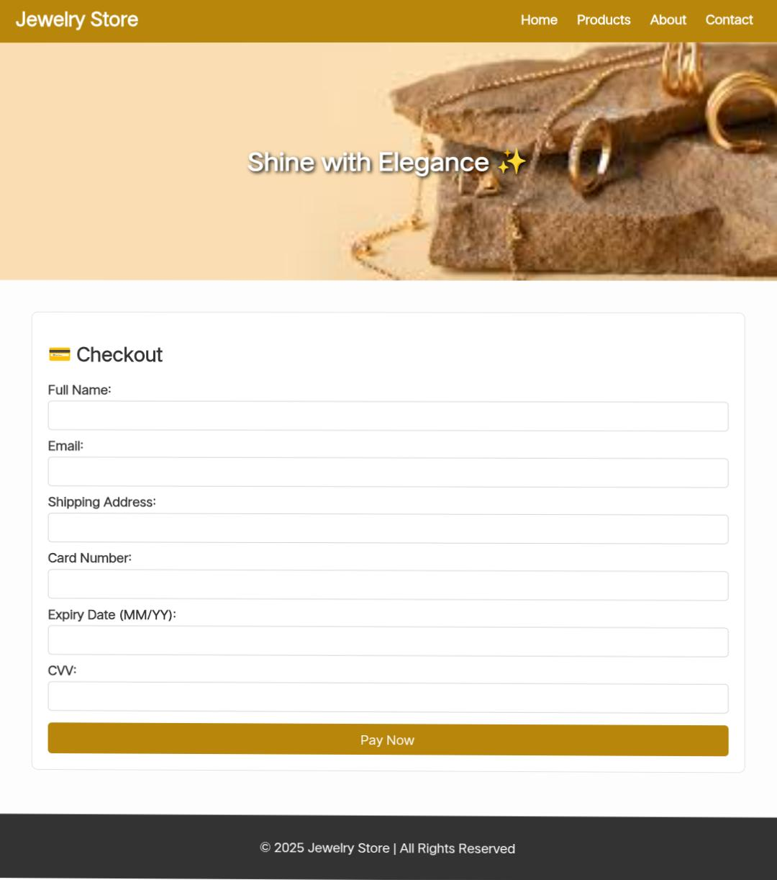
Screenshots – Products & Cart

Slide 25
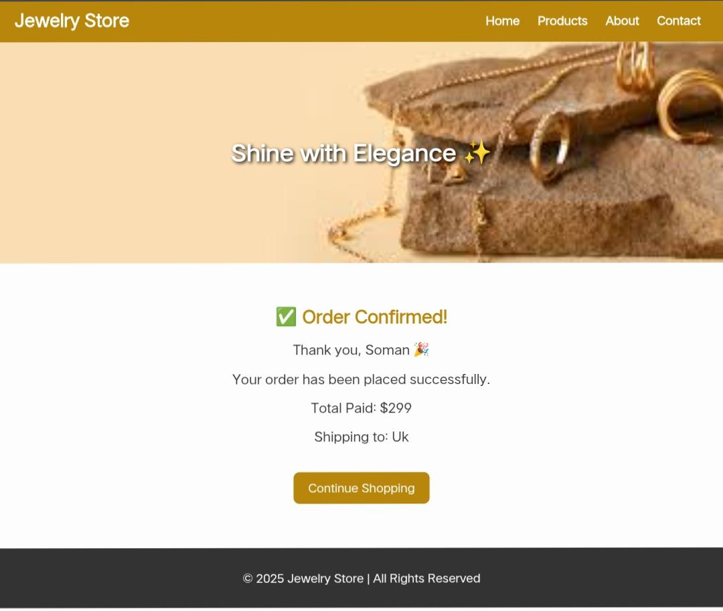
Results screenshot

Slide 26
Conclusion
• Project demonstrates HTML + CSS + JS integration
• Provides basic e-commerce functionality
• Can be extended into a real jewelry business website

