Slide 1
YOKESH . A
Final Project
3/21/2024 Annual Review

Slide 2
PROJECT TITLE
House-Price-Prediction Models
3/21/2024 Annual Review

Slide 3


AGENDA
Problem Statement
Project Overview
Who are the end users?
Solutions and value of propositions
WOW factor in the solution
Modelling
Results
3/21/2024 Annual Review

Slide 4

PROBLEM STATEMENT
Develop a machine learning model to predict house prices based on various features such as location, size, amenities, and other relevant factors. The goal is to create an accurate predictive model that can assist real estate agents, homeowners, and buyers in estimating the market value of residential properties. The model should be able to handle a diverse range of input data, including categorical variables such as neighborhood, numerical variables such as square footage, and possibly textual data such as property descriptions. The predicted prices should be as precise as possible, allowing stakeholders to make informed decisions about buying, selling, or listing properties.
3/21/2024 Annual Review

Slide 5

PROJECT OVERVIEW
The objective of this project is to develop a machine learning model for predicting house prices, leveraging various features such as location, size, amenities, and other relevant factors. The model aims to provide accurate price estimates to assist real estate agents, homeowners, and buyers in making informed decisions about residential properties.
The project begins with data collection and preprocessing, where a comprehensive dataset containing information on houses, including features like size, location, number of bedrooms, bathrooms, amenities, and historical sale prices, is gathered and cleaned.
Following this, thorough exploratory data analysis (EDA) is conducted to understand feature distributions, identify correlations, and address outliers or missing values. Feature engineering techniques may be applied to enhance the predictive power of the model, including encoding categorical variables and scaling numerical features.
3/21/2024 Annual Review

Slide 6

WHO ARE THE END USERS?
Home Sellers: Homeowners seeking to sell their properties utilize house price prediction models to determine competitive listing prices. By understanding the estimated market value of their homes, sellers can optimize their pricing strategy to attract potential buyers and maximize returns.
Home Buyers: Individuals or families looking to purchase residential properties rely on house price prediction models to estimate the fair market value of homes they are interested in. This information helps them make informed decisions about which properties to pursue and negotiate prices effectively.
Housing Market Analysts: Professionals involved in housing market research and analysis rely on house price prediction models to track market trends, forecast future price movements, and identify emerging patterns. These insights inform strategic planning, policy development, and investment strategies within the real estate industry.
3/21/2024 Annual Review

Slide 7

YOUR SOLUTION AND ITS VALUE PROPOSITION
Value Proposition:
User Interface Design: Create an intuitive and user-friendly interface accessible via web or mobile platforms. The interface should allow users to input relevant property details such as location, size, amenities, and other features easily.
Model Development: Develop a machine learning model capable of accurately predicting house prices based on the input features. Explore various regression algorithms such as linear regression, decision trees, random forests, and gradient boosting to determine the most suitable model for the task.
Data Integration: Integrate a comprehensive dataset containing historical property information, including sale prices, property features, neighborhood data, and market trends. Ensure data quality and consistency through preprocessing and validation procedures.
Real-Time Prediction: Implement a real-time prediction engine that can generate instant price estimates for properties based on user inputs. Utilize efficient algorithms and scalable infrastructure to handle simultaneous user requests.
3/21/2024 Annual Review

Slide 8

THE WOW IN YOUR SOLUTION
The WOW solution in our solution for House-Price-Prediction Models
Personalized User Experience: Our solution doesn't just offer a generic interface; it's designed to provide a personalized user experience tailored to the specific needs of each user segment. Whether you're a home buyer, seller, real estate agent, or investor, the interface dynamically adapts to your requirements, making the process seamless and intuitive.
AI-Powered Predictive Accuracy: Leveraging state-of-the-art machine learning algorithms and advanced data analytics techniques, our solution delivers unparalleled predictive accuracy. It doesn't just provide price estimates; it predicts with precision, taking into account a multitude of factors including market trends, neighborhood dynamics, and property features.
Real-Time Insights and Recommendations: What sets our solution apart is its ability to not only predict house prices but also provide real-time insights and actionable recommendations. Whether it's suggesting optimal listing prices for sellers, identifying investment opportunities for investors, or guiding buyers towards the best value properties, our solution goes beyond prediction to offer invaluable guidance.
Transparent and Explainable AI: Unlike black-box models, our solution prioritizes transparency and explainability. Users aren't just presented with price estimates; they're given clear explanations of the factors driving those estimates. This fosters trust and confidence in the system, empowering users to make informed decisions with full understanding.
3/21/2024 Annual Review
8

Slide 9
MODELLING
Linear Regression:
A linear regression model was trained using the LinearRegression class from scikit-learn.
Ridge Regression:
Ridge regression was implemented using the Ridge class from scikit-learn.
Lasso Regression:
Lasso regression was implemented using the Lasso class from scikit-learn.
Elastic Net:
Elastic Net regression was implemented using the ElasticNet class from scikit-learn.
Support Vector Machines (SVM):
SVM regression was implemented using the SVR (Support Vector Regression) class from scikit-learn.
Random Forest Regressor:
Random Forest regression was implemented using the RandomForestRegressor class from scikit-learn.
3/21/2024 Annual Review
9

Slide 10
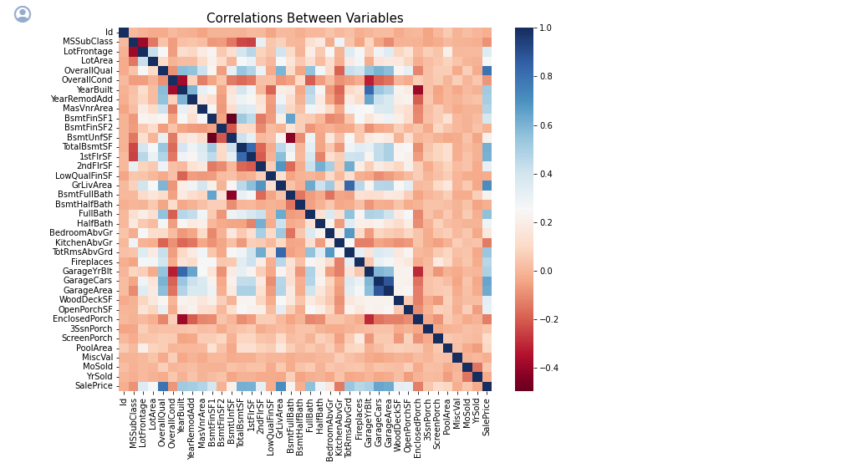
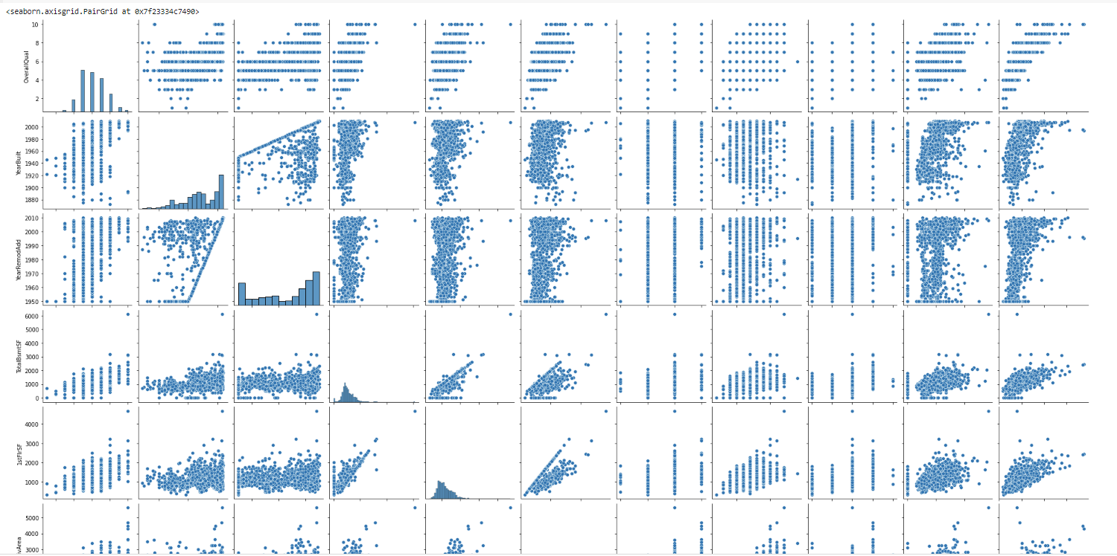
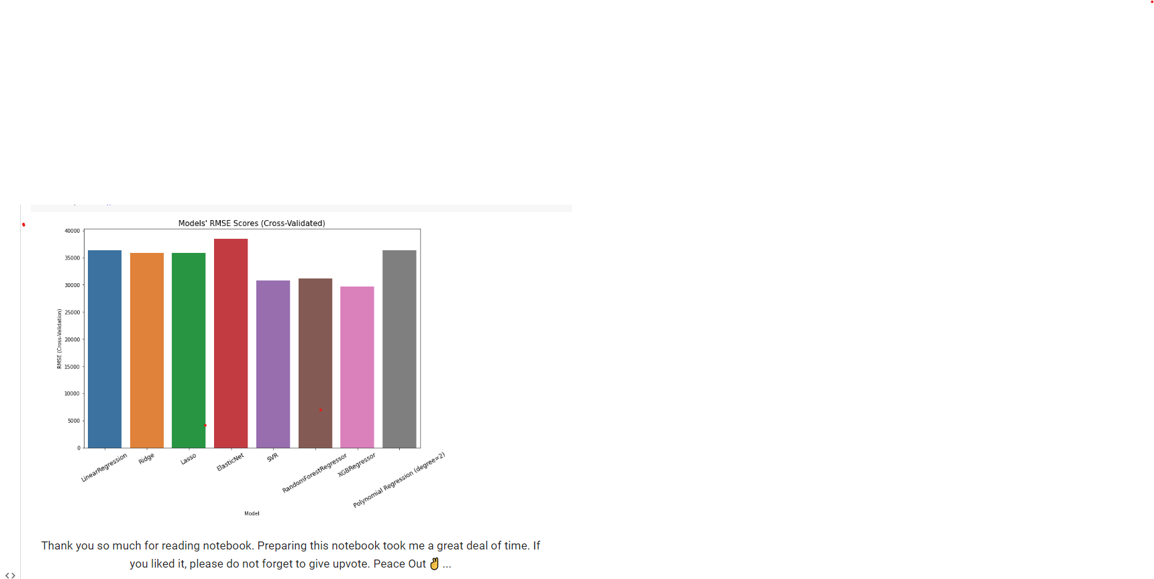
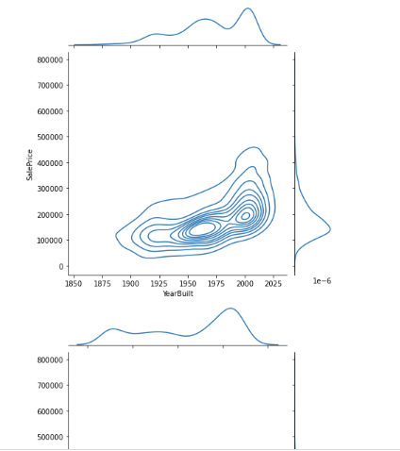
RESULTS
Demo Link
3/21/2024 Annual Review
10

