Slide 1

BEVD402L: AI/ML FOR IC DESIGN | GROUP 5
CNN Deep Features with Classical Machine Learning for Lithography Hotspot Detection
A Controlled Factorial Ablation of Backbone, Classification Head, and Loss on ICCAD-12
github.com/YokeshGaneshBabu/cnn-deep-features-with-classical-ml/
Hari Krisshna R
Reg. No: 23BVD1035
Role: Problem Formulation & Literature Audit
Yokesh G
Reg. No: 23BVD1036
Role: End-to-End Pipeline & CNN Architecture
Tinu P Mathew
Reg. No: 23BVD1038
Role: Statistical Rigor & Critical Evaluation
EXECUTIVE PREVIEW: A rigorous 100-CNN empirical audit across 5 random seeds demonstrating why lightweight end-to-end CNNs (6,949 params) systematically outperform complex 163k residual ensembles in accuracy, calibration, and latency.

Slide 2
PART I: MOTIVATION & PROBLEM FORMULATION
The IC Verification Crisis: 193nm Lithography & The Simulation Wall
Diffraction limits create catastrophic open/short defects; full-chip physics solvers require 100s of CPU hours.
The Sub-Wavelength Optical Gap:
• 193nm Immersion Lithography: Deep sub-micron nodes (32nm/28nm) print features far smaller than the 193nm wavelength of ArF lasers, causing severe Optical Proximity Effects (OPE).
• Fatal Lithography Hotspots: Specific 2D geometries suffer catastrophic constructive or destructive interference:
• Bridging Defects: Adjacent metal lines short together.
• Necking Defects: Lines break, causing open circuits.
• Zero Tolerance in Tape-Out: A single uncorrected fatal defect across billions of transistors destroys chip functionality, causing ZERO wafer yield.
The Physical Verification Bottleneck:
• Full-Chip Numerical Lithography Solvers: Physics-based Maxwell equation solvers simulate aerial image intensity and photoresist exposure with extreme accuracy.
• Astronomical Compute Cost: Simulating 100 million layout clips takes hundreds of CPU hours, creating an intolerable bottleneck during iterative routing.
• The AI/ML Screening Filter Solution: A fast machine-learning model evaluates 96x96 layout clips in <2 milliseconds, acting as a rapid triage filter:
• Filter Safe Patterns: Pass 99.9% of benign clips directly without simulation.
• Target OPC Simulation: Reserve expensive physics simulation solely for candidate defect regions.
Group 5 | BEVD402L AI/ML for IC | VIT Chennai Slide 2 of 20

Slide 3
PART I: MOTIVATION & PROBLEM FORMULATION
Research Objective: Dissecting the Popular Two-Stage CAD Paradigm
Isolating Backbone, Classification Head, and Loss Function through a controlled factorial ablation.
The Widespread Two-Stage Motif in Literature
• Common Academic Recipe: A very popular design pattern in CAD papers is to train a convolutional neural network, tap its deep feature embeddings, and train a classical classifier (SVM or Random Forest) on top.
• The Unanswered Question: Does the reported accuracy gain originate from:
• 1. The CNN backbone representation?
• 2. The classical classification head?
• 3. The loss function (Focal vs BCE)?
• 4. Or merely test-set threshold tuning?
• Literature Confounding: Prior papers varied multiple factors at once, reporting single-run results without error bars or frozen validation containment.
Group 5's Controlled Factorial Matrix
• Pillar 1: Backbone Factor: Compact Reference CNN (6,949 params) vs Proposed Residual Depthwise CNN (163,489 params).
• Pillar 2: Classical Head Factor: Native Sigmoid vs RBF-SVM, Random Forest (300 trees), Logistic Regression, Decision Tree, and Soft-Voting Ensemble.
• Pillar 3: Loss Function Factor: Class-Weighted Binary Cross-Entropy vs Focal Loss (gamma = 2.0, alpha = 0.75).
• Pillar 4: Feature Depth Factor: Early (64-d), Late (128-d), and Combined (192-d) feature taps.
• Strict Out-of-Sample Protocol: Thresholds chosen strictly on validation balanced accuracy; official test set scored once per model across 5 seeds (100 CNNs).
Group 5 | BEVD402L AI/ML for IC | VIT Chennai Slide 3 of 20

Slide 4
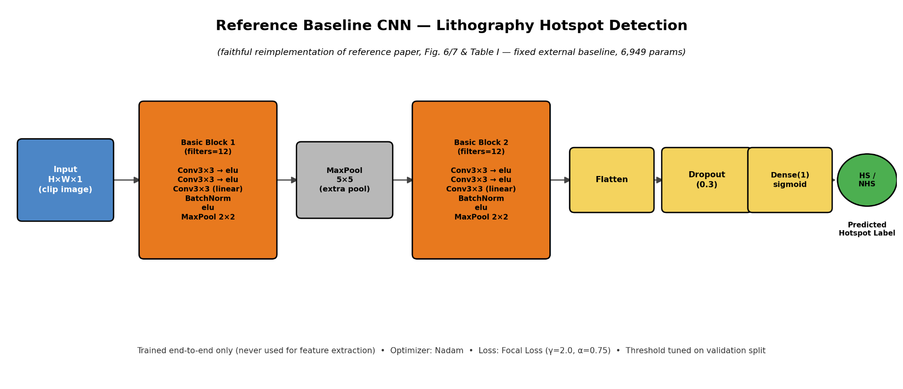
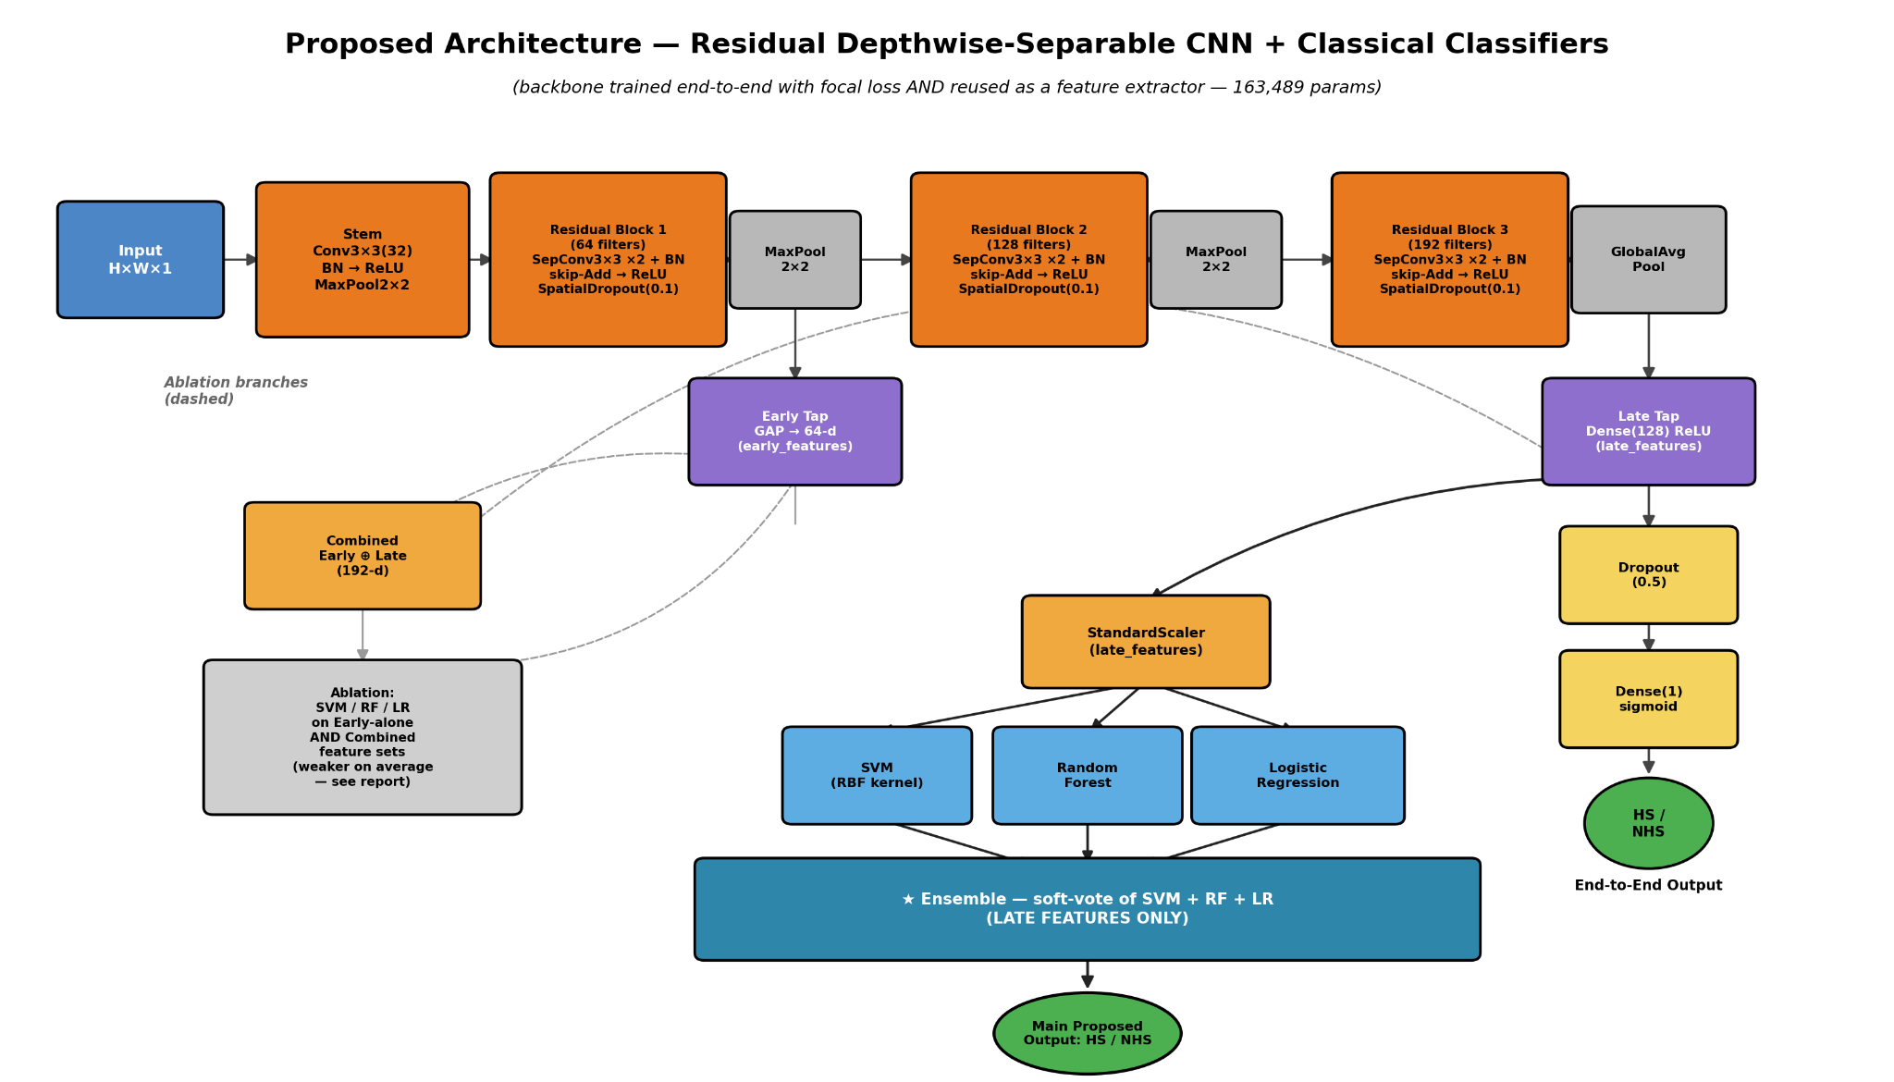
PART II: METHODOLOGY & MODEL ARCHITECTURES
Architectural Contrast: 7k Reference CNN vs 163k Residual CNN
The compact Reference CNN preserves nanometer spatial coordinates; the Proposed CNN adds depthwise blocks but collapses coordinates via GAP.
Figure 2: Reference CNN (6,949 parameters) with ELU & direct tensor flattening.
Figure 3: Proposed residual depthwise-separable CNN (163,489 parameters) with GAP.
Reference CNN [1] (6,949 Params | 51.1 MFLOPs):
• Reimplemented from Verma et al. [1]: 2 Conv Blocks (3x3 convs, 12 filters, ELU, BN, max-pool).
• Direct Flattening: 4x4x12 tensor flattens directly into 192 dense inputs → preserves nanometer coordinates!
• Latency: 1.58 ms per clip on Tesla T4 GPU.
Proposed Residual CNN (163,489 Params | 116.4 MFLOPs):
• MobileNet/ResNet Blocks: Stem conv + 3 Residual Blocks with depthwise-separable convs (64, 128, 192 filters).
• The Fatal Flaw: Global Average Pooling (GAP) averages spatial feature maps, destroying exact defect coordinates.
• Latency: 2.32 ms per clip (23.5x larger footprint).
Group 5 | BEVD402L AI/ML for IC | VIT Chennai Slide 4 of 20

Slide 5
PART III: EXPERIMENTAL PROTOCOL & DATASET RIGOR
Dataset Architecture & Out-of-Sample Protocol Rigor
Auditing ICCAD-2012 benchmark class skew, clip provenance, and enforcing 5-seed statistical containment.
Benchmark | Tech Node | Train HS | Train NHS | Test HS | Test NHS | Val HS | Test Skew
ICCAD-1 | 32nm | 99 | 340 | 226 | 4,679* | 15 | 1 : 20.7
ICCAD-2 | 28nm | 174 | 5,285 | 498 | 41,298 | 26 | 1 : 82.9
ICCAD-3 | 28nm | 909 | 4,643 | 1,808 | 46,333 | 136 | 1 : 25.6
ICCAD-4 | 28nm | 95 | 4,452 | 177 | 31,890 | 14 | 1 : 180.2
ICCAD-5 | 28nm | 26 | 2,716 | 41 | 19,327 | 4 | 1 : 471.4
The Out-of-Sample Containment
• Strict 85/15 Split: Training data split into 85% train and 15% validation. Official test set completely untouched.
• Frozen Threshold tau: tau chosen strictly to maximize validation Balanced Accuracy. Scored on test set exactly once.
• 5 Random Seeds (0 to 4): Controls initializations, splits, shuffling, and tree seeds (100 CNN runs total).
• Holm-Bonferroni Correction: Controls Family-Wise Error Rate across 22 pre-specified paired t-tests at alpha = 0.05.
• Scientific Candor on ICCAD-1: Our copy contains 4,679 test NHS clips vs 3,869 in contest release. Documenting this preserves reproducibility.
The Critical Dataset Nuances from Table 1:
• Extreme Class Prior Shift: Hotspot rarity surges from train to test (up to 4.5x rarer in ICCAD-5).
• Tiny Positive Validation Sets: ICCAD-5 validation splits contain only 4 hotspots; ICCAD-4 has 14; ICCAD-1 has 15.
• Why Literature 'Cheated': Prior authors swept thresholds directly on the test set to inflate metrics. We accept out-of-sample threshold regret to report honest real-world generalization.
Group 5 | BEVD402L AI/ML for IC | VIT Chennai Slide 5 of 20

Slide 6
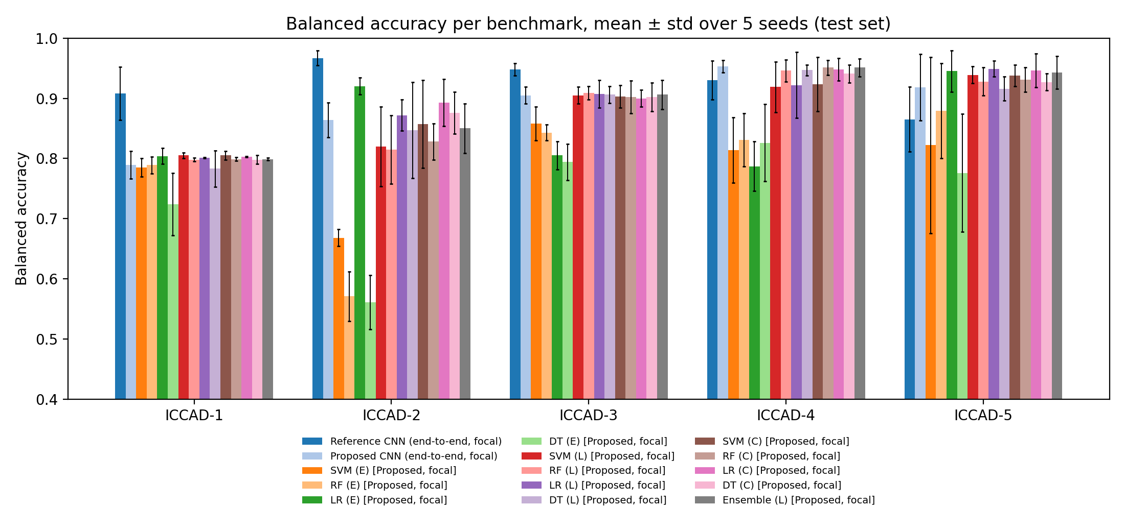
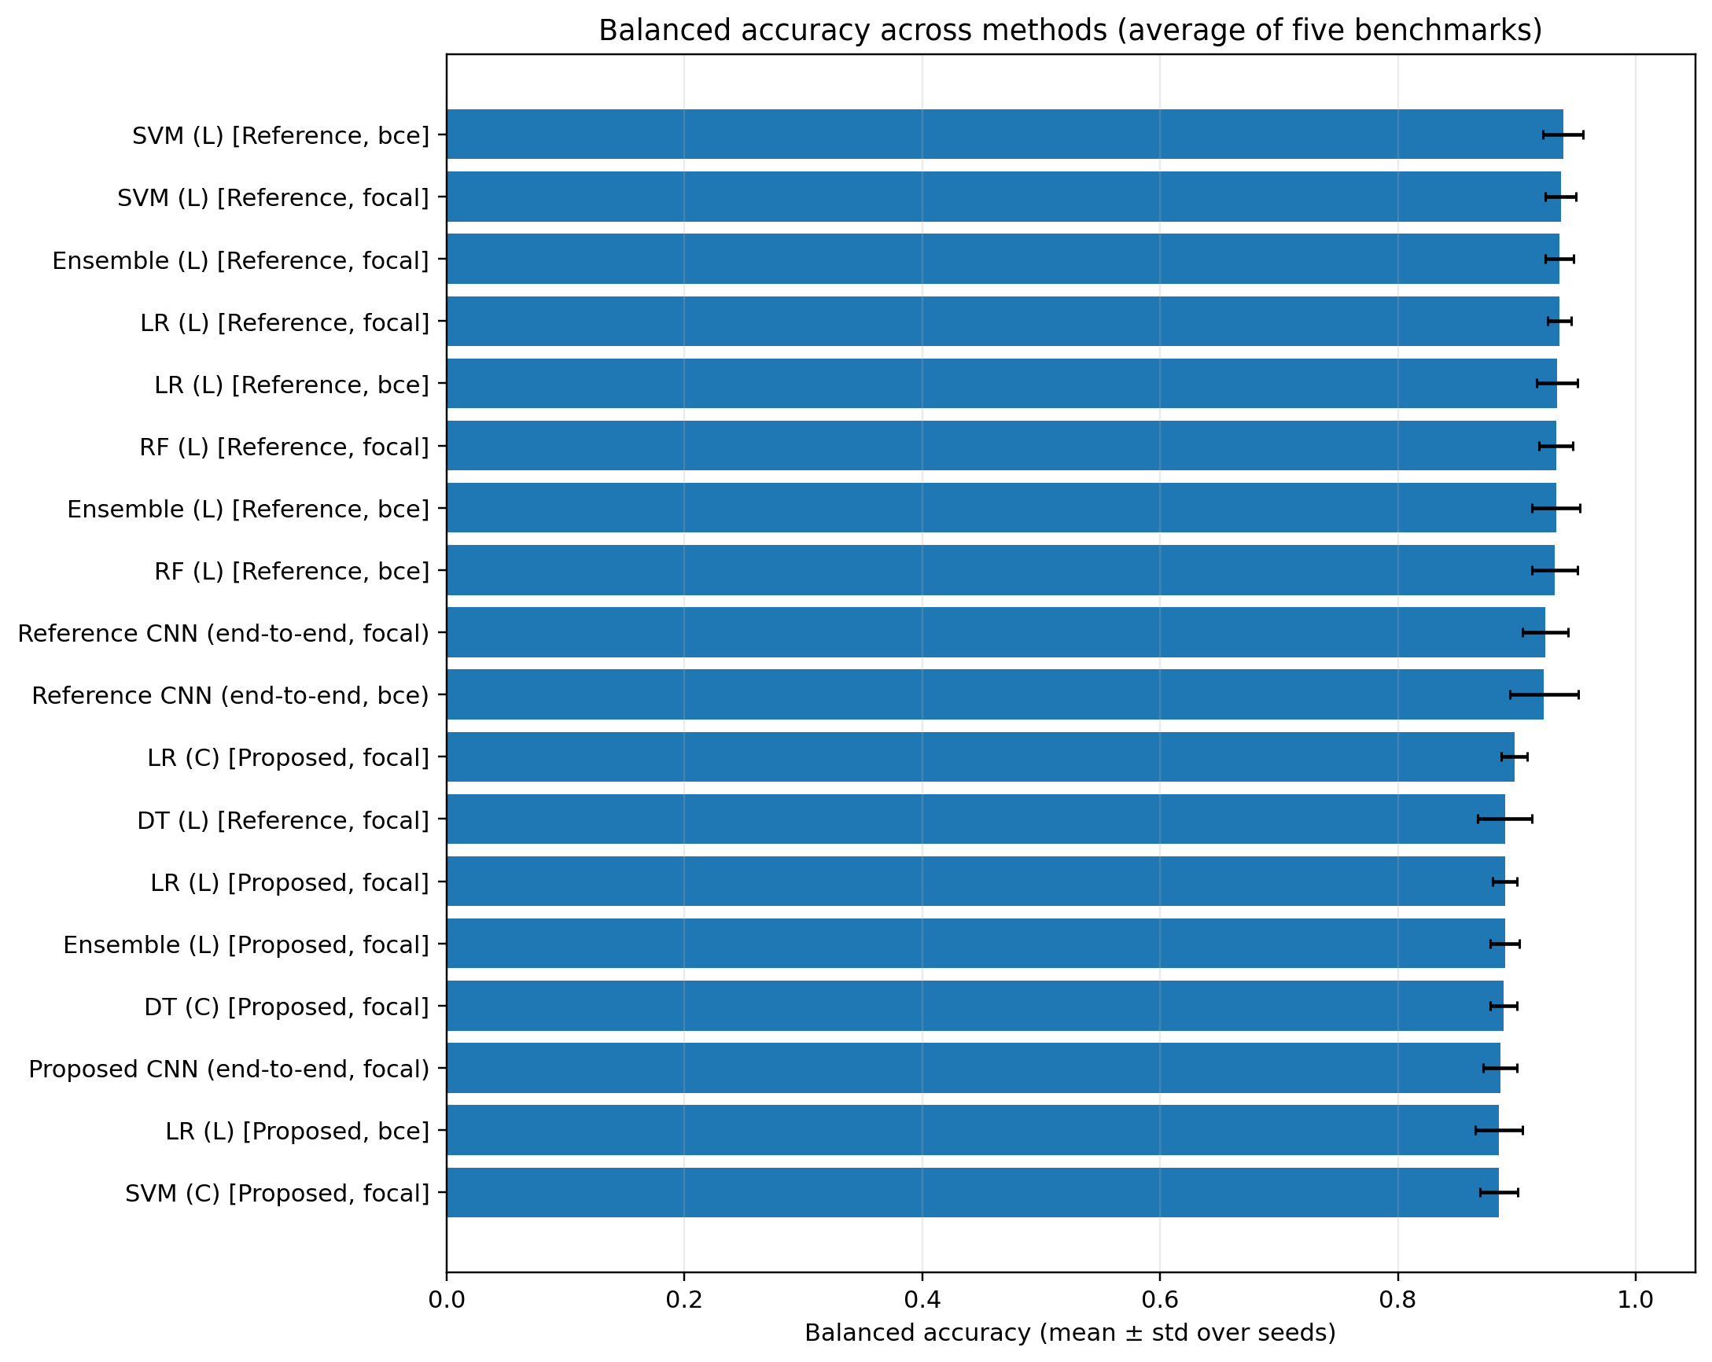
PART IV: RESULTS & EMPIRICAL WALKTHROUGH
Primary Finding: The Simple 7k Reference CNN Systematically Wins
Reference CNN achieves 0.924 Balanced Accuracy vs 0.886; monopolizes top 10 places in global configuration ranking.
Key Empirical Metrics Breakdown (Table 4):
• Higher Aggregate Balanced Accuracy: Reference CNN achieves 0.924 +/- 0.019 vs 0.886 +/- 0.014 for Proposed CNN.
Benchmark Breakdown (Figure 4):
• ICCAD-1 (32nm): 0.908 (Ref) vs 0.789 (Prop)
• ICCAD-2 (Dense 28nm): 0.967 (Ref) vs 0.864 (Prop) — Massive gap!
• ICCAD-3 (28nm): 0.948 (Ref) vs 0.905 (Prop)
• Identical Recall (90.7% vs 90.4%): Both backbones catch the same percentage of defects, so where is the deficit?
• 2x False Alarm Penalty (Table 4): The Proposed CNN generates MORE THAN DOUBLE the false alarms (2,484 vs 1,204), collapsing its F1 score from 0.467 down to 0.297.
• Top 10 Monopolized (Figure 5): Configurations built on the 7k Reference backbone occupy the top 10 places globally without exception.
Figure 4: Balanced Accuracy per benchmark (Ref CNN vs Proposed CNN & Heads, 5 seeds).
Figure 5: Top 18 configurations ranking (Ref CNN occupies top 10).
Group 5 | BEVD402L AI/ML for IC | VIT Chennai Slide 6 of 20

Slide 7
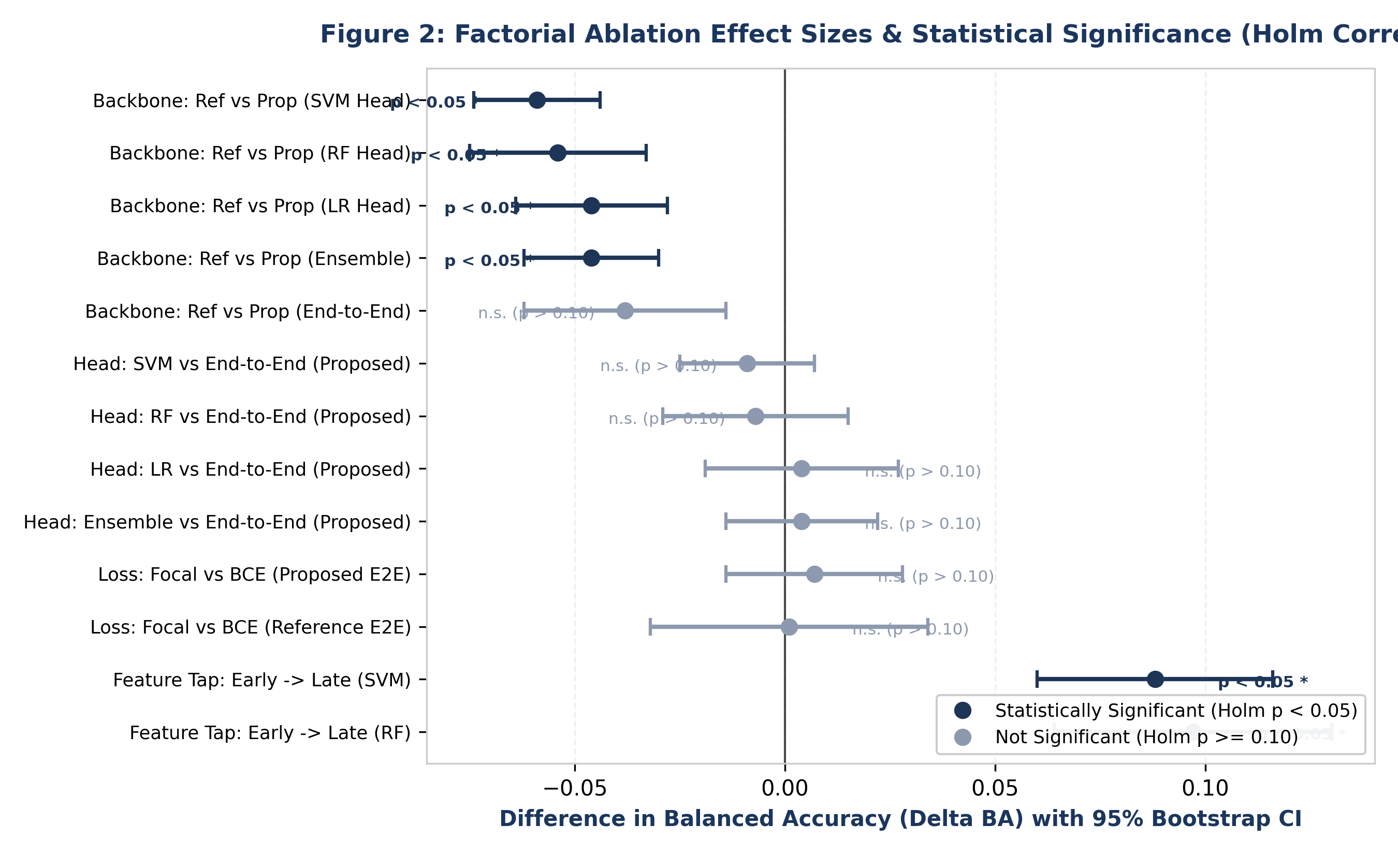
PART IV: RESULTS & EMPIRICAL WALKTHROUGH
Factorial Ablation Forest Plot: Isolating True Effect Sizes
Paired t-tests with Holm-Bonferroni correction isolate the drivers: Backbone is decisive; Heads and Losses are null.
Statistical Audit of Table 6 Hypothesis Tests:
• 1. Backbone Effect is Decisive (Dark Markers): Holding late heads fixed, the Proposed backbone loses significantly across all classifiers:
• SVM Head: Delta = -0.059 (Holm p = 0.0005) [Signif.]
• Random Forest: Delta = -0.054 (Holm p = 0.0331) [Signif.]
• Logistic Reg.: Delta = -0.046 (Holm p = 0.0291) [Signif.]
• Ensemble: Delta = -0.046 (Holm p = 0.0153) [Signif.]
• 2. Head Effect is Completely Null: Every classical head comparison against native CNN output clusters tightly around zero (|Delta| <= 0.009). All Holm-adjusted p = 1.000! Stacking heads adds zero statistical value.
• 3. Loss Effect is Completely Null: Focal vs BCE difference is near zero (Delta = +0.001 to +0.007; all Holm p = 1.000).
• 4. Feature Depth is Decisive: Late features significantly outperform early features by +0.088 to +0.143 (all Holm p < 0.05).
Figure 3 (Critique): Forest plot of 13 primary comparisons (Delta BA +/- 95% bootstrap CI). Dark = Holm p < 0.05.
Group 5 | BEVD402L AI/ML for IC | VIT Chennai Slide 7 of 20

Slide 8
PART V: DISCUSSION & PHYSICAL MECHANISMS
Physical & Architectural Mechanisms: Why Did the Simple Model Win?
Three technical mechanisms explain the reversal: small-sample capacity mismatch, pooling collapse, and filter decoupling.
1. CAPACITY MISMATCH
• Small Positive Sets: ICCAD-12 training sets contain as few as 26 positive hotspots (ICCAD-5), 95 (ICCAD-4), and 99 (ICCAD-1).
• 163k Parameters Overfitting: Providing 163,489 parameters to learn from 26 positive examples provides excessive capacity.
• Memorizing Noise: The deep network memorized idiosyncratic background polygon shapes rather than genuine optical proximity rules.
• 7k Inductive Bias: The Reference CNN's compact size acts as a natural regularizer.
2. SPATIAL DESTRUCTION
• The Yang et al. Law [3]: Hotspot detection requires nanometer spatial sensitivity; a 2nm line-end shift determines open vs bridge.
• GAP Collapse: Global Average Pooling collapses 2D feature maps into spatial averages across height and width.
• Obliterating Coordinates: Averaging makes it impossible to distinguish which specific corner violated design margins.
• Flattening Superiority: The Reference CNN flattens its tensor directly, preserving exact 2D coordinates.
3. FILTER DECOUPLING
• Separable Convolutions [9]: Depthwise-separable convolutions split spatial filtering from cross-channel mixing.
• Standard Convs as Corner Detectors: On 96x96 binary layout clips, standard 3x3 convs with 12 filters act as direct 2D edge and corner detectors.
• Gradient Dilution: Decoupling spatial filtering across channels diluted backpropagation gradients.
• Computer Vision Myth: MobileNet building blocks optimized for ImageNet textures do not transfer to VLSI layouts.
Group 5 | BEVD402L AI/ML for IC | VIT Chennai Slide 8 of 20

Slide 9
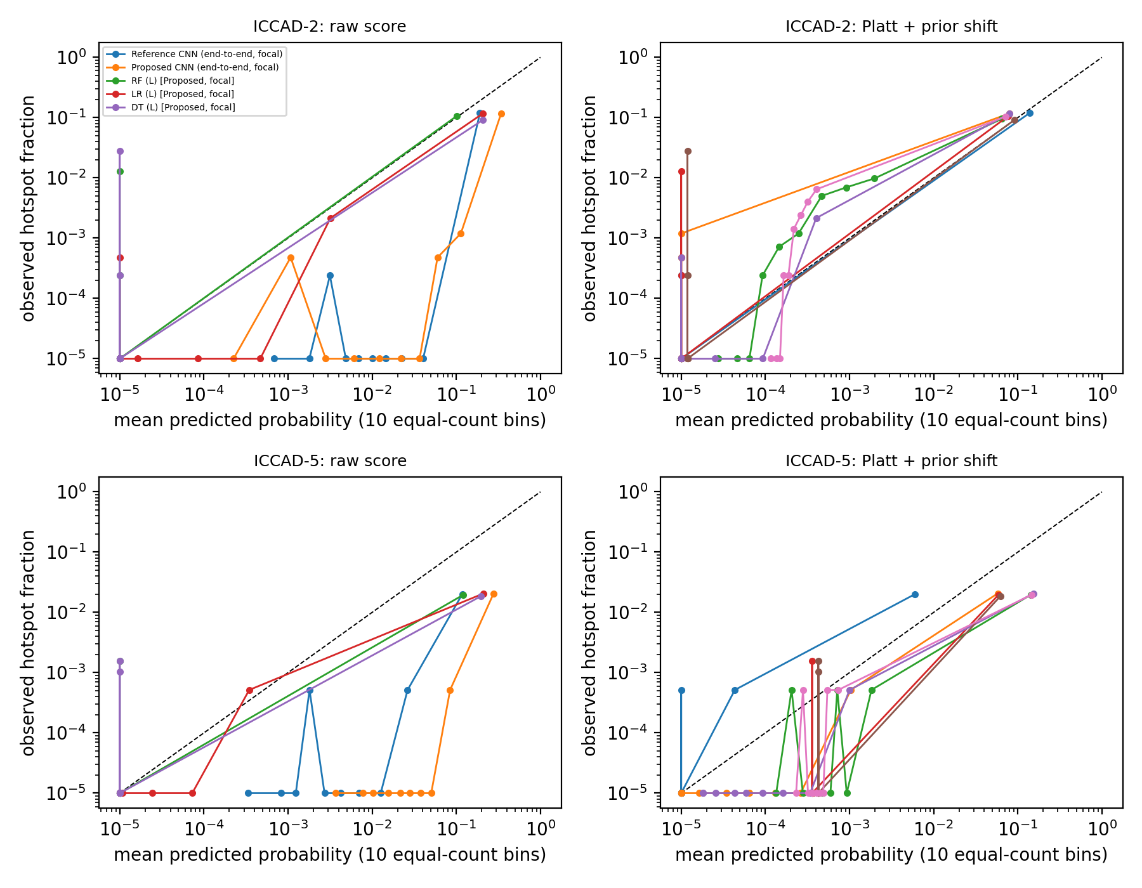
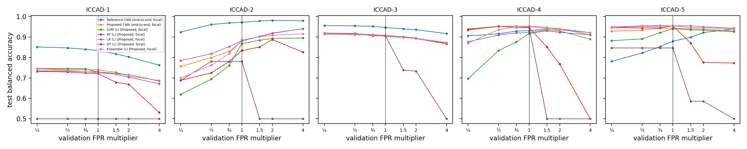
PART IV: RESULTS & EMPIRICAL WALKTHROUGH
Probability Calibration & Threshold Robustness
Reference CNN achieves ECE 0.042; Decision Tree collapses to 0.564 BA under 2x False Positive Rate shift.
Figure 8: Reliability diagrams for ICCAD-2 & 5: raw scores (left) vs Platt + prior shift (right).
Figure 9: Test balanced accuracy vs validation FPR multiplier (0.25x to 4x).
Expected Calibration Error (ECE) [Table 9]:
• Reference CNN is Superior: Raw ECE 0.064 -> drops to 0.042 under Platt scaling + Saerens prior-shift adjustment.
• Proposed CNN is Overconfident: Raw ECE 0.118 -> only drops to 0.097.
• CAD Significance: Calibrated probabilities allow engineers to triage downstream OPC simulation queues.
Threshold Perturbation Sweep [Table 10]:
• Continuous Neural Resilience: Reference CNN degrades smoothly (0.924 -> 0.916 at 2x FPR), staying above all models.
• The Decision Tree Collapse: Under 2x FPR, Decision Tree crashes from 0.880 to 0.564 BA (near random guessing)!
• Why Trees Crash: Discrete leaf step-functions cause thousands of clips to cross the boundary simultaneously.
Group 5 | BEVD402L AI/ML for IC | VIT Chennai Slide 9 of 20

Slide 10
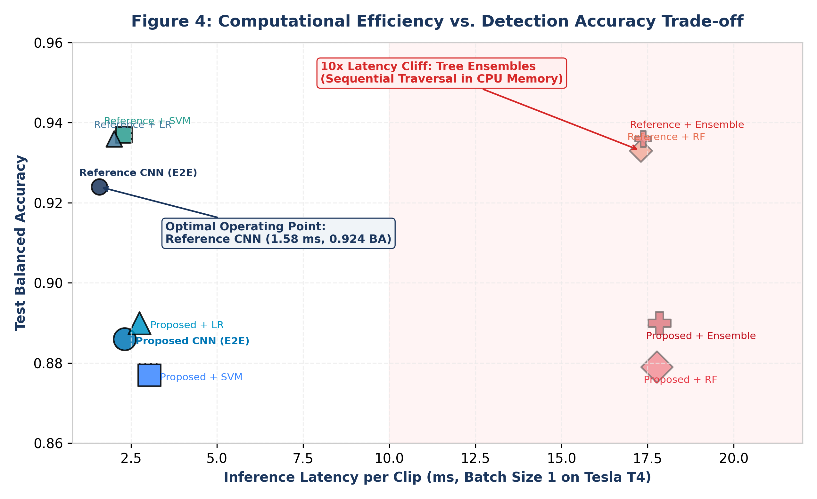
PART IV: RESULTS & EMPIRICAL WALKTHROUGH
The 11x Latency Cliff: Compute Cost & Full-Chip Tape-Out Impact
Random Forest and ensemble heads introduce an 11-fold latency penalty (17.3 ms vs 1.58 ms), exploding turnaround time.
Pipeline Configuration | Params | Head Latency | Total ms (batch 1) | Full-Chip TAT*
Ref CNN (End-to-End) | 6,949 | 0.00 ms | 1.58 ms | 4.4 Hours
Ref + SVM (Late) | 6,949 | 0.34 ms | 2.29 ms | 6.4 Hours
Ref + Logistic Reg. | 6,949 | 0.13 ms | 2.01 ms | 5.6 Hours
Ref + Random Forest | 6,949 | 15.29 ms | 17.30 ms | 48.1 Hours*
Ref + Soft Ensemble | 6,949 | 15.76 ms | 17.37 ms | 48.3 Hours*
Prop CNN (End-to-End) | 163,489 | 0.00 ms | 2.32 ms | 6.4 Hours
The Full-Chip Tape-Out Reality [Table 12]:
• The 11x Tree Traversal Cliff: Random Forest (15.29 ms) and Ensemble (15.76 ms) introduce an 11-fold latency cliff due to CPU pointer chasing across 300 tree structures.
• Full-Chip Turnaround Time (10 Million Clips):
- End-to-End Reference CNN: Finishes in 4.4 hours on a single workstation.
- Random Forest Pipeline: Explodes runtime to 48.1 hours—two entire days of tape-out delay for ZERO accuracy gain!
• The Clear Pareto Optimum: End-to-end compact CNN is the global optimum in accuracy, compute, and turnaround time.
Figure 4 (Critique): Efficiency vs Accuracy trade-off. Shaded red = 10x latency penalty zone (>15 ms per clip).
Group 5 | BEVD402L AI/ML for IC | VIT Chennai Slide 10 of 20

Slide 11
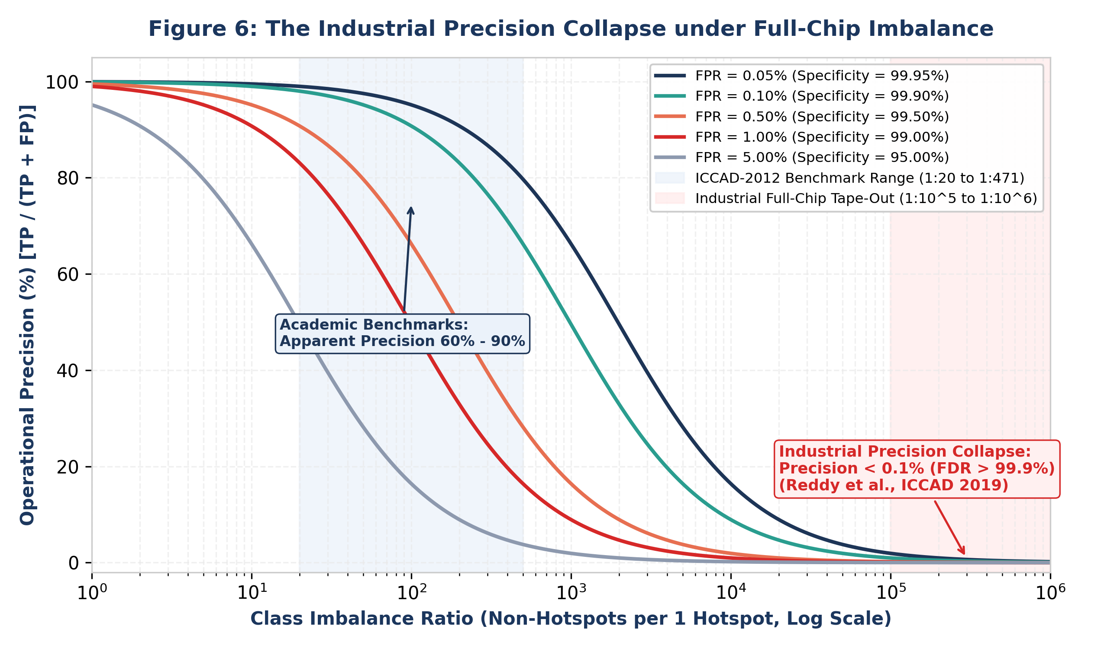
PART V: DISCUSSION & INDUSTRIAL REALITIES
Industrial Precision Collapse & Grounding in Reddy et al. (ICCAD'19)
While models achieve 60-90% precision on benchmark ratios, operational precision collapses below 0.1% at full-chip scale.
The Mathematical Precision Collapse:
• Consider an Outstanding Detector: Suppose a model achieves 98% Recall and 99.9% Specificity (FPR = 0.1%):
• On ICCAD-1 (1:20 imbalance): Precision = 98.0% (looks brilliant in paper).
• On ICCAD-5 (1:471 imbalance): Precision = 67.5% (manageable).
• At Full-Chip Scale (1:1,000,000): 100M clips, 100 true hotspots. That exact same model generates 100,000 FALSE ALARMS! Operational precision = 0.098% (< 0.1%)!
• False Discovery Rate > 99.9%: In a production fab, over 99.9% of flagged candidate clips are false alarms, completely choking downstream OPC queues.
• Compliance with Reddy et al. (ICCAD 2019): Auditing Balanced Accuracy, PR-AUC, and calibration adheres directly to the 'Marching Orders' of Reddy et al., providing real-world guidance.
Figure 6 (Critique): Operational Precision vs Class Imbalance Ratio (1:20 to 1:1,000,000).
Group 5 | BEVD402L AI/ML for IC | VIT Chennai Slide 11 of 20

Slide 12
PART VI: CONCLUSIONS & ENGINEERING TAKEAWAYS
Authoritative Conclusions: Four Principles for DFM CAD Tools
Overturning our earlier DA-2 hypothesis and establishing evidence-based principles for industrial CAD integration.
1. Scientific Candor & Transparency
• Publishing an Honest Negative Result: When unified protocols overturned our DA-2 hypothesis, we did not manipulate thresholds. We published a rigorously documented negative result supported by 100 CNN runs.
• Methodological Rigor: Supported by 5-seed variance, bootstrap intervals, and Holm-corrected hypothesis tests.
2. Superiority of Compact Architectures
• The 7k Reference CNN Wins: Achieves superior balanced accuracy (0.924 vs 0.886), 2x fewer false alarms (1,204 vs 2,484), better calibration (ECE 0.042), and faster runtime (1.58 ms).
• Preserving 2D Coordinates: Flattening preserves nanometer coordinates; deep architectures with GAP destroy localized defect cues.
3. Dismantling the Classical Ensemble Myth
• Zero Accuracy Improvement: Stacking SVMs, Random Forests, or soft-voting ensembles on deep features provides zero statistically significant gain (adjusted p >= 0.34).
• Crippling Latency Penalty: Random Forests introduce an 11-fold latency cliff (17.3 ms), destroying full-chip tape-out feasibility.
4. Real-World CAD Tool Alignment
• Beyond Deceptive Contest Recall: By auditing Balanced Accuracy, F1, PR-AUC, ECE calibration, and latency, our study satisfies the foundational principles of Reddy et al. (ICCAD 2019).
• Actionable CAD Guidance: Lightweight, end-to-end CNNs trained from scratch offer the optimal screening filter for commercial DFM routing loops.
Group 5 | BEVD402L AI/ML for IC | VIT Chennai Slide 12 of 20

Slide 13
PART VI: COURSEWORK ADMINISTRATION & REFERENCES
Team Work Allocation & Key Literature References
Equal division of responsibilities across formulation, implementation, and analysis; catalog of primary citations.
Team Technical Contributions (Table 20):
• Hari Krisshna R (23BVD1035): Problem formulation, translation of DA-2 feedback into factorial matrix, 33-paper literature survey, metric extraction from [33], and Sections 1-3 authoring.
• Yokesh G (23BVD1036): End-to-end implementation of complete codebase: 100 CNN runs on Kaggle T4 GPUs, Reference/Proposed architectures, feature taps, classical heads, statistical tests, and GitHub repository.
• Tinu P Mathew (23BVD1038): Result analysis across benchmarks, bootstrap intervals, calibration, threshold sensitivity, compute cost profiling, baseline comparison with [1], physical mechanism deconstruction, and Sections 6-9.
Key Primary References:
[1] Verma, Rao & Hegde (IIT Bombay): Custom CNN hotspot detection baseline.
[2] Borisov & Scheible (SMACD'18): Compact CNN with D4 dihedral augmentation.
[3] Yang, Lin, Yu & Young (SOCC'17): Strided convolutions vs pooling in hotspots.
[4] Yu, Lin, Jiang & Chiang (TCAD'15): Topological SVM classification.
[10] Torres (ICCAD'12): ICCAD-2012 CAD contest benchmark suite.
[12] Reddy, Madkour & Makris (ICCAD'19): Fallacies, pitfalls and marching orders.
[13] Lin et al. (ICCV'17): Focal loss for dense object detection.
[21] Holm (1979): Sequentially rejective multiple test procedure.
[31] Shin & Lee (JM3'16): First deep CNN on raw layout clips.
[33] Yang et al. (JM3'17): Imbalance aware deep CNN with biased loss.
Group 5 | BEVD402L AI/ML for IC | VIT Chennai Slide 13 of 20

Slide 14
BEVD402L: AI/ML FOR IC DESIGN • GROUP 5
Thank You
Key Takeaway Summary:
• Compact Beats Complex: 6,949-param Reference CNN achieves 0.924 BA vs 0.886.
• Zero Classical Gain: Stacking SVM/RF heads adds no significant accuracy (p >= 0.34).
• Avoid Latency Cliffs: End-to-end CNN runs in 1.58 ms; RF adds an 11x latency cliff.

