Slide 1
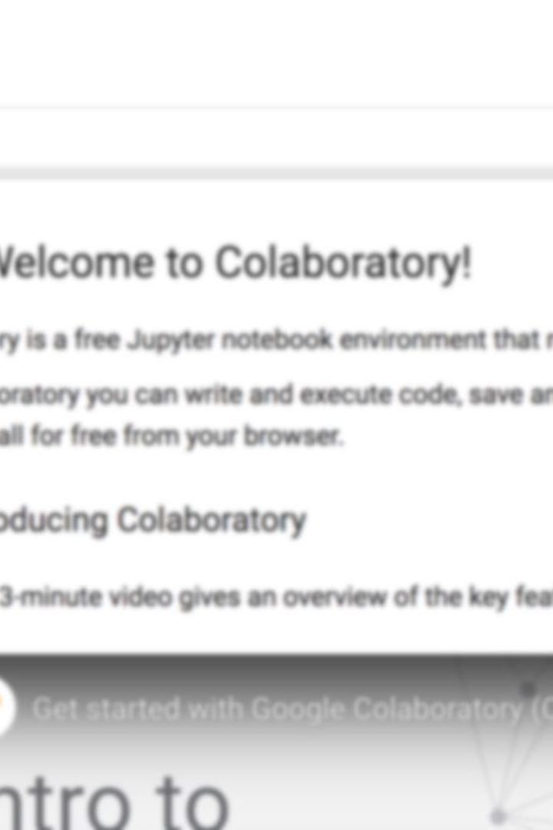
Unlocking the Power of Google Colab
Google Colab is a free, cloud-based platform that provides a complete python environment for machine learning and data analysis projects. This guide will show you how to get started.
CX
by CHEN XINYU
Notes:
Good afternoon, everyone!
Today, I'm going to introduce a powerful tool called Google Colab.
Google Colab is a free, cloud-based platform that provides a complete python environment for machine learning and data analysis projects.
you can write, run, and share Python code.

Slide 2

Creating Your Account
1
Open Google Colab
2
Access with Email
3
Complete Registration
Open the Google Colab website (https://colab.research.google.com/).
Google Colab is fully integrated with Gmail, so you can easily sign in and start using it right away.
Once you're signed in, follow the simple steps to complete your registration and start using Google Colab.
Notes:
Now, let's walk through the steps to get started with Google Colab.
Step 1: Open Google Colab
Open the Google Colab website (https://colab.research.google.com/).
2: Sign in with your Google Account
If you already have a Gmail or Google account, sign in with your account. If not, you can create a new account easily.
Once you're signed in, follow the simple steps to complete your registration and start using Google Colab.

Slide 3
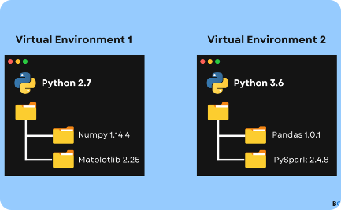

Creating a New Notebook
Step 1: Click on "New Notebook"
Step 2: Give your notebook a name
In the dashboard, click on the "New Notebook" button to create a new Colab notebook.
A dialog box will appear asking you to provide a name for your notebook. Enter a descriptive name that reflects the purpose of your project.
Notes:
Creating a New Colab Notebook
Once you're signed in, you'll see the Google Colab dashboard.
Creating a new Colab notebook is straightforward.
Step 1: Click on "New Notebook"
In the dashboard, click on the "New Notebook" button to create a new Colab notebook.
Step 2: Give your notebook a name

Slide 4
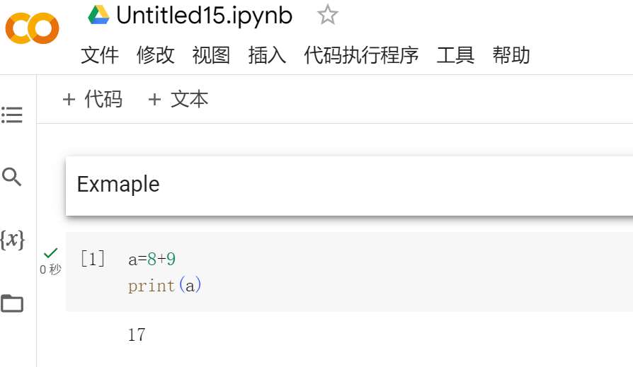
Understanding the Colab Interface
1
2
3
Menu bar:
Code cell
Text cell
It contains various options for managing and running your notebook, such as saving, running code cells, and changing runtime settings.
This is where you can write and run Python code. Each code cell can be run individually.
You can add text explanations or notice using text cells. They are useful for providing instructions or adding comments to your code
Notes:
Understanding the Colab Interface
Now, let's take a closer look at the Google Colab interface.
The Colab interface consists of different sections:
Menu bar: It contains various options for managing and running your notebook, such as saving, running code cells, and changing runtime settings.
Code cell: This is where you can write and execute Python code. Each code cell can be run individually.
Code cell: You can add text explanations or notice using text cells. They are useful for providing instructions or adding comments to your code

Slide 5
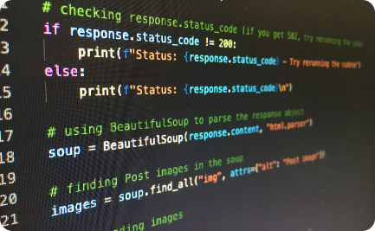

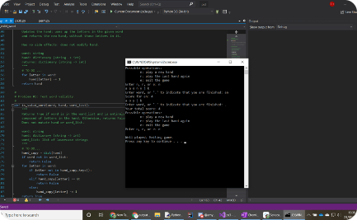

Writing and Running Code
Step 1：Adding a code cell
Step 2：Writing your code
Step 3：Run the code cell
To add a code cell, simply click on the "+" button in the toolbar.
In the code cell, you can write your Python code.
For example
we add 5+9, and we print the rtesult.
print(5+9)
you can click the play button.
Notes:
Writing and Running Code
Now that you're familiar with the interface, let's move on to writing and running code in Google Colab.
Step 1: Adding a code cell
To add a code cell, simply click on the "+" button in the toolbar。
Step 2: Writing your code
In the code cell, you can write your Python code. for example we add 5+9， and we print the rtesult.
To run a code cell, you can click the play button. The code will be run, and the output will be displayed in the output cell.

Slide 6
Creating a New Notebook
Start from Scratch
Open Existing Notebook
Import form Github
Create a new, blank notebook in Google Colab by accessing the Notebook menu.
If you already have a notebook, you can easily open it in Google Colab by selecting it from your files.
Google Colab makes it easy to import existing notebooks from online websites, for example Github.
Notes:
Step 1: Click on "New Notebook"
we alos can Open Existing Notebook or import notebook
for example. we can upload our code from computer or google cloud or web.
now i will introduce how to upload code from github

Slide 7
Import form Github
Finding the Code on GitHub
Copying the Repository Link
Open the Colab
Visit the GitHub website (github.com).
Search for the code repository provided for this lesson.
https://github.com/Chenxy875/4201
Once you have found the repository, locate the "Code" button and click on it. Copy the link.
Open this link from google colab.
Notes:
github is a warehouse，there are many open code
1Finding the Code on GitHub
Visit the GitHub website (github.com).
Search for the code repository provided for this lesson.
2Copying the Repository Link
Once you have found the repository, locate the "Code" button and click on it.
Copy the link
Open this link from google colab

Slide 8
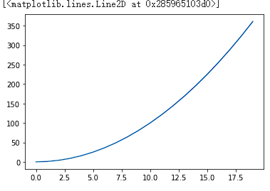
Step 1：
Running Code in Google Colab
Step 1：Import model
Step 2：Creat array
Step 3：Draw the squares of array
import matplotlib.pyplot as plt
import numpy as np
data = np.arange(20)
print(data)
plt.plot (data**2)
Notes:
Opening our example, such as H1
We can see that the code imported from GitHub is displayed here.
First, let's run the code. It creats an array /əˈreɪ/ from 0 to 20.
Next, we will use a plotting module to draw the squares of this array./əˈreɪ/

Slide 9
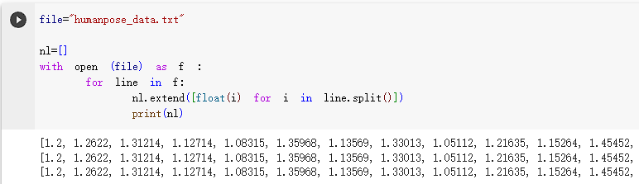
Running Code in Google Colab
Code cell
Text cell
file="humanpose_data.txt"
nl=[]
with open (file) as f :
for line in f:
nl.extend([float(i) for i in line.split()])
print(nl)
First we need to define our file path so that the program can find our file.
We're creating an empty array to hold our data.
Next we use the OPEN model to read each line of our file and then output it.
We can output our data.
Different data require reading and output methods, here we only carried out the txt method.
Notes:
if you want to up loed yourself data to google colab, you can move computer files to the file area.
We uploaded our TXT file, and if we want to read it out, we can use the open module.
First we need to define our file path so that the program can find our file.
We're creating an empty array to hold our data
Next we use OPEN to read our file, each line read and then output.
We can see our data.
Different data require reading and output methods, here we only carried out the txt method

