Slide 1



Foundations of Mental Health
Steve Joordens
Professor of Psychology
University of Toronto Scarborough

Slide 2


Slide 3


Start with the Basics!

Slide 4
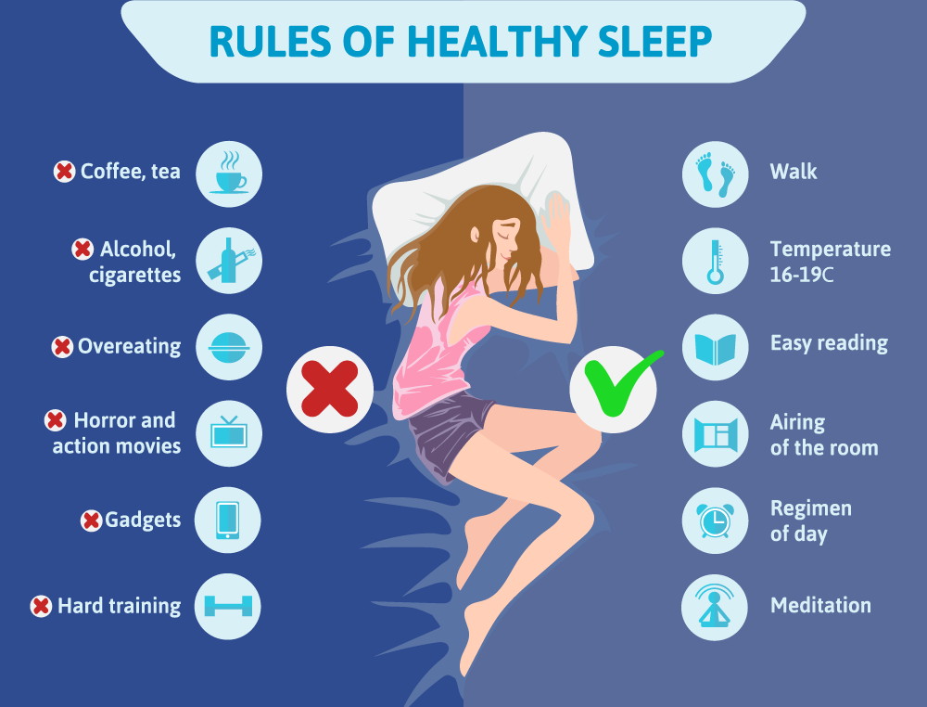

Slide 5
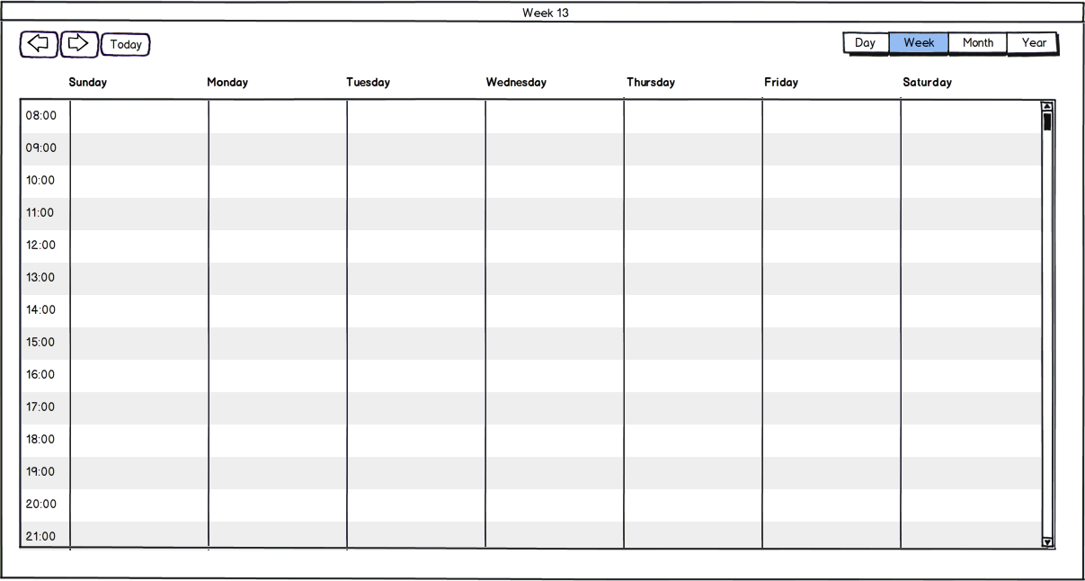
Friend Time
Music
Music
Music
Friend Time
Karaoke Night
Comedy
Concert Night
Relaxation
Relaxation
Relaxation

