Slide 1



Just Relax!
Steve Joordens
Professor of Psychology
University of Toronto Scarborough

Slide 2

General Rule of
Behavior Change
Promote the Good
Ignore the Bad (it will get crowded out)

Slide 3
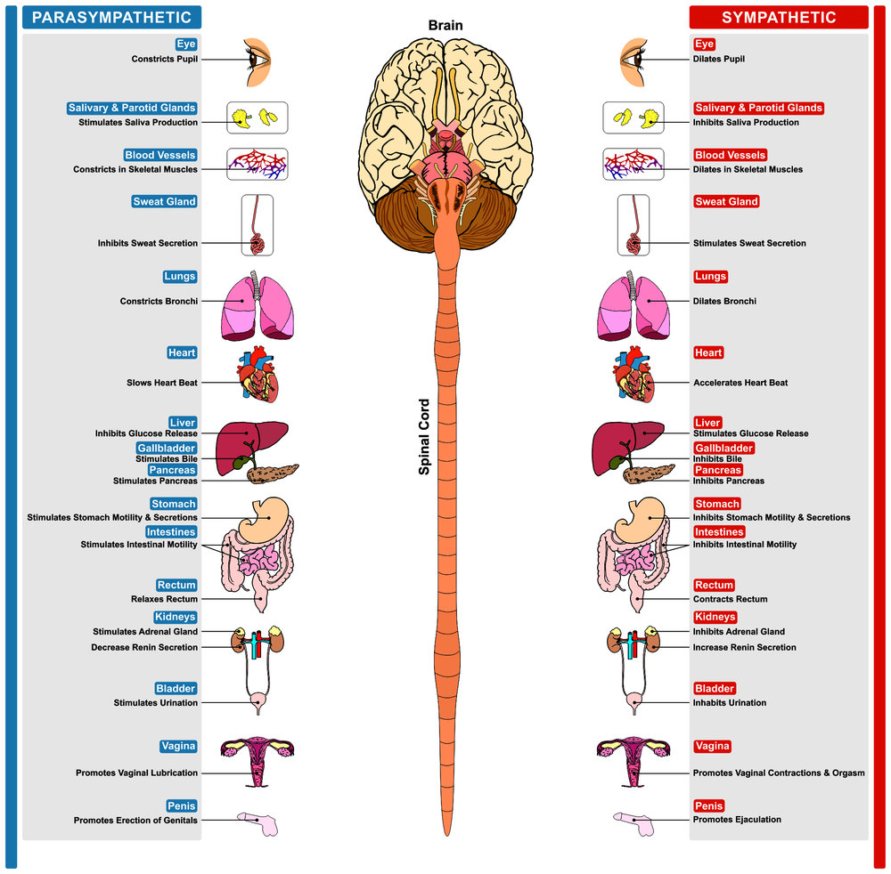
Rest & Digest
Fight or Flight

Slide 4
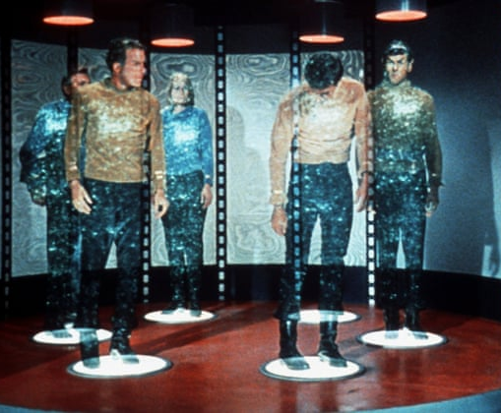

With practice we can “transport” ourselves into a relaxed state
Unlike the Star Trek transporter though, ours requires us to first be intimately familiar with the destination
Thus initially we need help from an external resource to get to that place … once there we must really attend to it, and associate it with a trigger word

Slide 5
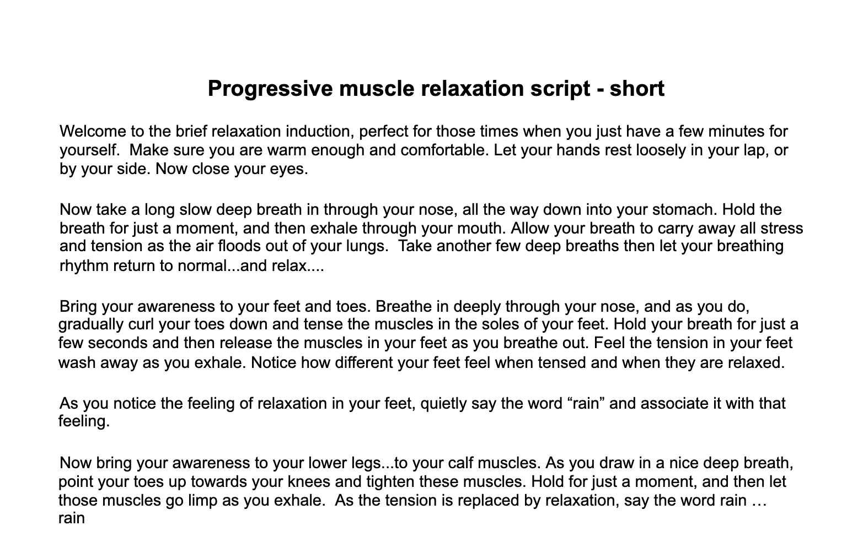

Slide 6




Steps to Skill Proficiency
Listen to guided relaxation audios … as you feel relaxed really attend to that feeling and associate it with a trigger word
Do this often if possible (nightly?)
At some point, lay back and try to bring yourself to that relaxed state WITHOUT using the guided relaxation audio
Set random alarms on your phone and when they go off … turn them off … then wherever you are, whatever you are doing, try to bring your body to that relaxed state
Become mindful of when your anxious … when you feel anxiety rise use your trigger word to summon relaxation
Do not focus on the anxiety, focus on the relaxation

Slide 7
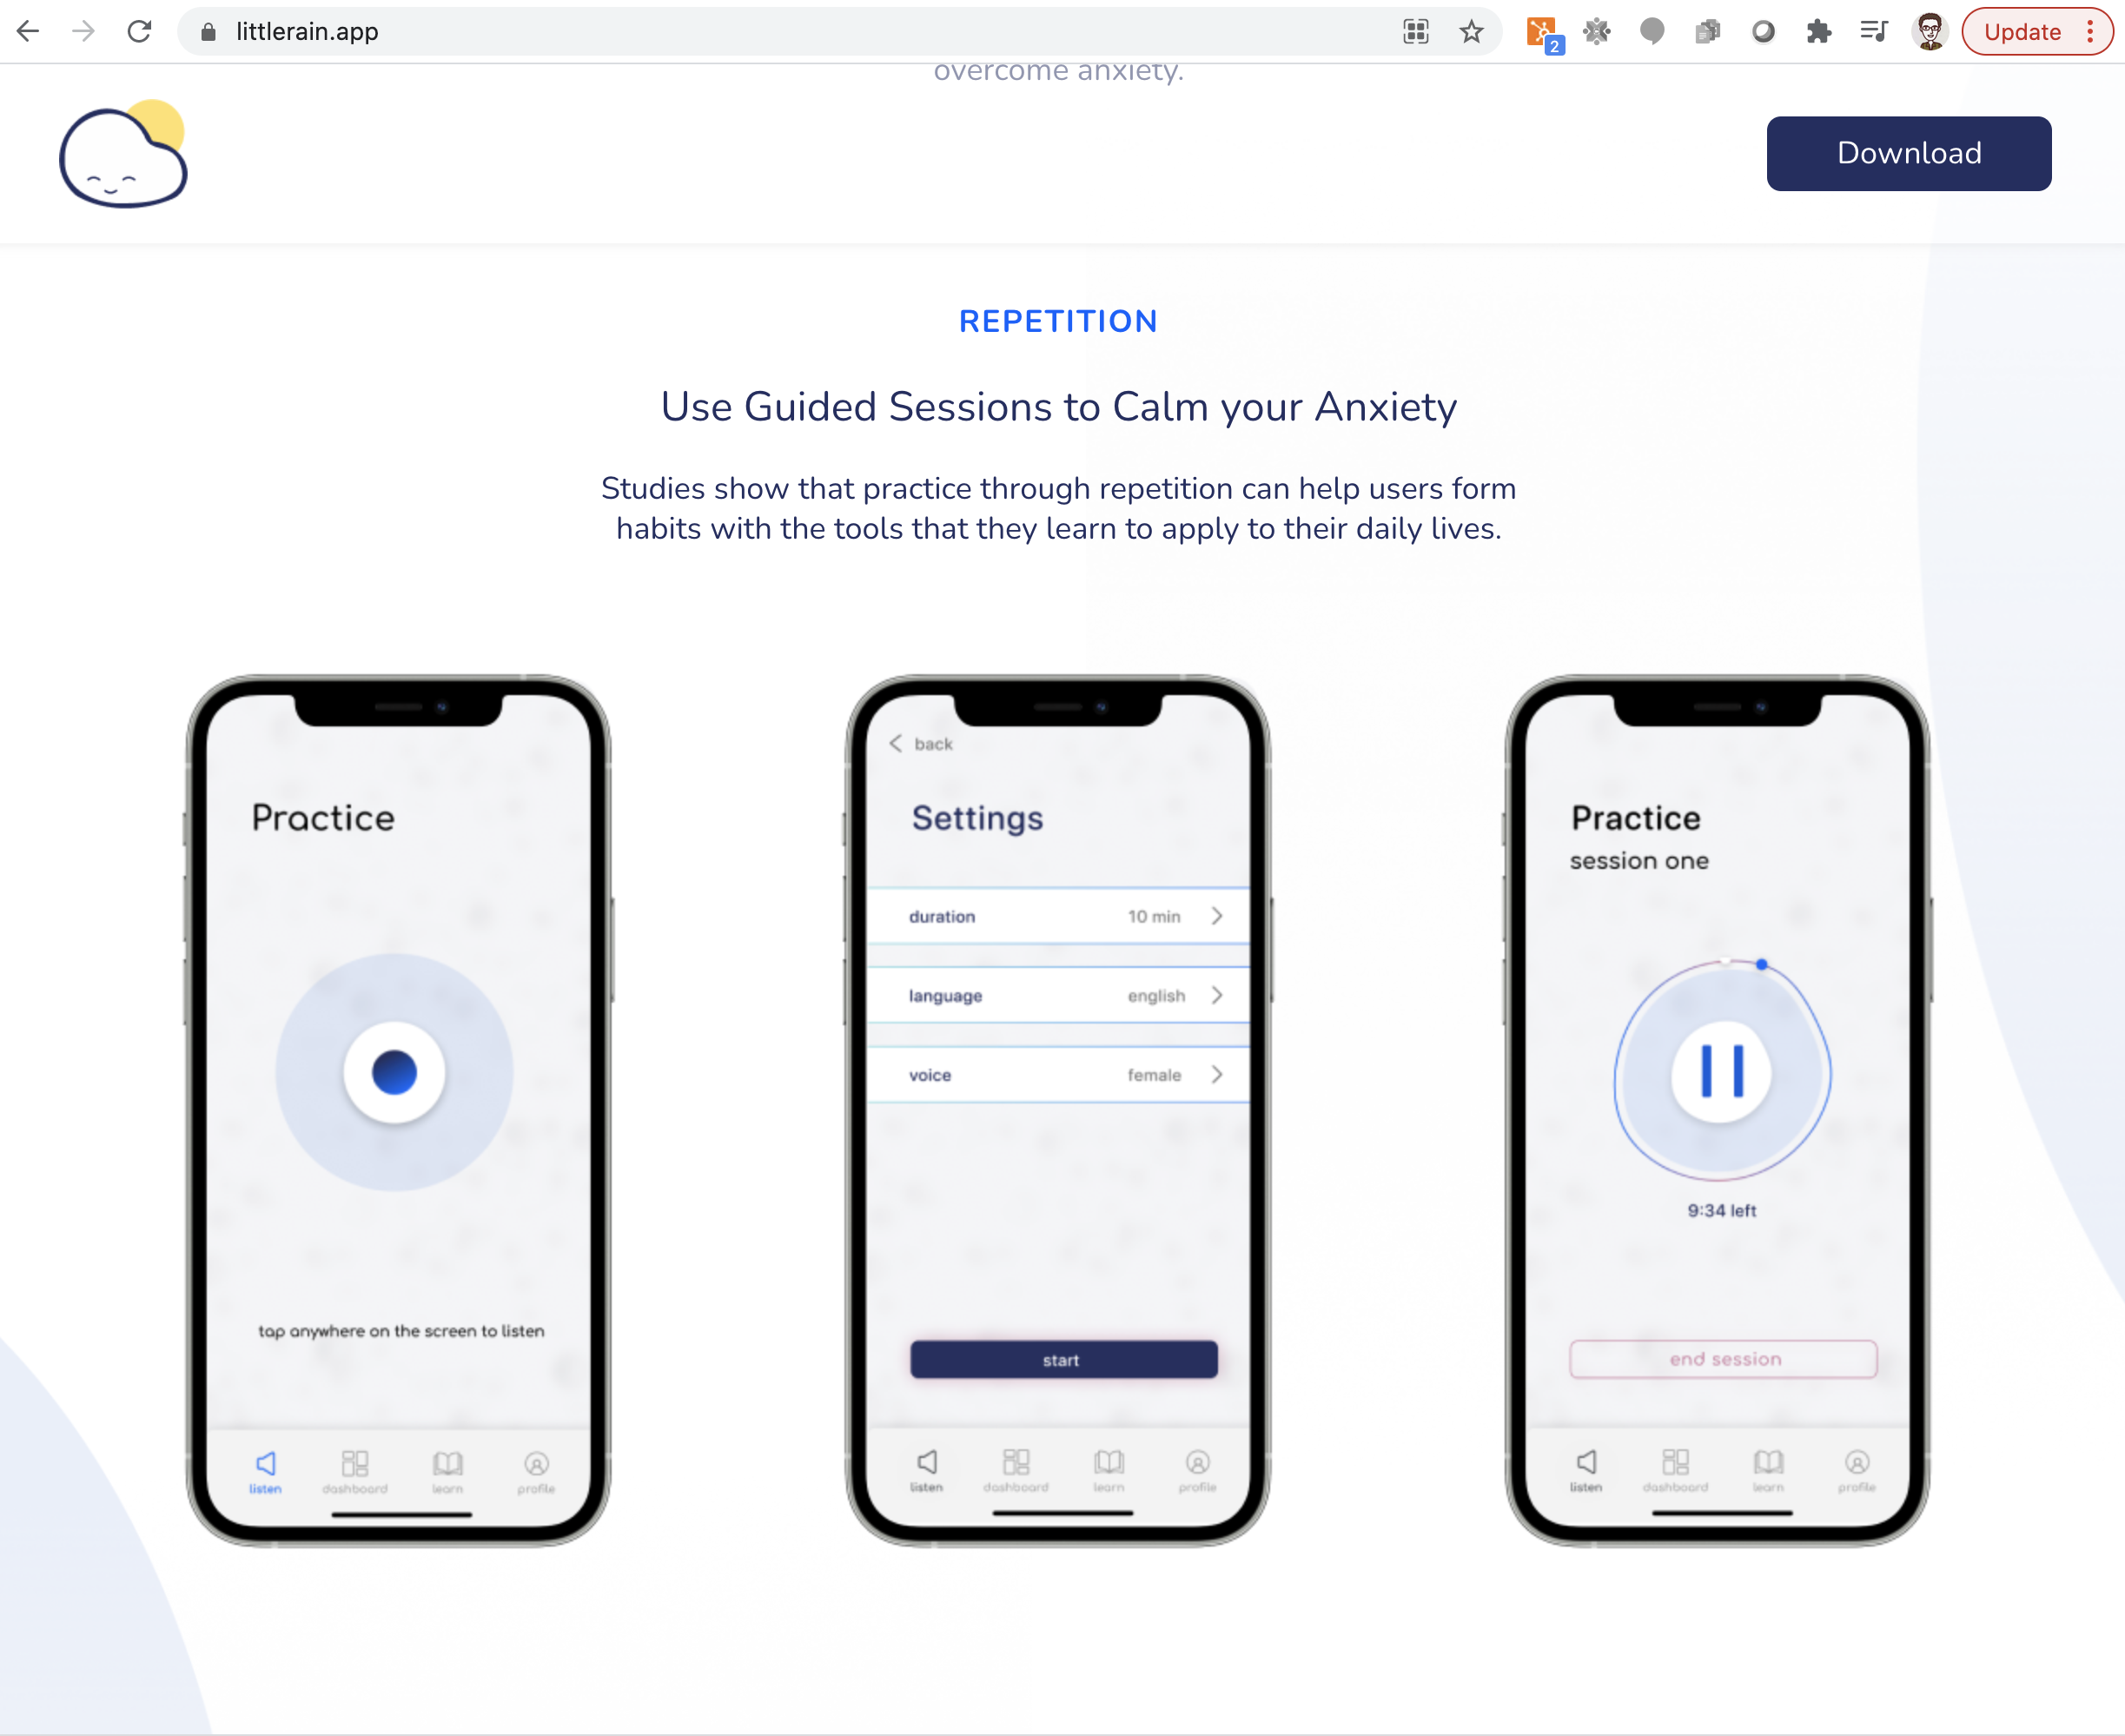

Littlerain.app

