Slide 1



Everything is Relative
Steve Joordens
Professor of Psychology
University of Toronto Scarborough

Slide 2
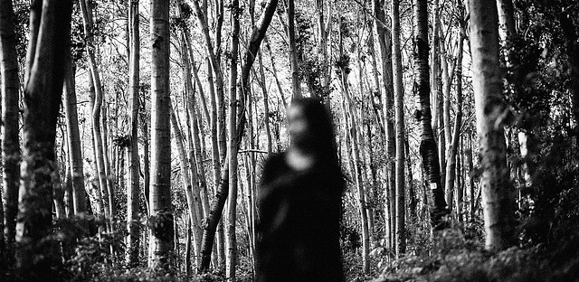
Losing the Forest for the Trees

Slide 3
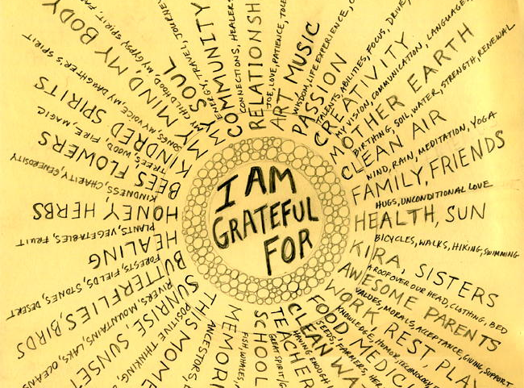

Slide 4
Gratitude …
Can put things in perspective by allowing us to see the big picture … the entire forest as it were
Especially highlights important social connections we have, which brings with it all the benefits of feeling loved and part of a larger community that cares

