Slide 1
Refresh the Spirit: Gratitude to Build Resilience
Heather Gordon, EdD, MSW, RSW
March 2021
Notes:
The Wellness team is happy to be here during this challenging time.
We are dealing with collective grief and the inconveniences that comes with COVID.
We also have extra stressors in our role as human resource staff, so today we bring to you a few activities that touches on the components of mind, body, spirit. We are leaving you with tools and resources to help minimize the effects of COVID.

Slide 2
Goals & Objectives
Presentation Goal
Using Gratitude Practices to Refresh the Spirit
Learning
Objectives
Understand Benefits of Gratitude
Engage in gratitude Practices: BRITE, journaling & letter/note to someone significant
Build resilience and Maintain optimism
Do a gratitude reflection meditation

Slide 3
BENEFITS OF GRATITUDE
Builds Resilience
Cultivate deeper self-awareness
Create situations where happiness thrives
Reduce life-time risk for depression, anxiety and substance abuse disorder
Tangible benefits – feeling grateful & encourage sharing
(Emmons & Stern, 2013)

Slide 4

GRATITUDE REFLECTIVE MEDITATION

Slide 5
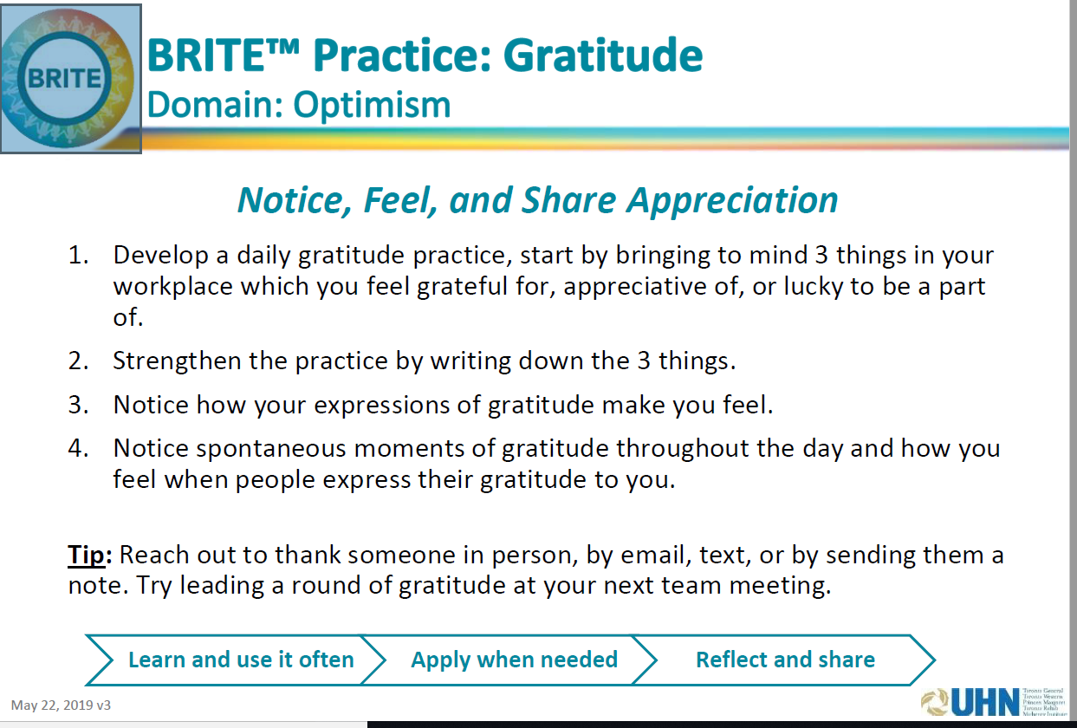
b

Slide 6

GRATITUDE PRACTICE
Show others you care:
Write gratitude each day:
Take out weekly Calendar – write gratitude for today
Each day, write 3 things you are grateful for
Write a note on qualities you appreciate in a classmate/colleague/friend
Email, Mail or Call to share / deliver
Notes:
Read activities from slide

Slide 7
Tools for Gratitude
7 Scientifically Proven Benefits of Gratitude :
https://www.forbes.com/sites/amymorin/2014/11/23/7-scientifically-proven-benefits-of-gratitude-that-will-motivate-you-to-give-thanks-year-round/#4d7d3c1c183c
Gratitude Scales that Scientists Use https://positivepsychology.com/measure-gratitude-questionnaires-scales
Notes:
This slide are the Stress Scales I mentioned Earlier. There are also Scales and Resources for Gratitude Practices

Slide 8
Quiz
Which of these 3 benefits of Gratitude Practice covered in this module?
A) Builds Resilience,
tangible Benefits, Self-awareness
B) Improve sleep, self-awareness, relaxation
C) Encourage sharing, reduce anxiety and improve diet
Which 3 gratitude practices that can be used on a regular basis to build resilience?
Gratitude Note, Journaling and Deep breathing
Giving thanks, Using the BRITE practices and Taking baths
BRITE practices ~ to be used individually or with teams, anywhere, anytime; Journaling; Gratitude Reflective Meditation

Slide 9


