Slide 1

Put on a Happy Face ☺
Steve Joordens
Professor of Psychology
University of Toronto Scarborough

Slide 2
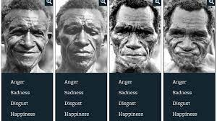
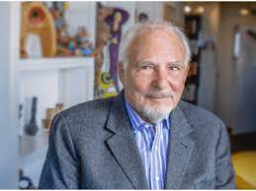
Paul Ekman

Slide 3


Slide 4
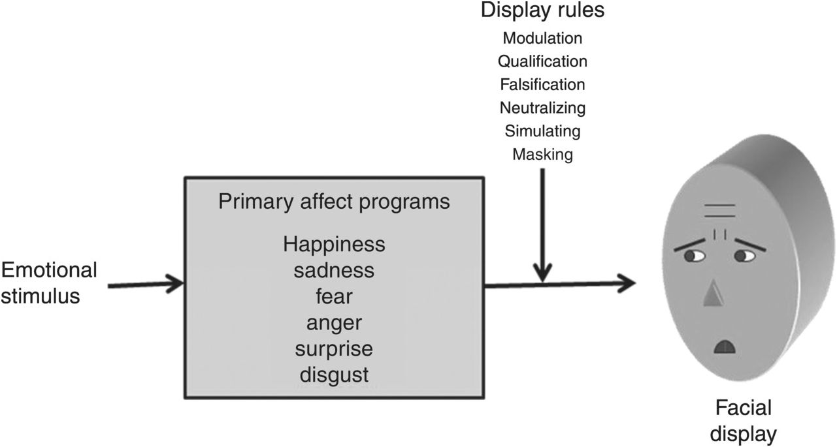

Slide 5
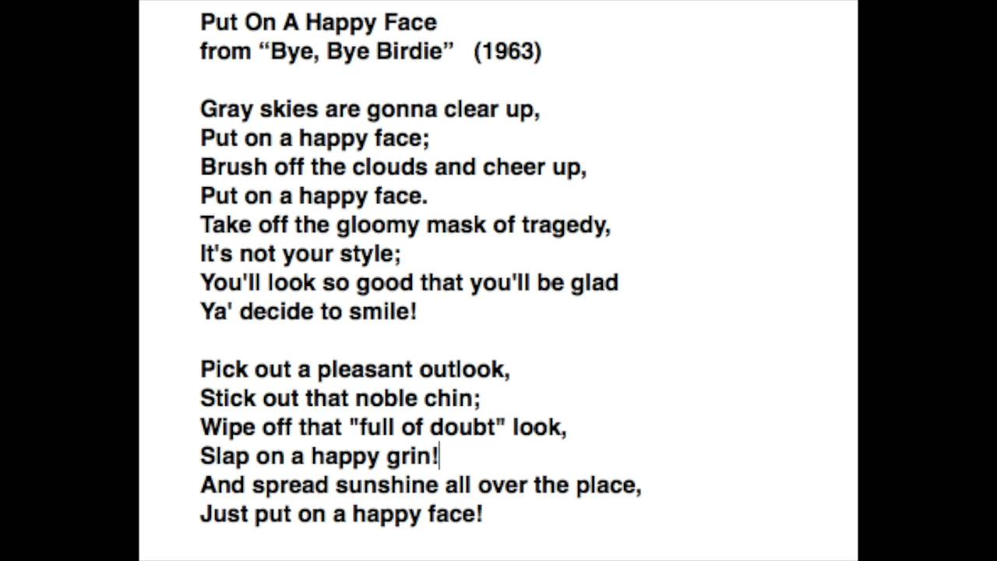

Slide 6
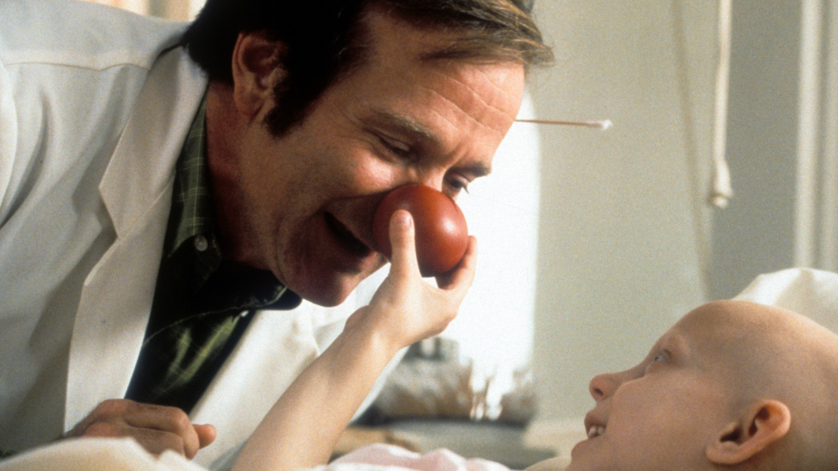
From Patch Adams

