Slide 1



With a Little Help From My Friends
Steve Joordens
Professor of Psychology
University of Toronto Scarborough

Slide 2


Slide 3
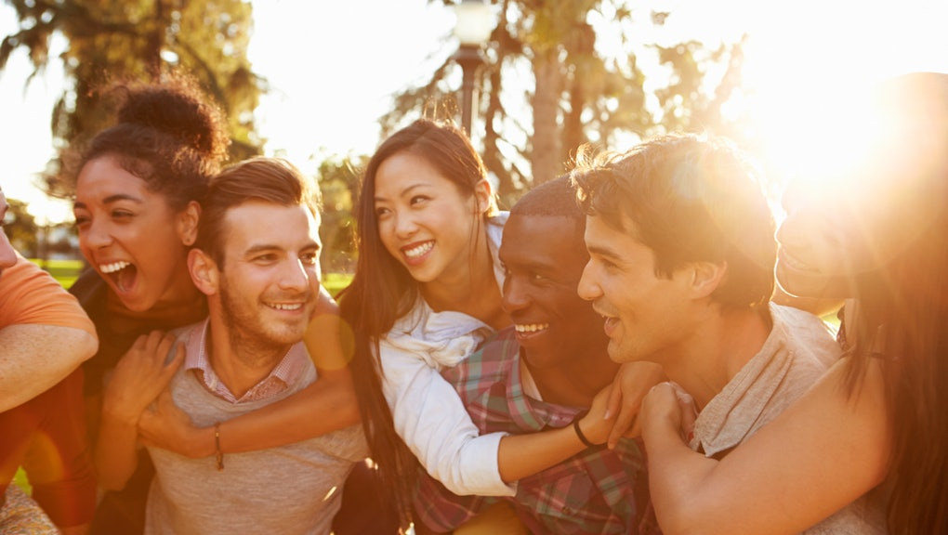

Slide 4
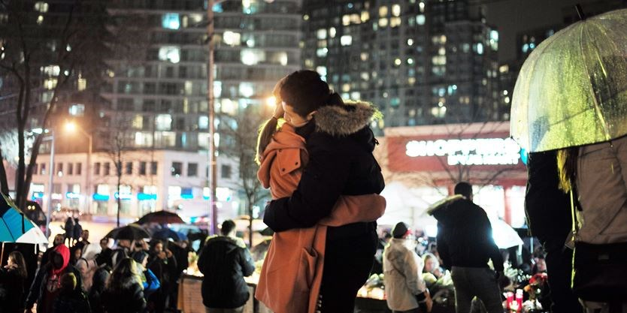

Slide 5
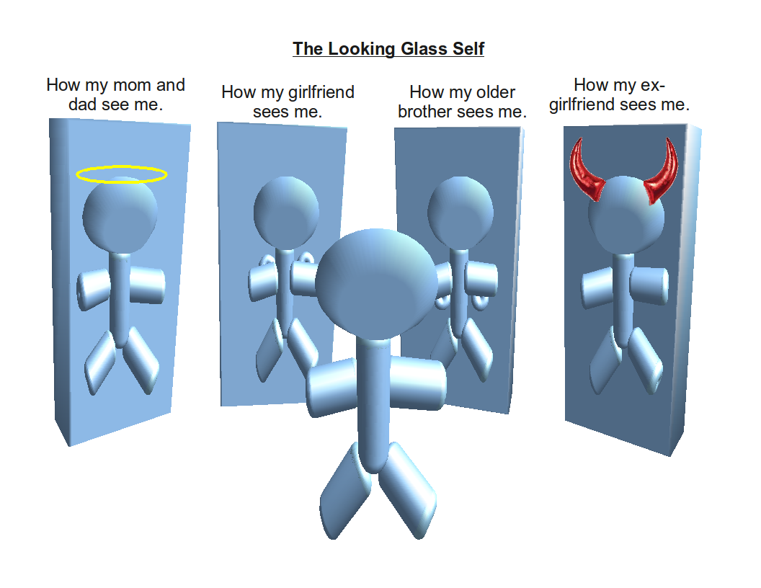
How many different people did you have some sort of social interaction during “normal” times?
What might happen if for some reason your social interactions decreases significantly?

Slide 6
Our Social Connections …
Bring us the security of being part of a larger group at times of threat, sadness and grief
Help us to gain a sense of who we are and what role we play
And during times of stress, they are medicine

Slide 7



Three Ways This is Relevant to Mental Health
Just like singing, dancing and laughing, connecting with those we love is critical as it counters anxiety.
When necessary, the phone is a fantastic device for social interactions!
Having a “buddy” learning to manage stress along with you can enhance both your learning and your motivation to learn
Institutionally, creating community at either a small (peer lane) or large (community building events) makes a lot of sense …
When creating events …

Slide 8

If Possible, Make it A Planned Event:
The Positive Power of Anticipation

