Slide 1



Taking the Wheel
Steve Joordens
Professor of Psychology
University of Toronto Scarborough

Slide 2
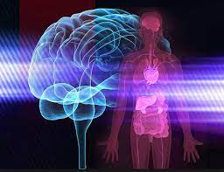
We often run on a form of auto-pilot, allowing our minds and bodies to just do their natural thing – (e.g., habits)
In times of chronic stress the natural thing is to be anxious, and to attend to the threats making us anxious
To escape anxiety then, we must learn that we can also influence our minds – we can take the wheel

Slide 3



Three Steps That Sound Easier Than They Are
Become mindful of your mind, especially right after or during some experience
Is that experience making your anxious? Is it making you feel good?
If some experience leaves you feeling anxious (e.g., News), note that connection, then limit your exposure to that experience going forward seeing it as a source of stress
If some experience leaves you feeling good (laughter, dancing), intentionally try to recreate the experience or one like it and view it as a sort of medicine, because it is!

Slide 4
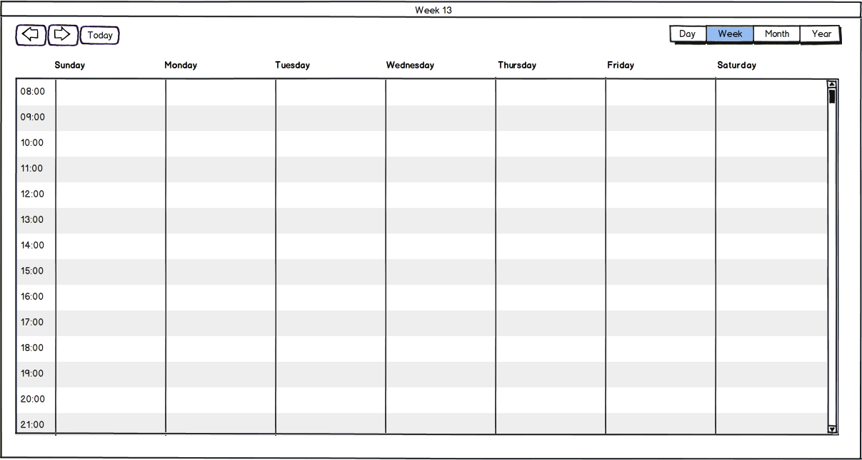
Friend Time
Music
Music
Music
Relaxation
Relaxation
Relaxation
Karaoke Night
Friend Time
Comedy

Slide 5

If Possible, Make it A Planned Event:
The Positive Power of Anticipation

