Slide 1
Overcoming and Preventing Burnout
Heather Gordon, EdD, MSW, RSW, PMP
Notes:
World Health Organization has declared burnout as a legitimate medical diagnosis. So its important that we bring this to the forefront to the forefront to raise awareness on what it is, how to prevent and overcome it. The university health network created a Wellness Management Tool, to help individuals and teams manage burnout during and engagement during the COVID pandemic, so UHN staff can engage with this tool. I will be sharing 2 self-assessment tools in this session, call the Abbreviated Maslav Inventory and a burnout test call the Oldenburg Burnout Inventory (OLBI) developed by Dr. Evangelia Demerouti.

Slide 2
Managing Burnout & Preventing
GOALS
Presentation Objectives
Address issues related to burnout and provide tools and resources to prevent and overcome burnout.
Learn signs of burnout
Assess for signs of burnout
Enhance understanding of the concept
Learn strategies to prevent and overcome burnout

Slide 3
What is Burnout?
A psychological syndrome
Chronic emotional and physical exhaustion
Depersonalization and reduced personal accomplishment
Depletion of emotional resources and not able to give of self on a psychological level
Common among healthcare workers, managers, teachers and caregivers
Affects individuals with severe stress
(Maslach & Leiter, 2016)
Notes:
According to CMA - Burnout is a significant problem in health care, threatening the well-being of physicians along with the quality of care they provide to their patients.
Addressing burnout requires meaningful system-wide change. Deliberate and concerted efforts are needed on a national scale to promote the conditions that will optimize physician health and wellness.
The literature speak to those susceptible to burnout. For example, high overachievers, those conscientious, hardworking, students, nurses….It can affects the best of us. The literature also speak to going beyond the symptoms and understanding the root cause. For example, Fache (2018), speak to how organizations need to unique cultural factors in organizations that can impeded progress in burnout
These factors include:
Inefficient work processes (e.g., increased administrative tasks, physician-entered documentation)
Excessive workloads, long hours and high patient volumes
Less time spent on meaningful work
Lack of control and autonomy
Inadequate support for “second victim” effects
Negative leadership behaviours and lack of social support
Limited opportunities for collaboration
Changes to work context and care delivery models due to new technology
According to Masclach et. al.,
Resource Burnout 101 Guide https://www.cma.ca/physician-wellness-hub/content/burnout-101-guide

Slide 4
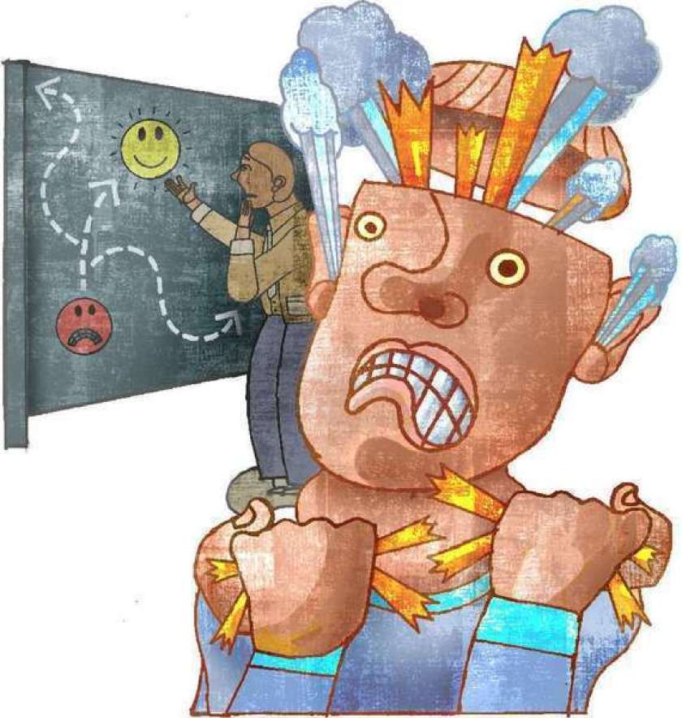
Symptoms of burnout
Characterized by 3 main features
Extreme exhaustion, fatigue and lethargy
Poor performance or reduced professional effectiveness
Depersonalization – Cynicism, lack of empathy and detached from clients and patients
The above features can lead to many symptoms and signs of burnout
Physical Illnesses
Feeling Irritable
Poor self-care (hygiene)
Feeling sad, depressed, helpless and/or apathetic
Questioning your own mortality
Increase cynical and negative outlook
Withdrawing from relationships
Using maladaptive coping strategies (excessive intake of sugar, caffeine, alcohol or drugs)
Seconding guessing yourself - Was there more I could have done?
(Fraga, 2019; CMA, 2021)
Notes:
Due to the prolonging of the Pandemic ~ we become at Risk to burnout. Therefore, we might experience some of these symptoms:
I want to bring to light some of the symptoms of burnout.
… . If you are at risk of burnout and compassion fatigue – What does that look like? You could be experiencing Irritability
Two big factor/issues related to workplace stress are burnout. Some of us who care for others can experience Compassion fatigues. Here are some of the symptoms:

Slide 5
The 12 Stages of burnout
Compulsion to prove oneself
Working harder
Neglecting needs
Displacement of conflicts
Revision of values
Denial of emerging problems
Withdrawal
Odd behavioral changes
Depersonalization
Inner-Emptiness
Depression
Burnout Syndrome
(Stillman, 2020)
Foe more information view
https://www.inc.com/jessica-stillman/the-12-stages-of-burnout-according-to-psychologist.html
Notes:
12-stage model of burnout developed by psychologists Herbert Freudenberger and Gail North. Here are the stages the scientists outline:

Slide 6
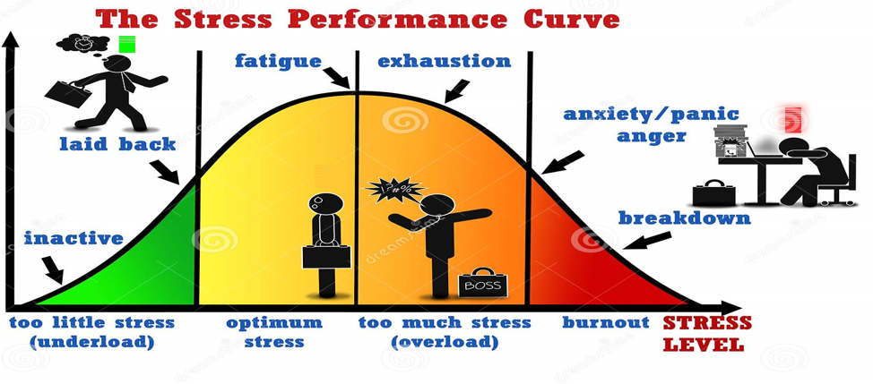
What is your stress level
(Dreamstime , 2020)
Notes:
This graphic shows how extreme stress leads to burnout Burnout is prevalent in our society today – with a pandemic, we are dealing with a lot of stressors and for some of us, HOME (where we go to relax from work, is now work, school and we’re challenge to disconnect and has constant stress........As Depicted her, too much stress put our health at risk, and Dr. Joordens has illustrates this well in one of his earlier lecture . Stress release adrenaline levels and when happens too often and too long, too many of the stress hormone cortisol is release, and this is what puts our health at risk, and according to Heart and Stroke Foundation, it damages internal organs such as the heart. SO STOP and RESET, don’t stay in a high stress state for long. I will give you Burnout test to see where you are at

Slide 7
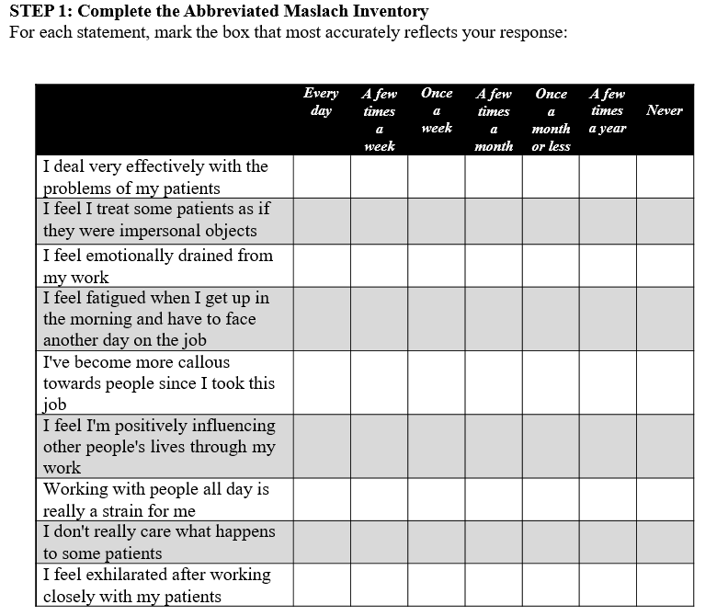
https://docs.google.com/forms/d/e/1FAIpQLSett0dlHohnn3Ejza2P9DWp2FXSSYg83X6XHh_XDwJFYjcR1w/viewform
https://questionnaires.bma.org.uk/burnout-questionnaire/?OpenForm
Notes:
STEP 1: Complete the Abbreviated Maslach Inventory
For each statement, mark the box that most accurately reflects your response
See how you scored

Slide 8
Who is susceptible to burnout?
.
The literature addressed working conditions and groups are more susceptible to burnout, including individuals with stressful jobs, healthcare workers and individuals who are high achievers, high resilience and difficulty saying no.
How do we effectively address burnout?
Addressing burnout requires meaningful system-wide change.
Efforts are needed on a large scale to promote conditions needed to promote and sustain health and wellness, i.e., in physicians (CMA, 2020)
Going beyond the symptoms and get a full understanding of the root causes, including the unique how cultural factors in organizations that can impeded progress in burnout (Krusie, 2018)
Effective plans in place to safely return to work is important

Slide 9
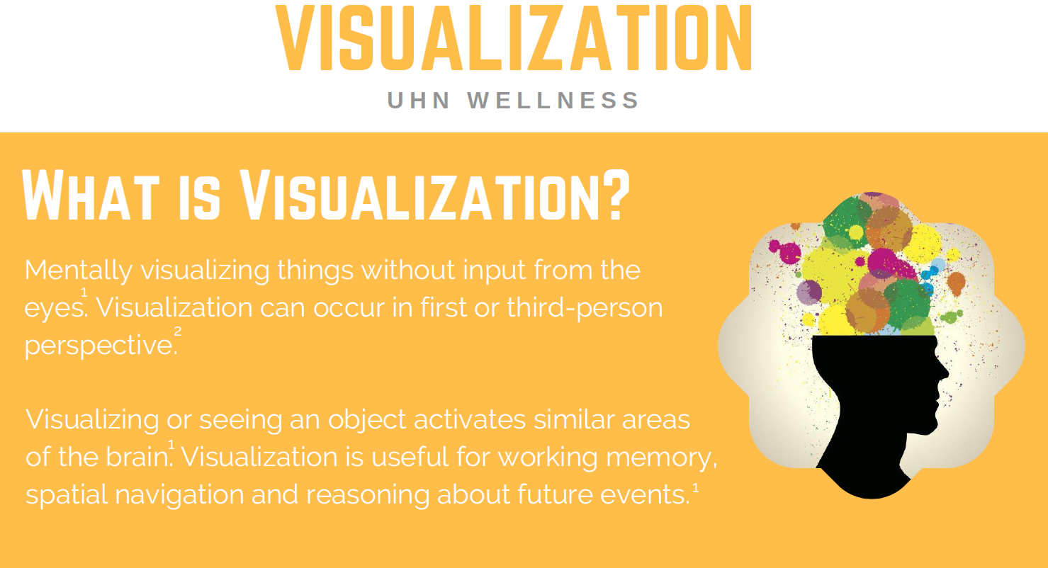

Slide 10
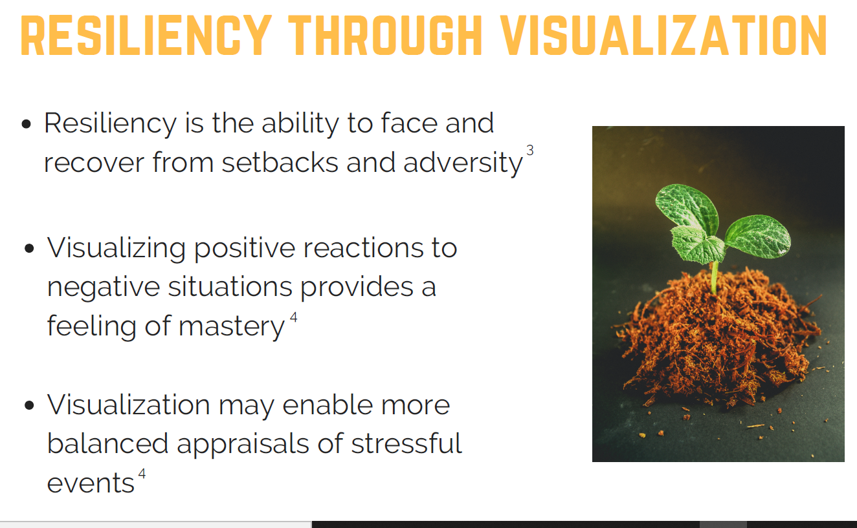

Slide 11
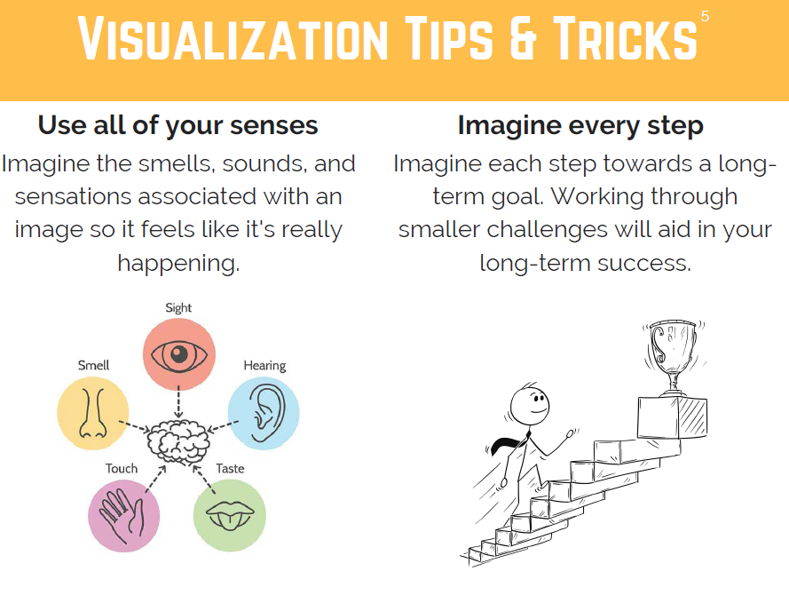

Slide 12
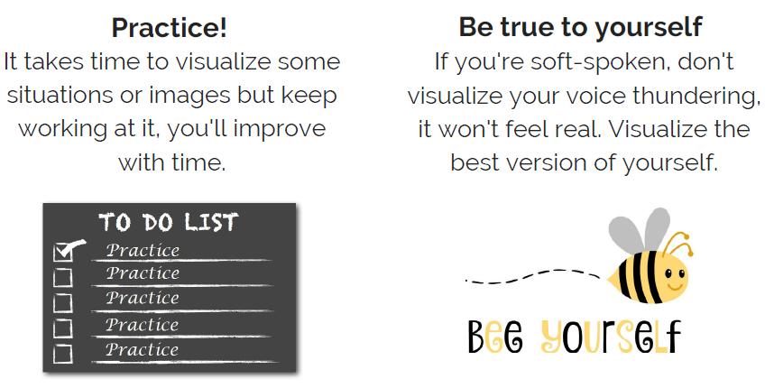

Slide 13

Visualization Activity

Slide 14
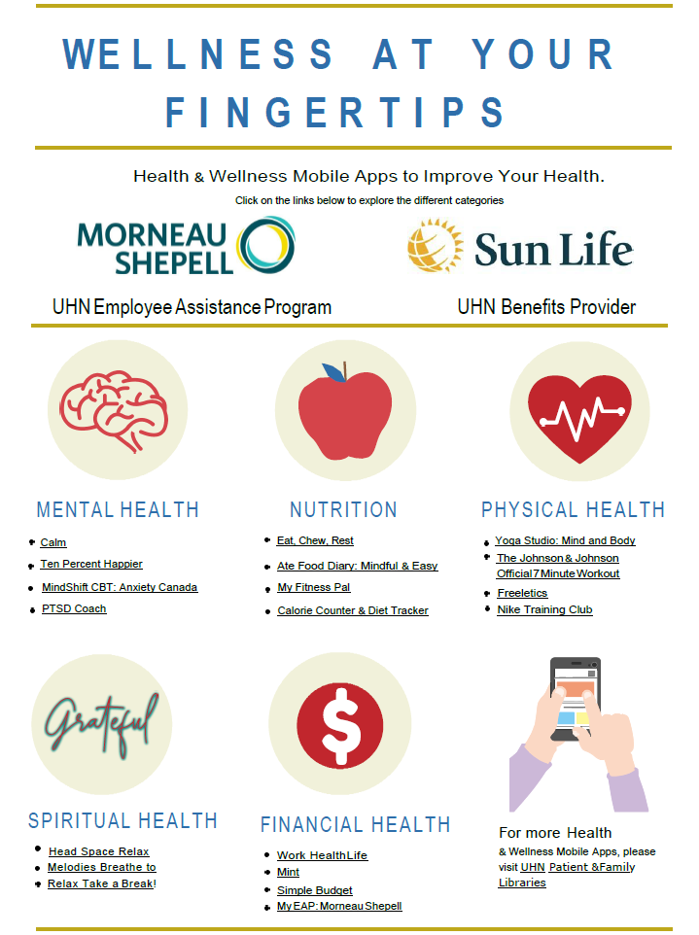
Notes:
-Wellness apps at your fingertips

Slide 15
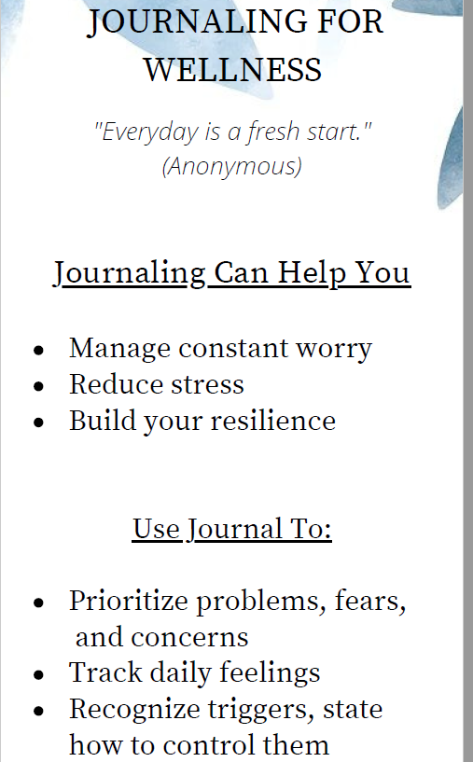
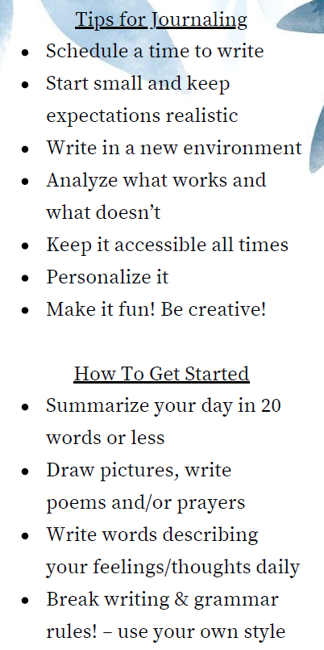

Slide 16

Tips for Preventing Burnout
Creating meaning in your life (volunteer, show gratitude, connect spiritually)
Build a routine with healthy lifestyle practice, walks, meditation and music
Nurture Significant people in your life and stay connected (letter writing, phone calls, daily/weekly conversation)
Take care of basic needs – hygiene, daily meals, drinking and sleeping
Ensure to take a Respite in your day - UHN have Respite Centers for staff to rest, relax, connect, get hydrated and have a snack
Join a Virtual Group – Choir, Laughter, Music, Church, Book club, Fitness
Normalize your experience by checking-in with friends and loved ones
Talk over your concerns with a counsellor, physician, spiritual leader or friend
Notes:
These are all on individual level – But keep in mind what CMA calls for System change that address workload demand, autonomy and control, limited collaboration and negative leadership behavior without adequate support. Address these with your direct report and find out about committee and policy being developed to address these will give hope and healing and help with recovery

Slide 17
