Slide 1
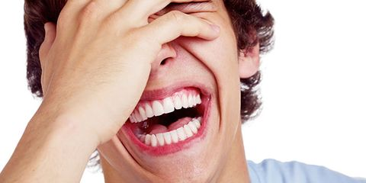

What is Laughter Yoga?
A concept where anyone can laugh for no reason, without relying on humor, jokes or comedy.
Combines laughter exercise and deep breathing.

Slide 2
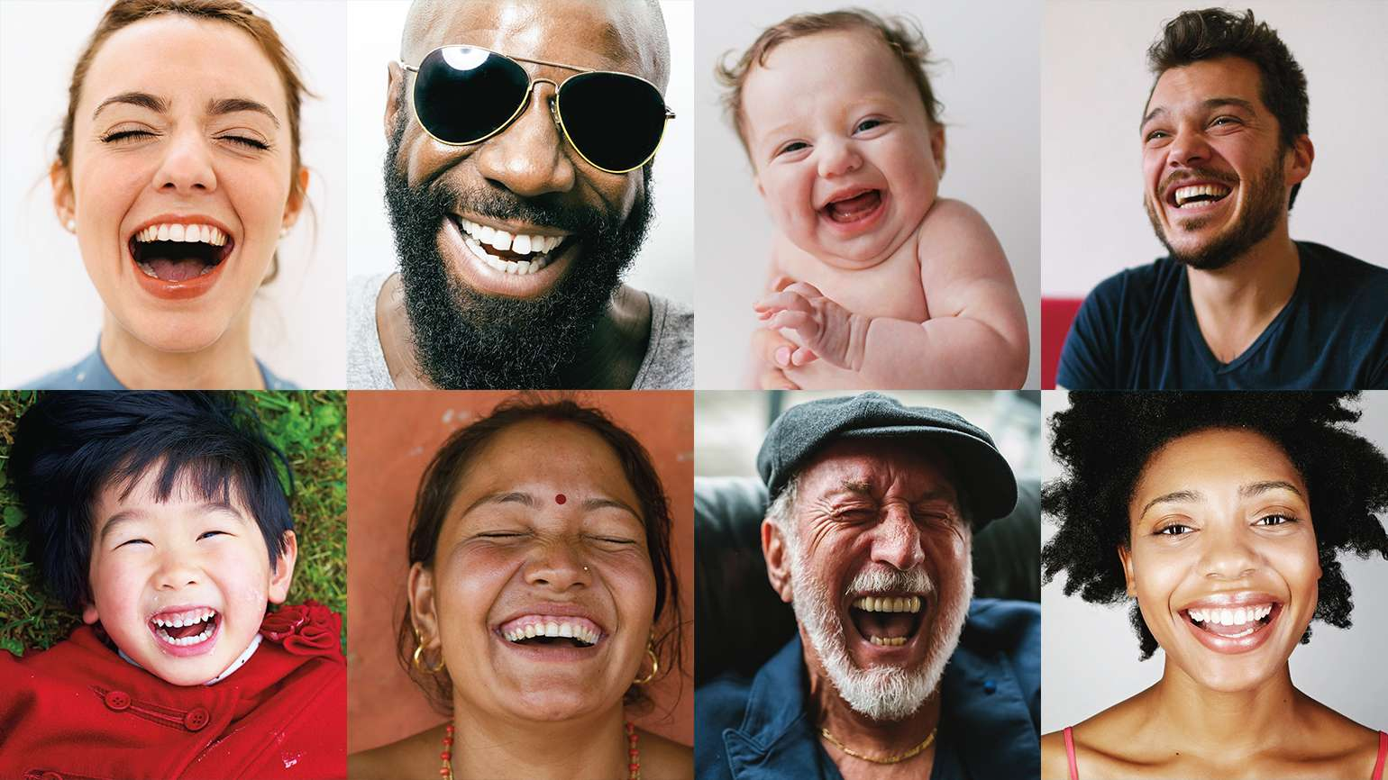
Laughter Yoga: Combines Laughter and Deep Breathing
Laughter ties to the essence of who we are – its built in.
Laughter activities are based off childlike fun, we resort to those childhood times where we laugh silly while having fun
Objectives
Mimick sounds to stimulate laughter
Engage in Rhythmic Clapping and Chanting
Participate in a deep breathing exercise
Do Self-affirmation and Affirm loved ones
Ends with Rhythmic Clapping and Chanting
Laughter releases stress, fear and worry using simple, playful, and fun Laughter, Breathing, and movement Exercises

Slide 3
Benefits of Laughter
Scientific studies show that the body cannot differentiate between real laughter and voluntary laughter if done willingly
One gets the same physiological and psychological benefits whether laugher is real or stimulated.
Clinical research done in the US and India has shown that laughter lowers the level of stress hormones in the blood.
Norman Cousin's wrote in his book "Anatomy of an Illness" that 10 minutes of genuine belly laughter had an anesthetic effect and would give him at least two hours of pain-free sleep
Brings more oxygen to the brain - makes one feel more energetic and healthier.

Slide 4

Mimic sounds to stimulate laughter
Repeat below 3 x
Throw hands in air for he he he
HO HO HA HA HA
HO HO HA HA HA
HO HO HA HA HA
He He He
Laugh effortless
The brain can’t
tell the difference

Slide 5
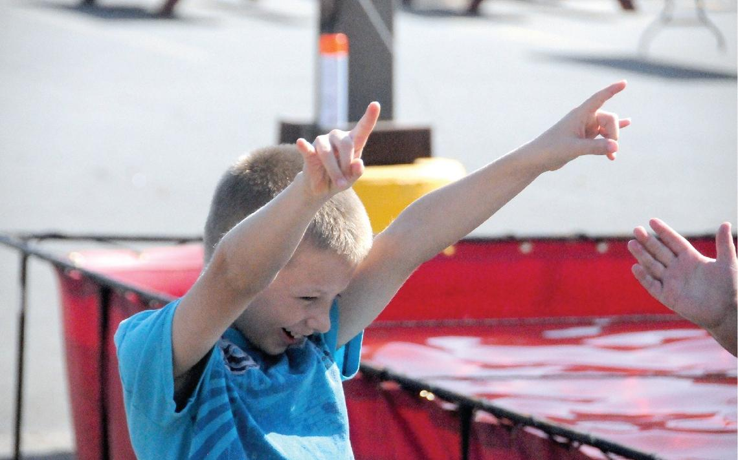
Mimic Laugher sounds
Repeat each bullet below 3x
Laugh out loud – mouth wide open saying ha ha ha ha
Laugh hesitantly – shape mouth like a funnel making sound ho ho ho ho
Laugh by grinning – make big smile showing teeth and making sound: He He He He
Do rythmic clapping and chanting below:
Berry good berry good Yeaaaah 3x

Slide 6

Affirmations: Self & Others
State your name and affirm 3 from the list
Then state the name of your loved-one. Choose 3 from the
list
Heather – you are:
Michael – you are:
Courageous
Incredible
Supportive
Impactful
Innovative
Grateful
Resilient
Compassionate

Slide 7

Deep Breathing Exercise
The POWER of the PAUSE
In this practice you are invited to put an intentional pause in your day, in order to become aware of your experience in the present moment.
Stop for a moment and pause.
Take 3-5 slow, deep, nourishing breaths.
Observe your experience by becoming aware of your current thoughts, emotions, and body sensations.
Proceed mindfully with your day. Tip: Link the use of S.T.O.P. to routine activities, such as washing your hands,
turning on your computer or waiting for the elevator.
Learn and use it often Apply when needed Reflect and share
BRITE is a novel workplace program comprised of 12 micro-practices, aimed at improving staff well-being and employee engagement, and ultimately quality of care, through the cultivation of individual resilience ‘on the go’.

Slide 8



