Slide 1

Game Theoretic Approach for Non-Cooperative Load Balancing between Local Cloudlets
Yuki Yokota
Sumiko Miyata
These research results were obtained from the commissioned research (No.05601) by NICT, Japan.
Shibaura Institute of Technology

Slide 2
Research background
Increase in the number of application that use Cloud Computing
More research about Edge Computing for latency sensitive applications
Cloudlets that are located on routers inside a Local Area Network
[M.Barbar+, IEEE Access, 2021]
[S.Mahadev+, IEEE Pervasive Computing, 2009]

Slide 3




What are cloudlets?
Local Area Network
Number of arriving jobs and their destinations cannot be controlled by cloudlets
Unbalanced load will lead to high processing delay
Goal : Efficient load balancing between cloudlets that reduces latency

Slide 4
Tradeoff of cloudlets
Local Area Network
Cloudlets aim for low Latency
Tradeoff
Cloudlets want high Utilization
High processing delay
Maximizing utilization while meeting the latency requirement

Slide 5
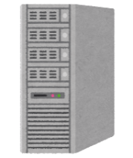




Conventional Method
Load balancing method by offloading using non-cooperative game theory
[S.Mondal+, IEEE Open Journal of the Communications Society, 2020]
Cloudlet $i$
Cloudlet $j$
Maximizing the utilization of cloudlets while limiting the total latency by approved latency

Slide 6
Problem of the conventional method
Evaluates the latency weighted by the fraction of each jobs
Cloudlet $i$
Cloudlet $j$
Latency of offloaded jobs
Latency of non-offloaded jobs
The latency of smaller fraction of jobs are not evaluated entirely
Conventional solutions allow small fraction of jobs to exceed latency requirements

Slide 7
Key idea
Load must be balanced among all cloudlets
Utilization of each cloudlet should be kept high to gain maximum profit
Consider the latency of both non-offloaded and offloaded jobs fairly
Alternate optimal solution that would allow more jobs to meet the latency requirement
Game theoretic load balancing method that would be fair for all the jobs

Slide 8
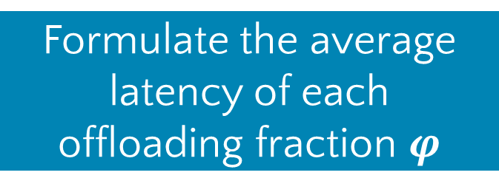
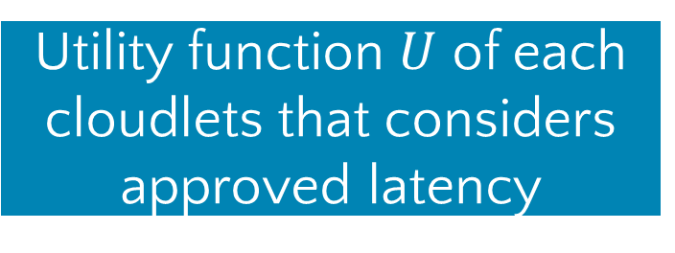
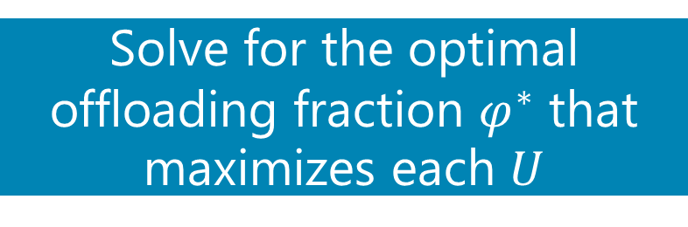
Proposed method ‐ Process Flow
Formulate the average latency of each offloading fraction $φ$
Modeling in M/M/1 using queuing theory
Utility function $U$ of each cloudlets that considers approved latency
Derive the optimal
offloading fraction using non-cooperative game
theory
Solve for the optimal offloading fraction $φ^{∗}$ that maximizes each $U$

Slide 9
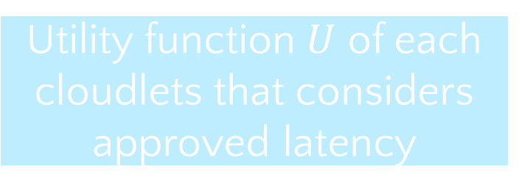
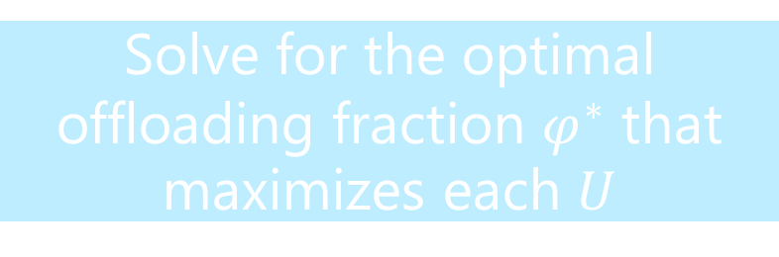
Proposed method ‐ Process Flow
Formulate the average latency of each offloading fraction $φ$
Modeling in M/M/1 using queuing theory
Utility function $U$ of each cloudlets that considers approved latency
Derive the optimal
offloading fraction using non-cooperative game
theory
Solve for the optimal offloading fraction $φ^{∗}$ that maximizes each $U$

Slide 10
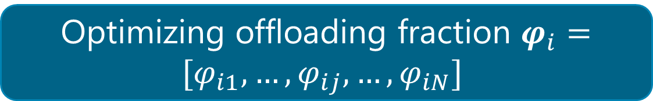





Proposed method - Assumed Environment
Modeling $N$ number of cloudlets in M/M/1
Cloudlet $i$
Cloudlet $j$
$$λ_{i}φ_{ij}$$
$$λ_{i}φ_{ii}$$
$$λ_{i}$$
$$λ_{j}$$
Optimizing offloading fraction $φ_{i}=[φ_{i1},…,φ_{ij},…,φ_{iN}]$

Slide 11
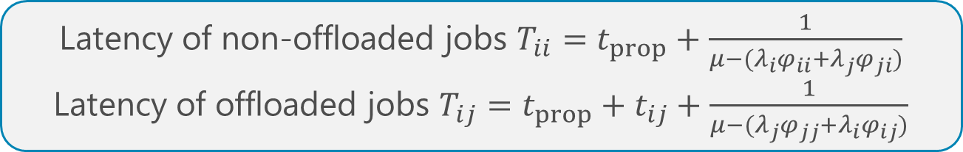


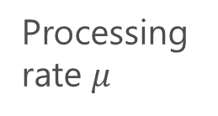

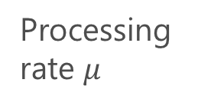
Proposed method - Average latency
Calculate each latency of offloaded and non-offloaded jobs
Cloudlet $i$
Cloudlet $j$
Processing rate $μ$
Processing rate $μ$
$$t_{ij}$$
$$t_{prop}$$
$$t_{prop}$$
Latency of non-offloaded jobs $T_{ii}=t_{prop}+\frac{1}{μ−(λ_{i}φ_{ii}+λ_{j}φ_{ji})}$
Latency of offloaded jobs $T_{ij}=t_{prop}+t_{ij}+\frac{1}{μ−(λ_{j}φ_{jj}+λ_{i}φ_{ij})}$

Slide 12
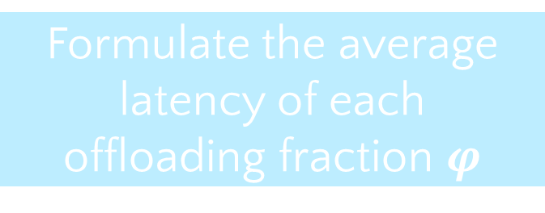
Proposed method ‐ Process Flow
Formulate the average latency of each offloading fraction $φ$
Modeling in M/M/1 using queuing theory
Utility function $U$ of each cloudlets that considers approved latency
Derive the optimal
offloading fraction using non-cooperative game
theory
Solve for the optimal offloading fraction $φ^{∗}$ that maximizes each $U$

Slide 13




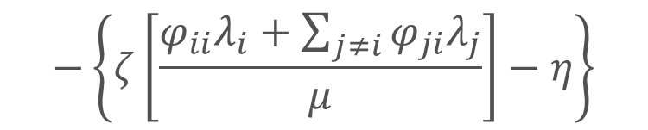


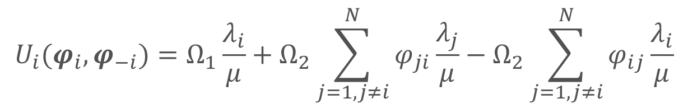

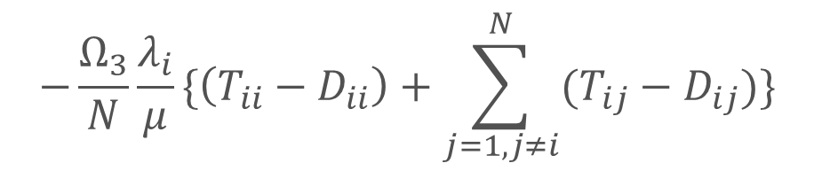

Proposed method - Utility function
Utility function $U_{i}$ of cloudlet $i$
$$U_{i}(φ_{i}, φ_{−i})=Ω_{1}\frac{λ_{i}}{μ}+Ω_{2}\sum_{j=1,j≠i}^{N}{φ_{ji}\frac{λ_{j}}{μ}}−Ω_{2}\sum_{j=1,j≠i}^{N}{φ_{ij}\frac{λ_{i}}{μ}}$$
$$−\left\{ζ\left[\frac{φ_{ii}λ_{i}+\sum_{j≠i}{φ_{ji}λ_{j}}}{μ}\right]−η\right\}$$
$$−\frac{Ω_{3}}{N}\frac{λ_{i}}{μ}\{\left({T_{ii}−D}_{ii}\right)+\sum_{j=1,j≠i}^{N}{(T_{ij}−D_{ij})}\}$$
$λ_{i}$ : Arrival rate
$μ$: Processing rate
$Ω_{1},Ω_{2}$, $Ω_{3}$ : Weighting constant
$ζ$ : Cost of processing each jobs
$T_{ij}$: Average latency
$η$: Cost of processing server
$D_{ij}$ : Approved latency

Slide 14

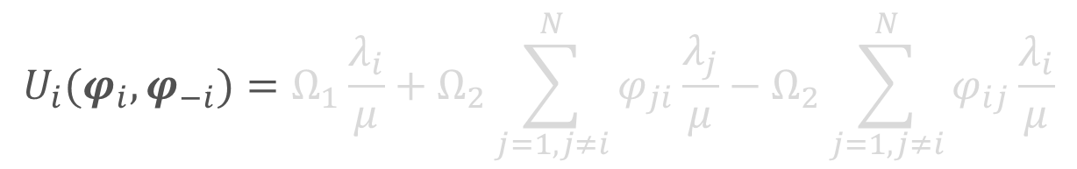
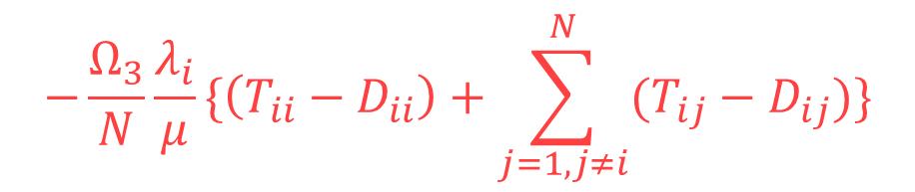
Proposed method - Utility function
Utility function $U_{i}$ of cloudlet $i$
$$U_{i}(φ_{i}, φ_{−i})=Ω_{1}\frac{λ_{i}}{μ}+Ω_{2}\sum_{j=1,j≠i}^{N}{φ_{ji}\frac{λ_{j}}{μ}}−Ω_{2}\sum_{j=1,j≠i}^{N}{φ_{ij}\frac{λ_{i}}{μ}}$$
$$−\left\{ζ\left[\frac{φ_{ii}λ_{i}+\sum_{j≠i}{φ_{ji}λ_{j}}}{μ}\right]−η\right\}$$
$$−\frac{Ω_{3}}{N}\frac{λ_{i}}{μ}\{\left({T_{ii}−D}_{ii}\right)+\sum_{j=1,j≠i}^{N}{(T_{ij}−D_{ij})}\}$$
$λ_{i}$ : Arrival rate
$μ$: Processing rate
$Ω_{1},Ω_{2}$, $Ω_{3}$ : Weighting constant
$ζ$ : Cost of processing each jobs
$T_{ij}$: Average latency
$η$: Cost of processing server
$D_{ij}$ : Approved latency
Evaluates the latency of each offloading fraction by approved latency

Slide 15
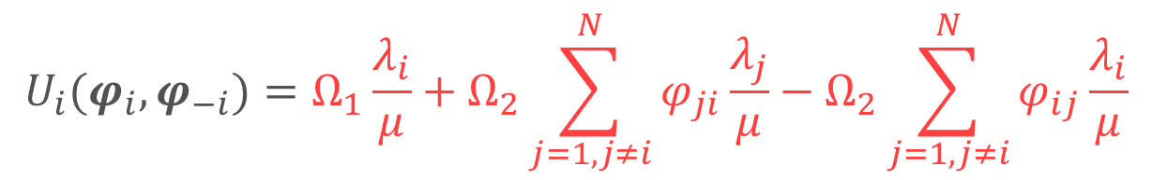


Proposed method - Utility function
Utility function $U_{i}$ of cloudlet $i$
$$U_{i}(φ_{i}, φ_{−i})=Ω_{1}\frac{λ_{i}}{μ}+Ω_{2}\sum_{j=1,j≠i}^{N}{φ_{ji}\frac{λ_{j}}{μ}}−Ω_{2}\sum_{j=1,j≠i}^{N}{φ_{ij}\frac{λ_{i}}{μ}}$$
$$−\left\{ζ\left[\frac{φ_{ii}λ_{i}+\sum_{j≠i}{φ_{ji}λ_{j}}}{μ}\right]−η\right\}$$
$$−\frac{Ω_{3}}{N}\frac{λ_{i}}{μ}\{\left({T_{ii}−D}_{ii}\right)+\sum_{j=1,j≠i}^{N}{(T_{ij}−D_{ij})}\}$$
$λ_{i}$ : Arrival rate
$μ$: Processing rate
$Ω_{1},Ω_{2}$, $Ω_{3}$ : Weighting constant
$ζ$ : Cost of processing each jobs
$T_{ij}$: Average latency
$η$: Cost of processing server
$D_{ij}$ : Approved latency
Calculates the total utilization of Cloudlet $i$

Slide 16
Proposed method ‐ Process Flow
Formulate the average latency of each offloading fraction $φ$
Modeling in M/M/1 using queuing theory
Utility function $U$ of each cloudlets that considers approved latency
Derive the optimal
offloading fraction using non-cooperative game
theory
Solve for the optimal offloading fraction $φ^{∗}$ that maximizes each $U$

Slide 17



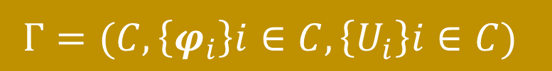
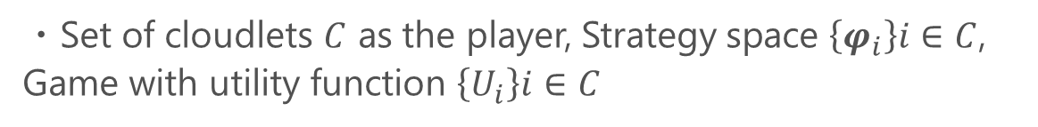
Proposed method - Non-cooperative game
Non-cooperative game for cloudlets
Utility function $U_{i}$ is concave over $φ_{i}$
$$Γ=(C, \left\{φ_{i}\right\}i∈C, \left\{U_{i}\right\}i∈C)$$
・Set of cloudlets $C$ as the player, Strategy space $\left\{φ_{i}\right\}i∈C$,
Game with utility function $\left\{U_{i}\right\}i∈C$
Optimal offloading fraction $φ^{∗}$can be derived by solving $∇U=0$

Slide 18




Numerical calculation
Consider offloading between 2 cloudlets
Compare the actual utilization difference with the conventional method
Cloudlet $1$
Cloudlet $2$
Load balancing is achieved as the difference is small

Slide 19
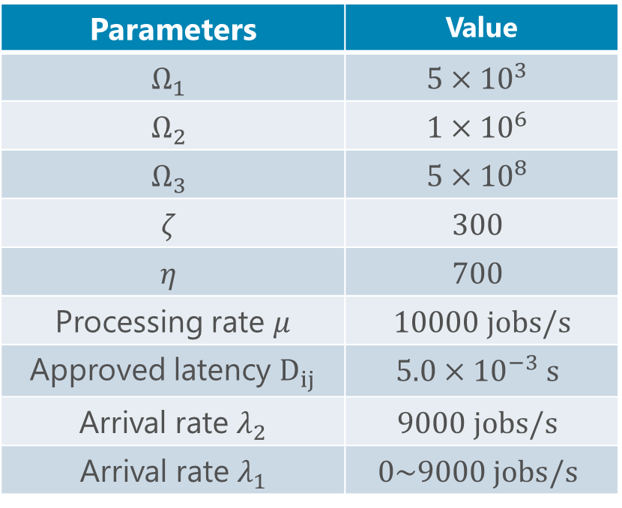
Numerical calculations - Parameters
Weighted parameters are same as conventional values
[Mondal+, 2020]
Parameters | Value
$$Ω_{1}$$ | $$5×{10}^{3}$$
$$Ω_{2}$$ | $$1×{10}^{6}$$
$$Ω_{3}$$ | $$5×{10}^{8}$$
$$ζ$$ | $$300$$
$$η$$ | $$700$$
Processing rate $μ$ | $$10000 jobs/s$$
Approved latency $D_{ij}$ | $$5.0×{10}^{−3} s$$
Arrival rate$λ_{2}$ | $$9000 jobs/s$$
Arrival rate$λ_{1}$ | $$0\sim 9000 jobs/s$$
Utilization set at 0.9
Utilization set from 0~0.9

Slide 20
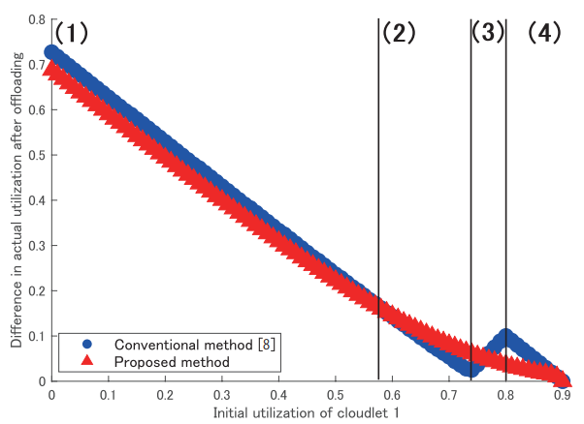
Result: Difference between utilization
Proposed method has slightly smaller difference
in utilization between 2 cloudlets
Better load balancing can be achieved
Notes:
The conventional results reverses due to the calculation of the difference, which is done by the absolute value. Therefore, the actual conventional difference of utilization decreseas until it reaches a certain point where offloading does not increase its utility.
The proposed

Slide 21
Conclusion and future work
Conclusion
Evaluated the latency of offloaded and non-offloaded jobs in a fairer way
Achieved smaller difference in the utilization while meeting the approved latency
Future work
Simulation to evaluate the change of number of jobs that exceed the latency requirement

