Slide 1
ICS 104 - Introduction to Programming in Python and C
LOOPS

Slide 2
Loops
Reading Assignment
Chapter 4 Sections 1, 2, 3, 5, 6, 7, 8 and 9.
Chapter Learning Outcomes
At the end of this chapter, you will be able to
implement while and for loops
become familiar with common loop algorithms
understand nested loops
process strings
generate random numbers

Slide 3
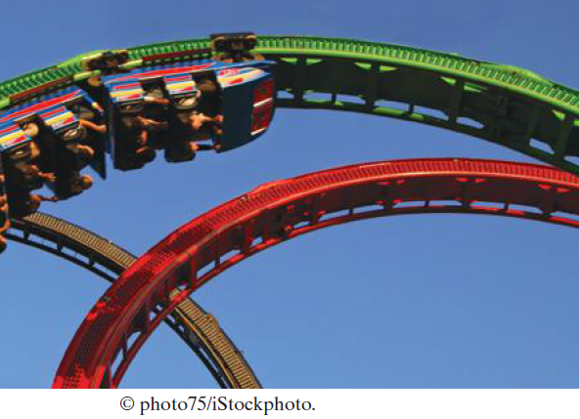
Loops
In a loop, a part of a program is repeated over and over until a specific goal is reached.
Loops are important for calculations that require repeated steps, and for processing input consisting of many data items.

Slide 4
The While Loops
Start with a year value of 0, a column for the interest, and a balance of $10,000.
Repeat the following steps while the balance is less than $20,000.
Add 1 to the year value.
Compute the interest as balance x 0.05 (i.e., 5 percent interest).
Add the interest to the balance.
Report the final year value as the answer.
For example, You put $10,000 into a bank account that earns 5 percent interest per year.
How many years does it take for the account balance to be double the original investment?
Question: How we can implement the "Repeat steps while the balance is less than $20,000?"
Answer: Using the while loop statement
year | interest | balance
0 |  | $10,000

Slide 5
The While Loops Syntax
while condition :
statements
TARGET = 20000
while balance < TARGET :
year = year + 1
interest = balance * RATE / 100
balance = balance + interest

Slide 6
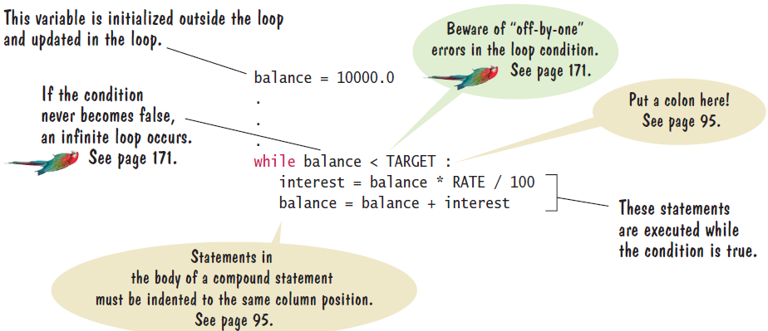
The While Loops Syntax

Slide 7
The While Loop
As long as the condition remains true, the statements inside the while statement are executed.
This statement block is called the body of the while statement.
For example, we want to increment the year counter and add interest while the balance is less than the target balance of $20,000:

Slide 8
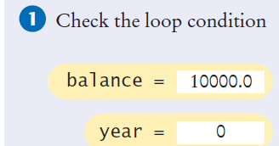
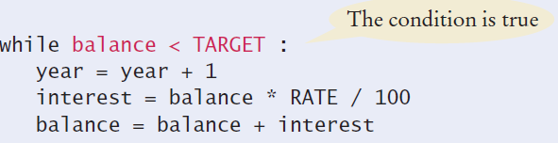
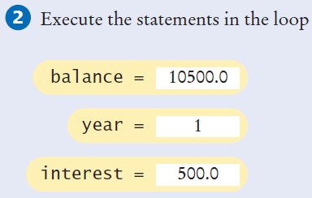
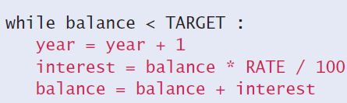
Execution of the While Loop
TARGET = 20000

Slide 9
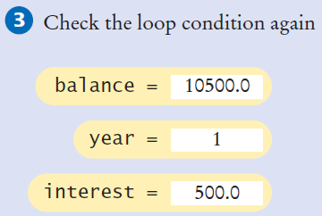
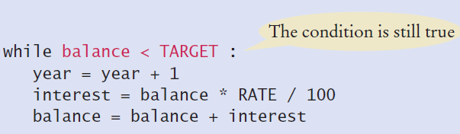

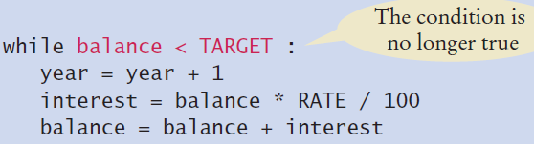
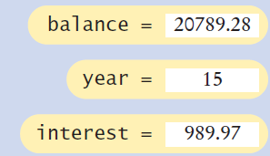
Execution of the While Loop
TARGET = 20000
print(year)

Slide 10
Execution of the While Loop
1 500.00 10500.00
2 525.00 11025.00
3 551.25 11576.25
4 578.81 12155.06
5 607.75 12762.82
6 638.14 13400.96
7 670.05 14071.00
8 703.55 14774.55
9 738.73 15513.28
10 775.66 16288.95
11 814.45 17103.39
12 855.17 17958.56
13 897.93 18856.49
14 942.82 19799.32
15 989.97 20789.28
15
RATE = 5
year = 0
balance = 10000.0
TARGET = 20000.0
while balance < TARGET :
year = year + 1
interest = balance * RATE / 100
balance = balance + interest
print("%8d %10.2f %10.2f"
% (year, interest, balance))
print(year)

Slide 11

The While Loop - Event-Controlled Loops
# This program computes the time required to double an investment.
# Create constant variables.
RATE = 5.0
INITIAL_BALANCE = 10000.0
TARGET = 2 * INITIAL_BALANCE
# Initialize variables used with the loop.
balance = INITIAL_BALANCE
year = 0
# Count the years required for the investment to double.
while balance < TARGET :
year = year + 1
interest = balance * RATE / 100
balance = balance + interest
# Print the results.
print("The investment doubled after", year, "years.")

Slide 12
The While Loop: Count-Controlled Loops
A while loop that is controlled by a counter:
counter = 1 # Initialize the counter
while counter <= 10 : # Check the counter
print(counter)
counter = counter + 1 # Update the loop variable
1
2
3
4
5
6
7
8
9
10

Slide 13
The While Loop: Student Activity
What does the following loop print?
n = 1
while n < 100:
n = 2 * n
print(n)
2
4
8
16
32
64
128

Slide 14
The While Loop: Student Activity
What does the following loop print?
1 1
2 3
3 6
4 10
i = 0
total = 0
while total < 10:
i = i + 1
total = total + i
print(i, total)

Slide 15
The While Loop: Student Activity
What does the following loop print?
i = 0
total = 0
while total < 0:
i = i + 1
total = total - i
print(I, total)
Nothing will be printed

Slide 16
4.3 While Loop with sentinel value
We want to write loops that read and process a sequence of input values.
A sentinel value denotes the end of a data set, but it is not part of the data.
We want to write a program that computes the average of a set of salary values.
We will use any negative value as the sentinel.
An employee would surely not work for a negative salary.

Slide 17
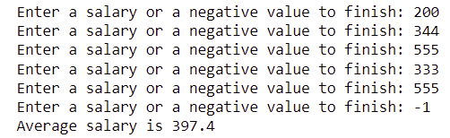
The While Loop
# This program prints the average of salary values that are terminated with
# a sentinel.
# Initialize variables to maintain the running total and count.
total = 0.0
count = 0
# Initialize salary to any non-sentinel value.
salary = 0.0
# Process data until the sentinel is entered.
while salary >= 0.0 :
salary = float(input("Enter a salary or a negative value to finish: "))
if salary >= 0.0 :
total = total + salary
count = count + 1
# Compute and print the average salary.
if count > 0 :
average = total / count
print("Average salary is", average)
else :
print("No data was entered.")

