Slide 1
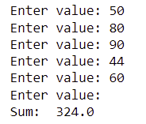
4.5 Common Loop Algorithms
Sum
total = 0.0
inputStr = input("Enter value: ")
while inputStr !="":
value = float(inputStr)
total = total + value
inputStr = input("Enter value: ")
print("Sum: ",total)

Slide 2
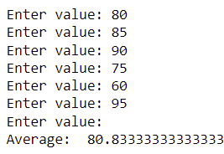
Common Loop Algorithms
Sum and Average Value
total = 0.0
count = 0
inputStr = input("Enter value: ")
while inputStr !="":
value = float(inputStr)
total = total + value
count = count + 1
inputStr = input("Enter value: ")
if count > 0:
average = total/count
else:
average = 0.0
print("Average: ",average)

Slide 3
Common Loop Algorithms
Counting Matches - You want to count how many negative values are included in a sequence of integers.
Keep a counter, a variable that is initialized with 0 and incremented whenever there is a match.

Slide 4
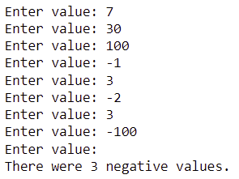
Common Loop Algorithms
Counting Matches
negatives = 0
inputStr = input("Enter value: ")
while inputStr !="":
value = int(inputStr)
if value < 0:
negatives = negatives + 1
inputStr = input("Enter value: ")
print("There were", negatives,"negative values.")

Slide 5
The for Loop
Uses of a for loop:
The for loop can be used to iterate over the contents of any container.
A container is an object (like a string) that contains or stores a collection of elements.
A string is a container that stores a sequence of characters.

Slide 6
The for Loop
Suppose we want to print a string, with one character per line.
We cannot simply print the string using the print function.
Instead, we need to iterate over the characters in the string and print each character individually.
An important difference between the while loop and the for loop:
In the while loop, the index variable i is assigned 0, 1 and so on.
In the for loop with a string container stateName , the element variable is assigned stateName[0], stateName[1], and so on.

Slide 7
The for Loop
stateName = "Virginia"
for letter in stateName :
print(letter)
The loop body is executed for each character in the string stateName, starting with the first character.
At the beginning of each loop iteration, the next character is assigned to the variable letter.
Then the loop body is executed.
V
i
r
g
i
n
i
a

Slide 8
Syntax of for statement
for variable in container :
statements
This variable is set
in each loop iteration.
A container
The variable
contains an element,
not an index.
for letter in stateName :
print(letter)
The statements
in the loop body are executed for each element in the container

Slide 9
The for Loop
Can we write this program using a while loop?
stateName = "Virginia"
for letter in stateName :
print(letter)
i = 0
stateName = "Virginia"
while i < len(stateName):
letter = stateName[i]
print(letter)
i = i + 1
V
i
r
g
i
n
i
a

Slide 10
The for Loop
The for loop can be used with the range function to iterate over a range of integer values.
When we write range(i,j), what are the range values (assuming that i < j?)
for i in range(1,10) :
print(i)
1
2
3
4
5
6
7
8
9

Slide 11
Student Activity
Write an equivalent while loop for the previous example:
for i in range(1,10) :
print(i)
i = 1
while i < 10:
print(i)
i = i + 1

Slide 12
The range Function
You can use a for loop as a count-controlled loop to iterate over a range of integer values.
We use the range function for generating a sequence of integers that can be used with the for loop.

Slide 13
Syntax of range function within for statement
for variable in range(…) :
statements
for variable in range(lim) :
statements
for variable in range(init, lim) :
statements
for variable in range(init, lim, inc) :
statements

Slide 14

Syntax of range function within for statement
for variable in range(lim) :
statements
for i in range(5) :
print(i) # Prints 0, 1, 2, 3, 4
With one argument,
the sequence starts at 0.
The argument is the first value
NOT included in the sequence.

Slide 15

Syntax of range function within for statement
for variable in range(init, lim) :
statements
for i in range(1, 5) :
print(i) # Prints 1, 2, 3, 4
With two arguments,
the sequence starts the first argument. The second argument is the first value NOT included in the sequence.

Slide 16

Syntax of range function within for statement
for variable in range(init, lim, incr) :
statements
for i in range(1, 11, 2) :
print(i) # Prints 1, 3, 5, 7, 9
With three arguments,
the third argument is
the step value.

Slide 17

The for Loop - Student Activity
Use the for loop to print only the odd values between 1 and 10 using the range function.
for i in range(1, 10, 2) :
print(i)

