Slide 1
ICS 104 - Introduction to Programming in Python and C
Functions
Part 2

Slide 2
Functions
Reading Assignment
Chapter 5 Sections 1, 2, 3, 4, 5 and 8.
Chapter Learning Outcomes
At the end of this chapter, you will be able to
implement functions
become familiar with the concept of parameter passing
develop strategies for decomposing complex tasks into simpler ones
determine the scope of a variable

Slide 3
Implementing and Testing Functions
Student Activity
Define a function squareArea that computes the area of a square of a given side length.

Slide 4

Implementing and Testing Functions
# This program computes the area of two squares.
def main() :
result1 = squareArea(4)
result2 = squareArea(10)
print("A square with side length 4 has area", result1)
print("A aquare with side length 10 has area", result2)
## Computes the area of a aquare.
# @param sideLength the length of a side of the square
# @return the area of the square
#
def squareArea(sideLength) :
area = sideLength * sideLength
return area
# Start the program.
main()

Slide 5
Parameter Passing
When a function is called, variables are created for receiving the function’s arguments.
These variables are called parameter variables.
Another commonly used term is formal parameters.
The values that are supplied to the function when it is called are the arguments of the call.
These values are also commonly called the actual parameters.

Slide 6
Parameter Passing
def main() :
result1 = cubeVolume(2)
result2 = cubeVolume(10)
print("A cube with side length 2 has volume", result1)
print("A cube with side length 10 has volume", result2)
def cubeVolume(sideLength) :
volume = sideLength ** 3
return volume
main()

Slide 7
Parameter Passing
def main() :
result1 = cubeVolume(2)
---
def cubeVolume(sideLength) :
volume = sideLength ** 3
return volume
main()
result1 =
8
sideLength =
2
8
volume =

Slide 8

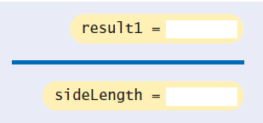
Parameter Passing
The parameter variable sideLength of the cubeVolume function is created when the function is called.

Slide 9

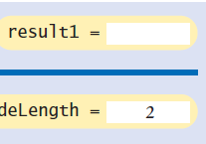
Parameter Passing
The parameter variable is initialized with the value of the argument that was passed in the call. In our case, sideLength is set to 2.

Slide 10
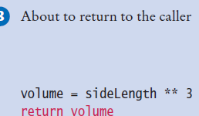
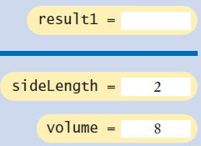
Parameter Passing
The function computes the expression sideLength ** 3, which has the value 8.
That value is stored in the variable volume.

Slide 11


Parameter Passing
The function returns. All of its variables are removed.
The return value is transferred to the caller, that is, the function calling the cubeVolume function.
The caller puts the return value in the result1 variable.

Slide 12
Parameter Passing: Student Activity
What does this program print? Use a diagram to find the answer.
def main():
a = 5
b = 7
print(mystery(a,b))
def mystery(x,y):
z = x + y
z = z / 2.0
return z
main()

Slide 13
Return Values
The return statement terminates a function call and yields the function result.
In the preceding examples, each return statement returned a variable.
However, the return statement can return the value of any expression.
Instead of saving the return value in a variable and returning the variable, it is often possible to eliminate the variable and return the value of a more complex expression:
def cubeVolume(sideLength):
return sideLength ** 3
When the return statement is processed, the function exits immediately

Slide 14
Return Values
Some programmers find this behavior convenient for handling exceptional cases at the beginning of the function:
def cubeVolume(sideLength):
if sidelength < 0:
return 0
# Handle the regular case.

Slide 15
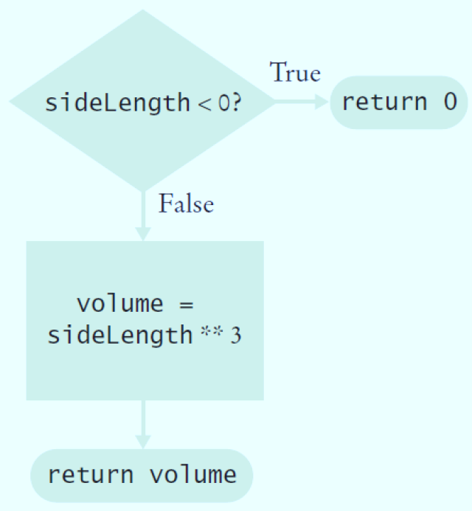
Return Values
def cubeVolume(sideLength):
if sidelength < 0:
return 0
# Handle the regular case.

Slide 16
Return Values
Some programmers dislike the use of multiple return statements in a function.
You can avoid multiple returns by storing the function result in a variable that you return in the last statement of the function.
For example:
def cubeVolume(sideLength):
if sideLength >= 0:
volume = sideLength ** 3
else:
volume = 0
return volume

Slide 17
Return Values: Student Activity
What does this function do?
def mystery(n):
if n % 2 == 0:
return True
else:
return False

Slide 18

Functions Without Return Values
Some functions may not return a value, but they can produce output.
Sometimes, you need to carry out a sequence of instructions that does not yield a value.
If that instruction sequence occurs multiple times, you will want to package it into a function.
Here is a typical example: Your task is to print a string in a box, like this:

Slide 19
Functions Without Return Values
Your task is to print a string in a box, like this:
## Prints a string in a box.
# @param contents the string to enclose in a box
def boxString(contents):
n = len(contents)
if n == 0:
return #Return immediately
print("-"*(n+2))
print("!"+contents+"!")
print("-"*(n+2))
def main():
boxString("Hello")
main()

Slide 20

Functions Without Return Values: Student Activity
## Prints a string in a box.
# @param contents the string to enclose in a box
def boxString(contents):
n = len(contents)
if n == 0:
return #Return immediately
print("-"*(n+2))
print("!"+contents+"!")
print("-"*(n+2))
def main():
boxString("Hello")
main()
What is wrong with the following statement?
print(boxString("Hello"))

Slide 21
Variable Scope
As your programs get larger and contain more variables, you may encounter problems where you cannot access a variable that is defined in a different part of your program, or where two variable definitions conflict with each other.
In order to resolve these problems, you need to be familiar with the concept of variable scope.
The scope of a variable is the part of the program in which you can access it.

Slide 22
Variable Scope
In the following code segment, the scope of the parameter variable sideLength is the entire cubeVolume function but not the main function.
def main() :
print(cubeVolume(10))
def cubeVolume(sideLength) :
return sideLength ** 3

Slide 23
Variable Scope
A variable that is defined within a function is called a local variable.
When a local variable is defined in a block, it becomes available from that point until the end of the function in which it is defined.

Slide 24
Variable Scope
For example, in the code segment below, the scope of the square variable is highlighted.
def main() :
sum = 0
for i in range(11) :
square = i * i
sum = sum + square
print(square,sum)
main()

Slide 25
Variable Scope
The scope of the sideLength variable is highlighted.
def main() :
sideLength = 10
result = cubeVolume()
print(result)
def cubeVolume() :
return sideLength **3
main()
NameError: name 'sideLength' is not defined

Slide 26
Variable Scope
def main() :
sideLength = 10
result = cubeVolume()
print(result)
def cubeVolume() :
return sideLength **3
main()
Note the scope of the variable sideLength.
The cubeVolume function attempts to read the variable, but it cannot;
The scope of sideLength does not extend outside the main function.

Slide 27
Variable Scope
It is possible to use the variable name more than once in a program.
def main() :
result = square(3) + square(4)
print(result)
def square(n) :
result = n * n
return result
main()
Each result variable is defined in a separate function, and their scope do not overlap.

Slide 28
Variable Scope
Any variable that is defined outside a function is a global variable.
A global variable is visible to all functions defined after it.
i.e., you can get the value of the variable.
However, any function that wishes to update a global variable must include a global declaration:

Slide 29
Variable Scope
Any function that wishes to update a global variable must include a global declaration:
balance = 1000 # A global varaible
def withdraw(amount) :
global balance # This function intends to
# update the global balance variable
if balance >= amount:
balance = balance - amount
withdraw(200)
print(balance)

Slide 30
Variable Scope
balance = 1000 # A global varaible
def withdraw(amount) :
if balance >= amount:
newBalance = balance - amount
print("New Balance =", newBalance)
withdraw(200)
print("Current value of balance =", balance)
If you omit the global declaration, then the balance variable inside the withdraw function is considered a local variable.

Slide 31
Variable Scope
Generally, global variables are not a good idea.
When multiple functions update global variables, the result can be difficult to predict.
Particularly in larger programs developed by multiple programmers, it is important that the effect of each function be clear and easy to understand.
You should avoid global variables in your programs.

Slide 32
Summary
A function is a named sequence of instructions.
Arguments are supplied when a function is called.
The return value is the result that the function computes.
When declaring a function, you provide a name for the function and a variable for each argument.
Function comments explain the purpose of the function, the meaning of the parameters and return values, as well as any special requirements.
Parameter variables hold the arguments supplied in the function call.

Slide 33
Summary
The return statement terminates a function call and yields the function result.
Complete computations that can be reused into functions.
Use the process of stepwise refinement to decompose complex tasks into simpler ones.
When you discover that you need a function, write a description of the parameter variables and return values.
A function may require simpler functions to carry out its work.

Slide 34
Summary
The scope of a variable is the part of the program in which the variable is visible.
Two local or parameter variables can have the same name, provided that their scope do not overlap.
You can use the same variable name within different functions since their scope does not overlap.
Local variable declared inside a function are not visible to code inside other functions.

