Slide 1
Becoming Familiar with Your Programming Environment
There are several ways of creating a computer program
Using an Integrated Development Environment (IDE)
Using a text editor
We will use the Jupyter Notebook (Details on installing it will be provided in the first lab)
Jupyter Notebook is an open-source web application that allows you to create and share documents that contain live code, equations, visualizations and narrative text.
Slides of this course have been developed using Jupyter.
A big advantage is that we use the same platform to present and run Python code.

Slide 2
Becoming Familiar with Your Programming Environment
Let us look at our first Python program
# My first Python program.
print("Hello, World!")
print("Hello")

Slide 3
How do Python programs run?
The compiler reads your source code (that is, the Python instructions that you wrote) all at once.
The compiler translates the instructions into byte code.
Byte codes are very simple instructions understood by the virtual machine (a separate program that is similar to the CPU of a computer).
Any necessary libraries are automatically located and included by the virtual machine.
For example, the implementation of the print function.
The virtual machine executes your byte code.

Slide 4
How do Python programs run?

Slide 5
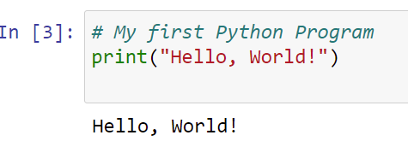
Analyzing Your First Program
# My first Python Program
print("Hello, World!")
The first line is a comment.
Comments start with a # and are not considered statements (ignored by the interpreter).
The second line displays a line of text, viz., Hello, World! using the print function.
A function is a collection of programming instructions that carry out a particular task.

Slide 6
Analyzing Your First Program
# My first Python Program
print("Hello, World!")
"Hello, World!" is called a string.
To use, or call, a function in Python, you need to specify:
The name of the function you want to use (in this case, print ).
Any values the function needs to carry out its task (in this case, "Hello, World!" ).
The technical term for such a value is an argument.
Arguments are enclosed in parentheses.
Multiple arguments are separated by commas.
The number of arguments required depends on the function.

Slide 7
Analyzing Your First Program: Syntax of the print statement

Slide 8
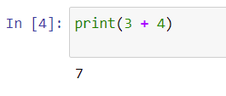
More Examples of the Print Statement
Printing numerical values
print(3 + 4)

Slide 9

More Examples of the Print Statement
Passing multiple values to the function
Note that each value passed to the function is displayed, one after another, with a blank space after each value.
print("The answers of adding", "and multiplying are", 6 + 7, 6 * 7, ", respectively")

Slide 10
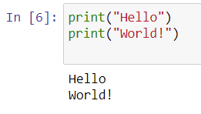
More Examples of the Print Statement
By default, the print function starts a new line after its arguments are printed
print("Hello")
print("World!")

Slide 11
Our Second Program (printtest.py)
##
# Sample program that demonstrates the print function.
#
# Prints 7.
print(3 + 4)
# Prints "Hello World!" in two lines.
print("Hello")
print("World!")
# Prints multiple values with a single print function call.
print("My favorite numbers are", 3 + 4, "and", 3 + 10)
# Prints three lines of text with a blank line.
print("Goodbye")
print(1/0)
print("Hope to see you again")

Slide 12
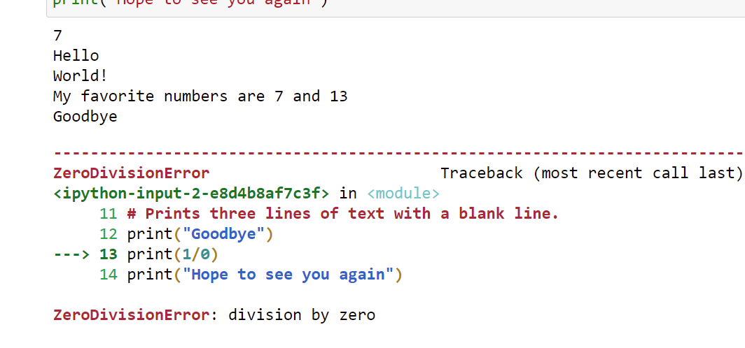
Our Second Program (printtest.py)

Slide 13
Errors
There are two Categories of Errors:
Compile-time Errors (Syntax Errors)
Run-time Errors (Logical Errors)

Slide 14
Compile-time Errors
Spelling, capitalization, punctuation
Ordering of statements, matching of parenthesis, quotes, ...etc.
No executable program is created by the compiler
Correct first error listed, then compile again.
Repeat until all errors are fixed
## Uncomment each statement to check.
#print("Hello, World!)
#Print("Hello, World!")
#print("Hello World!')
#print('Hello'

Slide 15
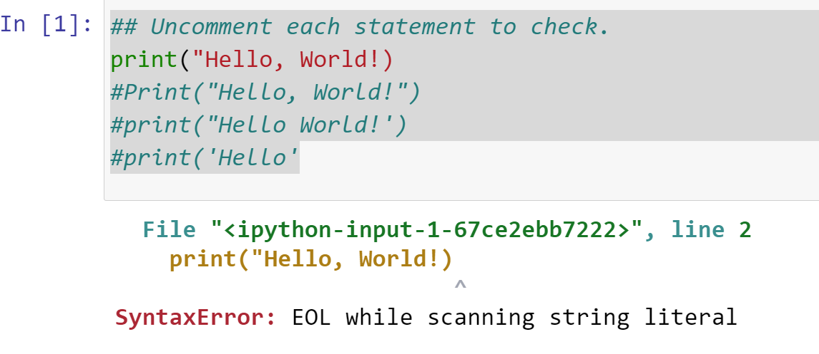
Compile-time Errors

Slide 16
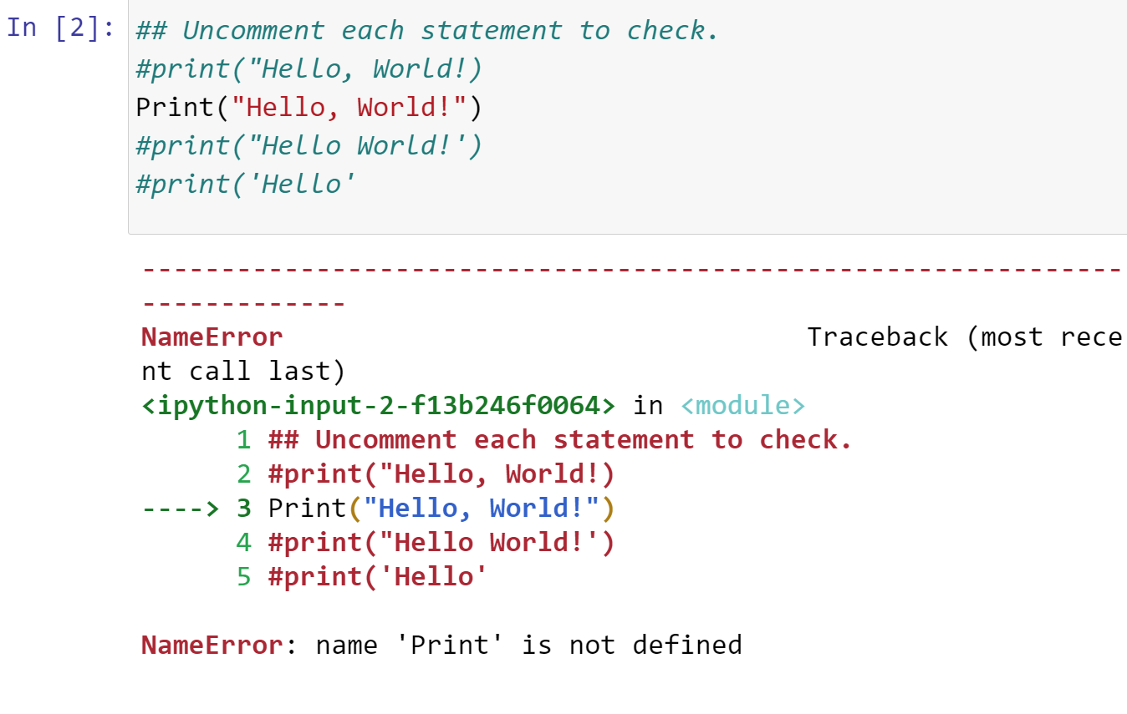
Compile-time Errors

Slide 17
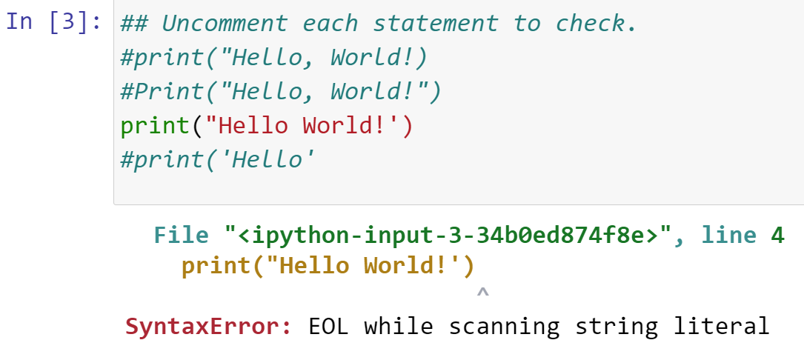
Compile-time Errors

Slide 18
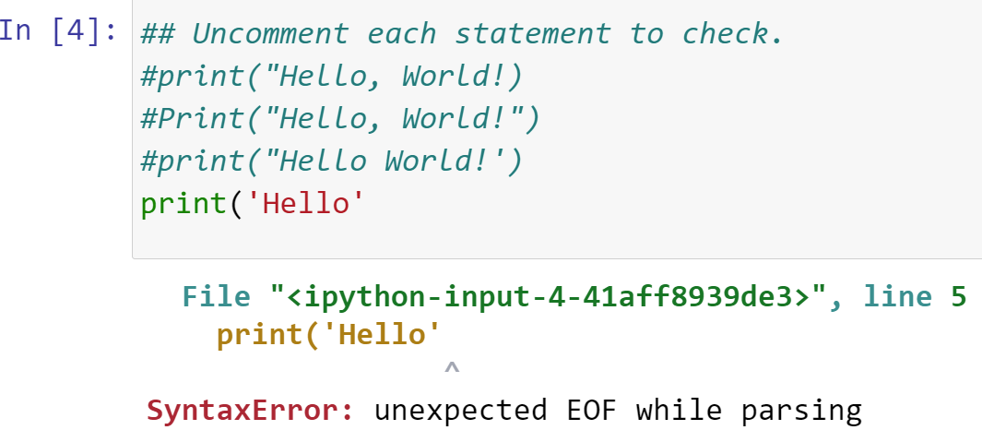
Compile-time Errors

Slide 19
Run-time Errors
The program runs, but produces unintended results
The program may crash
Note that run-time errors are more troublesome. They are the harder to find and fix because the interpreter cannot flag them for us.
## Uncomment each statement to check.
#print("Hello, Word!")
#print(1/0)

Slide 20
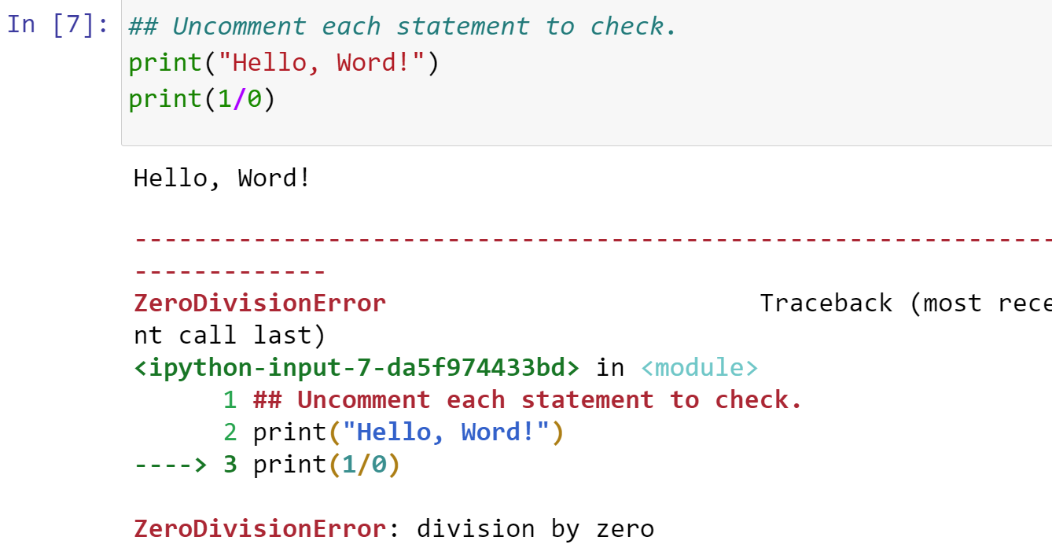
Run-time Errors

Slide 21
Problem Solving (Algorithm Design)
Self Reading
The topic will be discussed in Lab 2.

Slide 22
Summary
Computer Basics
Computers rapidly execute very simple instructions
A Program is a sequence of instructions and decisions
Programming is the art (and science) of designing, implementing, and testing computer programs
The Central Processing Unit (CPU) performs program control and data processing
Storage devices include memory and secondary storage (e.g., a USB Flash Drive)
Python
Python was designed in a way that makes it easier to learn than other programming languages such as Java, C and C++.
The designers goal was to give Python simpler and cleaner syntax.
Set aside some time to become familiar with the programming environment that you will use for your class work.
It is important to practice with the tool so you can focus on learning Python
An editor is a program for entering and modifying text, such as a Python program.
Python is case sensitive.
You must be careful about distinguishing between upper and lowercase letters.
The Python compiler translates source code into byte code instructions that are executed by the virtual machine.
A function is called by specifying the function’s name and its parameters.
A string is a sequence of characters enclosed in quotation marks.
Errors
A compile-time error is a violation of the programming language rules that is detected by the compiler.
A run-time error causes a program to take an action that the programmer did not intend.

