Slide 1
ICS 104 - Introduction to Programming in Python and C
Programming with Numbers and Strings

Slide 2
Programming with Numbers and Strings
Reading Assignment
Chapter 2 Sections 1, 2, 4 and 5.
Chapter Learning Outcomes
At the end of this chapter, you will be able to
define and use variables and constants
write arithmetic expressions and assignment statements
understand the properties and limitations of integers and floating-point numbers
appreciate the importance of comments and good code layout
create programs that read and process inputs, and display the results
learn how to use Python strings

Slide 3
Variables
Why do we need variables?
To carry out computation, we need to store values in order to use them later on.
These values are stored in variables.
Let us try to comprehend the use of variables by solving the following problem:
Soft Drinks:
Which is more Economic? cans or bottles?

Slide 4
Soft Drinks
Which is more Economic?
Soft drinks are sold in cans and bottles.
A store offers a six-pack of 12-ounce cans for the same price as a two-liter bottle.
Find the volume (in liters) of a six-pack of soda cans and the total volume of a six-pack and a two-liter bottle.
Note that 12 fluid ounces equal approximately 0.355 liters.

Slide 5
Defining Variables
A variable is a storage location in a computer program.
Each variable has a name and holds a value.
Just as a parking space has an identifier J053 and contents car

Slide 6
Assignment Statements
An assignment statement is used to place a value into a variable
In [ ]: cansPerPack = 6
How does the assignment statement work?
The right-hand side of the = sign is first evaluated (to the value 6).
The value is assigned to the variable on the left-hand side of the = sign (to the variable cansPerPack).
Once a variable is defined, it can be used in other statements

Slide 7
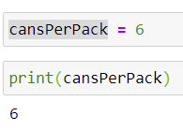
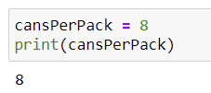
Assignment Statements
An assignment statement is used to place a value into a variable
In [ ]: cansPerPack = 6
How does the assignment statement work?
The right-hand side of the = sign is first evaluated (to the value 6).
The value is assigned to the variable on the left-hand side of the = sign (to the variable cansPerPack).
Once a variable is defined, it can be used in other statements
In [ ]: print(cansPerPack)
If an existing variable is assigned a new value, that value replaces the previous contents of the variable.
In [ ]: cansPerPack = 8
In [ ]: print(cansPerPack)

Slide 8
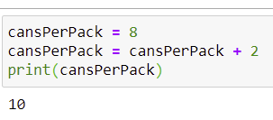
Assignment Statements
Assignment is not Equality in Algebra
Is the statement
cansPerPack = cansPerPack + 2
correct in Algebra? How about in Python?
cansPerPack = 8
cansPerPack = cansPerPack + 2
print(cansPerPack)
So, how does the assignment
cansPerPack = cansPerPack + 2 execute in python?

Slide 9
cansPerPack = cansPerPack + 2
First, the right-hand side is executed
This is done by fetching the current value of the variable cansPerPack
Then, carrying out the addition
Second, the value of the addition is stored in the variable cansPerPack

Slide 10
Number Types
Values and Types
2, "Hello World" and 8.4 are values
Each value belongs to a data type
2 is an integer int
"Hello World" is a string str
8.4 is a float-point float
2 and 8.4 are called number literals.

Slide 11
Why Data Types?
A data type of a value determines
how the data type is represented in the computer, and
what operations can be performed on that data.

Slide 12
Two Categories of Data Types in Python
Primitive data type
A data type provided by the language itself (e.g., int)
User-defined data type
A data type defined by the programmer (covered in Chapter 9: Objects and Classes)

Slide 13
Number literals in Python

Slide 14
Data Types in Python
The value determines the type of the variable.
For example, the following piece of code is correct, but not recommended
This is not a good idea, as it may lead to an error if you use the wrong operation on the variable
taxRate = 5
print(taxRate)
taxRate = 5.5
print(taxRate)
taxRate = "five point five"
print(taxRate)

Slide 15
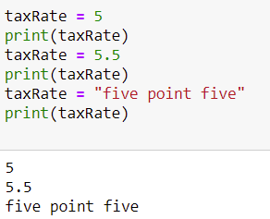
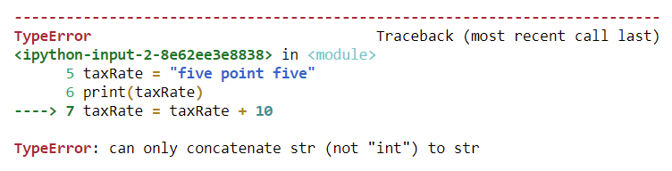
Data Types in Python
This is not a good idea, as it may lead to an error if you use the wrong operation on the variable
taxRate = taxRate + 10
Once a variable is initialized with a value of a type, keep storing values of the same type.

