Slide 1
Rules for Variable Names
Names must start with a letter or the underscore (_) character.
The remaining characters (if any) must be letters, digits or underscores.
Symbols such as ? or % cannot be used in a variable name.
Spaces cannot exist within a variable name.
Names are case sensitive.
Reserved words by python cannot be used as variable names. (e.g., if and class )

Slide 2
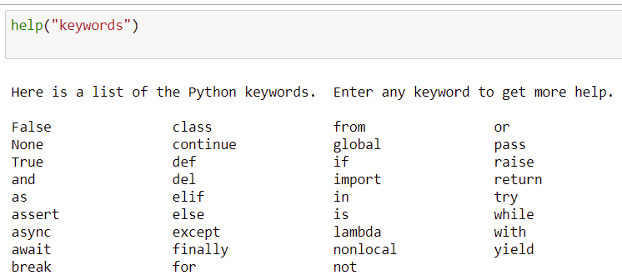
Rules for Variable Names – Reserved words

Slide 3
Rules for Variable Names
Which of the following names are proper variable names?
canVolume1 , x , CanVolume , 6pack , can volume , class, ltr/fl.oz
canVolume1 is proper
x is proper
CanVolume is proper
6pack is not proper (start with a digit)
can volume is not proper (has a blank)
class is not proper (reserved word)
ltr/fl.oz is not proper (has a symbol)

Slide 4
Recommended Variable Name Conventions
These are not strict rules for variable names but are rules of good taste that you should respect when writing code.
Use a descriptive name, such as cansPerPack than a terse name, such as cpp
If the variable name consists of more than one word, start the word with a capital letter, as shown above.
A variable starts with a small letter
A constant consists of all capital letters, where words are separated by the underscore _ character, such as CAN_VOLUME
A user defined data type starts with a capital letter (as we will see later), such as GraphicsWindow.

Slide 5
Recommended Variable Name Conventions

Slide 6
Constants
A constant variable, or simply a constant, is a variable whose value should not be changed after it has been assigned an initial value.
Some languages provide an explicit mechanism of declaring constants.
Hence, any attempt to change it after it has been assigned generates a syntax error.
Python leaves it to the programmer to make sure that constants are not changed.
The use of all capital letters for naming constants tells you and other programmers that you should not change the value of this variable once it is assigned.

Slide 7
Constants
Constants can make your code much more understandable.
For example, compare the following two statements:
totalVolume = bottles * 2
totalVolume = bottles * BOTTLE_VOLUME
Note that in the case where the bottle volume is changed from 2 to 2.5, then
in the first case, you need to change every line of code that has volume 2 to 2.5.
in the second case, all you need to do is change the value of the constant BOTTLE_VOLUME to 2.5 in one line ONLY. Every other occurrence of BOTTLE_VOLUME in the code will automatically have the new volume value.

Slide 8
Comments
As your programs get more complex, you should add comments, explanations for human readers of your code.
CAN_VOLUME = 0.355 # Liters in a 12-ounce can
This comment explains the significance of the value 0.355 to a human reader.
Python's interpreter does not execute comments at all.
It ignores everything from a # delimiter to the end of the line.

Slide 9
Why Write Comments?
Helps programmers who read your code understand your intent.
Helps you when you review your code (after some time).

Slide 10
How to Write Comments?
Provide a comment at the top of your source file that explains the purpose of the program.
The textbook follows the following style:
##
# This program computes the volume (in liters) of # a six-pack of soda cans.
#
OR
##
# This program computes the volume (in liters) of # a six-pack of soda cans.
#

Slide 11
Soft Drinks: Which is more Economic?
Soft drinks are sold in cans and bottles.
A store offers a six-pack of 12-ounce cans for the same price as a two-liter bottle.
Which one should you buy?

Slide 12
Solution Steps
Compute the totalVolume you get when you buy a six-pack
Define CAN_VOLUME and the number of cansPerPack
totalVolume = cansPerPack * CAN_VOLUME
print the totalVolume
Now you can compare the totalVolume to the value 2.0 and determine which one to buy

Slide 13
##
# This program computes the volume (in liters) of a six-pack of soda
# cans and the total volume of a six-pack and a two-liter bottle.
#
# Liters in a 12-ounce can and a two-liter bottle.
CAN_VOLUME = 0.355
BOTTLE_VOLUME = 2
# Number of cans per pack.
cansPerPack = 6
# Calculate total volume in the cans.
totalVolume = cansPerPack * CAN_VOLUME
print("A six-pack of 12-ounce cans contains", totalVolume, "liters.")
# Calculate total volume in the cans and a two-liter bottle.
totalVolume = totalVolume + BOTTLE_VOLUME
print("A six-pack and a two-liter bottle contain", totalVolume, "liters.")

Slide 14
Final Tips on Variables
Do not use undefined variables (or not yet defined)
canVolume = 12 * literPerOunce # Error
literPerOunce = 0.0296
Choose descriptive variable names
canVolume is better than cv
Do not use magic numbers
totalVolume = cansPerPack * 0.355

Slide 15

2.2 Arithmetic
Basic Arithmetic Operations
Python supports addition + , subtraction - , multiplication * and division /
The symbols + - * / are called operators
The combination of variables, literals, operators, and parentheses is called an arithmetic expression
For example, the mathematical formula
$\frac{a+b}{2}$ is written in python as (a + b) / 2

Slide 16
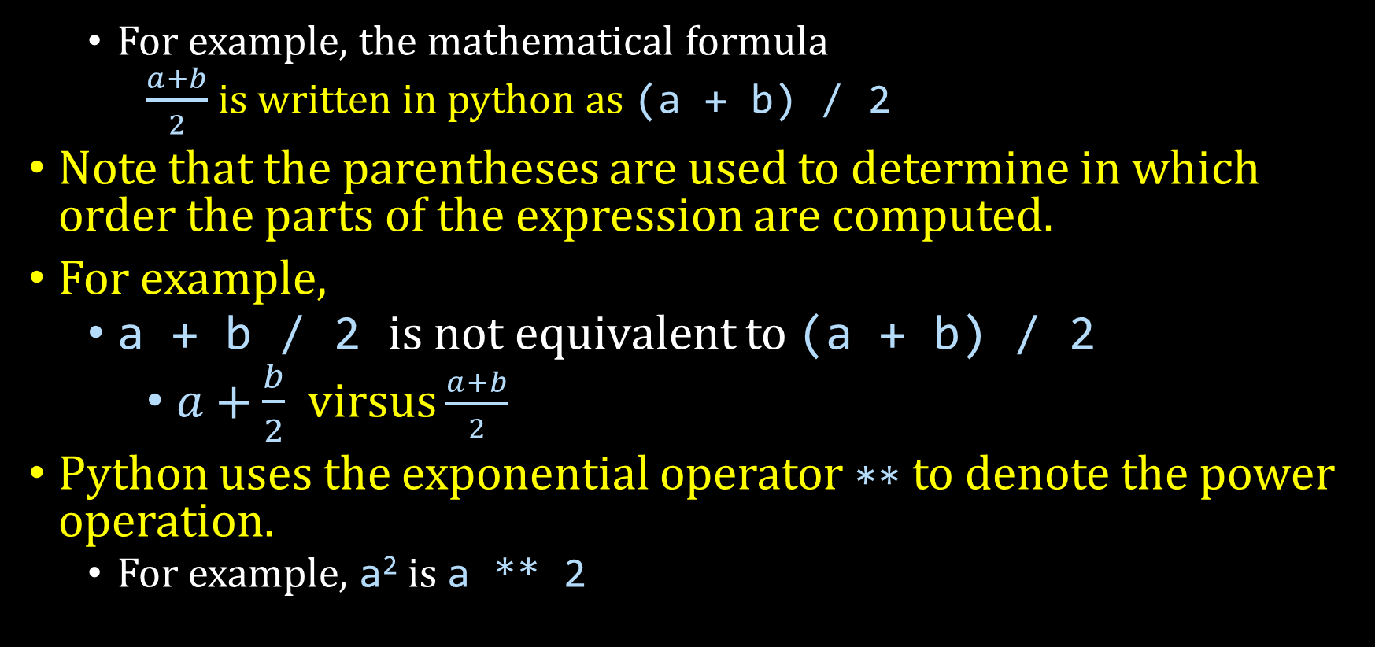
Basic Arithmetic Operations
For example, the mathematical formula
$\frac{a+b}{2}$ is written in python as (a + b) / 2
Note that the parentheses are used to determine in which order the parts of the expression are computed.
For example,
a + b / 2 is not equivalent to (a + b) / 2
$a+\frac{b}{2}$ virsus $\frac{a+b}{2}$
Python uses the exponential operator ∗∗ to denote the power operation.
For example, a² is a ** 2

Slide 17
Precedence of Arithmetic Operators
Python uses the precedence rules for algebraic notation
Precedence | Operator(s) | Description
1 | () | Parentheses
2 | ∗∗ | Power
3 | ∗ , / | Multiplication and Division
4 | +, − | Addition and Subtraction

Slide 18
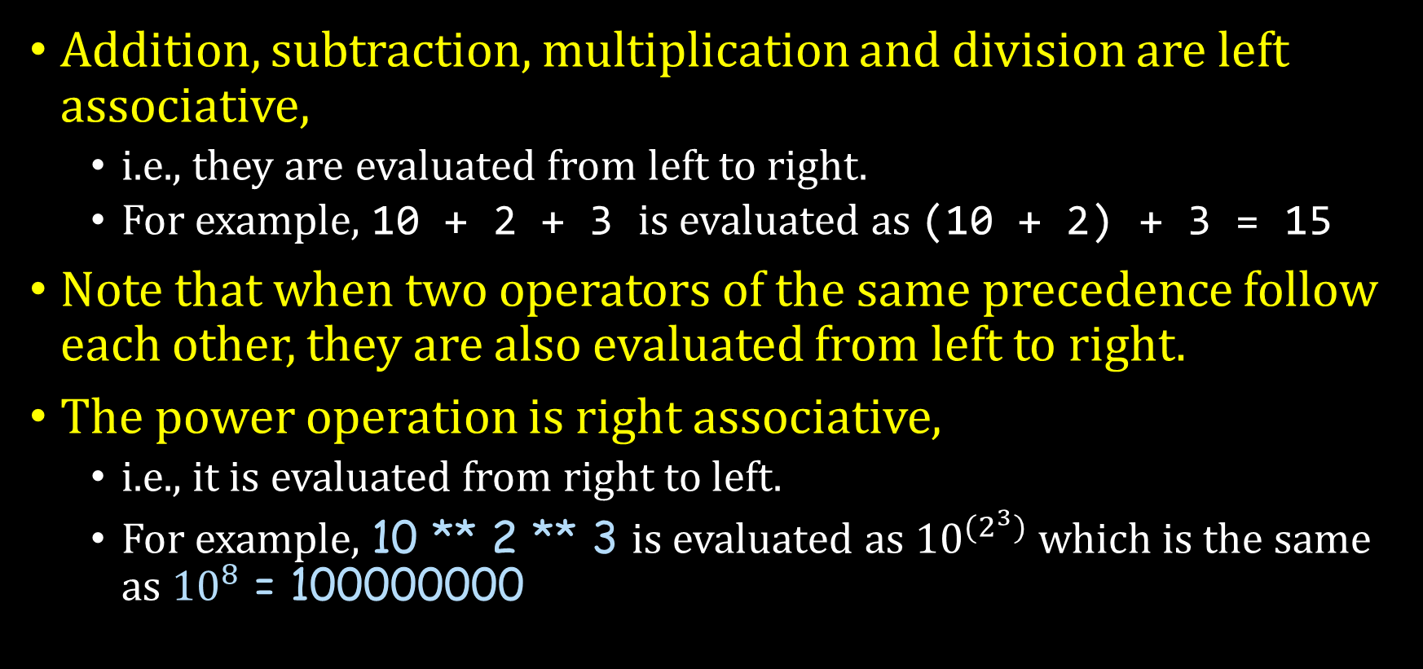
Order of Evaluation of Arithmetic Operators
Addition, subtraction, multiplication and division are left associative,
i.e., they are evaluated from left to right.
For example, 10 + 2 + 3 is evaluated as (10 + 2) + 3 = 15
Note that when two operators of the same precedence follow each other, they are also evaluated from left to right.
The power operation is right associative,
i.e., it is evaluated from right to left.
For example, 10 ** 2 ** 3 is evaluated as ${10}^{{(2}^{3})}$ which is the same as ${10}^{8}$ = 100000000

Slide 19

Example
The mathematical expression
b * (1 + r / 100) ** n is evaluated as follows
The expression between the parentheses is first considered,
(1 + r / 100)
Since division is higher than addition, division is evaluated: $\frac{r}{100}$
Addition is evaluated and hence we get the expression: $1+\frac{r}{100}$
Since we have multiplication and exponentiation, we carry out the exponentiation and the result becomes ${(1+\frac{r}{100})}^{n}$
(Finally, we carry out the multiplication to get the Mathematical Expression: ${b×(1+\frac{r}{100})}^{n}$

