Slide 1
Floor Division and Remainder
Division of two integers results in a floating-point value
7 / 4 yields 1.75
The floor division operator // when applied on positive integers computes the quotient and discards the fractional part.
7 // 4 yields 1
The modulus operator % can be used to get the remainder of the floor division.
7 % 4 yields 3, the remainder of the floor division of 7 by 4.
Some also call it modulo or mod

Slide 2
Floor Division and Remainder

Slide 3
Calling Functions
We have been using the print function to display information, but there are many other functions available in Python.
Most functions return a value.
i.e., when the function completes its task, it passes a value back to the point where the function was called.
For example, the call abs(-123) returns the value 123.
The value returned by a function can be stored in a variable.
distance = abs(x)
Note that x is called the argument of the abs function.
It can also be used anywhere that a value of the same type can be used
print("The distance from the origin is ", abs(x))

Slide 4
Arguments of a Function
When calling a function, you must provide the correct number of arguments.
abs(-10, 2) or abs() will generate an error.
Hence, the abs function requires exactly one argument.
abs(-10)
Some functions have optional arguments that you only provide in certain situations
Consider the round function: round(r) or round(r, d)
With one argument r, it returns the nearest integer to r.
For example, round(7.624) returns 8
With two arguments r and d, it returns the nearest floating-point number to r with d decimal digits.
For example, round(7.624, 2) returns 7.62

Slide 5
Note regarding the round function
In many other languages and calculators, round(2.5) returns 3. Not in Python.
Python uses a different way of computing the round function when it comes to 5, which is called round half to even.
This means that if we are to round x.5, we round to the closest even integer (whether it is x or x + 1).
For example, round(24.5) will round down to 24 [even], whereas round(25.5) will round up to 26.

Slide 6
The round function
print(round(7.624))
print(round(2.5))
print(round(2.501))
print(round(3.5))
print(round(7.624,2))
print(round(7.625,2))
print(round(7.645,2))
print(round(7.655,2))
8
2
3
4
7.62
7.62
7.64
7.66

Slide 7
Functions arguments
Some functions take an arbitrary number of arguments
For example, the max and min functions.
min(7.25, 10.95, 5.95, 6.05, 8)
returns the minimum of the function's arguments; in this case the number 5.95

Slide 8
Calling Functions

Slide 9
Libraries
A library is a collection of code that has been written and translated by someone else, ready for you to use in your program.
A standard library is a library that is considered part of the language and must be included with any Python system.
Python’s standard library is organized into modules.
Related functions and data types are grouped into the same module.

Slide 10
Mathematical Functions
Python’s math module includes a number of mathematical functions.
You must import it before you can use any of its functions
Note that you can use the print function without the use of import, since it is one of the built-in functions (part of the Python language and can be used directly in your programs).
To import more than one function from math, use
from math import *
from math import sqrt
y = sqrt(25)
print("y = ", y)
y = 5.0

Slide 11
Mathematical Functions

Slide 12
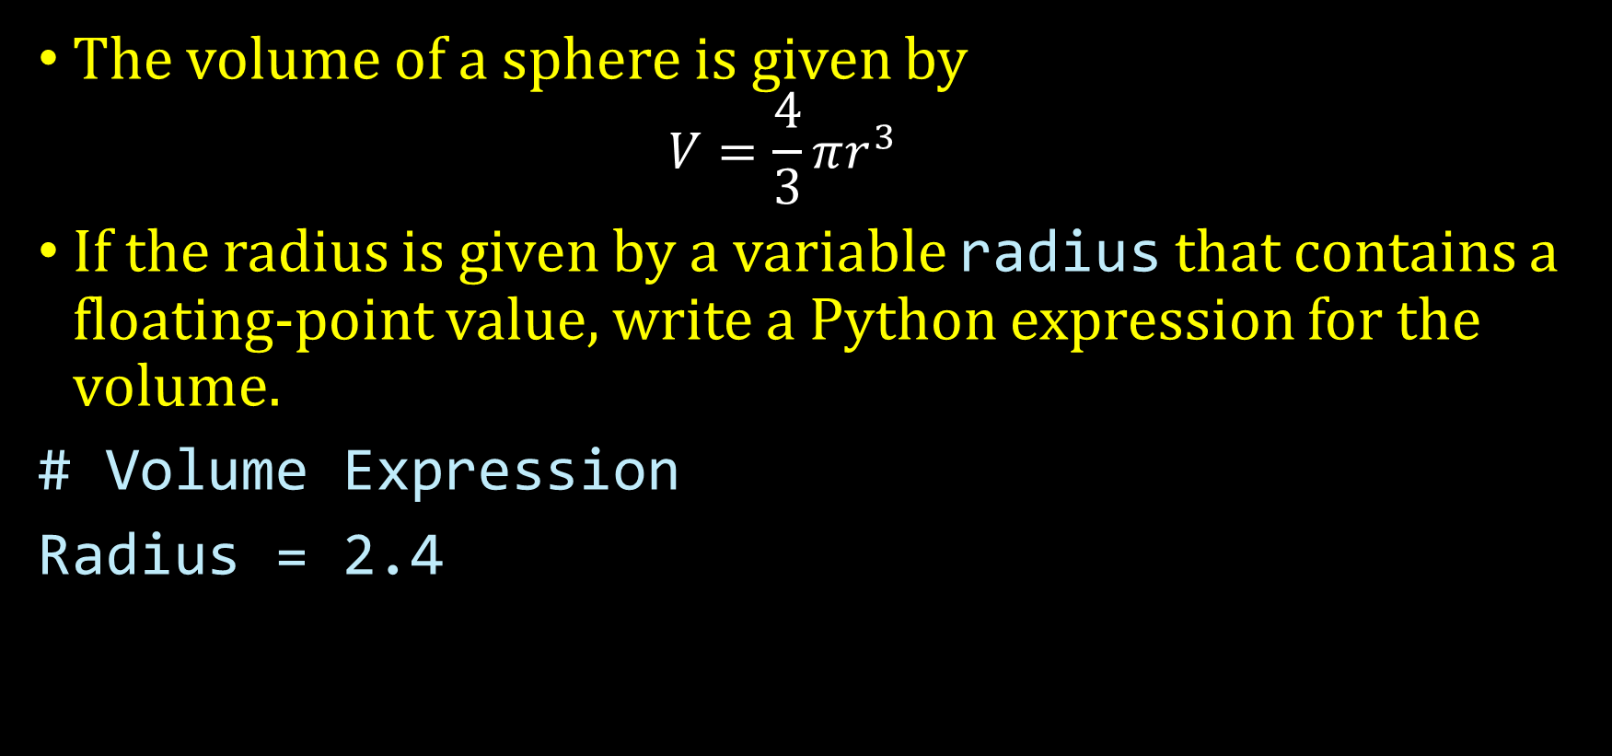
Student Activity
The volume of a sphere is given by
$$V=\frac{4}{3}πr^{3}$$
If the radius is given by a variable radius that contains a floating-point value, write a Python expression for the volume.
# Volume Expression
Radius = 2.4

Slide 13
2.4 Strings
A string is a sequence of characters
Characters include letters, numbers/digits, punctuation, spaces, special symbols and so on.
A string literal denotes a particular string (e.g. "Hello")
Just as a number literal (e.g. 34 ) denotes a particular number.
String literals are specified by enclosing a sequence of characters within a matching pair of either single or double quotes.
print("This is a string. ", 'So is this.')
How can I form the strings I'm a student or He said: "You did it!" ?
print("I'm a student", 'He said: "You did it!"')

Slide 14
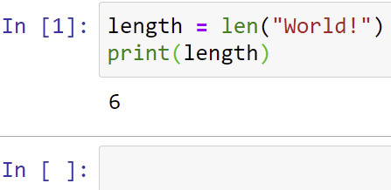
Strings
The number of characters in a string is called the length of the string.
For example, "Harry" is of length _____ and "World" is of length ______
An empty string is a string with no characters. It is of length zero and is written as "" or ''
Python's len function returns the length of the argument string.
length = len("World!")
print(length)
5
5

Slide 15
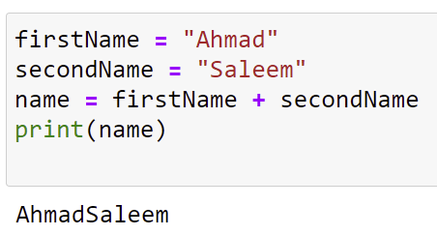
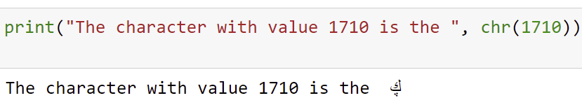
String Concatenation
Given two strings such as Ahmad and Saleem, you can concatenate them to one long string.
firstName = "Ahmad"
secondName = "Saleem"
name = firstName + secondName
print(name)
Note that if one of the operands of the + operator is a string, then all of them should be strings, otherwise a syntax error will occur.
print("The character with value 1710 is the ", chr(1710))

Slide 16
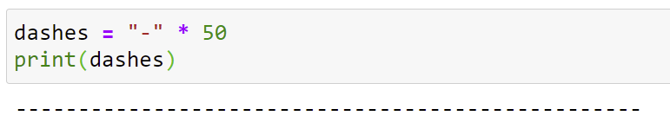
String Repetition
Given a string such as - , you can repeat it n times, where n is an integer using the string repetition operator *
dashes = "-" * 50
print(dashes)

