Slide 1
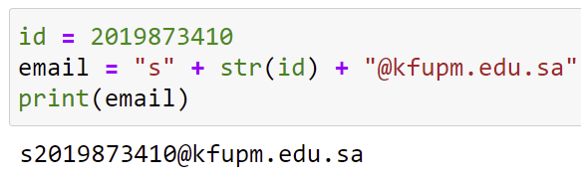
Converting between Numbers and Strings
Since you cannot concatenate a string and integer, Python provides the str function to convert an integer to a string.
id = 2019873410
email = "s" + str(id) + "@kfupm.edu.sa"
print(email)

Slide 2
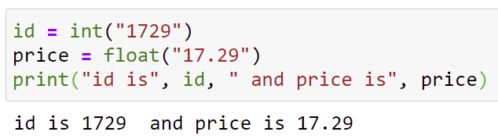
Converting between Numbers and Strings
Conversely, you can turn a string representing a number into its corresponding numerical value using the int and float functions.
id = int("1729")
price = float("17.29")
print("id is", id, " and price is", price)

Slide 3
Strings and Characters
Strings are sequences of Unicode characters.
Individual characters of a string can be accessed based on their position in the string
The position is called the index of the character.
The index starts from position 0, followed by 1 for the second character, ... and so on.
name = "Harry"

Slide 4
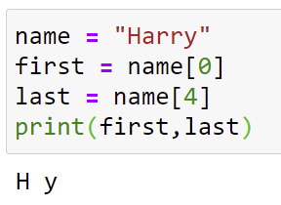
Strings and Characters
name = "Harry"
first = name[0]
last = name[4]
print(first, last)
The index value must be within the valid range of character positions
0 .. len(name)-1
otherwise, an "index out of range" exception will be generated at run time.

Slide 5
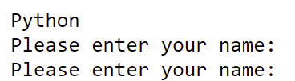
Student Activity
What are the results of the following statements
string = "Py"
string = string + "thon"
print(string)
print ("Please" + " enter your name: ")
print("Please" +
" enter your name: ")

Slide 6
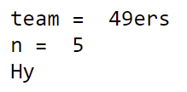
Student Activity
What is the result of the following statements
team = str(49) + "ers"
print("team = ", team)
greeting = "H & S"
n = len(greeting)
print("n = ", n)
string = "Harry"
n = len(string)
mystery = string[0] + string[n - 1]
print(mystery)

Slide 7

2.5 Input and Output
Asking the user to provide input values makes programs more flexible.
As opposed to having fixed values.
For example, You will have to change the values of first and second in the program below every time you would like to use different values.
##
# This program prints a pair of initials.
#
# Set the names of the couple.
first = "Rodolfo"
second = "Sally"
# Compute and display the initials.
initials = first[0] + "&" + second[0]
print(initials)

Slide 8
Input and Output
When a program asks for user input, it should first print a message (called a prompt) that tells the user which input is expected.
In Python, displaying a prompt and reading the keyboard input is combined in one operation.
##
# This program obtains two names from the user and prints # a pair of initials.
#
# Obtain the two names from the user.
first = input("Enter your first name: ")
second = input("Enter your significant other's first name: ")
# Compute and display the initials.
initials = first[0] + "&" + second[0]
print(initials)

Slide 9
Input and Output
first = input("Enter your first name: ")
second = input("Enter your significant other's first name: ")
# Compute and display the initials.
initials = first[0] + "&" + second[0]
print(initials)
Husni
Enter your first name:
Muhtaseb
Enter your significant other's first name:
H&M
Note that the output of the input function is always a string.

Slide 10
Reading Numerical Input
What if we need to read a numerical input?
Use the string conversion functions int and float on the output string
userInput = input("Please enter the number of bottles: ")
numberOfBottles = int(userInput)
bottleVolume = float(input("Enter the volume of each bottle: "))
# preferred style
print("The number of bottles = ", numberOfBottles,
" and the bottle volume = ", bottleVolume)
Please enter the number of bottles: 12
Enter the volume of each bottle: .3
The number of bottles = 12 and the bottle volume = 0.3

Slide 11
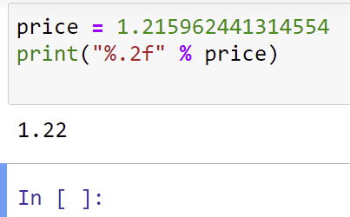
Formatted Output
Formatting Floating Point Values
When you print the result of a computation, you often want to control its appearance.
Instead of Would Like to Print
Price per liter: 1.215962441314554 Price per liter: 1.22
We can do that through the string format operator %
The following command displays the price with two digits after the decimal point:
price = 1.215962441314554
print("%.2f" % price)

Slide 12
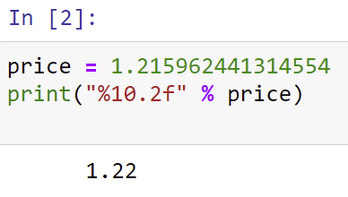

Formatting Floating Point Values
You can also specify a field width (the total number of characters, including spaces)
price = 1.215962441314554
print("%10.2f" % price)
%10.2f is called a format specifier.
See what happens when you play with the values of the format specifier.

Slide 13
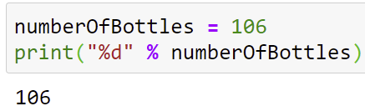
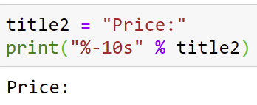
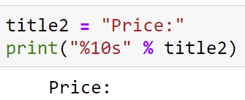
Formatting Integer and String Values
Use %d for integer values
numberOfBottles = 106
print("%d" % numberOfBottles)
Use %s for string values
title2 = "Price:"
print("%-10s" % title2)

Slide 14
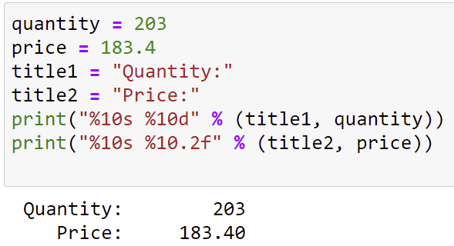
Multiple Format Specifiers
One can have more than one format specifier in the format string
In this case, the variables to the right of the string format operator % need to be included between parentheses and separated by commas.
quantity = 203
price = 183.4
title1 = "Quantity:"
title2 = "Price:"
print("%10s %10d" % (title1, quantity))
print("%10s %10.2f" % (title2, price))

Slide 15
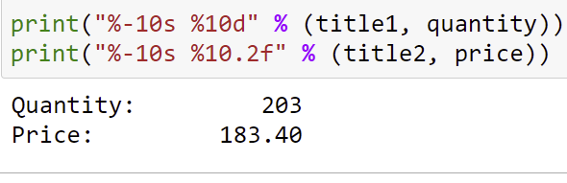
Multiple Format Specifiers
Try different values and see what happens to the output
# Strings are left aligned, numbers are right aligned
print("%-10s %10d" % (title1, quantity))
print("%-10s %10.2f" % (title2, price))

Slide 16
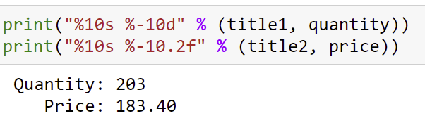
Multiple Format Specifiers
Try different values and see what happens to the output
# Strings are right aligned, numbers are left aligned
print("%10s %-10d" % (title1, quantity))
print("%10s %-10.2f" % (title2, price))

Slide 17
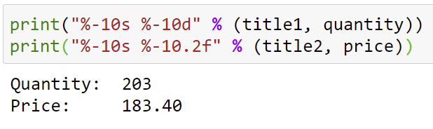
Multiple Format Specifiers
Try different values and see what happens to the output
# Strings and numbers are left aligned
print("%-10s %-10d" % (title1, quantity))
print("%-10s %-10.2f" % (title2, price))

Slide 18
Multiple Format Specifiers

Slide 19
String Format Operator

Slide 20

String Format Operator
The following statement
quantity = 24
total = 17.29
print("Quantity: %d Total: %10.2f"
% (quantity, total))
produces

Slide 21
Student Activity
What is problematic about the following statement sequence?
userInput = input("Please enter the number of cans")
cans = int(userInput)

Slide 22
Student Activity
# To Print Bottles and Cans
bottles = 8
cans = 24
## Insert your solution here

Slide 23
Student Activity
# To Print Bottles and Cans
bottles = 8
cans = 24
## Insert your solution here
print("Bottles: %8d" % bottles)
print("Cans: %8d" % cans)
print("Bottles: %8d" % bottles)
print("Cans: %11d" % cans)
print("%-8s %8d" % ("Bottles:", bottles))
print("%-8s %8d" % ("Cans:", cans))

