Slide 1
Module 01: Introduction To Programming
Chapter 1

Slide 2
Declaration
Please note that information in this lecture is mainly taken from:
Liang, Y. Daniel - Introduction to Java programming and data structures, comprehensive version (2019, Pearson).

Slide 3
Objectives
To understand programming basics(§§1.2–1.4).
To describe the relationship between Java and the World Wide Web (§1.5).
To understand Characteristics of Java (§1.6).
To explain the basic syntax of a Java program (§1.7).
To create, compile, and run Java programs (§1.8)
To use sound Java programming style. (§1.9).
To understand the differences between syntax errors, runtime errors, and logic errors (§1.10).

Slide 4
What is programming?
Computer Algorithm:
A finite, ordered, un-ambiguous, sequence of steps that solves a computer-solvable problem in a finite amount of time.
Computer program:
A sequence of instructions written to perform a specified task with a computer.
A computer algorithm translated into a program using a particular programming language.
Programming:
The translation of a computer algorithm into a program.
The act of designing and implementing computer programs is called programming.
Input: num1, num2
sum = num1 + num2
output: “Sum = ” , sum
Stop
Notes:
Computer programs, known as software, are instructions to the computer.
You tell a computer what to do through programs. Without programs, a computer is an empty machine. Computers do not understand human languages, so you

Slide 5
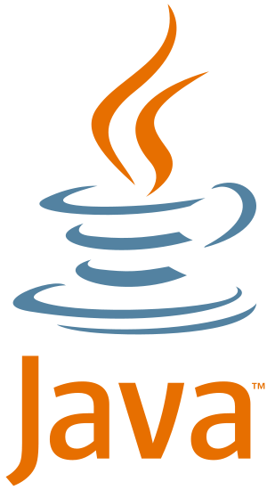
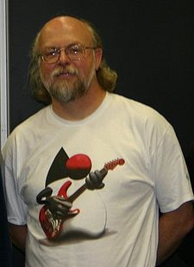
About Java
Java is an object-oriented programming language originally developed by James Gosling at Sun Microsystems.
It was first released in 1995.
The language derives much of its syntax from C and C++.
Has a simpler object model and fewer low-level facilities than C and C++.

Slide 6
Characteristics of Java?(1/9)
Java is a general purpose/Internet programming language.
Java can be used to develop applications for:
Web:
Run on browsers and contact with servers to perform tasks.
Desktop computers:
Run on a desktop, and don’t need web access to function.
Hand-held devices.
Run on mobile devices and built for a specific platform, such as iOS for the Apple iPhone or Android for a Samsung devices.
Notes:
Java can be used to develop web applications which run on browsers and contact with servers to perform tasks. They are not native to a particular system, and don’t need to be downloaded or installed.
Run on a desktop, and don’t need web access to function.
Run on mobile devices and built for a specific platform, such as iOS for the Apple iPhone or Android for a Samsung devices.
Java syntax is based on C++ (so easier for programmers to learn it after C++).
Java has removed many complicated and rarely-used features, for example, explicit pointers, operator overloading, etc.
There is no need to remove unreferenced objects because there is an Automatic Garbage Collection in Java.

Slide 7
Characteristics of Java?(2/9)
Java Is Simple:
Look familiar to a majority of programmers, based on C++.
Has Removed many complicated and rarely features such as:
Explicit pointers, preprocessors and header files and multiple inheritance.
Provides garbage collation to destroy the useless object which frees memory.
Provides libraries of tested objects that provide functionality ranging from basic data types through I/O and network interfaces to graphical user interface toolkits.
Notes:
Java syntax is based on C++ (so easier for programmers to learn it after C++).
Java has removed many complicated and rarely-used features, for example, explicit pointers, operator overloading, etc.
There is no need to remove unreferenced objects because there is an Automatic Garbage Collection in Java.

Slide 8
Characteristics of Java?(3/9)
Java Is Object-Oriented:
Everything in Java is an object. (All methods and data live within objects and classes.)
Organizes software as a combination of different types of objects that incorporates both data and behavior.
Supports major Object-Oriented programming features like Encapsulation, Abstraction, Inheritance and Polymorphism.
https://www.oracle.com/java/technologies/object-oriented.html

Slide 9
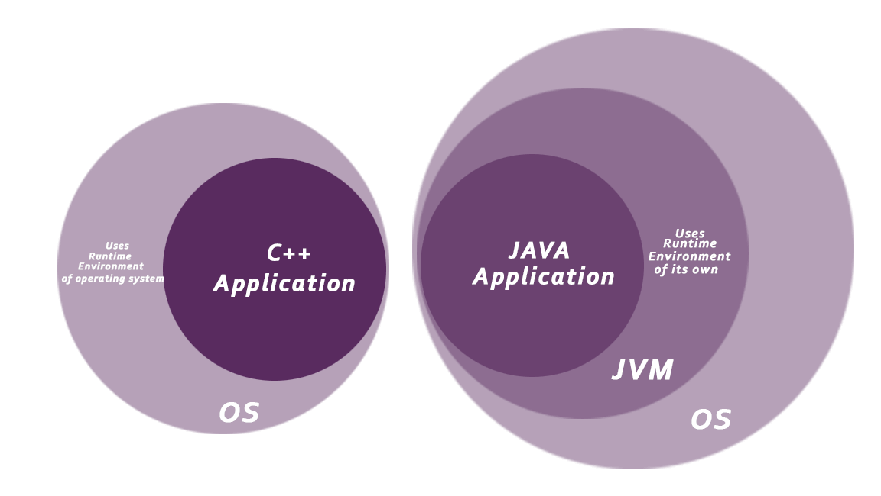
Characteristics of Java?(4/9)
Java Is Secure
No explicit pointer: we can not gain access to a particular variable.
Java Programs run inside a virtual machine sandbox.
Underlying system is not affected.
Bytecode Verification
Ensure that only legitimate bytecodes are executed in the Java runtime.
https://www.oracle.com/java/technologies/security-in-java.html
https://docs.oracle.com/javase/7/docs/technotes/guides/security/overview/jsoverview.html
Notes:
Java is a more secure language as compared to C/C++, as it does not allow a programmer to explicitly create pointers. Thus in Java, we can not gain access to a particular variable if we do not initialize it properly.
Programs run in a virtual machine sandbox – A separate environment that allows users to execute their applications without affecting the underlying system.
If a Java program behaves badly, it only does so within the context of the JVM instead of behaving badly directly on your native machine
A bytecode verifier is invoked to ensure that only legitimate bytecodes are executed in the Java runtime.
It checks that the bytecodes conform to the Java Language Specification and do not violate Java language rules or namespace restrictions. The verifier also checks for memory management violations, stack underflows or overflows, and illegal data typecasts. Once bytecodes have been verified, the Java runtime prepares them for execution.

Slide 10
Characteristics of Java?(5/9)
Java Is Robust
Has a strong memory management system.
It provides extensive compile-time checking, followed by a second level of run-time checking.
Is capable of handling run-time errors through exception-handling.
Notes:
Robust. Both the Java compiler and the Java interpreter provide extensive error checking. Java manages all dynamic memory, checks array bounds, and other exceptions.

Slide 11
Characteristics of Java?(6/9)
Java Is Architecture-neutral and Portable:
Produces Byte-code that is independent of hardware architectures, operating system interfaces, and window systems.
There are no implementation dependent features, for example, the size of primitive types is fixed.
Java specifies the sizes of all its primitive data types and the behavior of arithmetic on them.
Notes:
One disadvantage of most programming languages is that the compiler translates the high-level-language program directly into the machine language for your computer. Since different computers have different machine languages, this means you need a different compiler for each type of computer. Java, however, uses a slightly different and much more versatile approach to compiling.
In C programming, int data type occupies 2 bytes of memory for 32-bit architecture and 4 bytes of memory for 64-bit architecture. However, it occupies 4 bytes of memory for both 32 and 64-bit architectures in Java.

Slide 12
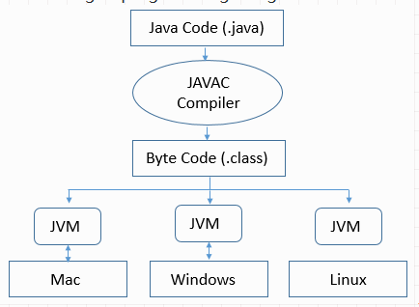
Characteristics of Java? Portability of Java
Write once, run anywhere:
Can be run on any platform without being recompiled.
Notes:
Because applications written in the Java are compiled into machine-independent bytecodes, they run consistently on any Java platform.

Slide 13
Characteristics of Java?(7/9)
Java Is Distributed:
Distributed computing involves several computers working together on a network.
Java has rich networking capability
Sending and receiving data.
Allows programmers to create distributed application.
Send byte-code over the Internet to another computer and have it easily run on that computer.

Slide 14
Characteristics of Java?(8/9)
Java Is Multithreaded:
Executing multiple tasks simultaneously or executing multiple portions (functions) of the same program in parallel.
Maximum utilization of resources is possible.
Multithread programming is integrated in Java, whereas in other languages you have to call procedures specific to the operating system to enable multithreading.

Slide 15
Characteristics of Java?(9/9)
Java's Performance
Memory available when needed: Garbage collector runs as a low-priority background thread.
Compute-intensive sections: can be rewritten in native machine code as required.
Just-In-Time (JIT) compiler
If higher performance is required, chunks of bytecodes can be translated on the fly (at run time) into machine code for the particular CPU on which the application is executing.
Notes:
Performance is always a consideration. The Java platform achieves superior performance by adopting a scheme by which the interpreter can run at full speed without needing to check the run-time environment.
The automatic garbage collector runs as a low-priority background thread, ensuring a high probability that memory is available when required, leading to better performance.
Applications requiring large amounts of compute power can be designed such that compute-intensive sections can be rewritten in native machine code as required and interfaced with the Java platform.
The JIT compiler reads the byte-code in chunks and compiles entire chunks to native machine language instructions as needed. The compiled machine language instructions are remembered—that is, cached—for future use, so the chunk needs to be compiled only once.
This model generally runs programs faster than the interpreted model, which always has to translate the next byte-code instruction to machine code instructions

Slide 16
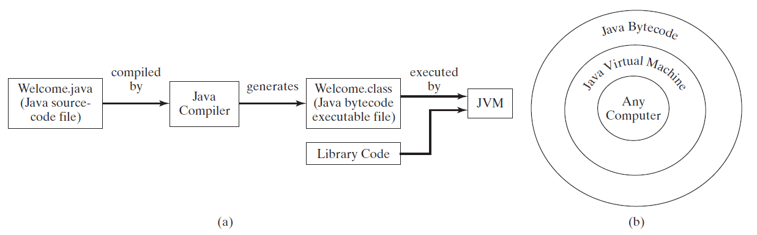
Java Compile and Run Environments: Life Cycle
Notes:
To run a Java program, first use the compiler to translate the Java program into byte-code. Then, use the JVM for your computer to translate byte-code instructions to machine language and to run the machine language instructions
A Java program is divided into smaller parts called classes, and normally each class definition is in a separate file and is compiled separately. In order to run your program, the byte-code for these various classes needs to be connected together. The connecting is done by a program known as the class loader. It is typically done automatically, so you normally need not be concerned with it. (In other programming languages, the program corresponding to the Java class loader is called a linker.)

Slide 17
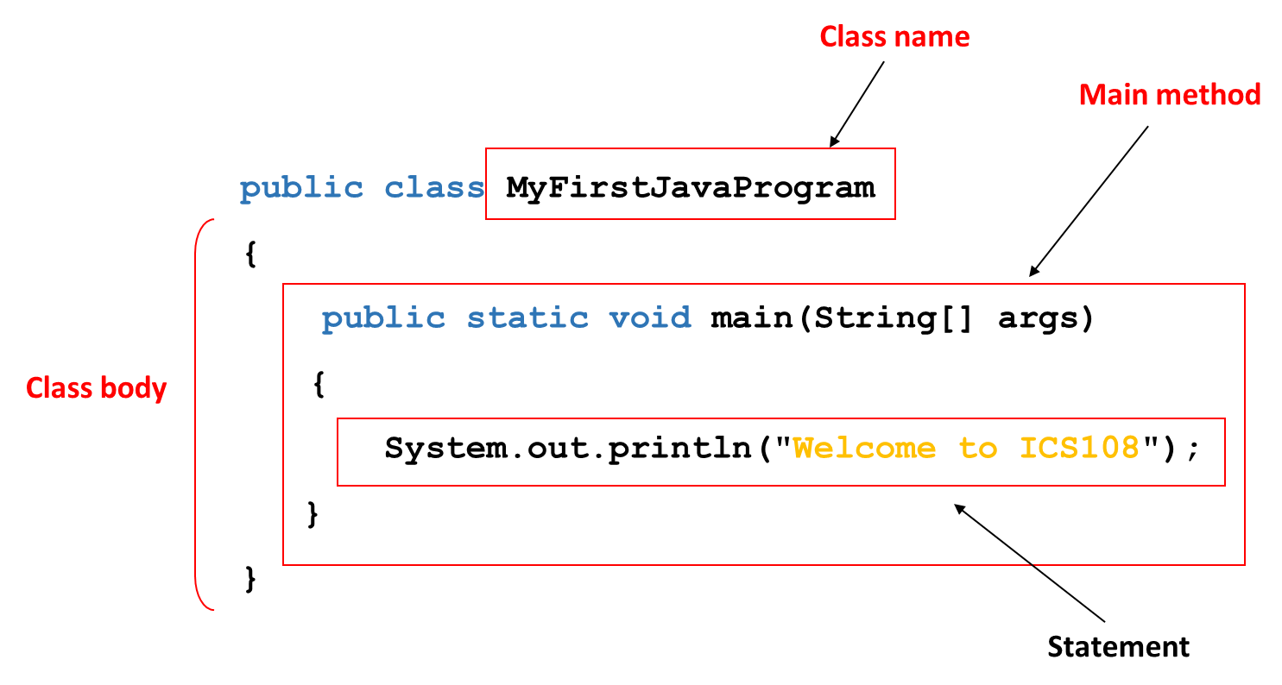
A Simple Java Program
Every Java program must have at least one class.
Each class has a name which starts with an uppercase letter. In this example, the class name is MyFirstJavaProgram.
In order to run a class, the class must contain a method named main. The program is executed from the main method.
A pair of braces in a program forms a block that groups components of a program.
Notes:
Every Java program must have at least one class. Each class has a name. By convention, class names start with an uppercase letter. In this example, the class name is MyFirstJavaProgram.
In order to run a class, the class must contain a method named main. The program is executed from the main method

Slide 18
Anatomy of a Java Program
A Java program consists of one or more classes.
Java classes reside in one or more files.
A Java class consists of some variables and one or more methods.
A Java method consists of one or more statements.
The file name of a Java program has .java extension.
A Java Program
Java
classes
Java
Methods

Slide 19
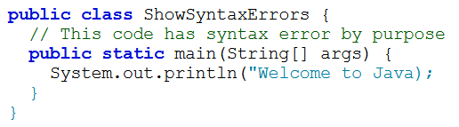
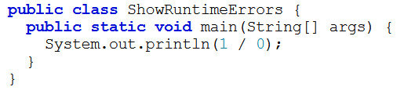
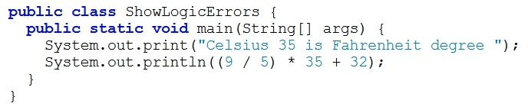
Programming Errors
Syntax errors:
Violating the rules, syntax, of the language.
Detected by the compiler: Program will not run unless it is syntax-error free.
Runtime errors:
Occur while the program is running.
Operations can not be carried out. e.g. division by zero.
Causes the program to abort.
Logical errors:
Program produces un incorrect results.

Slide 20


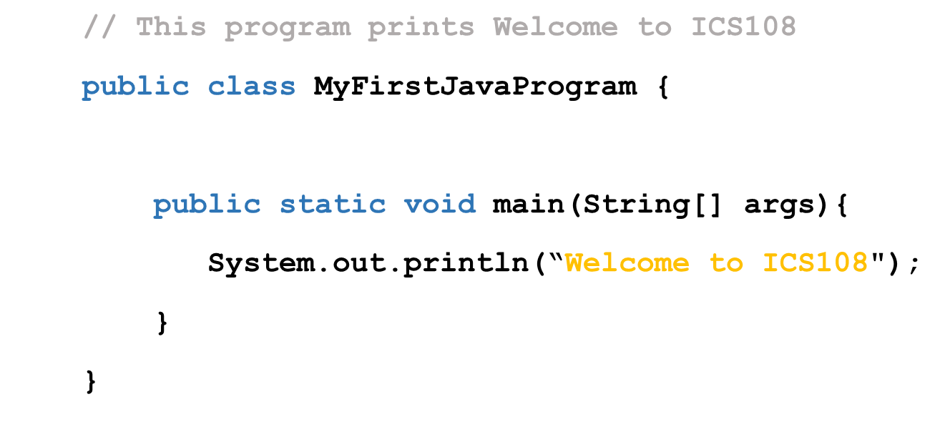
Programming Style
Proper Indentation:
Indent two spaces.
Spacing:
Use blank line to separate segments of the code
Appropriate Comments
Explain what the programs does.
line comments beginning with //
block comments beginning with /* and ends with */
Block Styles:
Use end-of-line style for braces.

Slide 21
Naming Conventions
Identifier | Naming Convention
Variables and method names | Use lowercase. If the name consists of several words, concatenate all in one, use lowercase for the first word, and capitalize the first letter of each subsequent word in the name. For example, the variables radius and area, and the method computeArea.
Class names | Capitalize the first letter of each word in the name. For example, the class name CircleArea.
Constants | Capitalize all letters in constants, and use underscores to connect words. For example, the constant PI and MAX_VALUE

