Slide 1
Module 02: Java Basics
Chapter 2 - 6

Slide 2
Declaration
Please note that information in this lecture is mainly taken from:
Liang, Y. Daniel - Introduction to Java programming and data structures, comprehensive version (2019, Pearson).

Slide 3
Objectives
To explore Java data types (§2.9.1).
To use variables, constants and literals (§§2.5–2.7).
To write and evaluate numeric expressions
To cast the value of one type to another type (§2.15).
To avoid common errors and pitfalls in elementary programming (§2.18).
To obtain input from the console using the Scanner class (§2.3).
To write Java programs to solve mathematical problems (§4.2).
To process strings using the methods in the string object (§4.4).

Slide 4
Objectives
To use boolean variables and expressions (§3.2).
To implement selection control structure(§§3.3-3.5).
To program using selection statements (SubtractionQuiz, BMI) (§§3.7–3.9)
To implement selection control using switch statements(§3.13).
To write expressions using the conditional operator(§3.14).
To write loops using:
While statement (§5.2).
Do-while statement (§5.3).
For statement (§5.4).
To write programs using loops((§§5.5-5.11)

Slide 5
Objectives
To understand why do we need Methods (§6.1).
To learn how to define and invoke methods (§6.2).
To understand the difference between void methods and value-returning methods (§6.3-6.4).
To learn how to pass arguments by value (§6.5).
To understand code reusability (§6.6).
To use method overloading and understand ambiguous overloading (§6.8).
To determine the scope of variables (§6.9).

Slide 6
Primitive Data Types
Type Name | Kind of Value | Memory Used | Range of Values
byte | Integer | 1 byte | –2⁷ to 2⁷ – 1 (-128 to 127)
short | Integer | 2 bytes | –2¹⁵ to 2¹⁵ – 1 (-32768 to 32767)
int | Integer | 4 bytes | –2³¹ to 2³¹ – 1 (-2147483648 to 2147483647)
long | Integer | 8 bytes | –2⁶³ to 2⁶³ – 1 -9,223,372,036,854,775,808 to 9,223,372,036,854,775,807
float | Floating-point | 4 bytes | -3.4028235E+38 to -1.4E-45 1.4E-45 to 3.4028235E+38
double | Floating-point | 8 bytes | -1.7976931348623157E+308 to -4.9E-324 4.9E-324 to 1.7976931348623157E+308
char | Single character (Unicode) | 2 bytes | All Unicode values from 0 to 65,535
boolean |  |  | true or false
1.0 / 3.0 is 0.3333333333333333
The double type values are more accurate than the float type values
1.0F / 3.0F is 0.33333334
Notes:
Every data type has a range of values. The compiler allocates memory space for each variable or constant according to its data type.
The double type values are more accurate than the float type value

Slide 7
Variables
A variable is
A storage location in the computer’s memory.
It has a type, name, and value.
Used to represent information about problems.
Every variable in a Java program must be declared before it can be used.
A variable declaration tells the compiler what kind of data (type) will be stored in that variable.
Syntax
dataType variableName;
or
dataType variableName = value;
Examples:
int length, width;
double radius, area = 0.0;
char letter = ’A’;
boolean found = true;
String courseTitle = “ICS108”;
What are the required variables to write a program that computes Rectangle’s area?
Variables to represent student information:
length, width and area
name, id, major, level, etc…

Slide 8
Constants
A final variable is a variable that can be initialized only once.
To declare a variable as final, add the keyword final to the declaration.
Examples:
final double PI=3.14159;
final int HOURS_PER_DAY = 24;
final double MAX_SIZE = 70.5;
Note: If you try to change the value of a final variable you will get a compilation error: cannot assign a value to final variable.
Capitalize all letters in constants and use underscore to connect words.
Constants do not change their values;
variables can change their values
Notes:
In Java, the final keyword is used to denote constants. It can be used with variables, methods, and classes.
Once any entity (variable, method or class) is declared final, it can be assigned only once. That is,
the final variable cannot be reinitialized with another value
the final method cannot be overridden
the final class cannot be extended

Slide 9
Literals
Any constant that appears directly in the program and can be assigned to a variable is called as literal.
Integer Literals
byte b =120;
byte b = 1000; //compilation error; 1000 needs more than one byte
int num = 176;
long num1 = 5234L;
Java Literals
Integral literals
Boolean literals
Floating point literals
Char literals
String literals
To improve readability, Java allows you to use underscores between two digits in a number literal
long ssn = 232_45_4519;
45_ or _45 is incorrect
Notes:
Any value which can be assigned to a variable is called as literal.
An integer literal can be assigned to an integer variable as long as it can fit into the variable. A compilation error would occur if the literal were too large for the variable to hold.
Floating-point literals are written with a decimal point. By default, a floating-point literal is treated as a double type value. For example, 5.0 is considered a double value, not a float value. You can make a number a float by appending the letter f or F, and make a number a double by appending the letter d or D

Slide 10
Literals
Floating-Point Literals
double area = 123.4;
float area = 123.4f;
float x =1.4; //error should be 1.4f
float x =34; // legal
double x =1.23456e+2; // equivalent to 123.456 //scientific notation
double x = 2L; // 2f;
char letter =‘a’;
boolean found = true;
String name=“Ahmed”;
Notes:
Any value which can be assigned to a variable is called as literal.
An integer literal can be assigned to an integer variable as long as it can fit into the variable. A compilation error would occur if the literal were too large for the variable to hold.
Floating-point literals are written with a decimal point. By default, a floating-point literal is treated as a double type value. For example, 5.0 is considered a double value, not a float value. You can make a number a float by appending the letter f or F, and make a number a double by appending the letter d or D

Slide 11
Numeric Type Conversion
You cannot store a value of one type in a variable of another type
int value;
value = 2.99; ×
The problem is a type mismatch. The constant 2.99 is of type double, and the variable value is of type int.
In Java, an augmented expression of the form x1 op= x2 is implemented as x1 = (T)(x1 op x2), where T is the type for x1. Therefore, the following code is correct.
int sum = 0;
sum += 4.5; // sum becomes 4 after this statement
sum += 4.5 is equivalent to sum = (int)(sum + 4.5).
Notes:
You can assign a value of type char to a variable of type int or to any of the numeric types that follow int in our list of types (but not to those that precede int). However, in most cases it is not wise to assign a character to an int variable, because the result could be confusing.

Slide 12
Type Casting
Type Casting takes a value of one type and produces a value of another type with an "equivalent" value.
There are some special cases where it is permitted to assign a value of one type to a variable of another type.
byte → short → int → long → float → double
char
Implicit casting
Explicit casting
Widening: casting a type with a small range to a type with a larger range
byte i = 100;
long k = i * 3 + 4;
double d = i * 3.1 + k / 2;
int x = ( int ) 2.9;
double d = (double) n/m;
// where n and m are of type int
Narrowing: large range to a type with a smaller range
When computing mathematical expression involving operands of different types, Java automatically converts the result to the type with larger range
Notes:
You can assign a value of type char to a variable of type int or to any of the numeric types that follow int in our list of types (but not to those that precede int). However, in most cases it is not wise to assign a character to an int variable, because the result could be confusing.

Slide 13
Arithmetic Operators
Name | Meaning | Example | Result
+ | Addition | 10 + 20 | 30
- | Subtraction | 20.0 – 5.1 | 14.9
* | Multiplication | 30 * 2.0 | 60.0
/ | Division (integer and float) | 1.0/2.0 | 0.5
% | Reminder | 24 % 5 | 4
++ -- | Postincrement/Postdecrement | int i=5; j=i++; | j = 5 i = 6
++ -- | preincrement/predecrement | int i=5; j=--i | i = 4 j = 4
34 / 5 yields an integer 6
34.0 / 5 yields a double value 6.8
Notes:
As in most other languages, Java allows you to form expressions using variables, constants, and the arithmetic operators: + (addition), - (subtraction), * (multiplication), / (division), and % (modulo, remainder). These expressions can be used anyplace it is legal to use a value of the type produced by the expression.

Slide 14
Operator Precedence
Highest Precedence
Operator | Type | Associativity
()[] | Parentheses, Array subscript | Left to Right
multiplicative | * / % | Left to right
additive | + - | Left to right
assignment | = += -= *= /= %= etc.. | Right to left
Lowest Precedence
Notes:
The operators in the following table are listed according to precedence order. The closer to the top of the table an operator appears, the higher its precedence.
Operators with higher precedence are evaluated before operators with relatively lower precedence. Operators on the same line have equal precedence.
When operators of equal precedence appear in the same expression, a rule must govern which is evaluated first.
All binary operators except for the assignment operators are evaluated from left to right; assignment operators are evaluated right to left.

Slide 15
Common Errors and Pitfalls
Undeclared/Uninitialized Variables and Unused Variables.
Integer Overflow
Round-off Errors
Unintended Integer Division
Redundant Input Objects
double interestRate = 0.05;
double interest = interestrate * 45;
int value = 2147483647 + 1;
value will actually be -2147483648
System.out.println(1.0 - 0.9);
0.09999999999999998
double x = 5/2; double x = 5/2.0;
Scanner input = new Scanner(System.in);
int v1 = input.nextInt();
Scanner input = new Scanner(System.in);
int v1 = input.nextInt();

Slide 16
Console Input and Output
Console Output | Console Input
System.out refers to the standard output device | System.in refers to the standard input device
The default output device is the display monitor | The default input device is the keyboard.
println method is used to display a primitive value or a string to the console | the Scanner class is used to create an object to read input from System.in
Data is stored in output buffer before it is sent to the monitor or to an output file. | data is stored in scanner buffer before it is sent to the program
 | Whenever a user presses the Enter key, the '\n' generated is also sent to the input buffer.
keyboard
or input file
monitor
or output file
input buffer
program
output buffer
Notes:
Java uses System.out to refer to the standard output device, and System.in to the standard input device.
By default, the output device is the display monitor, and the input device is the keyboard.
To perform console output, you simply use the println method to display a primitive value or a string to the console.
To perform console input, you need to use the Scanner class to create an object to read input from System.in, as follows:
Scanner input = new Scanner(System.in)
The syntax new Scanner(System.in) creates an object of the Scanner type. The syntax Scanner input declares that input is a variable whose type is Scanner. The whole line Scanner input = new Scanner(System.in) creates a Scanner object and assigns its reference to the variable input.

Slide 17
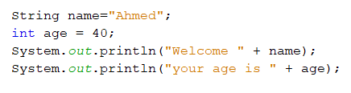
Screen Output
println: outputs one line to the screen and generates a new line after it finishes.
The items that are output can be quoted strings, variables, numbers, or almost any object you can define in Java.
To output more than one item, place a plus sign between the items.
SYNTAX System.out.println(Item_1 + Item_2 + ... + Last_Item);
Example:
The output:
Welcome Ahmed
your age is 40

Slide 18
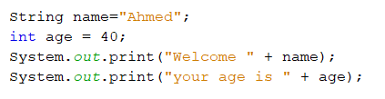

Screen Output
print: outputs one line to the screen and stays on the same line.
Example:
The output:
printf: formats output based on a format specifier, %s %d %f %c
Example
The output
Welcome Ahmedyour age is 40
$ 19.88 each
Notes:
The only difference between System.out.println and System.out.print is that with println, the next output goes on a new line, whereas with print, the next output is placed on the same line.
The print and println methods do not provide much control over the formatting
of output.
Java includes a method named printf that can be used to give output in a specific format
The printf method formats multiple arguments based on a format string.
The format string consists of a string constant embedded with format specifiers

Slide 19
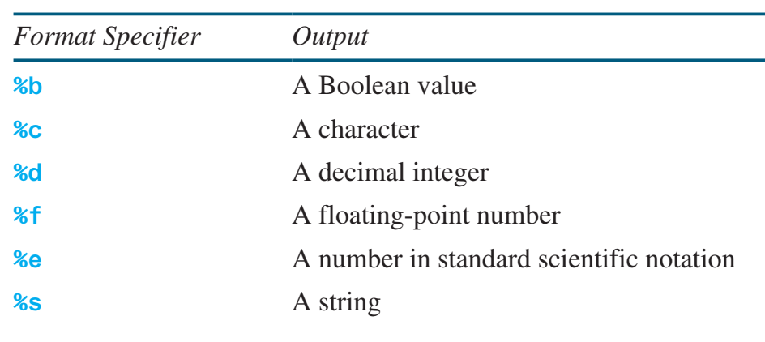
Formatting Console Output
A format specifier has the following structure
Width: The minimum total width of the formatted output, including the decimal point.
Precision: For floating point (double or float), precision is the number of digits after the decimal point.
% | Width | . Precision | Conversion code
$ 19.88 each

Slide 20
Reading Input from the Console
To perform console input, you need to use the Scanner class to create an object to read input from System.in, as follows:
Scanner input = new Scanner(System.in)
An object of this class has methods for input of different types.
By default white space characters are used to separate input data items or tokens
Notes:
The syntax new Scanner(System.in) creates an object of the Scanner type. The syntax Scanner input declares that input is a variable whose type is Scanner. The whole line Scanner input = new Scanner(System.in) creates a Scanner object and assigns its reference to the variable input.

Slide 21
Reading Input from the Console
To read | Method used | Effect
integer | input.nextInt(); | Skips leading white space in the input buffer and then consumes and returns the next token. '\n' at the end of the line is not consumed
long | input.nextLong();
float | input.nextFloat();
double | input.nextDouble();
String (one word) | input.next();
String (complete line) | input.nextLine(); | Reads the rest of the current line and returns it as a string. The line terminator character '\n' at the end of the line is consumed
Notes:
The syntax new Scanner(System.in) creates an object of the Scanner type. The syntax Scanner input declares that input is a variable whose type is Scanner. The whole line Scanner input = new Scanner(System.in) creates a Scanner object and assigns its reference to the variable input.

Slide 22
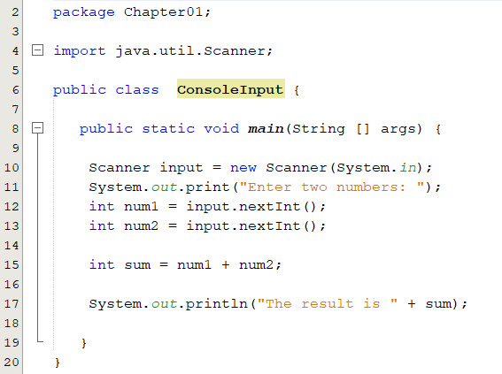
Console Input using Scanner : An Example
Import Scanner class
Create a Scanner object
Read an integer and assign it to the variable num1
Read another integer and assign it to variable num2
Sample run:
Enter two numbers: 4
12
The result is 16
Sample run:
Enter two numbers: 2 3
The result is 5

Slide 23
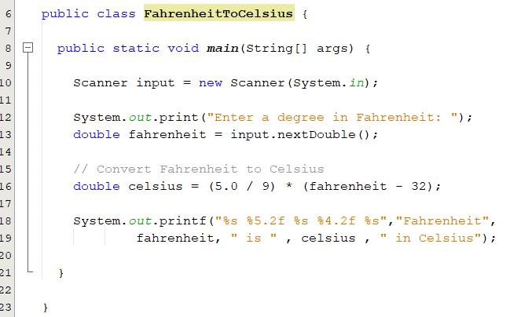
Problem: Converting Temperatures
Write a program that converts a Fahrenheit degree to Celsius using the formula:
Enter a degree in Fahrenheit: 300
Fahrenheit 300.00 is 148.89 in Celsius

Slide 24
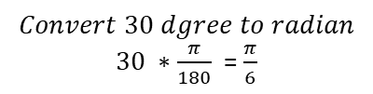
The Math Class
Java provides many useful methods in the Math class for performing common mathematical functions.
Constants: PI and E
The Math class is in the java.lang package. Any class in the java.lang package is automatically imported. So there is no need to import it explicitly.
Method | Description
sin(radians) | Returns the trigonometric sine of an angle in radians.
cos(radians) | Returns the trigonometric cosine of an angle in radians.
toRadians(degree) | Returns the angle in radians for the angle in degrees.
toDegrees(radians) | Returns the angle in degrees for the angle in radians
asin(a) | Returns the angle in radians for the inverse of sine
acos(a) | Returns the angle in radians for the inverse of cosine.
Math.sin(Math.PI / 6) returns 0.5
Math.cos(Math.PI / 2) returns 0
$$Convert 30 dgree to radian$$
$30 ∗\frac{π}{180}$ = $\frac{π}{6}$
The parameter for sin, cos, and tan is an angle in radians.
Math.toDegrees(Math.acos(0.5))

Slide 25
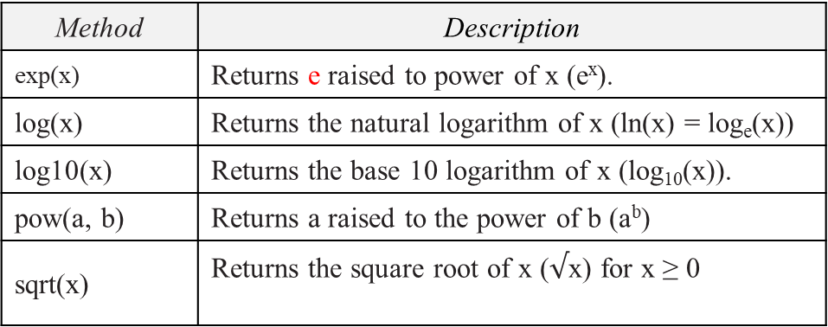
Exponent and Rounding Methods
Method | Description
exp(x) | Returns e raised to power of x (e^{x}).
log(x) | Returns the natural logarithm of x (ln(x) = log_{e}(x))
log10(x) | Returns the base 10 logarithm of x (log₁₀(x)).
pow(a, b) | Returns a raised to the power of b (a^{b})
sqrt(x) | Returns the square root of x ($√$x) for x ≥ 0
Math.exp(1) returns 2.71
Math.log(2.71) returns 1.0
Math.pow(2, 3) returns 8.0
Math.pow(3, 2) returns 9.0
Math.sqrt(4) returns 2.0
Math.sqrt(10.5) returns 3.24
Method | Description
ceil(x) | x is rounded up to its nearest integer. This integer is returned as a double value.
floor(x) | x is rounded down to its nearest integer. This integer is returned as a double value.
rint(x) | x is rounded to its nearest integer. If x is equally close to two integers, the even one is returned as a double value
round(x) | Returns (int) Math.floor(x + 0.5) if x is a float and returns (long) Math.floor(x + 0.5) if x is a double.
Math.ceil(2.1) returns 3.0
Math.ceil(-2.1) returns -2.0
Math.floor(2.1) returns 2.0
Math.floor(-2.1) returns -3.0
Math.rint(2.1) returns 2.0
Math.round(2.6) returns 3
Math.round(-2.6) returns -3

Slide 26
The min, max, and abs Methods
max(a, b) and min(a, b)
Returns the maximum or minimum of two parameters.
abs(a)
Returns the absolute value of the parameter.
random(): Returns a random double value in the range [0.0, 1.0).
Math.max(2, 3) returns 3
Math.min(2.5, 4.6) returns 2.5
Math.max(Math.max(2.5, 4.6),
Math.min(3, 5.6)) returns 4.6
Math.abs(−2) returns 2
Math.abs(−2.1) returns 2.1
▼check exercise 4.2.5

Slide 27
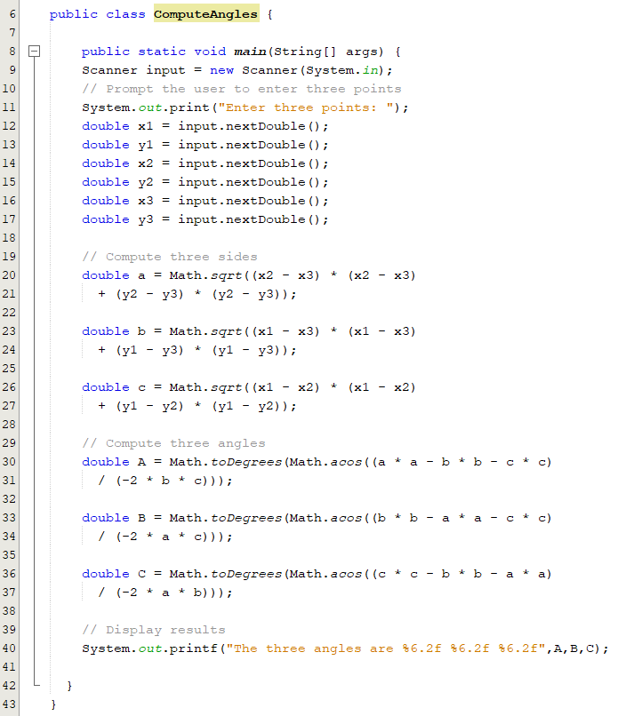
Case Study: Computing Angles of a Triangle
Write a program that prompts the user to enter the x- and y-coordinates of the three corner points in a triangle and then displays the triangle’s angles.

Slide 28
Character Declaration
A character literal is enclosed in single quotes.
A char can be cast into any numeric type, and vice versa.
When an integer is cast into a char, only its lower 16 bits of data are used; the other part is ignored.
char letter;
char letter = 'A'; //(ASCII)
char numChar = '4'; //(ASCII)
char letter = '\u0041'; //(Unicode)
char numChar = '\u062C'; //(Unicode)
char c = 97; // same as char c ='a';
int i = 'a'; // same as int i = (int) 'a';
char ch = (char) 65.25; // ch is A

Slide 29
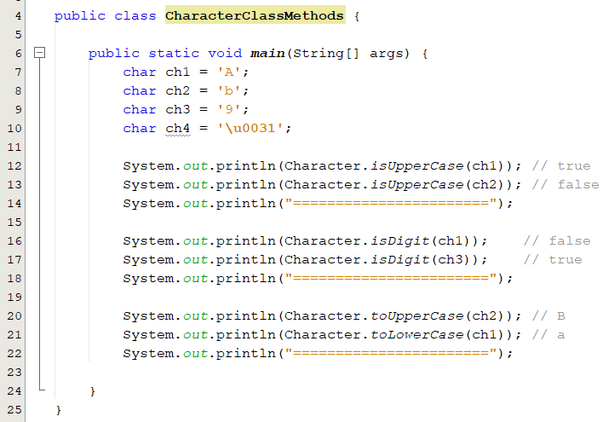
The Character class
Java provides the following methods in the Character class for testing characters
Method | Description
isDigit(ch) | Returns true if the specified character is a digit.
isLetter(ch) | Returns true if the specified character is a letter.
isLetterOrDigit(ch) | Returns true if the specified character is a letter or digit
isLowerCase(ch) | Returns true if the specified character is a lowercase letter.
isUpperCase(ch) | Returns true if the specified character is an uppercase letter
toLowerCase(ch) | Returns the lowercase of the specified character.
toUpperCase(ch) | Returns the uppercase of the specified character.

Slide 30
The Class String
Objects of type String are sequence of characters that are written within double quotes.
“KFUPM” “ICS018”
The class String is a predefined class that is made available to you when you are programming in Java.
String declaration:
String courseTitle; or String courseTitle = “ICS108”;
The String type is not a primitive type. It is known as a reference type.
String objects are immutable, which means that once created, their values cannot be changed; however, references to String objects may be changed.
String courseTitle = new String(" ICS108 ");
Notes:
You can obtain a string literal simply by enclosing a sequence of characters in double quotation marks.
A String object can be constructed by either:
directly assigning a string literal’s starting address to a String reference variable.
By assigning a String object’s starting address to a String reference variable via the new operator and a constructor

Slide 31
The Class String
String word1, word2;
word1 = new String("Java");
word2 = word1;
Memory is allocated for word1 and word2 but with no values
A String object with value “Java” is created and word1 refers to it
The address in word1 is assigned to word2 so both refer to the same String object
word1
6000
6000
Memory
Java
word2
6000

Slide 32
String Literals vs. String Objects
String Literals | String Objects
A set of characters that is created by enclosing them inside a pair of double quotes. String str = “Java”; | A set of characters that is created using the new() operator. String str = new String(“Java”);
If the string already exists, the new reference variable will be pointing to the already existing literal. | Even the string already exists or not, a new String object will be created.
Stored in a string common pool. | Stored in the heap.
Facilitates sharing of storage for strings with the same contents to conserve memory. | There is no sharing of storage for the same contents.
str1 = "Java";
str2 = "Java";
str3 = "Java";
str1 = new String("Java");
str2 = new String("Java");
str1
str1
str2
str2
str3
Java
Java
Java
Notes:
This means, that the character sequence “Java" will be stored at a central place, and whenever the same literal “Java" is used again, the JVM will not create a new String object but use the reference of the cached String.

Slide 33
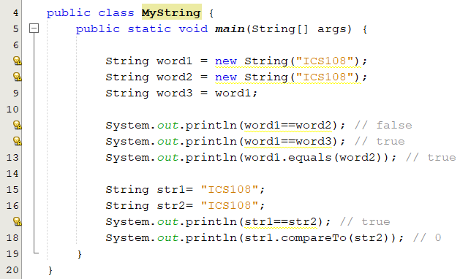
String Comparison
== tests whether the referenced objects are stored in the same memory location, compares references not values.
!= tests whether the referenced objects are in different memory locations.
String s1 = new String("ICS108");
String s2 = new String("ICS108");
System.out.println(s1 == s2);
String s1 = new String("ICS108");
String s2 = s1;
System.out.println(s1 == s2);
Outputs: false
Outputs: true
Use the method equals,, compareTo, or to test the equality of String objects.
equals() method: compares values of string for equality
System.out.println(s1.equals(s2));
System.out.println(s1.compareTo(s2));
Outputs: true
Outputs: 0

Slide 34
String concatenation
Concatenation: Using the + operator on two (or more) strings in order to connect them to form one longer string.
When a string is combined with almost any other type of item, the result is a string.
Strings may also be concatenated by using the String concat method:
String courseID = “ICS108";
String courseTitle = " OOP:Java";
String course = courseID + courseTitle;
ICS018OOP:Java
int no = 108;
String s = "ICS";
System.out.println(s + no);
String courseTitle = "ICS ".concat("108 ");

Slide 35
Comparing Strings Methods
Assume str1=“ICS108 Course” and str2 = “ICS108 course”
Method | Description | Result
str1.equals(str2) | Returns true if the contents of the String objects referenced by str1 and str2 are equal; otherwise it returns false. | false
str1.compareTo(str2) | Compares a String to another String and returns an int less than zero, zero, or greater than zero, indicating, respectively, whether this String (the String referenced by str1) is smaller, equal to or larger than the other String. For example: str1.compareTo(str2) | Negative number
boolean contains(String str) | Returns true if and only if this string contains the string str. | str1.contains("CS"); // true
int length() | Returns how many characters in a string | str1.length() //returns 13
StringMethods.java

Slide 36
Methods for Obtaining Substrings
Assume str1=“ICS108 Course”
Method | Description | Example
String substring(int beginIndex) | Returns a new string that is a substring of this string, starting from beginIndex to the end of this string. (Error if beginIndex is not valid) | String str2 = str1.substring(3); // str2 = “108 Course"
String substring(int beginIndex, int endIndex) | Returns a new string that is a substring of this string starting from beginIndex to endIndex - 1. (Error if any of the index is not valid) | String str2 = str1.substring(2,5); // str2 = "S10"
char charAt(int index) | Returns the char value at the specified index. (Error if index is not valid) | char ch = str1.charAt(1); // ch = ‘C'
str1. substring(3,6) is 108
str1. substring(7) is Course
0 | 1 | 2 | 3 | 4 | 5 | 6 | 7 | 8 | 9 | 10 | 11 | 12
I | C | S | 1 | 0 | 8 |  | C | o | u | r | s | e
str1.charAt(1)

Slide 37
Conversion between Strings and Numbers
int i = Integer.parseInt("200");
float a = Float.parseFloat("200.5");
double a = Double.parseDouble("200.5");
String s3 = Integer.toString(99);
String s4 = Float.toString(99.5);
String s5 = Double.toString(99.5);
String s = number + ""; // number + String → String
Boolean, Character, Integer, Float and Double are wrapper classes.
They will be covered later in the course.

Slide 38
Comparison & Logical Operators
Math Notation | Name | Java Notation | Examples
= | Equal to | == | balance == 0 answer == 'y'
≠ | Not equal to | != | income != tax
> | Greater than | > | expenses > income
≥ | Greater than or equal to | >= | points >= 60
< | Less than | < | pressure < max
≤ | Less than or equal to | <= | expenses <= income
A boolean expression is an expression that evaluates to either true or false
A | B | A && B | A || B | !(A) | A ^ B
true | true | true | true | false | false
true | false | false | true | false | true
false | true | false | true | true | true
false | false | false | false | true | false
boolean b = (1 > 2);
b is a boolean variable
(x > 0) && ( x < 10)
Notes:
Often in a program you need to compare two values, such as whether i is greater than j. Java provides six comparison operators

Slide 39
Decision/Selection Structure
This structure lets us execute a block of code under a certain condition.
Finding the square root of a given number, ( x > 0).
Withdrawing money from your account (as long as you have enough balance).
Calculating students letter grade( A+, A, B+, B, etc…).
The if and switch statements are used to implement the decision/selection in Java.
There are mainly five types of selection statements:
Simple if (One-way if Statement)
if-else (Two-way if Statement)
if-else if else (Multi-way if Statement)
switch statement
Conditional operators
Notes:
The selection control structure allows one set of statements to be executed if a condition is true and another set of actions to be executed if a condition is false.
Every decision a computer program makes involves evaluating a Boolean expression

Slide 40
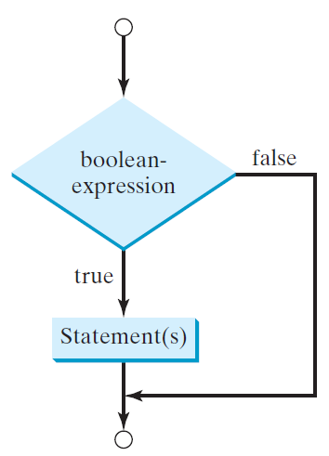
One-way if Statement
The simple if statement is a one-way statement because it selects or ignores a single action.
Example: suppose that the passing grade on an exam is 50.
If student’s grade is greater than or equal to 50 Print “Passed”
if ( grade >= 50) {
System.out.println("Passed");
}
The if statement has two parts: a condition and a body.
If the condition is true, the body of the statement executes.
The body consists of one or more statements.
Common Errors
if (grade >= 0); Equivalent to if (grade >= 0) { };
The braces can be omitted if the block contains a single statement.

Slide 41
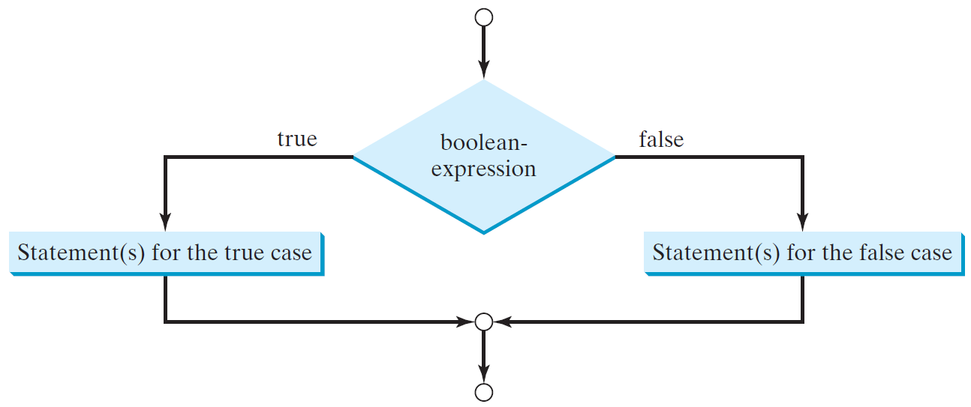
Two-way if Statement
Two-way if Statement allows you to specify an action to perform when the condition is true and another action when the condition is false.
Syntax:
if (boolean-expression) {
statement(s)-for-the-true-case;
}
else {
statement(s)-for-the-false-case;
}
if (grade >= 50)
System.out.println("Pass");
else
System.out.println("Fail");
Good Programming Practice: Indent both body statements of an if…else statement.

Slide 42
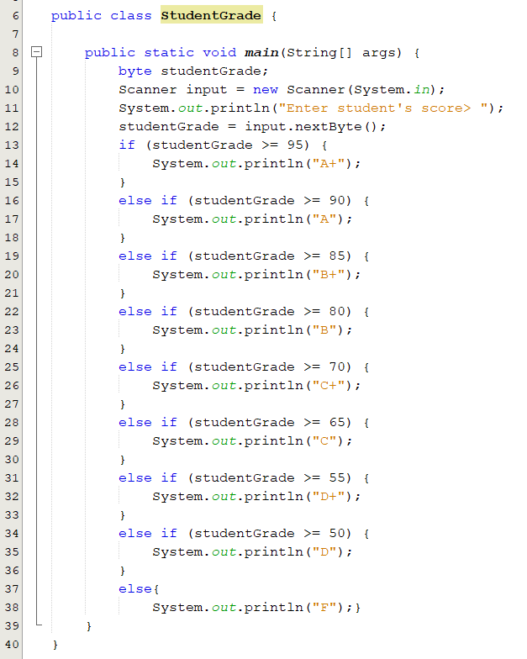
Multi-Way if-else Statement
if else if else is a multiple-selection statement because it selects among many different actions.
if (studentGrade >= 95) {
System.out.println("A+");
}
else if (studentGrade >= 90) {
System.out.println("A");
}
else if (studentGrade >= 85) {
System.out.println("B+"); }
else if (studentGrade >= 80) { System.out.println("B"); }
.
.
.
.
else { System.out.println("F"); }
StudentGrade.java

Slide 43
Equivalent Expressions
if (even = true) {
System.out.println("It is even");
}
even = true;
if (even == true) {
System.out.println("It is even");
}
!( a && b)
!a || !b
!( a || !b)
!a && b

Slide 44
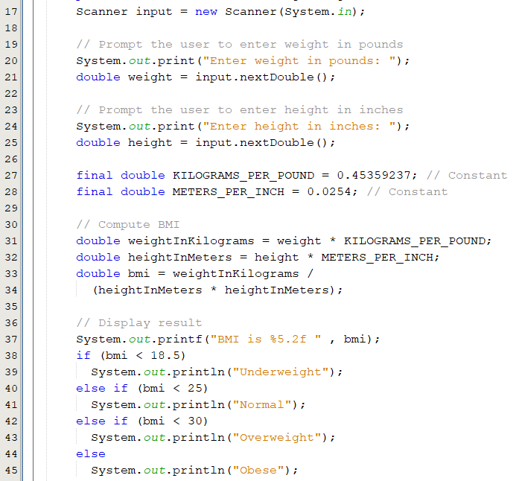
Example: Body Mass Index
Body Mass Index (BMI) is a measure of health on weight. It can be calculated by taking your weight in kilograms and dividing by the square of your height in meters. The interpretation of BMI for people 16 years or older is as follows
BMI Interpretation
-------------------------------------------------
BMI < 18.5 Underweight
18.5 <= BMI < 25.0 Normal
25.0 <= BMI < 30.0 Overweight
30.0 <= BMI Obese
BMICalculation.java

Slide 45
Switch Statement
When a multiway if-else statement has many possible outcomes, it can be hard to read.
If the choice is based on the value of an integer or a character expression, the switch statement can make your code easier to understand
The value1, ..., and valueN must have the same data type as the value of the switch-expression.
switch (switch-expression) {
case value1:
statement(s)1;
break;
case value2:
statement(s)2;
break;
…
case valueN:
statement(s)N;
break;
default:
statement(s)-for-default;
}
Notes:
The body of the statement is always enclosed in a pair of braces. Listing 3.5 shows a sample switch statement, whose controlling expression is the variable numberOfBabies.
Within the braces is a list of cases, each case consisting of the keyword case followed by a constant—called a case label—then a colon, and then a list of statements, which are the actions for that case:

Slide 46
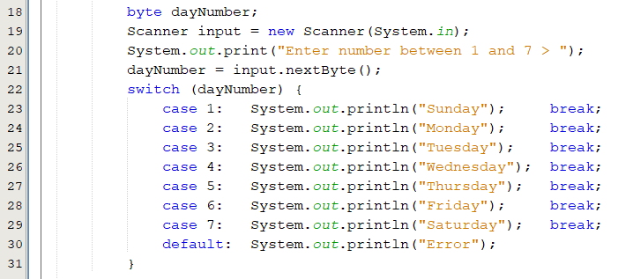
How Switch Statement executes?
The controlling expression is evaluated.
The value of the expression is compared with the value of each case.
If there is a match, the associated block of code is executed.
The statements starting from this case are executed until either a break statement or the end of the switch statement is reached
Days.java
Notes:
When the switch statement is executed, the controlling expression— dayNumber in this example is evaluated.
The list of alternatives is then searched until a case label that matches the value of the controlling expression is found, and the action associated with that label is executed.
You cannot have duplicate case labels, since that would produce an ambiguous situation. Notice that the action for each case in Listing 3.5 ends with a brea
Case doesn’t always need to have order 1, 2, 3 and so on. It can have any integer value after case keyword. Also, case doesn’t need to be in an ascending order always, you can specify them in any order based on the requirement.
2) You can also use characters in switch case. for example

Slide 47
Popup Question(1)
What is the output of the following code if the value of the variable day is 2?
switch (day) {
case 1:
case 2: System.out.println(“Monday");
case 3:
case 4:
case 5: System.out.println(“Thursday"); break;
case 6:
case 0: System.out.println(“Saturday");
}

Slide 48
Conditional Operators
A conditional operator evaluates an expression based on a condition.
Syntax
boolean-expression ? exp1 : exp2
Example
if (n1 > n2)
max = n1;
else
max = n2;
can be expressed as follows:
max = (n1 > n2) ? n1 : n2;

Slide 49
Popup Question(2)
What is the output of the following code?
A
int i = 1, j = 2, k = 3;
if (i > j)
if (i > k)
System.out.println("A");
else
System.out.println("B");
int i = 1, j = 2, k = 3;
if (i > j)
if (i > k)
System.out.println("A");
else
System.out.println("B");
B
The else clause matches the most recent if clause in the same block
C
int i = 1, j = 2, k = 3;
if (i > j){
if (i > k)
System.out.println("A");
}
else
System.out.println("B");
To force the else clause to match the first if clause, you must add a pair of braces:

Slide 50
Loop Statements
Java has three types of loop statements:
while statement
do-while statement
for statement
A loop consists of:
Body: The code that is repeatedly executed inside the loop.
Condition (boolean expression): as long as it is true, the body executes.
Each repetition of the loop body is called an iteration.
loop
condition
false
true
Statements
Loop body
Notes:
A Loop condition that controls the execution of the body. It is evaluated each time to determine if the loop body is executed.

Slide 51
While Statement: Example
A while statement is used to execute statements while the condition is true.
As long as loop-condition is true, the loop body executes.
The loop-condition is re-tested after each iteration.
The loop terminates when the condition becomes false.
while (loop-condition) {
// loop-body;
Statement(s);
}
int n= 100;
int count = 1;
while (count <= n) {
System.out.println("Welcome to ICS108!");
count++;
}
n = 100; count = 1;
false
count<=n?
true
System.out.println("Welcome to ICS108!");
count++;
How many times the loop executes if we replace the statement count++ with count = count + 2
Notes:
Using a loop statement, you can simply tell the computer to display a string a hundred times without having to code the print statement a hundred times, as follows:

Slide 52
Do-While Statement
A do-while statement is used to execute a block of statements one or more times.
Syntax
do {
// Loop body;
Statement(s);
} while (loop-condition);
Statements
loop body
loop
condition
int n = 100, count = 1;
do {
System.out.println("Welcome to ICS108!");
count++;
} while(count <= n);
true
false
int n= 100, count = 1;
while (count <= n) {
System.out.println("Welcome to ICS108!");
count++;
}

Slide 53
For Statement
A for loop allows you to efficiently write a loop that needs to execute a specific number of time.
Syntax
for (counter-initialization; loop-condition; counter-update) {
// loop body;
Statement(s);
}
counter-initialization
loop
condition
false
for (int i=1; i<=100; i++) {
System.out.println("Welcome to ICS108!");
}
true
Statements
Loop body
int i = 1;
while (i <= 100) {
System.out.println("Welcome to ICS108!");
i++;
}
counter-update

Slide 54
Loop Statements:
int n = 100, i =1;
while (i <= n) {
System.out.println(i);
i++;
}
int n =100;
for (int i = 1; i <= n ; i++) {
System.out.println(i);
}
int n = 100; i = 1;
do {
System.out.println(i);
i++;
} while (i<=n);

Slide 55
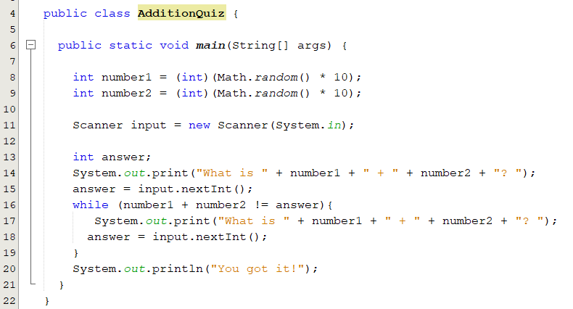
Example : AdditionQuiz
Write a program that prompts the user to enter an answer for a question on addition of two single digits. Let the user enter a new answer until it is correct.
Using while loop
AdditionQuiz.java

Slide 56
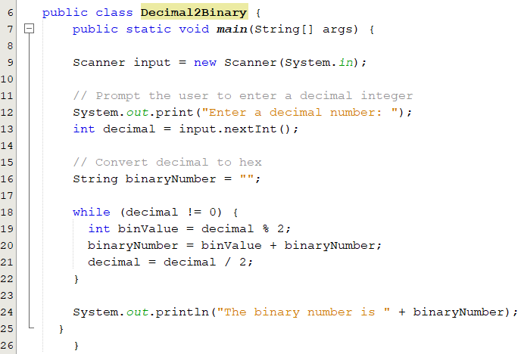
Example : Converting Decimals to Binary
Sample run:
Enter a decimal number: 13
The binary number is 1101
Division by 2 | Quotient | Remainder | Bit #
13/2 | 6 | 1 | 0
6/2 | 3 | 0 | 1
3/2 | 1 | 1 | 2
1/2 | 0 | 1 | 3
Conversion steps:
Divide the number by 2.
Get the remainder for the binary digit.
Get the integer quotient for the next iteration.
Repeat the steps until the quotient is equal to 0.
Decimal2Binary.java

Slide 57
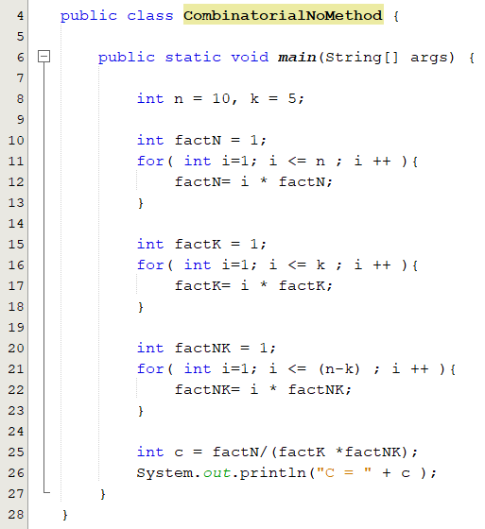
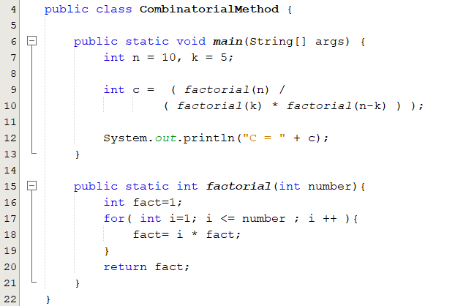
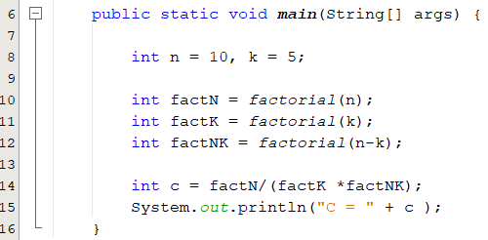
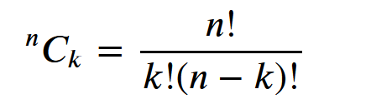
Using Methods to Reuse Code(1/2)
CombinatorialMethod.java

Slide 58
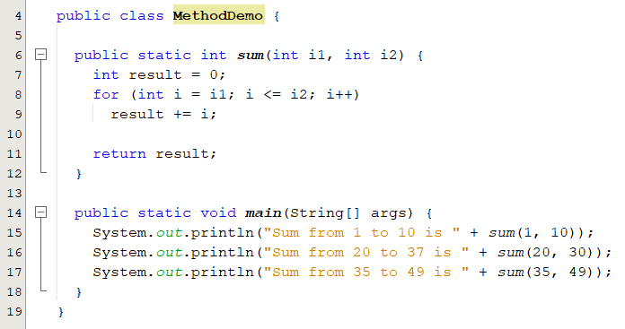
Using Methods to Reuse Code(2/2)
public static int sum(int i1, int i2) {
int sum = 0;
for (int i = i1; i <= i2; i++)
sum += i;
return sum;
}
public static void main(String[] args) {
System.out.println("Sum from 1 to 10 is " + sum(1, 10));
System.out.println("Sum from 20 to 30 is " + sum(20, 30));
System.out.println("Sum from 35 to 45 is " + sum(35, 45));
}
Sum from 1 to 10 is 55
Sum from 20 to 37 is 275
Sum from 35 to 49 is 630
output
MethodDemo.java

Slide 59
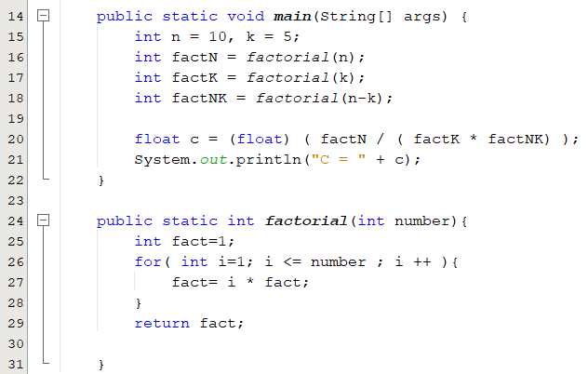
What is a Method?
A method is a collection of statements that are grouped together to perform a specific task.
To use a method, we have to:
Declare/define the method.
Call/Invoke the method.
Reuse, organize and simplify code.
Define a method
Call a method
n, k and n-k are actual parameters
number is a formal parameter

Slide 60
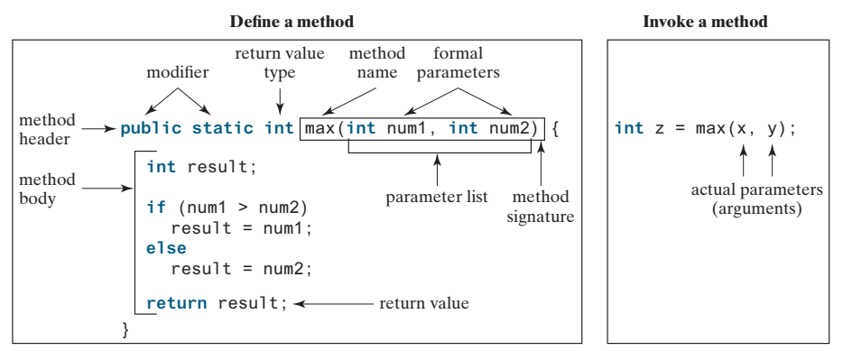
Defining a Method
A method definition consists of a header and a body.
Header:
modifier: so far we put the public modifier.
returnValueType: can be void, byte, int, long, double, etc…
methodName: a descriptive name that reflects what a function does.
Parameters: Information can be passed to methods using parameters.
modifier returnValueType methodName( list of parameters ){
// Method body; }
In the method header, you need to declare each parameter separately. For instance,
max( int num1, int num2) is correct, but max( int num1, num2) is wrong.

Slide 61
Method Parameters
Parameters are specified after the function name, inside parentheses.
You can use as many parameters as you want, just separate them with a comma.
Parameters act as variables inside the function.
A parameter is like a placeholder: when a method is invoked, you pass a value to the parameter.
Parameters are optional; that is, a method may have no parameters.

Slide 62
Popup-Question(3): Checkpoint 6.4.6
Write method headers (not the bodies) for the following methods:
Return a sales commission, given the sales amount and the commission rate.
Display the calendar for a month, given the month and year.
Test whether a number is even and returning true if it is.
(a) public static double getCommission(double salesAmount, double commissionRate)
(b) public static void printCalendar(int month, int year)
(d) public static boolean isEven(int value)

Slide 63
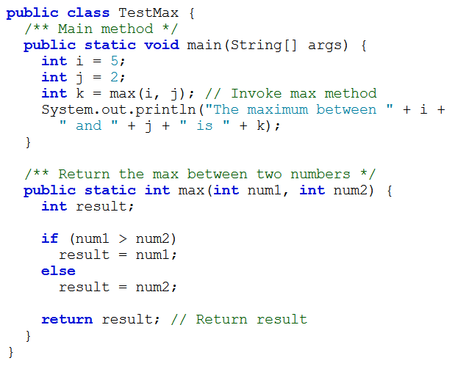
Calling a Method
In a method definition, you define what the method is to do.
To execute the method, you have to call or invoke it.
To call a method, just use method name followed by a set of parentheses that can contain arguments for the method .
When a program calls a method, program control is transferred to the called method.
When a method finishes its work, it returns control to the caller
When its return statement is executed or when its ending brace is reached.
TestMax.java

Slide 64
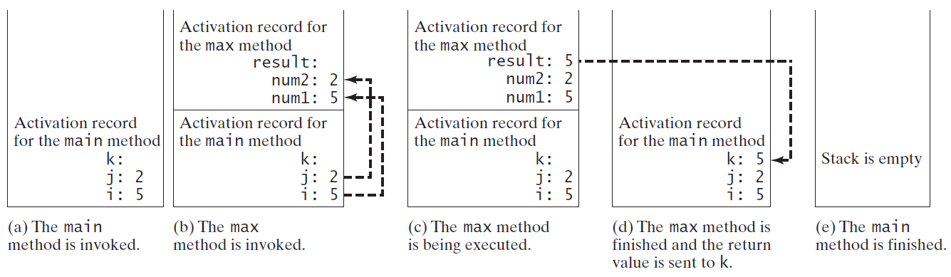
Call/Runtime Stacks
When a method is invoked,
Its parameters and variables are stored in an area of memory known as a call stack.
When a method finishes its work,
Its parameters and variables are removed from the call stack.

Slide 65
Void vs. Value-Returning Methods
A method may perform operations without returning a value.
In this case, the returned ValueType is the keyword void.
A method may return a value.
The returnValueType is the data type of the value the method returns. e.g. int, double, float.
A return statement is required for a value-returning method
public static void myMethod()
public static int factorial( int number)
public static int sign(int n) {
if (n > 0)
return 1;
else if (n == 0)
return 0;
else if (n < 0)
return –1;
}
public static int sign(int n) {
if (n > 0)
return 1;
else if (n == 0)
return 0;
else
return –1;
}
Should be
(a): compilation error the Java compiler thinks it possible that this method does not return any value
(b) To fix this problem, delete if (n < 0) in (a), so that the compiler will see a return statement to be reached regardless of how the if statement is evaluated.

Slide 66
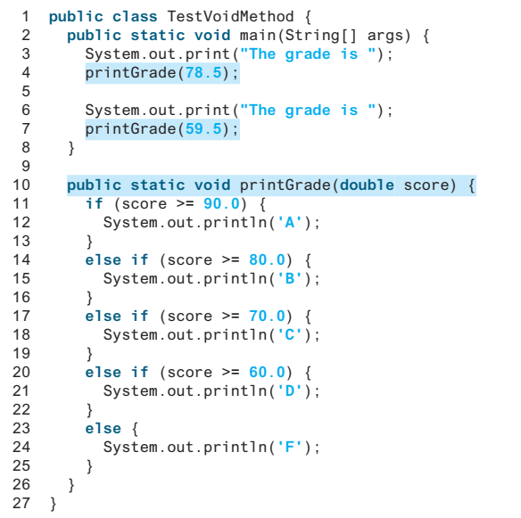
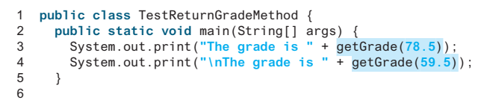
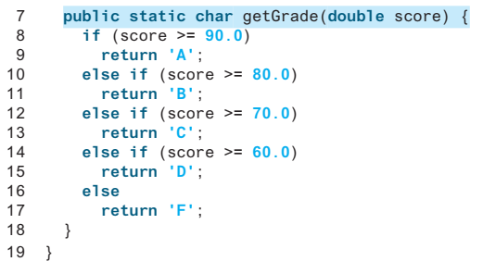
Void vs. Value-Returning Methods
Methods that do not return a value, their invocations stand alone; they are not embedded in another Java statement.
The method getGrade returns a value of type char, and so you can call it anywhere that it is valid to use a value of type char.
System.out.println(printGrade(78.5));
//compilation error
TestVoidMethod.java
TestReturnGradeMethod.java

Slide 67
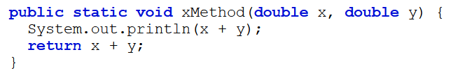
Popup-Question(4): Checkpoint 6.4.6
What would be wrong with not writing a return statement in a value-returning method?
Can you have a return statement in a void method?
Does the return statement in the following method cause syntax errors?
1. A syntax error occurs if a return statement is not used to return a value in a value-returning method.
2. A return statement is not needed for a void method, but it can be used for terminating the method and returning to the method’s caller. The syntax is simply return;
3. Yes, A syntax error occurs.

Slide 68
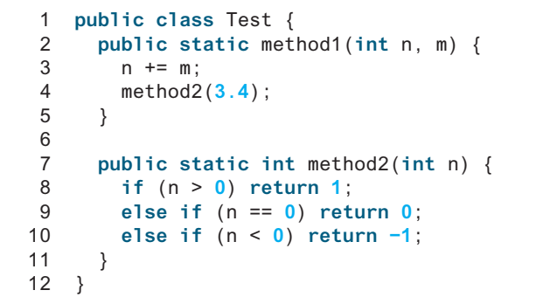
Popup-Question(5): Checkpoint 6.4.9
Identify and correct the errors in the following program
Line 2: method1 is not defined correctly. It does not have a return type or void.
Line 2: type int should be declared for parameter m.
Line 7: parameter type for n should be double to match method2(3.4).
Line 11: if (n < 0) should be removed in method, otherwise a compile error is reported.

Slide 69
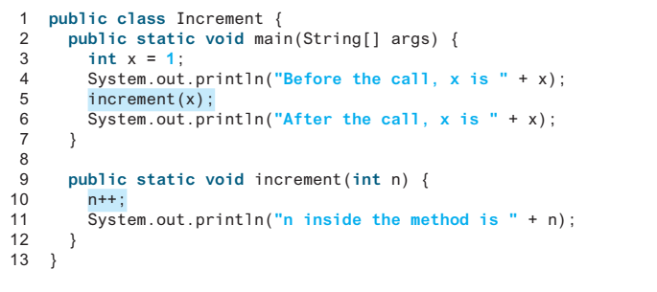
Passing Parameters by Values(1/1)
When you invoke a method with an argument,
The value of the argument is passed to the parameter. This is referred to as pass-by-value.
It makes no difference whether the parameter and the argument have the same name.
The variable is not affected, regardless of the changes made to the parameter inside the method.
The parameter is a variable in the method with its own memory space.
The arguments must match the parameters in order, number, and compatible type, as
defined in the method signature.
Increment.java
Notes:
As given in Listing 6.4, the value of x (1) is passed to the parameter n to invoke the increment method (line 5). The parameter n is incremented by 1 in the method (line 10), but x is not changed no matter what the method does.

Slide 70
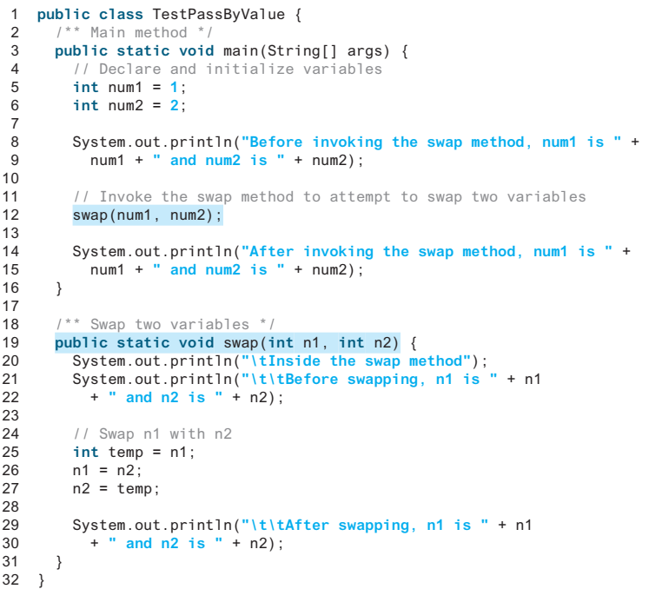
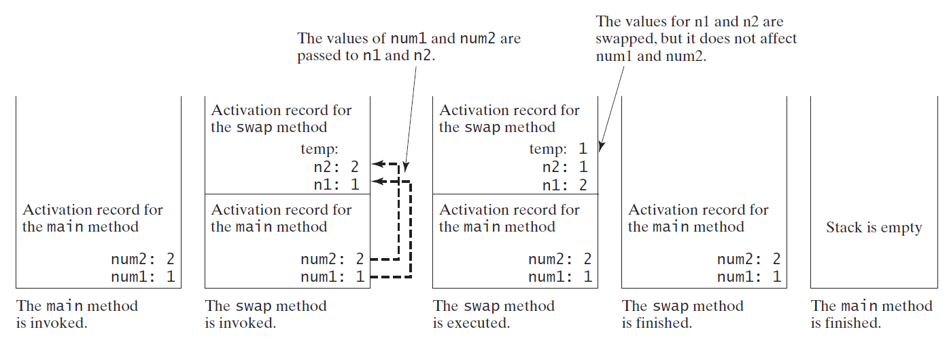
Passing Parameters by Values(2/2)
TestPassByValue.java

Slide 71
Popup-Question(6): Checkpoint 6.5.2
Identify and correct the errors in the following program:
1 public class Test {
2 public static void main(String[] args) {
3 nPrintln(5, "Welcome to Java!");
4 }
5
6 public static void nPrintln(String message, int n) {
7 int n = 1;
8 for (int i = 0; i < n; i++)
9 System.out.println(message);
10 }
11 }
The arguments are not passed in the right order.
n is a parameter, but is redeclared in the nPrintln method in line 7.

Slide 72
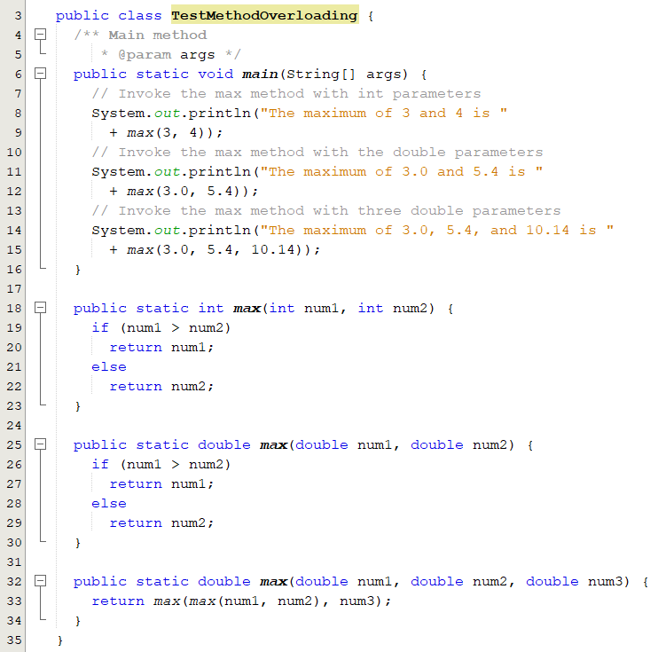
Overloading Methods
A feature that allows you to define more than one method with the same name as long as their parameter lists are different.
If you call max with int parameters,
the max method that expects int parameters will be invoked.
If you call max with double parameters,
the max method that expects double parameters will be invoked.
You cannot overload methods
based on different modifiers or return types.
Two methods or more within one class have the same name but different parameter lists.
TestMethodOverloading.java

Slide 73
Ambiguous Invocation
Ambiguous invocation occurs when there are two or more possible matches for a method call and the compiler cannot determine the most specific match.
Ambiguous invocation is a compile error.
public class AmbiguousOverloading {
public static void main(String[] args) {
System.out.println(max(1, 2.5));
System.out.println(max(1.5, 2));
System.out.println(max(1, 2));
}
public static double max( int num1, double num2) {
if (num1 > num2)
return num1;
else
return num2;
}
public static double max( double num1, int num2) {
if (num1 > num2)
return num1;
else
return num2;
}
}
Both max(int, double) and max(double, int) are possible candidates to match max(1, 2).
Because neither is more specific than the other, the invocation is ambiguous, resulting in a compile error.
AmbiguousOverloading.java

Slide 74
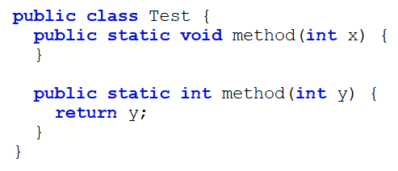
Popup-Question(7): Checkpoint 6.8.2
What is wrong in the following class?
System.out.println(x);
Two method have the same signature method(int).

Slide 75
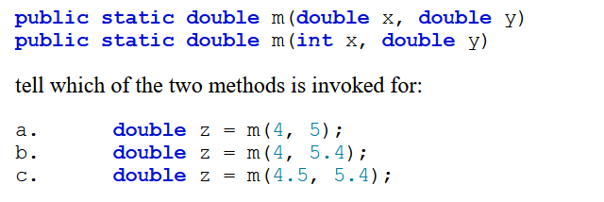
Popup-Question(8): Checkpoint 6.8.3
Given two method definitions,
invokes the second method.
invokes the second.
invokes the first method.

Slide 76
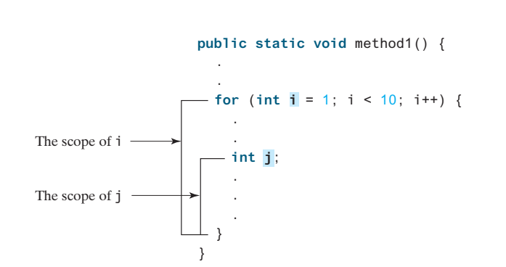
The scope of variables(1/2)
Scope: the part of the program where the variable can be referenced.
A variable defined inside a method is referred to as a local variable.
Must be declared and assigned a value before it can be used.
The scope of a local variable starts from its declaration and continues to the end of the block that contains the variable.
The scope of a method parameter covers the entire method.
A variable declared in the initial-action part of a for-loop header has its scope in the entire loop.

Slide 77
The scope of variables(2/2)
You can declare a local variable with the same name in different blocks in a method,
You cannot declare a local variable twice in the same block or in nested blocks
public static void method1() {
int x = 1;
int y = 1;
for (int i = 1; i < 10; i++) {
x += i;
}
for (int i = 1; i < 10; i++) {
y += i;
}
}
public static void method2() {
int i = 1;
int sum = 0;
for (int i = 1; i < 10; i++) {
sum += i;
}
}
It is fine to declare i in two non-nesting blocks
It is wrong to declare i in two nesting blocks
A common mistake is to declare a variable in a for loop and then attempt to use it outside the loop

Slide 78
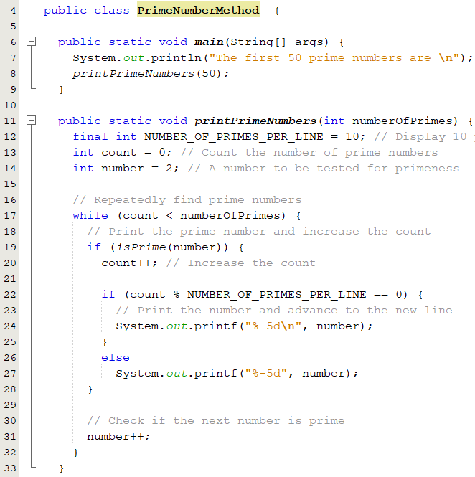
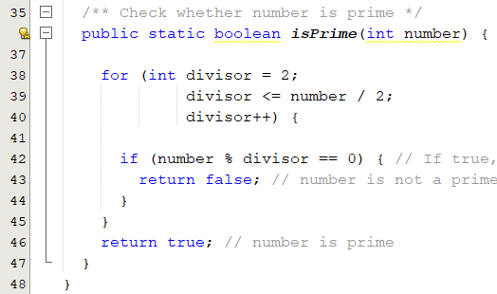
Modularizing Code
Methods can be used to reduce redundant coding and enable code reuse.
Methods can also be used to modularize code and improve the quality of the program.
PrimeNumberMethod.java

Slide 79
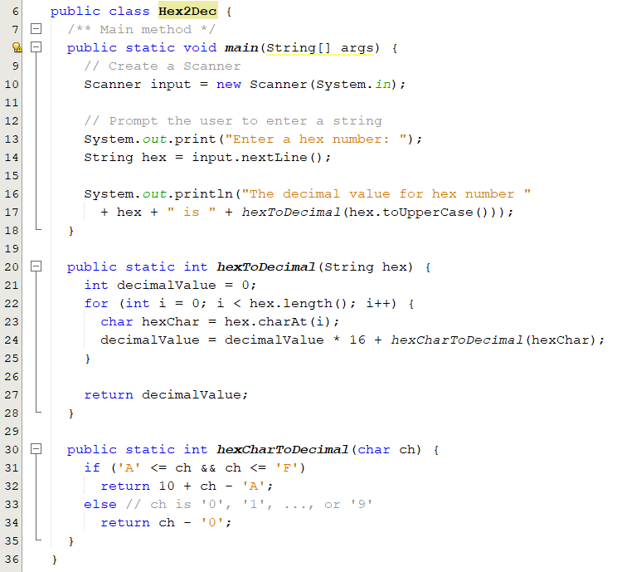
Case Study: Converting Hexadecimals to Decimals
Write a method that converts a hexadecimal number into a decimal number.
ABCD =>
A*16^3 + B*16^2 + C*16^1+ D*16^0
= ((A*16 + B)*16 + C)*16+D
= ((10*16 + 11)*16 + 12)*16+13 = ?

Slide 80
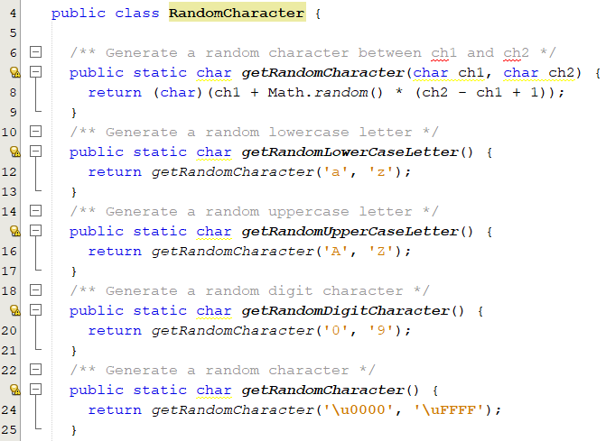
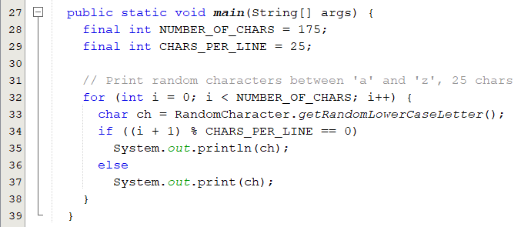
Case Study: Generating Random Characters
Each character has a unique Unicode between 0 and FFFF in hexadecimal (65535 in decimal).
To generate a random character is to generate a random integer between 0 and 65535 using the following expression: (int) (Math.random() * (65535 + 1))
A random lowercase letter is
(char) ('a' + Math.random() * ('z' - 'a' + 1))
RandomCharacter.java

