Slide 1
Module 03: Arrays
Chapter 7

Slide 2
Declaration
Please note that information in this lecture is mainly taken from:
Liang, Y. Daniel - Introduction to Java programming and data structures, comprehensive version (2019, Pearson).

Slide 3
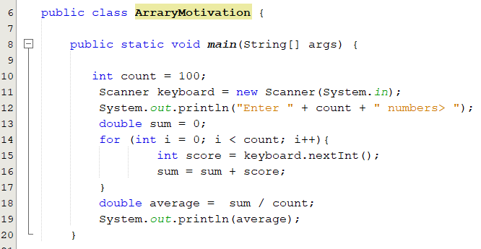
Motivation: Why do we need arrays?
What does the following program do?
Suppose we want to compute the average score of 100 students and find out how many students are above the average.
To be able to count how many students above the average, we must remember the 100 scores and then compare them to the average.
How can we do this? Use 100 variables. What do you think? Is it practical solution?

Slide 4
Motivation: Why do we need arrays?
In many programs, you need to manipulate collections of related values.
It would be impractical to use a sequence of variables such as value1, value2, value3, . . . , and so on.
The array construct provides a better way of storing a collection of values.
Notes:
An array is a data structure used to process a collection of data that is all of the same
type, such as a list of numbers of type double or a list of strings. In this chapter, we
introduce you to the basics of defining and using arrays in Java

Slide 5
Objectives
Declare, create and initialize 1D-array (§§7.2.1–7.2.2).
Access array elements using indexes (§7.2.4).
Process 1D-array:(§7.2.6).
Printing and reading.
Randomly initializing arrays.
Summing array elements.
Finding minimum, maximum and their positions.
Random shuffling.
Shifting arrays.
To copy contents from one array to another (§7.5).
Arrays and methods (passing and returning array) values (§§7.6–7.9).
To search elements using the linear or binary search algorithm (§7.10).
To sort an array using different approaches (§7.11).
To use the methods in the java.util.Arrays class (§7.12)

Slide 6
Introducing Arrays
An array is a sequence of values of the same type.
The values that are stored in the array are called its “elements”
myArray
myArray[0]
myArray[1]
myArray[2]
myArray[3]
myArray[4]
myArray[5]
myArray[6]
myArray[7]
myArray[8]
myArray[9]
4.5
12.1
5.6
2.1
7.3
4.2
5.5
12.0
9.3
45.0
Array reference variable
Element at index 7
8th element
Element value

Slide 7
Declaring 1D-array
To declare an array, define the variable type with square brackets:
dataType[] arrayRefVar ;
Example: double[] myArray;
datatype arrayRefVar[]; // This style is allowed, but not preferred
Example: double myArray[];
No space allocated in the memory for the array.
A space is allocated only for the reference to an array.
Its value is null.
You cannot assign elements to an array unless it has already been created.
Address | value
myArray | null
Notes:
the declaration of an array variable does not allocate any space in memory for the array.
It creates only a storage location for the reference to an array. If a variable does not contain a reference to an array, the value of the variable is null. You cannot assign elements to an array unless it has already been created. After an array variable is declared, you can create an array by using the new operator and assign its reference to the variable with the following syntax: arrayRefVar = new elementType[arraySize];
arrayName = new dataType [6] does two things:
(1) it creates an array using new elementType[6] and (2) it assigns the reference of the newly created array to the variable arrayName

Slide 8
Creating 1D-array
The new operator is used to create an array and assign its reference to the variable with the following syntax:
arrayRefVar = new dataType [arraySize];
e.g. myArray = new double [4];
Address | value
myArray
Address | value
 | 0.0
 | 0.0
 | 0.0
 | 0.0
Declaring and creating an array can be combined in one statement.
double[] myArray = new double [4];
When creating an array:
Its size must be given. It cannot be changed after the array is created.
Size can be obtained using arrayName.length. myArray.length is 4.
Its elements are assigned the default value of 0 for the numeric primitive data types, \u0000 for char types, false for boolean types, and null for objects.
Notes:
Unlike declarations for primitive data type variables, the declaration of an array variable does not allocate any space in memory for the array.
It creates only a storage location for the reference to an array. If a variable does not contain a reference to an array, the value of the variable is null. You cannot assign elements to an array unless it has already been created. After an array variable is declared, you can create an array by using the new operator and assign its reference to the variable with the following syntax: arrayRefVar = new elementType[arraySize];
arrayName = new dataType [6] does two things:
(1) it creates an array using new elementType[6] and (2) it assigns the reference of the newly created array to the variable arrayName

Slide 9
Initializing 1D-array
Initializing 1D-array: Using the Shorthand Notation
dataType[] arrayRefVar = {value₀, value₁, ..., value_{n}};
Examples:
double[] myArray = {3.5, 5.3, 2.7, 5.6};
This is equivalent to
double [] myArray = new double[4];
myArray[0] = 3.5;
myArray[1] = 5.3;
myArray[2] = 2.7;
myArray[3] = 5.6;
Using the shorthand notation, you have to declare, create, and initialize the array all in one statement. Splitting it would cause a syntax error.
double[] myArray;
myArray = {3.5, 5.3, 2.7, 5.6};
Notes:
Java has a shorthand notation, known as the array initializer, which combines the declaration, creation, and initialization of an array in one statement using the following syntax:
elementType[] arrayRefVar = {value0, value1, ..., valuek};
For example, the statement
double[] myArray = {1.9, 2.9, 3.4, 3.5};

Slide 10
Accessing Array Elements
The array elements are accessed through the index.
Array elements are indexed from 0 to array length - 1.
Bounds checking of indices is done by Java.
Each element in the array is represented using the following syntax, known as an indexed variable:
arrayRefVar[index] where 0 <= index < arrayName.length
Example:
double[] myArray = {3.4, 5.3, 2.7, 5.6};
System.out.println(myArray[0]); → 3.4
myArray[2] = 4.5; →
myArray[1] = myArray[0] + myArray[2]; →
0 | 1 | 2 | 3
3.4 | 5.3 | 2.7 | 5.6
0 | 1 | 2 | 3
3.4 | 5.3 | 4.5 | 5.6
0 | 1 | 2 | 3
3.4 | 7.9 | 4.5 | 5.6
Notes:
Array elements are indexed from 0 to array size -1

Slide 11
Trace Program with Arrays
What is the contents of the array after executing the following code?
After line 3
0
1
2
3
4
0
0
0
0
0
1 public class Test {
2 public static void main(String[] args) {
3 int[] values = new int[5];
4 for (int i = 1; i < 5; i++) {
5 values[i] = i + values[i-1];
6 }
7 values[0] = values[1] + values[4];
8 }
9 }
After line 7
0
1
2
3
4
11
1
3
6
10

Slide 12
Popup-Question(1): Checkpoint: 7.2.8
Write statements to do the following:
Create an array to hold 10 double values.
Randomly generate an index and display the element of this index in the array.
Use an array initializer to create an array with the initial values 3.5, 5.5, 4.52, and 5.6.
double[] arr = new double[10];
idx = (int) (Math.random() * arr.length);
System.out.println(arr[idx]);
double[] arr = {3.5, 5.5, 4.52, 5.6};

Slide 13
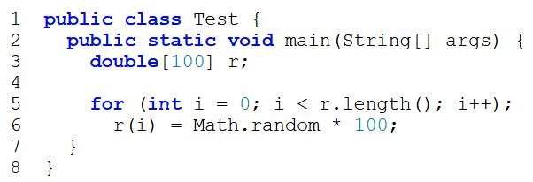
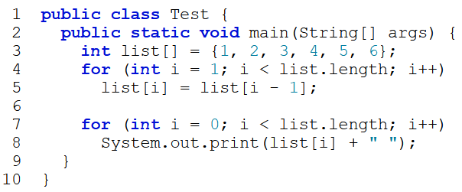
Popup-Question(2)
Checkpoint: 7.2.10: Identify and fix the errors in the following code?
Checkpoint: 7.2.11: What is the output of the following code?
Line 3: the array declaration is wrong. It should be double[]. The array needs to be created before its been used. e.g. new double[10]
Line 5: The semicolon (;) at the end of the for loop heading should be removed.
Line 5: r.length() should be r.length.
Line 6: random should be random()
Line 6: r(i) should be r[i].
Index | 0 | 1 | 2 | 3 | 4 | 5
Value | 1 | 2 | 3 | 4 | 5 | 6
New Value
New Value | 1 | 1 | 1 | 1 | 1 | 1

Slide 14
Processing Array
To process arrays, we often use a loop.
Printing array
System.out.println(Arrays.toString(values));
int[] array = {90, 60, 70, 85, 75};
for( int i = 0; i<array.length; i++){
System.out.println("[" + i + "] = " + array[i]);
}
for (double e: array) {
System.out.print(e + " ");
}
Reading array elements
for (elementType value: arrayRefVar){
// Process the value
}
Scanner input = new Scanner(System.in);
int[] array = new int[5];
System.out.print("Enter " + array.length + " values: ");
for (int i = 0; i < array.length; i++)
array[i] = input.nextInt();
Initializing arrays with random values
int[] array = new int[5];
for (int i = 0; i < array.length; i++)
array[i] = (int) ( Math.random() * 100 );
ArrayWithMethod.java

Slide 15
Processing Array
Summing array elements
int sum = 0;
for (int i = 0; i < array.length; i++)
sum = sum + array[i];
Finding the largest element
int maxNumber = Integer.MIN_VALUE;
for (int i = 0; i < array.length; i++)
if (array[i]> maxNumber )
maxNumber = array[i];
System.out.println("Maximum = " + maxNumber);
Find the smallest index of the largest element?
Random shuffling
int[] array = {90, 60, 70, 85, 75};
for (int i = 0; i < array.length; i++){
int j = ( int ) ( Math.random() * array.length);
int temp = array[i];
array[i] = array[j];
array[j] = temp;
}

Slide 16
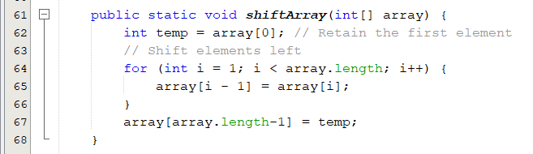
Shifting arrays
Shift array elements right to left
0 | 1 | 2 | 3 | 4 | 5 | 6 | 7 | 8 | 9
50 | 90 | 65 | 80 | 60 | 75 | 95 | 78 | 64 | 81
0 | 1 | 2 | 3 | 4 | 5 | 6 | 7 | 8 | 9
90 | 65 | 80 | 60 | 75 | 95 | 78 | 64 | 81 | 50
Shift array elements left to right?
ArrayShift.java

Slide 17
Array Assignment (1/2)
Array contents are stored together in one section of memory.
The location of the entire array contents can be specified by one memory address, the memory address of the array.
Using = operator
Does not copy the contents of the array referenced by array1 to array2.
Copies the reference value from array1 to array2
Before the assignment
array2 = array1;
After the assignment
array2 = array1;
array1
Elements of array1
array1
Elements of array1
array2
Elements of array2
array2
Elements of array2
Notes:
This statement does not copy the contents of the array referenced by array1 to array2, but instead merely copies the reference value from array1 to array2

Slide 18

Array Assignment (2/2)
Before statement 3
Address | value
 | 10
 | 20
 | 30
 | 0
 | 0
 | 0
Address | value
a
b
int[] a = {10, 20, 30 }
int[] b = new int[3];
b = a;
a[1]++;
print( a[1], b[1] )
after statement 3
Address | value
a
b
Address | value
 | 10
 | 21
 | 30
after statement 4
When we change the value of a[1]
we are also changing the value of b[1]
Address | value
a
b

Slide 19
Copying Arrays
Using a loop:
Using the arraycopy utility
Using clone method
targetArray = sourceArray.clone()
int[] sourceArray = {2, 3, 1, 5, 10};
int[] targetArray = new int[sourceArray.length];
for (int i = 0; i < sourceArray.length; i++)
targetArray[i] = sourceArray[i];
int[] sourceArray = {2, 3, 1, 5, 10};
int[] targetArray = new int[sourceArray.length];
System.arraycopy( sourceArray, 0, targetArray, 0, sourceArray.length);
The syntax for arraycopy is:
arraycopy( sourceArray, srcPos, targetArray, tarPos, length);
ArrayCopy.java
Notes:
You can write a loop to copy every element from the source array to the corresponding element in the target array. The following code, for instance, copies sourceArray to targetArray using a for loop:
Another approach is to use the arraycopy method in the java.lang.System class to copy arrays instead of using a loop. The syntax for arraycopy is:arraycopy(sourceArray, srcPos, targetArray, tarPos, length);

Slide 20
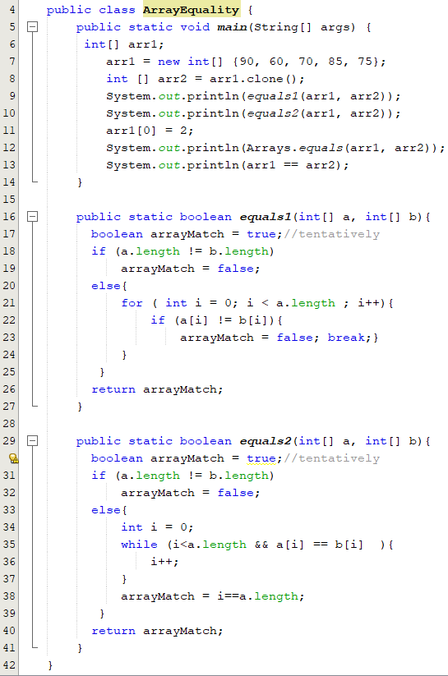
Array Equality
You must test whether each element in one array equals the corresponding element in the other array.
The equality operator = = tests whether two arrays are stored in the same place in the computer’s memory.
If two arrays, a and b, contain the same integers in the same order and the arrays are stored in different places in memory,
So b == a is false, since == tests for equal memory addresses.
If you want to test whether two arrays contain the same elements,
With break
Without break
ArrayEquality.java

Slide 21
Arrays and Methods
You can use both array indexed variables and entire arrays as arguments to methods.
Passing an indexed variable:
Can be an argument to a method in exactly the same way that any variable of the array base type can be an argument.
Suppose we have the following declaration,
int[] myArray = {3, 5, 2, 5};
Suppose that myMethod is a method that takes one argument of type int, so the following is legal
myMethod (myArray[myIndex]) ,where 0<=myIndex<4
Passing an array:
The reference ( name ) of the array is passed to the method.
public static void printArray(int[] a) // printArray is a method that takes argument of type array (int[]).
To call this method, use: printArray( myArray );
Notes:
You can also define a method that has a formal parameter for an entire array so that when the method is called, the argument that is plugged in for this formal parameter is an entire array. Whenever you need to specify an array type, the type name has the form Base_Type[], so this is how you specify a parameter type for an entire array. For example, the method doubleArrayElements, given in what follows, will accept any array of double as its single argument:

Slide 22
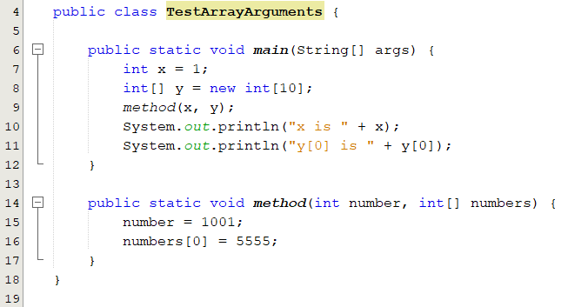
Passing Arrays to Methods
When passing an array to a method, the reference of the array is passed to the method.
Anonymous Array
method(x, new int[]{3, 1, 2, 6, 4, 2});
No explicit reference variable for the array.
TestArrayArguments.java

Slide 23
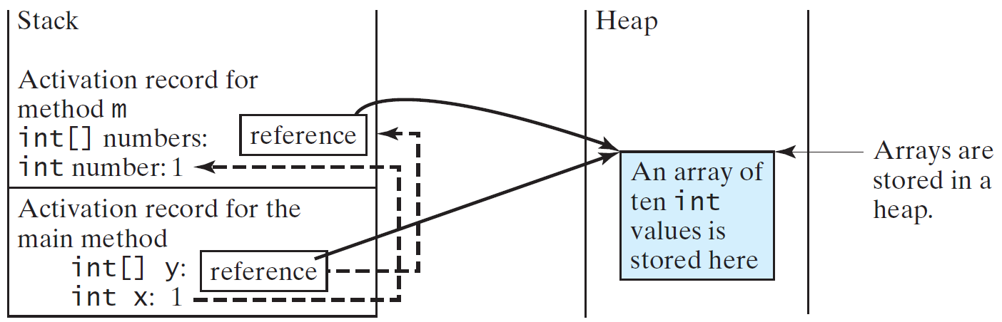
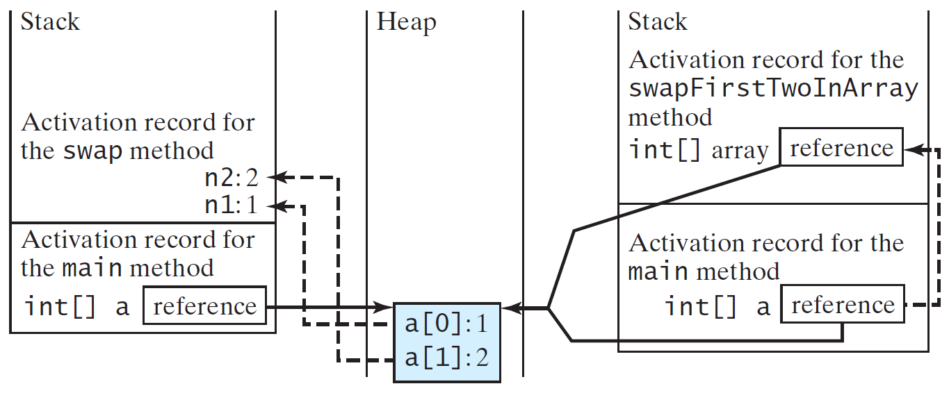
Call Stack
The JVM stores the array in an area of memory, called heap, which is used for dynamic memory.

Slide 24
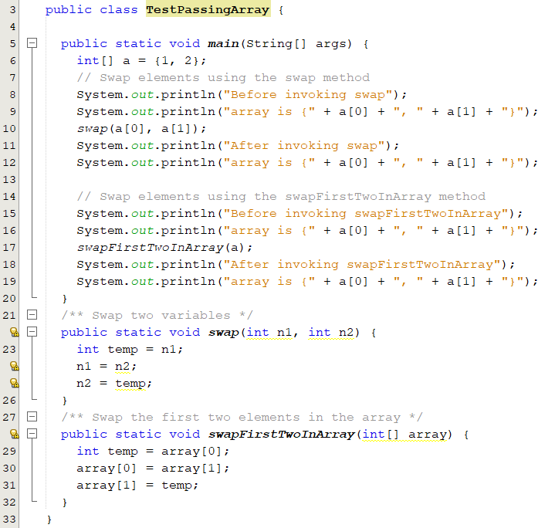
Popup-Question(3)
What is the output of the following code?
Before invoking swap
array is {1, 2}
After invoking swap
array is {1, 2}
Before invoking swapFirstTwoInArray
array is {1, 2}
After invoking swapFirstTwoInArray
array is {2, 1}
TestPassingArray.java

Slide 25
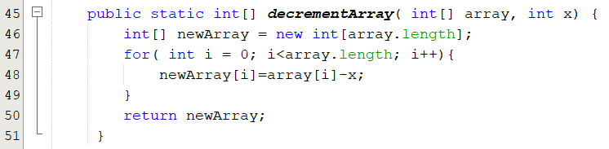
Methods That Return an Array
In Java, a method may return an array.
You specify the return type for a method that returns an array in the same way that you specify a type for an array parameter.
Syntax:
public static dataType[] methodName(Parameter_List)
The following is an example of a method that returns an array:

Slide 26
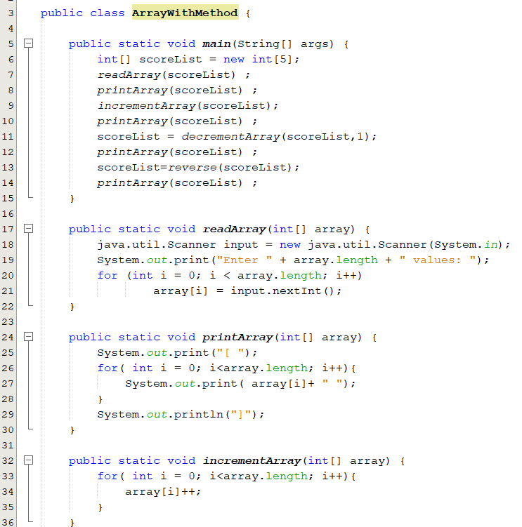
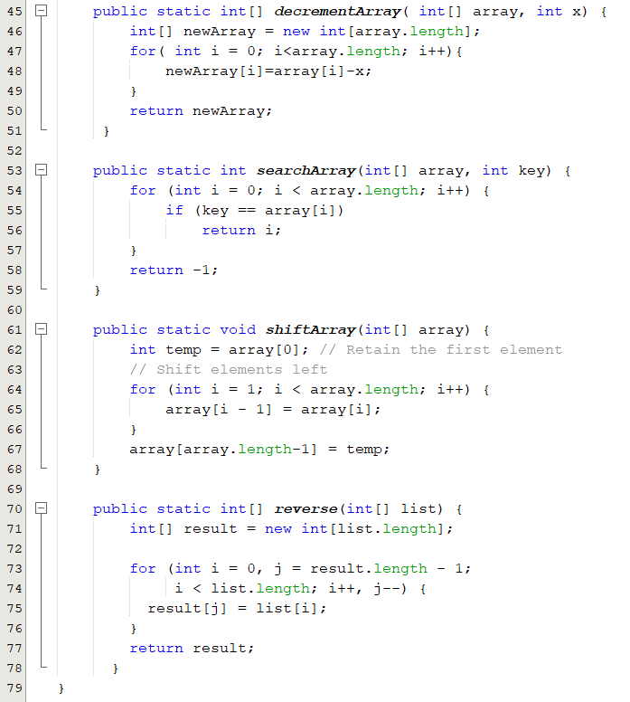
Arrays and Methods: Example
ArrayWithMethod.java

Slide 27
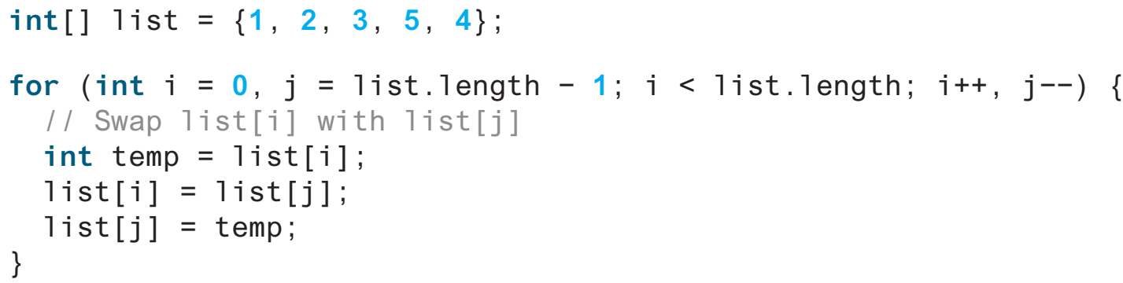
Popup-Question(4): Checkpoint: 7.7.1
Suppose the following code is written to reverse the contents in an array, explain why it is wrong. How do you fix it?
It swaps the elements twice. For example, the first element is swapped with the last element once and then the last element is swapped with the first element another time. In effect, the elements are not swapped. Here is the fix:
i < list.length / 2;

Slide 28
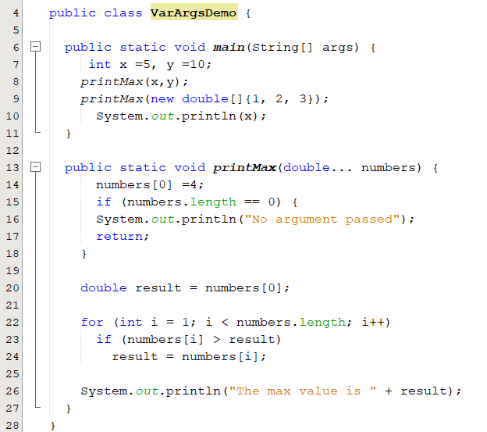
Variable-Length Arguments
You can pass a variable number of arguments of the same type to a method.
Only one variable-length parameter may be specified in a method, and this parameter must be the last parameter.
The method return type cannot be a variable-length parameter
The max value is 10.0
The max value is 4.0
5
VarArgsDemo.java

Slide 29
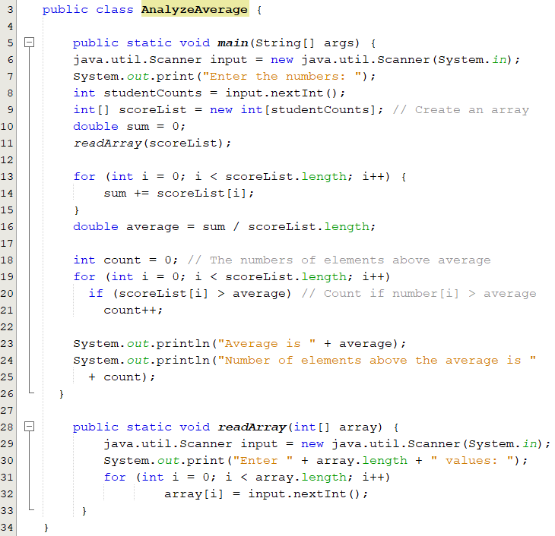
Motivation: Solution
Find the average score of n students and find out how many students are above the average
AnalyzeAverage.java

Slide 30
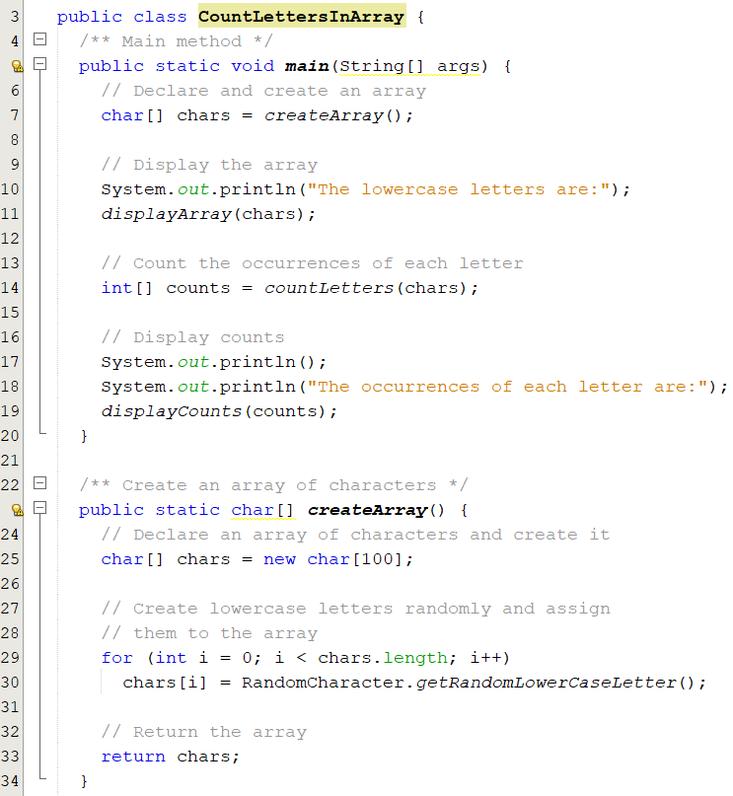
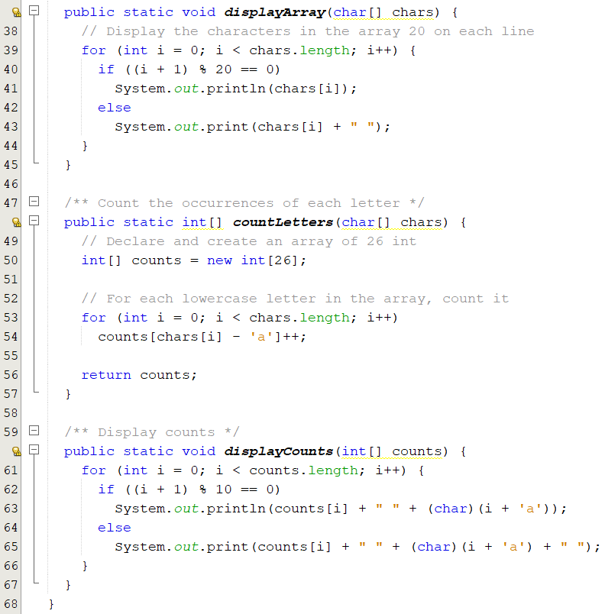
Problem: Counting Occurrence of Each Letter
Generate 100 lowercase letters randomly and assign them to an array of characters. Count the occurrence of each letter in the array.
CountLettersInArray.java

Slide 31
Sorting and Searching I

Slide 32
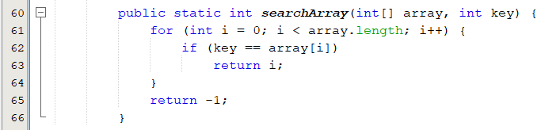
Searching Arrays: The Linear Search Approach
The process of looking for a specific element in an array.
discovering whether a certain value is included in a array.
The Linear Search Approach:
Compares the key sequentially with each element in the array.
It continues to do so until the key matches an element in the array, or the array is exhausted without a match being found.
If a match is made, the linear search returns the index of the element in the array that matches the key.
If no match is found, the search returns -1.

Slide 33
Searching Arrays: The Linear Search Approach
3
6 | 4 | 1 | 9 | 7 | 3 | 2 | 8
Key
array
3
6 | 4 | 1 | 9 | 7 | 3 | 2 | 8
3
6 | 4 | 1 | 9 | 7 | 3 | 2 | 8
3
6 | 4 | 1 | 9 | 7 | 3 | 2 | 8
3
6 | 4 | 1 | 9 | 7 | 3 | 2 | 8
3
6 | 4 | 1 | 9 | 7 | 3 | 2 | 8
Live example
3
6 | 4 | 1 | 9 | 7 | 3 | 2 | 8

Slide 34
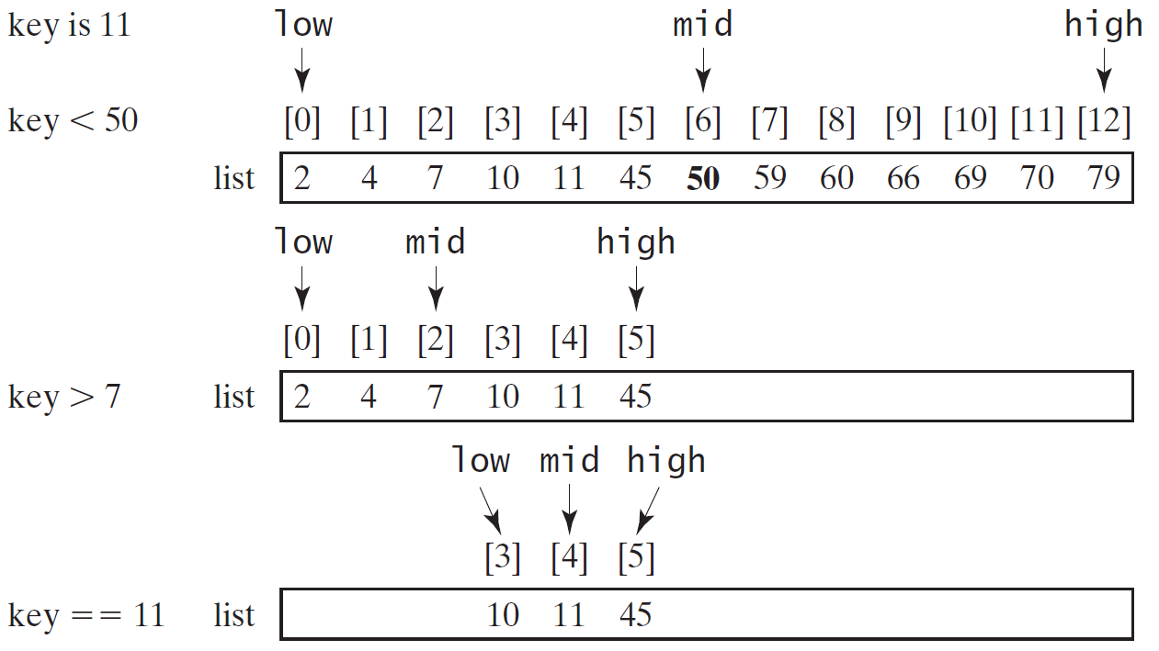
The Binary Search Approach(1/4)
For binary search to work, the elements in the array must already be ordered.
Live example

Slide 35
The Binary Search Approach(2/4)

Slide 36
The Binary Search Approach(3/4)
Elements in the array must already be ordered.
2 4 7 10 11 45 50 59 60 66 69 70 79
The binary search first compares the key with the element in the middle of the array.
If the key is equal to the middle element, the search ends with a match.
If the key is less than the middle element, you only need to search the key in the first half of the array.
If the key is greater than the middle element, you only need to search the key in the second half of the array

Slide 37
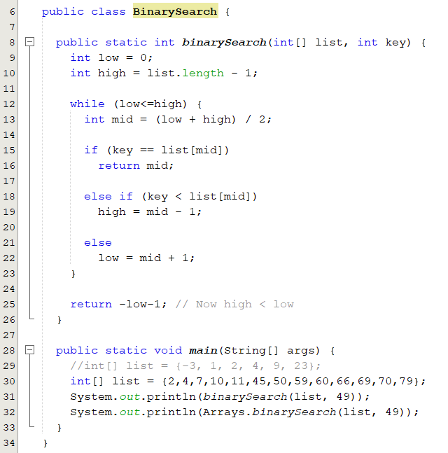
The Binary Search Approach(4/4)
The binarySearch method returns the index of the element in the list that matches the search key if it is contained in the list.
Otherwise, it returns
-insertion point - 1.
The insertion point is the point at which the key would be inserted into the list.
BinarySearch.java

Slide 38
Sorting
Sorting is a common task in computer programming.
There are three reasons for studying sorting algorithms.
They illustrate many creative approaches to problem solving.
Can be applied to solve other problems.
A good for practicing fundamental programming techniques using selection statements, loops, methods, and arrays.
Excellent examples to demonstrate algorithm performance.
The data to be sorted might be integers, doubles, characters, or objects.
Data are stored in an array.
Data are sorted in ascending order.

Slide 39
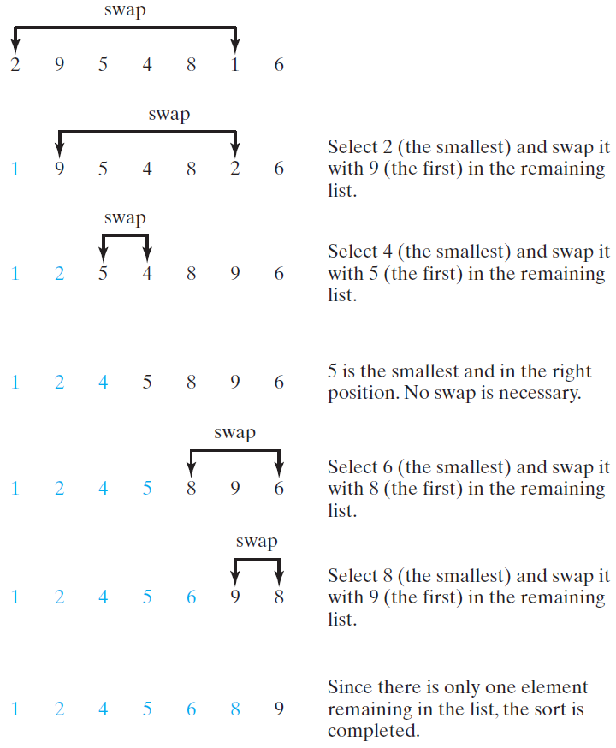
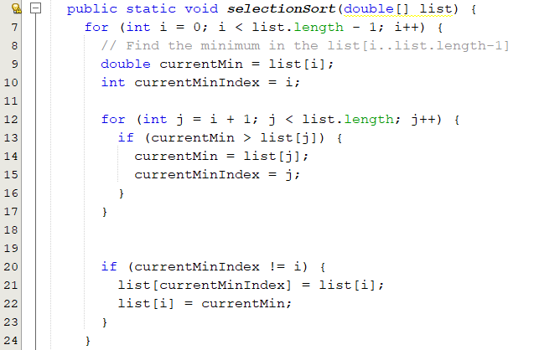
Selection Sort
Finds the smallest number in the list and places it first.
It then finds the smallest number remaining and places it second, and so on until the list contains only a single number.
SelectionSort.java

Slide 40
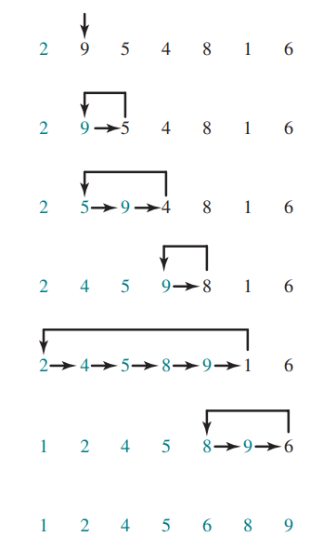
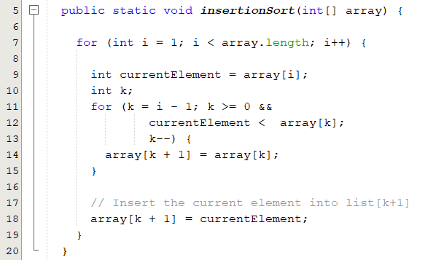
Insertion Sort
The insertion-sort algorithm sorts a list of values by repeatedly inserting a new element into a sorted sublist until the whole list is sorted
InsertionSort.java

Slide 41
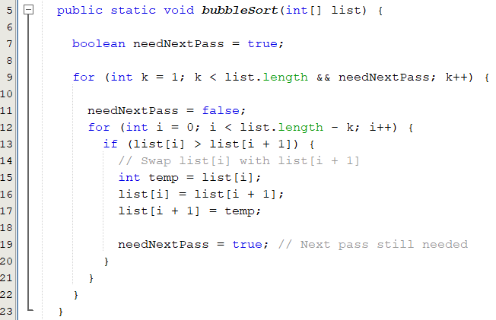
Bubble Sort
A bubble sort sorts the array in multiple passes.
Each pass successively swaps the neighboring elements if the elements are not in order
BubbleSort.java

Slide 42
The Arrays Class
The java.util.Arrays class contains various static methods for
Sorting and searching arrays
Arrays.sort(array);
Arrays.binarySearch(array,15);
Comparing arrays
Arrays.equals(array1, array2);
Filling array elements
Arrays.fill(array, 1);
Returning a string representation of the array.
Arrays.toString(array);
These methods are overloaded for all primitive types.

