Slide 1
Module 5: Inheritance & Polymorphism
Chapter 11
Notes:
In the last lecture, you learned how to write individual classes consisting of attributes and methods (operations). You also learned how to use existing classes (e.g., String and Scanner) to facilitate your programming. These classes are part of the Java Application Programming Interface (API).

Slide 2
Motivation
Person
Faculty
Staff
Student
Code sharing
Why do we need Inheritance?
Code reusability:
Classes may have some common features and behaviors.
Can be generalized in a class that can be shared by other classes.
Avoid redundancy
Create a special version of the class without rewriting the existing code.

Slide 3
Objectives
To describe inheritance as a feature of OOP(§11.1).
To learn how to implement inheritance (§11.2).
To learn what is inherited from super/parent class.
To learn how to override and overload class’s methods (§11.4).
To distinguish differences between overriding and overloading (§11.5).
To learn how to invoke super class’s methods and constructors (§11.3).
To learn how access modifiers affects inheritance(§11.14) .
To learn about object class and its toString method (§11.6).
To learn how to prevent class extending and method overriding (§11.15).
Notes:
This lecture describes important features of Java that support Object‐Oriented Programming (OOP). Object‐oriented languages allow you to build and exploit hierarchies of classes in order to write code that may be more easily reused in new applications.
You will learn how to extend an existing Java class to define a new class that inherits all the attributes of the original, as well as having additional attributes of its own.
We also discuss class Object, which all classes extend, and we describe several of its methods that may be used in classes you creat

Slide 4
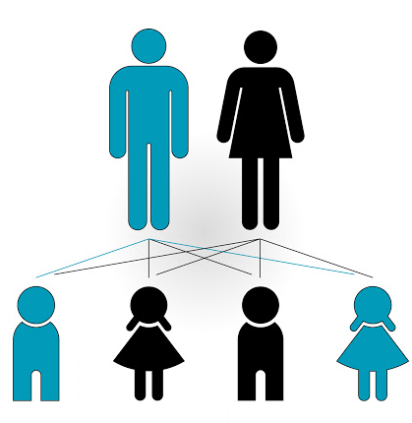
Inheritance in Real life
Children inherit some characteristics from their parents.
They have their own characteristics.

Slide 5
Inheritance
A parent-child relation between classes in OOP.
The process by which a new class is derived from another class.
One class inherits capabilities from another class.
The relation between a child class and its parent class is called “is-a relation”. Student is a Person
Person class is the parent/baseclass/superclass of Student class.
Student class is a child/subclass/derived/extended class of the Person class.
An existing class (a general class ) has collection of fields and methods.
Another class (a specialized class ) inherits them and adds its own new features.
Can add new data fields and methods.
Can override superclass methods.
Person
Staff
Student
PhD Student
Notes:
Talk about function in python
How they are used to reuse code. ( projects)
Inheritance is the process by which a new class—known as a derived class—is created from another class, called the base class.
A derived class automatically has all the instance variables and all the methods that the base class has, and can have additional methods and/or additional instance variables.
Inheritance allows you to define a very general class and then later define more specialized classes that add some new details to the existing general class definition. This saves work, because the more specialized class inherits all the properties of the general class

Slide 6
Inheritance Implementation
In Java, a class can only extend one class.
The extends keyword is used to implement inheritance.
Syntax:
class BaseClassName {
}
Subclass
Superclass
class DerivedClassName extends BaseClassName{
}

Slide 7
Inheritance: Example 1 (1/5)
Define classes to model circles, rectangles, squares and triangles.
These classes have many common features.
Color, filled or unfilled, date created, etc.
What is the best way to design these classes so as to avoid redundancy and make the system easy to comprehend and easy to maintain?

Slide 8
Inheritance: Example 1 (2/5)
A general class SimpleShape can be used to model all geometric shapes.
Contains common features: color, filled, date created, etc…
Contains common behavior: Set color, get color, set filled, set date created
A specialized class can be defined for each shape.
Each one has its own special features (attributes).
Circle: radius, diameter.
Rectangle: width, height
Each one has its own special behavior ( methods).
Circle: set radius. Rectangle: get width.
Each one inherits the common features from the SimplShape class.
Color, data created
Redefine the behavior of the superclass
Override methods.
Notes:
Ageneral class GeometricObject can be used to model all geometric objects.
This class contains the properties color and filled and their appropriate getter and setter methods. Assume this class also contains the dateCreated property, and the getDateCreated()
Since a circle is a special type of geometric object, it shares common properties and methods with other geometric objects. Thus, it makes sense to define the Circle class that extends the GeometricObject class.
Likewise, Rectangle can also be defined as a special type of GeometricObject.

Slide 9
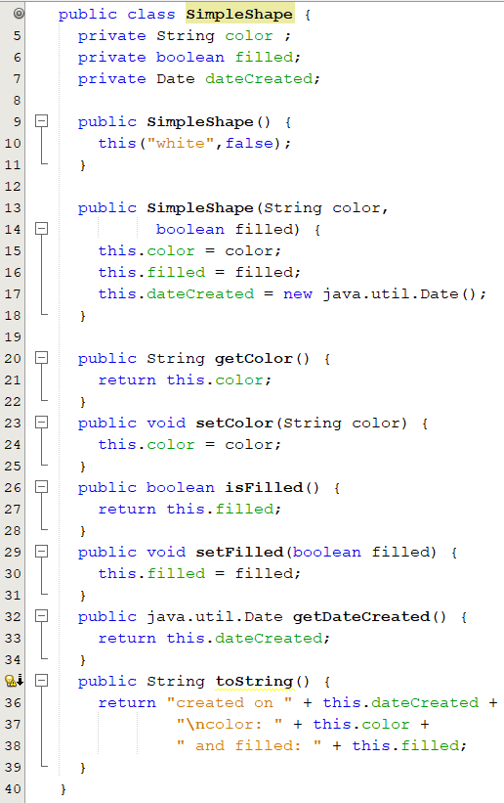
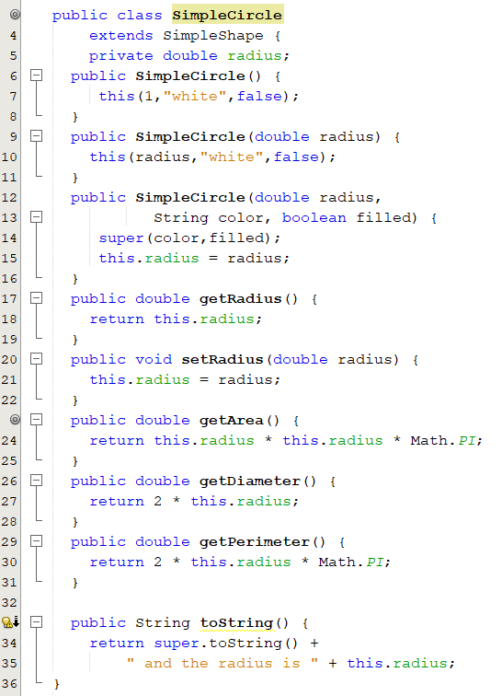
Inheritance: Example 1 (4/5)

Slide 10
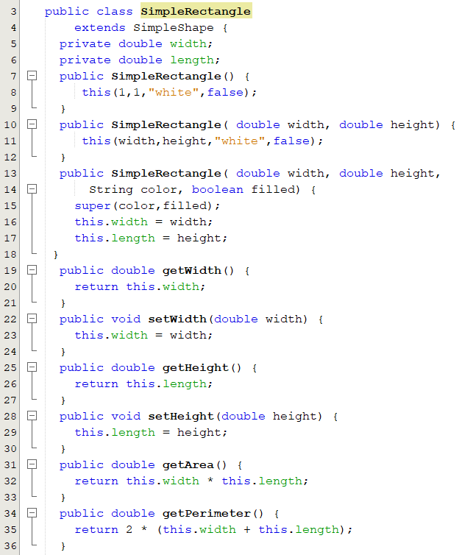
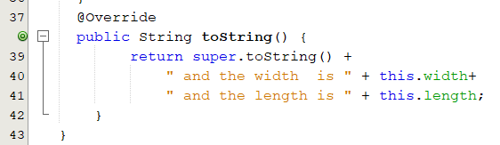
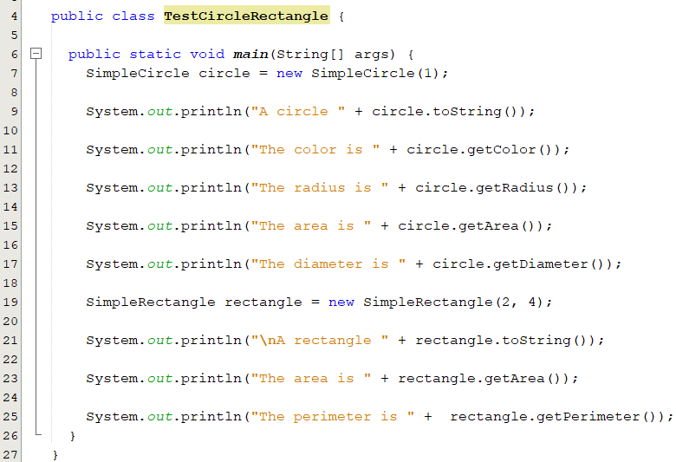
Inheritance: Example 1 (5/5)

Slide 11
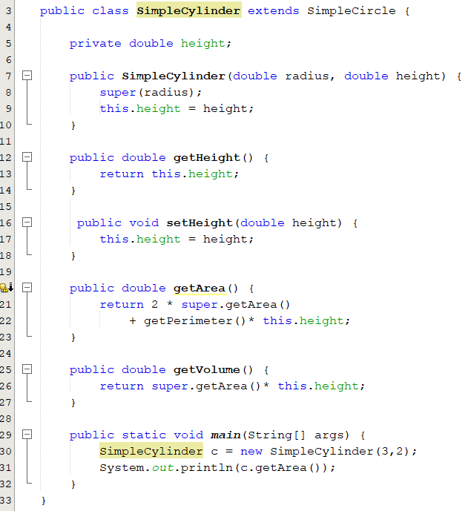
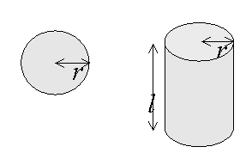
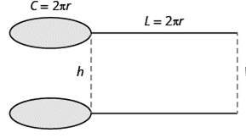
Inheritance: Example 2 The Circle and Cylinder Classes
We want to define a Cylinder class. Cylinders are like Circles, but they have another variable, their height.
public double getSurfaceArea() {
return 2 * getArea()
+ getPerimeter()*height;
}

Slide 12
Calling Superclass Constructors
The constructors of a superclass are not inherited by its subclasses.
A constructor may invoke an overloaded constructor or its superclass constructor
They can only be invoked EXPLICILY from the constructors of the subclass using the keyword super, it should be the first statement.
If neither is invoked explicitly(super/sub class constructor), the compiler IMPLICITLY invokes the default constructor of the superclass when we create the object of the subclass.
public A() {
this(3);
}
public A(int x) {
}
public A() {
this(3);
}
public A(int x) {
super();
}
is equivalent to
Notes:
If the execution of any constructor in a subclass does not invoke a superclass constructor,
Java automatically invokes the no‐parameter constructor for the superclass. Java does this to
initialize that part of the object inherited from the superclass before the subclass starts to
initialize its part of the object. Otherwise, the part of the object that is inherited would
remain uninitialized.

Slide 13
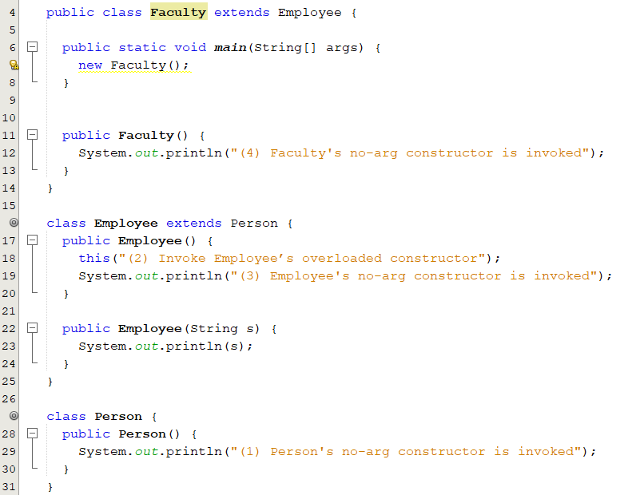
Constructor Chaining
4
3
Employ() does not call Person() implicitly since it calls another constructor, Employ(String s)
X
2
1

Slide 14
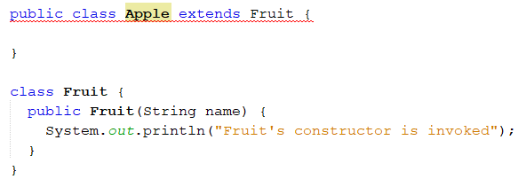
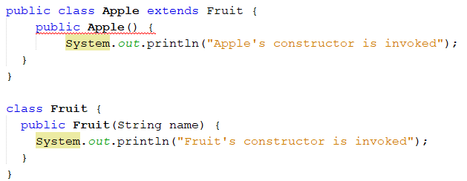
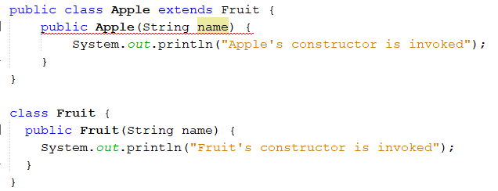
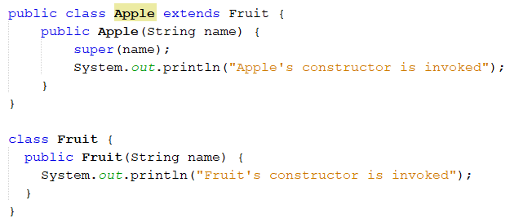
Impact of a Superclass without no-arg Constructor
The subclass Apple implicitly invokes the no-arg constructor of the superclass Fruit.
However, there is no such constructor in the superclass. The compiler doesn’t add a default one because it contains a
parameterized constructor.
Thus, A compilation error occurs.
The subclass calls the parameterized Constructor using super(name). So, no compilation error occurs

Slide 15
Using the super Keyword
The keyword super refers to the superclass of the class in which super keyword appears.
It can be only used in the child class in two ways:
To call a direct parent constructor:
Use arguments to specify the desired constructor. super(); or super(name);
To call direct parent methods, even the overridden methods.
super.method(arguments); // super.super.method(); is not allowed.
To access a direct parent dataField.
super.dataField
It must be the first line of the child constructor.
You can not call the constructor using its name.
Why do we need to call the constructor of the super class?
Notes:
A call to the base class constructor can never use the name of the base class, but uses the keyword super instead

Slide 16
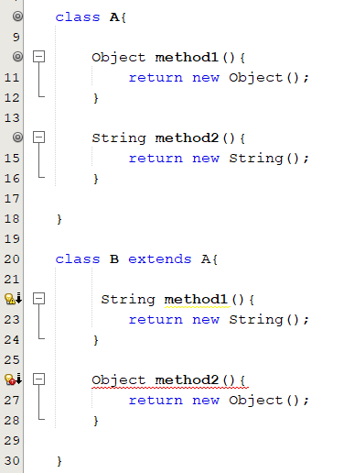
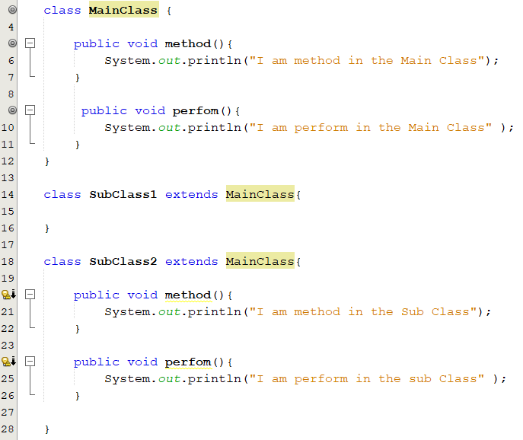
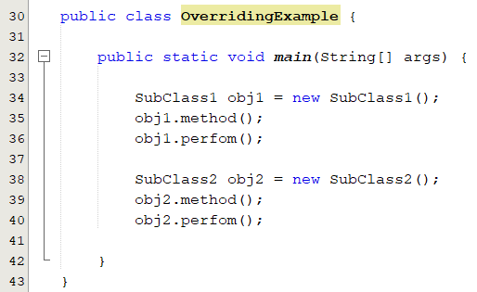
Overriding Methods
Method overriding: modifying the implementation of a method defined in a superclass by its subclass.
To override a method, the method must be defined in the subclass using the same:
Signature and return type. Can be compatible return type.
covariant return type
Compatible means: a subtype of the overridden method’s return type.
A child class type is compatible with a parent class type.

Slide 17
Overriding Methods
You can only override accessible instance methods.
private methods cannot be overridden. They are not accessible outside their own class.
Static methods cannot be overridden: if a static method redefined in a subclass, the method defined in the superclass is hidden.
Hidden methods can be invoked using the syntax SuperClassName.staticMethodName
To invoke an overridden/hidden superclass method from a subclass, use super.method() or super.method(args).
Notes:
A subclass inherits methods from a superclass. Sometimes, it is necessary for the subclass to modify the implementation of a method defined in the superclass. This is referred to as method overriding.
The overriding method must have the same signature as the overridden method and same or compatible return type. Compatible means that the overriding method’s return type is a subtype of the overridden method’s return type. ■■ An instance method can be overridden only if it is accessible. Thus, a private method cannot be overridden, because it is not accessible outside its own class. If a method defined in a subclass is private in its superclass, the two methods are completely unrelated. ■■ Like an instance method, a static method can be inherited. However, a static method cannot be overridden. If a static method defined in the superclass is redefined in a subclass, the method defined in the superclass is hidden. The hidden static methods can be invoked using the syntax SuperClassName.staticMethodName

Slide 18
Overriding Methods: Changing the Access Permission
You can change the access permission of an overridden method in any way that makes access permissions more permissive(not restricted).
You cannot replace public/protected by private
Doing that would break the “is-a” relationship
It is required that all subclass objects be able to respond to method calls that are made to public methods declared in the super class.
Method in the base class | Method in the child class
Public | Public
Protected | Protected or public
Default | Default, protected or public
Private | Private, default, protected or public (not overridden )
Instance | Instance. Otherwise (a compile-time error)
Static | Static. Otherwise (a compile-time error) (not overridden )
A Subclass Cannot Weaken the Accessibility
AccessModifierOverriden.java
Notes:
The access specifier for an overriding method can allow more, but not less, access than the overridden method. For example, a protected instance method in the superclass can be made public, but not private, in the subclass.
This makes sense, because you want code written for the base class method to work for the derived class method. You can use a public method anyplace that you can use a private method, but it is not true that you can use a private method anyplace that you can use a public method.
Once a method is declared public in a super class, the method remains public for all direct and indirect subclasses

Slide 19
Overloading Methods
Defining multiple methods with the same name.
The compiler determines which method should be invoked by signature matching:
method name and parameter types and number of parameters.
Signature differentiate one from another.
printAge( int age) and printAge( double age ) are different
printAge( int age) and printAge( int myAge ) are the same
printAge( String name, int age) and printAge( int age, String name) are different
√
×
√

Slide 20
Overriding vs. Overloading
Overridden Methods
Allow to define similar task in different ways for different classes.
In different classes related by inheritance.
Have the same signature.
Overloaded Methods
Allow to define similar task in different ways for different data.
Can be either in the same class, or in different classes related by inheritance.
Have different signature.

Slide 21
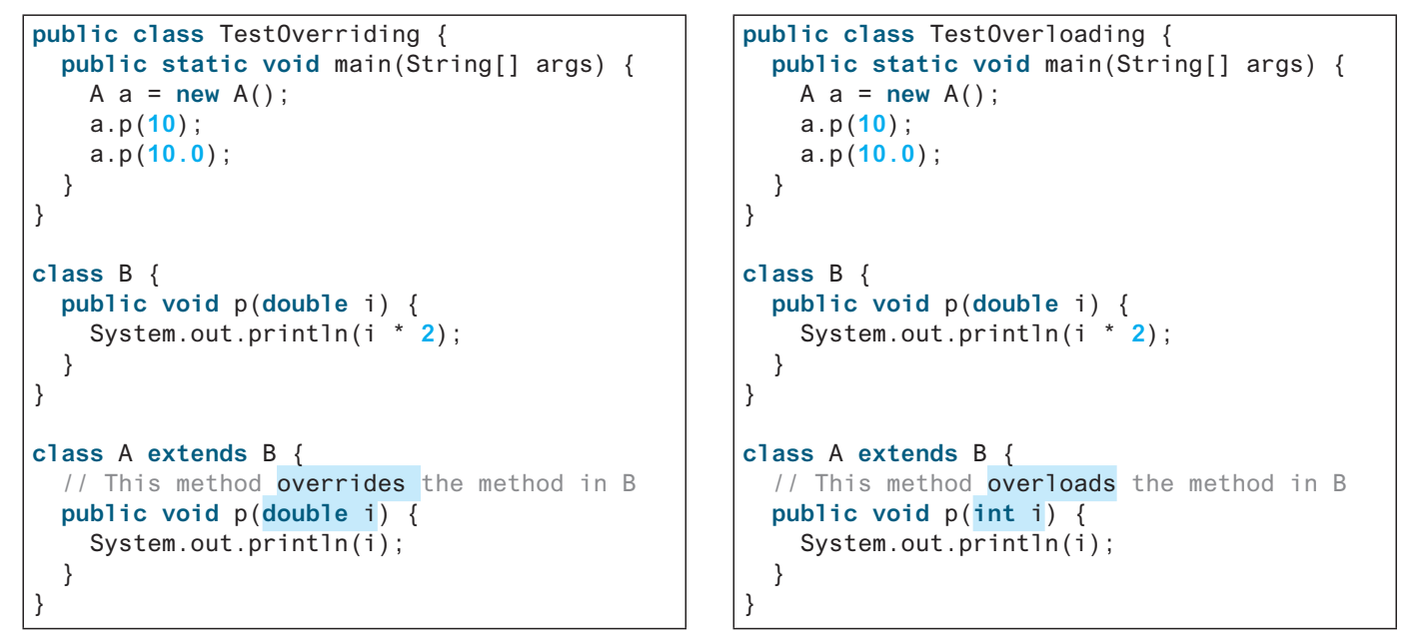
Overriding vs. Overloading: Example
When the child class overloads a method in the super class it still inherits the original method from the super class as well.

Slide 22
Access Modifiers and Inheritance
private, default, protected, public
A protected member of a class can be accessed from a subclass.
package
Modifiers on members in a class | Same Class | Same Package | Another Package
Public | Yes | Yes | Yes
Protected | Yes | Yes | No ( Yes if subclass)
Default (no keyword) | Yes | Yes | No
Private | Yes | No | No

Slide 23
Access Modifiers and Inheritance
Notes:
The data field v4 inherited from class Computer have private visibility. Therefore, they can be
accessed only within class A. Because it is fairly common for a subclass method to
reference data fields declared in its superclass, Java provides a less restrictive form of visibility called protected visibility. A data field (or method) with protected visibility can be accessed
in the class defining it, in any subclass of that class, or in any class in the same package

Slide 24
Final Keyword with Inheritance
The final class cannot be extended
public final MyClass{
}
The final variable is a constant
final static double PI = 3.14159;
Final variables must be initialized when they’re declared (static variables) or by each of a class’s constructors( instance variables)
The final method cannot be overridden by its subclasses
public final void methodName()
The final modifier can also be used with local variables in a method.
Notes:
An entire class can be declared final, in which case you cannot use it as a base class to derive any other class
example: public final MyClass{ }
To specify that a method cannot be overridden by derived class, you can add the final modifier to the method heading
Example: public final void methodName()

Slide 25
The Object Class
The parent class of all the classes in java by default.
Every Java class is a direct or indirect descendant (or subclass) of the Object class of the java.lang package.
Every object of every class is of type Object as well as being of the type of its class and all its ancestor classes.
Student x = new Student();
Person x = new Student();
Object x = new Student();
Person
Defines the basic state and behavior that all objects must have:
convert to a string.
compare oneself to another object.
return the object's class.
Staff
Student
PhD Student

Slide 26
The Object Class
Every class you use or write inherits the instance methods of Object class.
Three of these methods are:
public String toString()
Returns a string representation of the object.
public boolean equals(Object obj)
returns true if the objects are equal, false otherwise.
public final Class getClass()
Returns a Class object, which has methods you can use to get information about the class
obj.getClass().getName()

Slide 27
The toString Method
The toString method returns a string representation of the data in the calling object in the form:
“class name @ hexadecimal hash code”
System.out.println is written so that it automatically invokes toString() method.
Examples:
Circle circle1 = new Circle();
Circle circle2 = new Circle();
System.out.println(circle1.toString());
System.out.println(circle2);
The output:
Circle@2c69421d
Circle@ae03421d
invoked automatically whenever an object reference is used in a String context

Slide 28
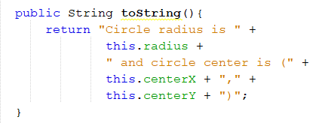
The toString Method
The toString() method can be overridden to return informative String representation of the object that contains information about its instance variables.
Examples: in the circle class that we defined earlier
System.out.println(circle1.toString());
System.out.println(circle2);
The output:
Circle radius is 10.0 and circle center is (0.0 , 0.0)
Circle radius is 15.0 and circle center is (0.0 , 1.0)

Slide 29
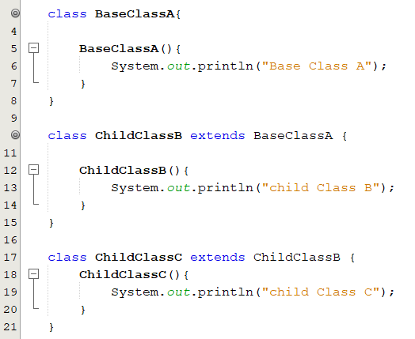
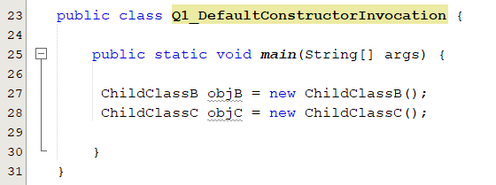
Popup-Question(1): Invocation of the Default Constructor
What would be the output if we run the following code?
Base Class A
Child Class B
Base Class A
Child Class B
Child Class C
Notes:
you can invoke a constructor of the base class within the definition of a derived class constructor. A constructor for a derived class uses a constructor from the base class in a special way.
The statement super() invokes the no-arg constructor of its superclass, and the statement
super(arguments) invokes the superclass constructor that matches the arguments. The
statement super() or super(arguments) must be the first statement of the subclass’s constructor; this is the only way to explicitly invoke a superclass constructor

Slide 30
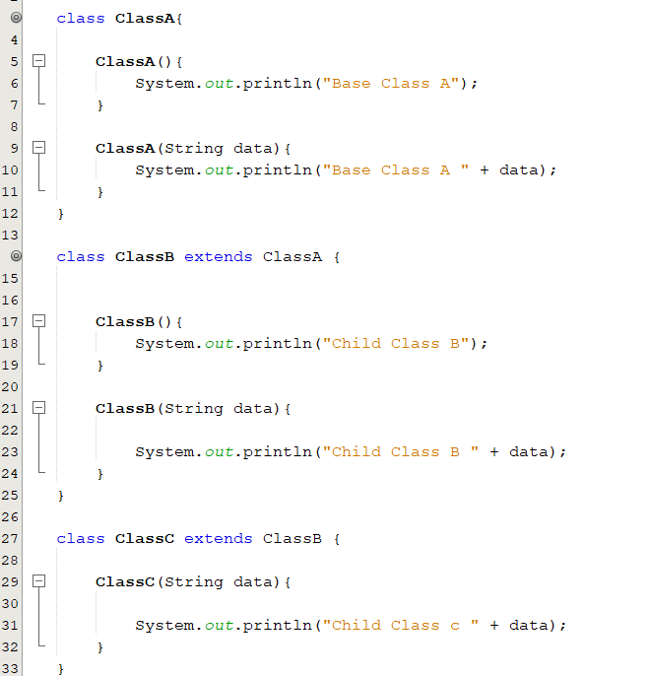
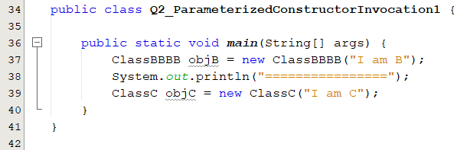
Popup-Question(2): Invocation of Parameterized Constructor
What would be the output if we run the following code?
Base Class A
Child Class B I am B
================
Base Class A
Child Class B
Child Class c I am C
What would happen if we remove the constructor ClassA or ClassB?
An error occurs if no such default constructor exists.

Slide 31
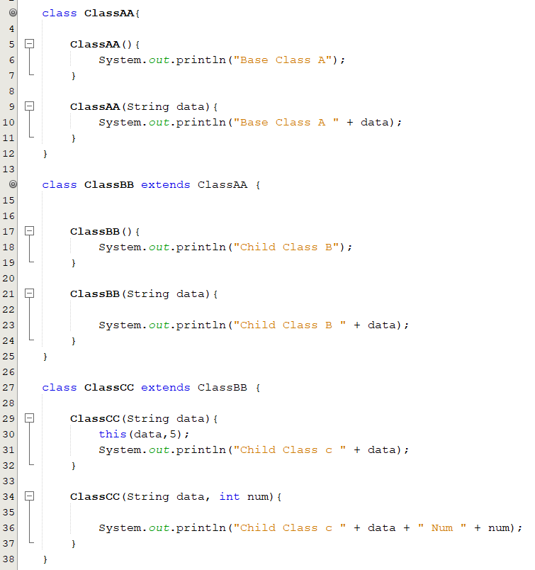
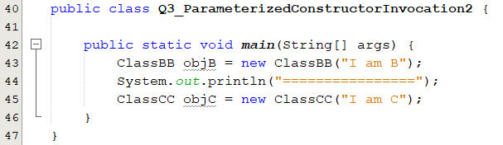
Popup-Question(3): Invocation of Parameterized Constructor
What would be the output if we run the following code?
Base Class A
Child Class B I am B
================
Base Class A
Child Class B
Child Class c I am C Num 5
Child Class c I am C
What would happen if we remove the constructor ClassA or ClassB?
An error occurs if no such default constructor exists.

Slide 32
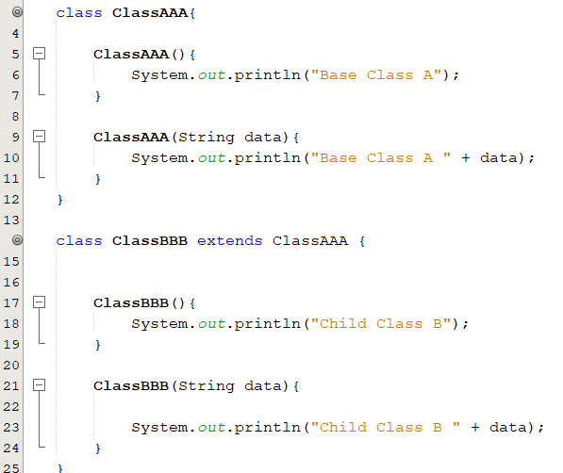
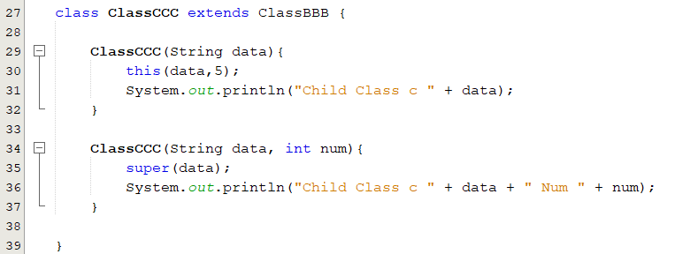
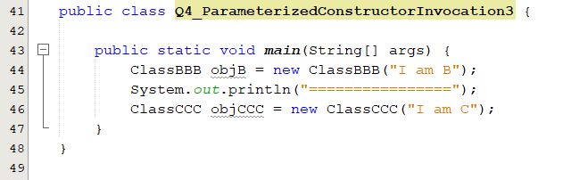
Popup-Question(4): Invocation of Parameterized Constructor
What do you expect the output?
Base Class A
Child Class B I am B
================
Base Class A
Child Class B I am C
Child Class c I am C Num 5
Child Class c I am C
What would happen if we remove the constructor ClassA or ClassB?

Slide 33
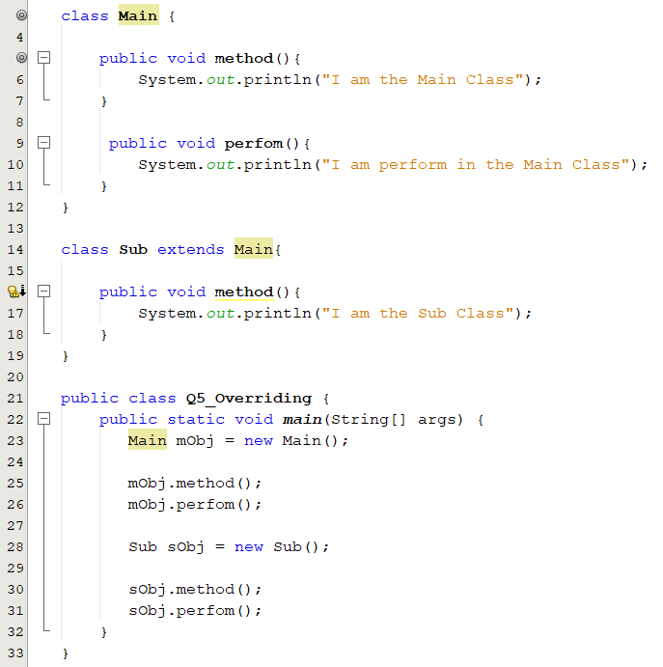
Popup-Question(5): Overriding Methods
What is the output of the following code?
I am the Main Class
I am perform in the Main Class
I am the Sub Class
I am perform in the Main Class

Slide 34
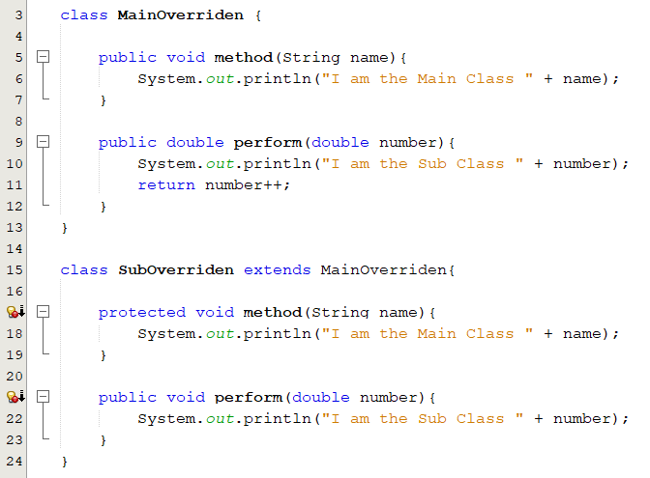
Popup-Question(6): Overriding Methods
What is legal and illegal in the following classes?
Attempting to assign weaker access privileges; protected. It was public, line 5.
return type void is not compatible with double as declared in line 9
Q6_Overriding.java

Slide 35
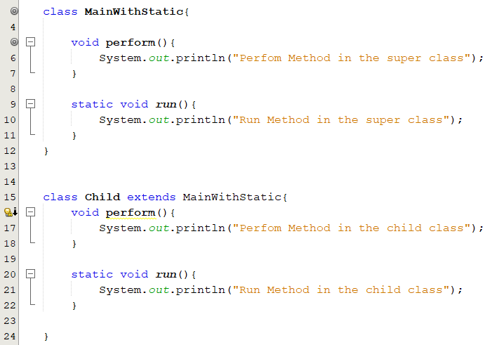
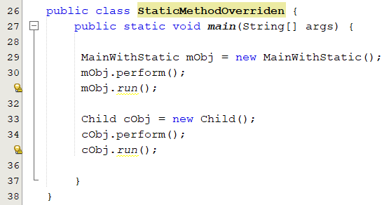
Popup-Question(7): Overriding Methods
What is the output of the following code?
Perfom Method in the super class
Run Method in the super class
Perfom Method in the child class
Run Method in the child class

Slide 36
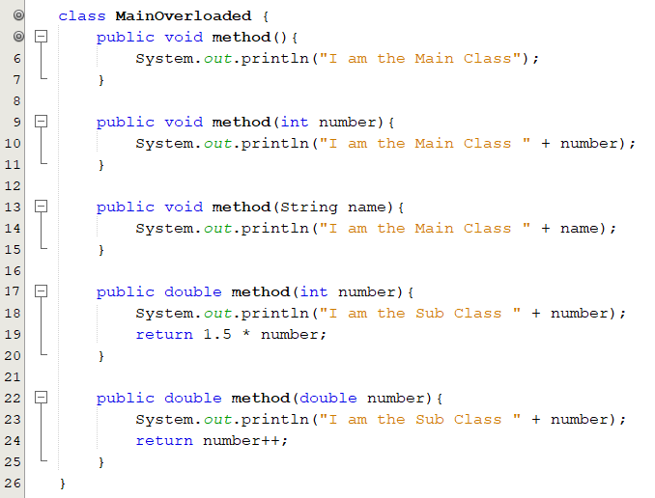
Popup-Question(8): Overloading Methods
What is legal and illegal in the following class?
method( int ) is already defined in line 9.
Q8_Overloading.java

Slide 37
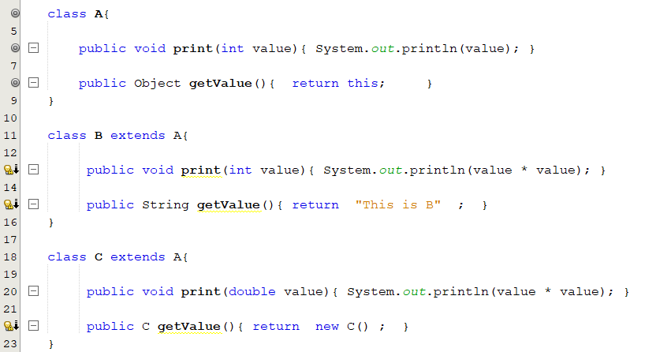
Popup-Question(9): Overriding vs. Overloading
Which are overridden/overloaded methods?
Overriding
Overriding
Overloading
Overriding
Q9_OverrideOverload.java

Slide 38
Module07: Polymorphism
Chapter 11

Slide 39







Introduction
What is common among pictures on each side?
In real life: the ability to perform a single action in different ways.

Slide 40
Objectives
To understand the polymorphism concept (§11.7).
To differentiate between static and dynamic binding (§11.8).
To understand casting (§11.9).
To explore the equals method in the Object class (§11.10).

Slide 41
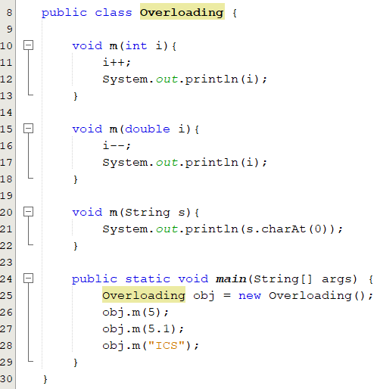
What is Polymorphism?
In programming:
Example: we can use + operator for number addition and string concatenation based on operands.
In OOP programming: the capability of an object to respond differently to the same message (method call).
Methods appear in multiple forms. Overloading
Do different things based on methods signature.
Methods appear in class inheritance hierarchy. Overriding
Do different things based on the object that it is acting upon.
Polymorphism means many (poly) shapes (morph)
The term polymorphism literally means "having many forms”

Slide 42
Polymorphism and Inheritance
An object can have several types because of inheritance.
Every instance/object of a subclass is also an instance of its superclass, but not vice versa.
An object of a class can be referenced by a variable of any ancestor type
An object of a child class has the type of the child class(itself), and it also has the type of its ancestor classes (higher level classes)
A student object is an instance of the Student class
A student object is an instance of the Person class
Person personObj = new Person();
Student studentObj = new Student();
PhdStudent phdStudent = new PhdStudent();
Person studentObj = new Student();
What else?
Person
Student
PhD Student
Notes:
The Person class is used to derive a class called Student. A Student is a person.
Therefore, Person reference could be used to point to a Student object.

Slide 43
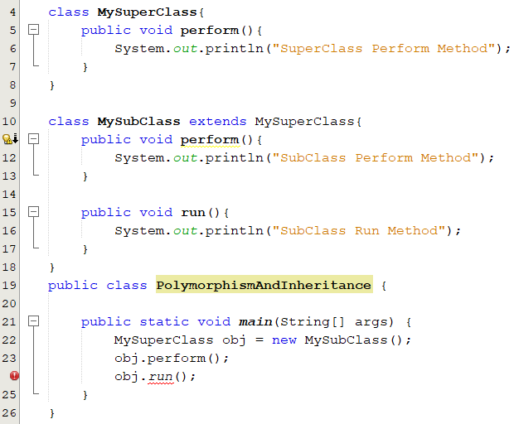
Polymorphism and Inheritance
A reference variable’s type determines what methods can be used at compile time.
A superclass reference variable can be used to invoke only methods declared in the superclass.
Person studentObj = new Student();
The object’s type determines which definition of a method will be invoked at runtime.

Slide 44
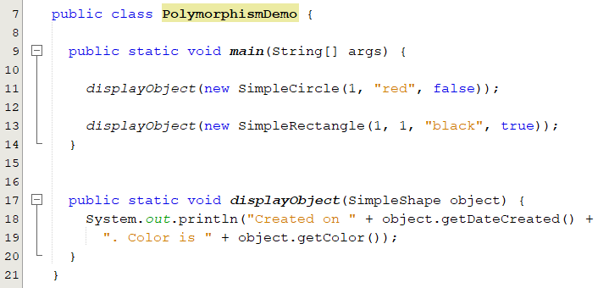
Polymorphism: Example(1)
SimpleShape
A class defines a type.
Circle and Rectangle are subtypes of SimpleShape.
SimpleShape is a supertype for Circle and Rectangle.
Rectangle
Circle
SimpleShape obj = new Cricle ();
polymorphic call
An object of a subtype can be used wherever its supertype value is required. This feature is known as polymorphism.
Notes:
A class defines a type.
A type defined by a subclass is called a subtype.
A type defined by its superclass is called a supertype.

Slide 45
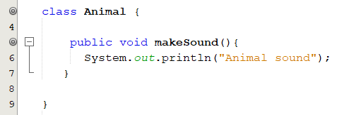
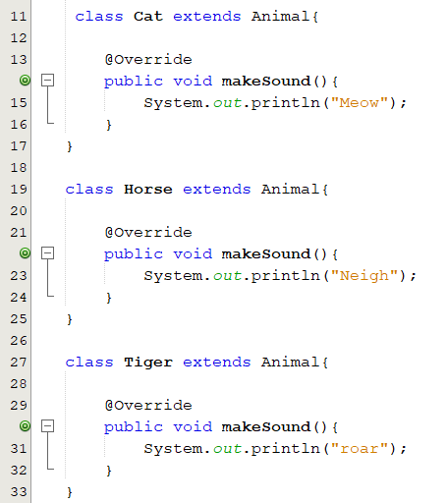


Polymorphism: Example(2)
Tiger
makeSound()
Animal
makeSound()
Horse
makeSound()
Cat
makeSound()
All Animals make sounds, but each one has its own sound.

Slide 46

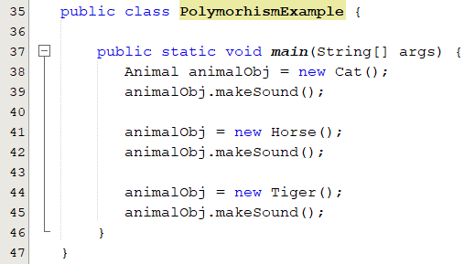
Polymorphism: Example(2)
A polymorphic reference
A variable of a supertype can refer to a subtype object.
A polymorphic reference is a variable that can refer to different types of objects at different points in time

Slide 47
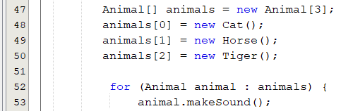
Polymorphism: Example(2)
The method invoked through a polymorphic reference can change from one invocation to the next.

Slide 48
Method Binding
The process of associating a method definition with a method invocation.
Method Call
at compile time
Static or early binding
Object.method();
Static Binding
Methods marked private, final, or Static.
Based on the type of the reference variable, not the object.
The compiler finds a matching method according to
Parameter type, number of parameters and order of parameters
Dynamic binding
A method can be defined in a superclass and overridden in its subclasses.
The JVM decides which method to invoke at runtime.
Based on the object, not the type of the reference variable.
Dynamic or late binding
at runtime

Slide 49
Polymorphism and Late Binding
public class PolymorphismDemo2 {
public static void
main(String[] args) {
display( new GraduateStudent());
display( new Student());
display( new Person());
display( new Object());
}
public static void display(Object obj) {
System.out.println(obj.toString());
}
}
class Person {
public String toString() {
return "Person";
}
}
// Student Class
class Student extends Person {
public String toString() {
return "Student";
}
}
// GraduateStudent Class
class GraduateStudent
extends Student {
}
The method “display” takes a parameter of the Object type. You can invoke it with any object.
This feature is known as polymorphism.
Object obj = new GraduateStudets();
Object obj = new Student();
Object obj = new Person();
Object obj = new Object();
Polymorphism allows methods to be used generically for a wide range of object arguments. This is known as generic programming.

Slide 50
Dynamic Binding
Class_{n}
m()
JVM searches the implementation for a method m in C₁, C₂, ..., C_{n-1} and C_{n}, in this order, until it is found.
Once an implementation is found, the search stops and the first-found implementation is invoked.
Class₃
m()
Class₂
m()
Class₁
m()

Slide 51
Dynamic Binding(1/6)
A method can be defined in a superclass and overridden in its subclasses.
Class_{n}
m()
Assume that we have the following classes hierarchy:
Class₃
m()
Suppose we have the following definition:
Class1 obj = new Class1();
Which m will be invoked ????
Class₂
m()
Class₁
m()

Slide 52
Dynamic Binding(2/6)
A method can be defined in a superclass and overridden in its subclasses.
Class_{n}
m()
Assume that we have the following classes hierarchy:
Class₃
m()
Suppose we have the following definition:
Class1 obj = new Class1();
Which m will be invoked ????
Class₂
m()
Class₁

Slide 53
Dynamic Binding(3/6)
A method can be defined in a superclass and overridden in its subclasses.
Class_{n}
m()
Assume that we have the following classes hierarchy:
Class₃
Suppose we have the following definition:
Class1 obj = new Class1();
Which m will be invoked ????
Class₂
Class₁

Slide 54
Dynamic Binding(4/6)
A method can be defined in a superclass and overridden in its subclasses.
Class_{n}
m()
Assume that we have the following classes hierarchy:
Class₃
m()
Suppose we have the following definition:
Class3 obj = new Class2();
Which m will be invoked ????
Class₂
m()
Class₁
m()

Slide 55
Dynamic Binding(5/6)
A method can be defined in a superclass and overridden in its subclasses.
Class_{n}
m()
Assume that we have the following classes hierarchy:
Class₃
Suppose we have the following definition:
Class3 obj = new Class1();
Which m will be invoked ????
Class₂
m()
Class₁

Slide 56
Dynamic Binding(6/6)
A method can be defined in a superclass and overridden in its subclasses.
Class_{n}
m()
Assume that we have the following classes hierarchy:
Class₃
Suppose we have the following definition:
Class3 obj = new Class2();
Which m will be invoked ????
Class₂
Class₁
m()

Slide 57
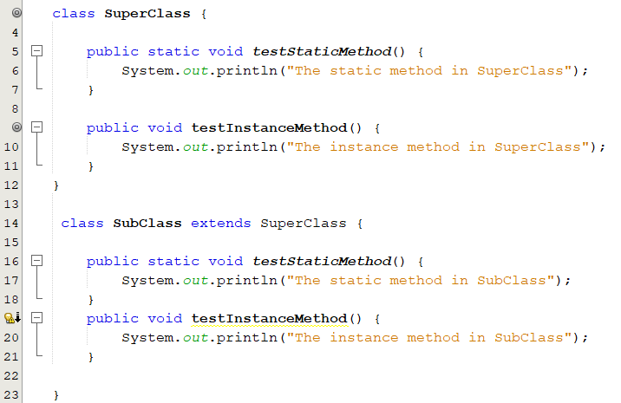
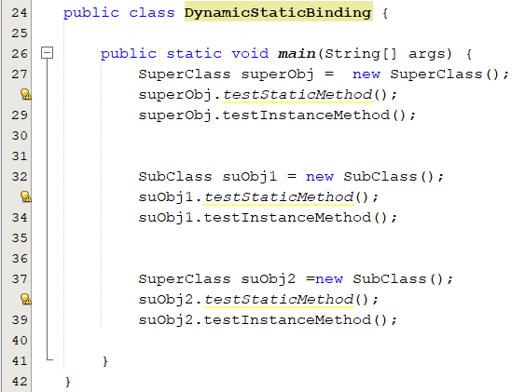
Binding: Example
What is the output of the following code?
The static method in SuperClass
The instance method in SuperClass
The static method in SubClass
The instance method in SubClass
The static method in SuperClass
The instance method in SubClass

Slide 58
Casting Objects
Conversion of one type to another type implicitly or explicitly.
int to double.
Child object or parent to another.
We use casting operators to convert variables of one primitive type to another.
Person
class Test{ public static void main(String args[]) { double d; int i;
d = 13; i = 45.6; i = (int) 45.6; } }
Down-Casting
Up-Casting
Student
√
PhDStudent
X
√
Parent p = new Child();
√
Child c = p;
X
Child c = (Child) p;
√
Notes:
Typecasting is one of the most important concepts which basically deals with the conversion of one data type to another datatype implicitly or explicitly
Up-casting is when an object of a derived class is assigned to a type of a base class (or any ancestor class)
This assigning is called up-casting, because we are going up the inheritance tree
An object can be used as its own type or as a type of its super classes
Up-casting is considered to be a widening conversion since the subclass object has more methods than its super class
Down casting: is when a type cast is performed from a base class to a derived class (or from any ancestor class to any descendent class)
t is the responsibility of the programmer to use down casting only in situations where it makes sense

Slide 59
Casting Objects: Upcasting
Upcasting (Generalization or Widening)
Converting a child object to a parent object (specialized to common).
Can be done implicitly.
An object can be used as its own type or as a type of its super classes.
Gives us the flexibility to access the parent class members but it is not possible to access all the child class member.
These statements are known as implicit casting.
It is legal because an instance of a child is automatically an instance of a parent.
Person p = new Student();
Person
Student c = new Student();
Person p = c;
Down-Casting
Up-Casting
Student
PhDStudent
Notes:
Typecasting is one of the most important concepts which basically deals with the conversion of one data type to another datatype implicitly or explicitly
Up-casting is when an object of a derived class is assigned to a type of a base class (or any ancestor class)
This assigning is called up-casting, because we are going up the inheritance tree
An object can be used as its own type or as a type of its super classes
Up-casting is considered to be a widening conversion since the subclass object has more methods than its super class
Down casting: is when a type cast is performed from a base class to a derived class (or from any ancestor class to any descendent class)
t is the responsibility of the programmer to use down casting only in situations where it makes sense

Slide 60
Typecasting: Downcasting
Downcasting (specialization or narrowing)
Converting a parent object to a child object ( common to specialized)
Cannot be done implicitly. Why?
Person p = new Staff();
Staff c = (Staff) p;
Person
√
Staff
Student
Person p = new Student();
Staff c = (Staff) p;
X
A Child object is always an instance of a parent object, but a parent object is not necessarily an instance of the child object.
If the superclass object is not an instance of the subclass, a runtime ClassCastException occurs
Notes:
Typecasting is one of the most important concepts which basically deals with the conversion of one data type to another datatype implicitly or explicitly
Up-casting is when an object of a derived class is assigned to a type of a base class (or any ancestor class)
This assigning is called up-casting, because we are going up the inheritance tree
An object can be used as its own type or as a type of its super classes
Up-casting is considered to be a widening conversion since the subclass object has more methods than its super class
Down casting: is when a type cast is performed from a base class to a derived class (or from any ancestor class to any descendent class)
t is the responsibility of the programmer to use down casting only in situations where it makes sense

Slide 61
Typecasting : When Casting Is Necessary? (1/2)
This type of casting may not always succeed.
Superclass
subclass
SuperClass obj = new SuperClass();
SubClass c = (subclass) obj;
X
√
public static void method(Object x){
Object x = new Student();
Student studObj = x;
}
public static void method(Object x){
Object x = new Student();
Student studObj = (Student) x;
}
Even though you can see that x is really a Student object, the compiler is not so clever to know it.
Notes:
Explicit casting must be used when casting an object from a superclass to a subclass.

Slide 62
Typecasting: When Casting Is Necessary? (2/2)
Consider the analogy of fruit, apple, and orange with the Fruit class as the superclass for Apple and Orange.
Fruit
Apple
Orange
√
Fruit fruit= new Apple();
Apple x = fruit;
Apple x = (Apple) fruit
Orange x = (Orange) fruit;
An apple is a fruit
X
A fruit is not necessarily an apple
√
So you have to use explicit casting to assign an instance of Fruit to a variable of Apple
X
ClassCastException

Slide 63
Checking Whether Downcasting Is Legitimate
instanceof Operator
test whether an object is an instance of a class
Fruit fruit= new Apple();
Apple x = fruit;
Apple x = (Apple) fruit
Orange x = (Orange) fruit;
Fruit
X
Apple
Orange
√
X
if (fruit instanceof Apple)
Apple x = (Apple) fruit;
else if (fruit instanceof Orange)
Orange x = (Orange) fruit;

Slide 64
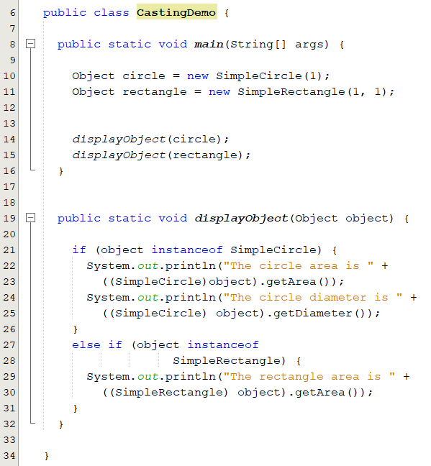
Typecasting: Example

Slide 65
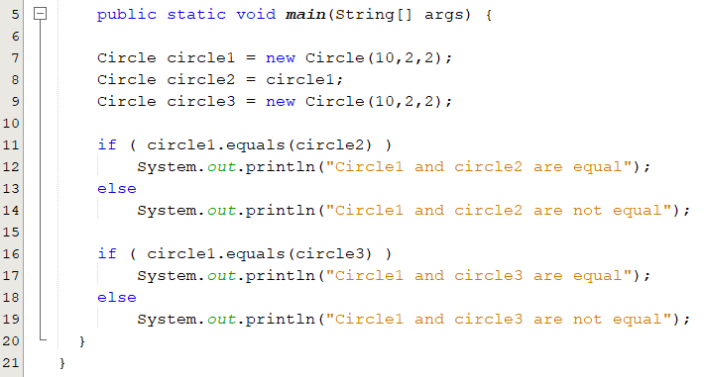
The equals Method(1/3)
A boolean valued method to compare two objects of the class to see whether they are equal.
The default implementation uses the equality operator == to test whether the object references are equal.
It is overridden in the class String
Class object1 = new Class(); Class object2 = object1;
Are these two “Objects” equal?
Class object1 = new Class(); Class object2 = new Class();
public boolean equals(Object obj) {
return this == obj;
}
For objects, == tests whether the two are the same object.
Output:
Circle1 and circle2 are equal
Circle1 and circle3 are not equal
Notes:
An equals method compares the calling object to another object and should return true when the two objects are intuitively equal
The equals() method compares the contents of two objects. The default implementation of the equals method in the Object class is as follows:

Slide 66
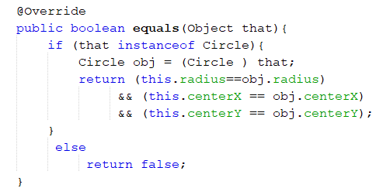
The equals Method(2/3): Requirements
equals method is always inherited from the Object class.
It should be overridden.
The overridden version of equals must meet the following conditions:
Its parameter should of the type Object.
The parameter should be casted down to the type of the overridden class.
It should compare each instance variables of the overridden object and the parameter object.

Slide 67
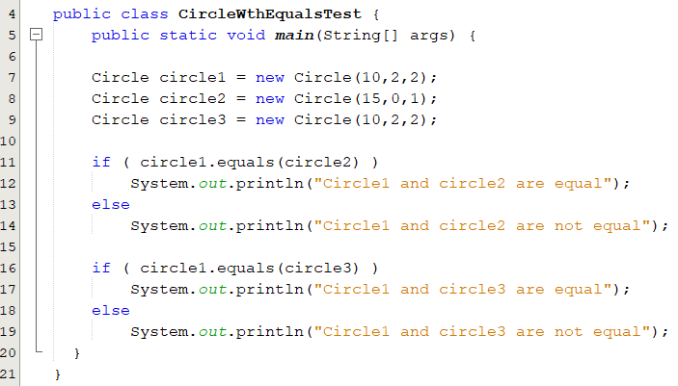
The equals Method(3/3): Implementation
To test whether two objects are equal in the sense of containing the same information
Circle1 and circle2 are not equal
Circle1 and circle3 are equal
CircleWthEquals.java
CircleWthEqualsTest.java

Slide 68
Popup-Question(1):
public class PolymorphismDemo2 {
public static void
main(String[] args) {
display( new GraduateStudent());
display( new Student());
display( new Person());
display( new Object());
}
public static void display(Object obj) {
System.out.println(obj.toString());
}
}
class Person {
public String toString() {
return "Person";
}
}
// Student Class
class Student extends Person {
public String toString() {
return "Student";
}
}
// GraduateStudent Class
class GraduateStudent
extends Student {
}
The method “display” takes a parameter of the Object type. You can invoke it with any object.
Which toString implementation is invoked will be determined dynamically by the Java Virtual Machine at runtime
PolymorphismDemo2.java

Slide 69
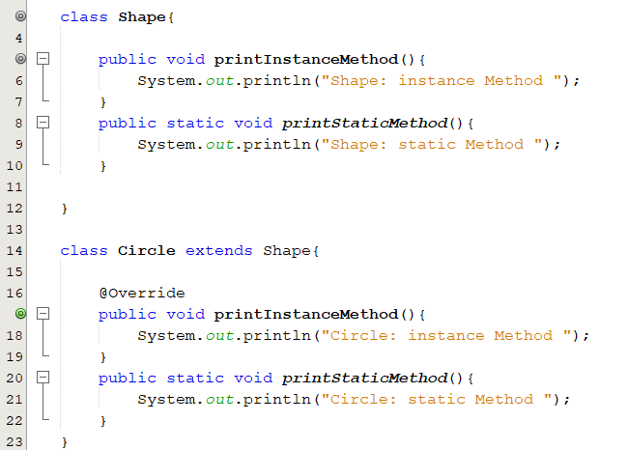
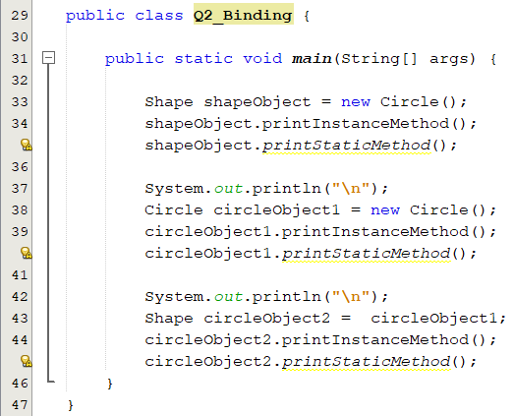
Popup-Question(2)
What is the output of the following code?
Circle: instance Method
Shape: static Method
Circle: instance Method
Circle: static Method
Circle: instance Method
Shape: static Method
Notes:
When Java (or any language) does not use late binding, it uses static binding. With static binding, the decision of which definition of a method to use with a calling object is made at compile time based on the type of the variable naming the object
Java does not use late binding with private methods, methods marked final, or static methods. With private methods and final methods, this is not an issue because dynamic binding would serve no purpose anyway. However, with static methods it can make a difference when the static method is invoked using a calling object. Such cases arise more often than you might think.

Slide 70
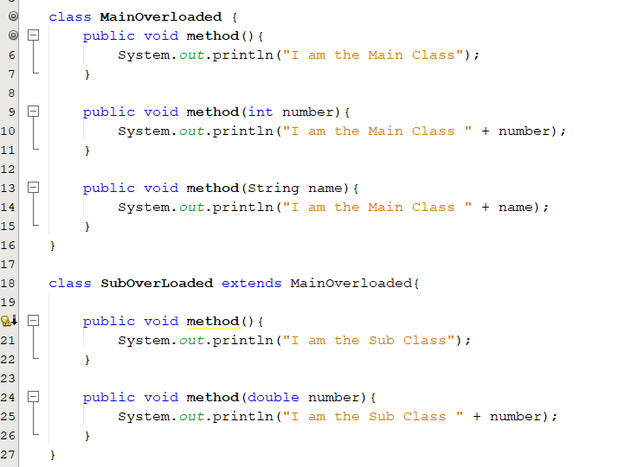

Popup-Question(3)
What is legal and illegal in the following classes?
mObj.method(10.6); illegal
Q3_Overloading.java

Slide 71

Popup-Question(4)
After removing the illegal statement, what is the output?
I am the Main Class
I am the Main Class 3
I am the Sub Class
I am the Main Class 4
I am the Sub Class 5.2
Q3_Overloading.java

Slide 72


Popup-Question(5)
What is the output of the following code?
I am a circle.
I am a circle.
I am a circle.
I am a circle.

Slide 73


Popup-Question(6)
What is the output of the following code?
I am a shape.
I am a circle.
I am a shape.
I am a circle.

Slide 74
Popup-Question(7): Typecasting
What is legal and illegal here? Why?
method(new Student());
public static void method(Object x){
Object y = new Student();
Student z = x;
}
X
method(new Student());
public static void method(Student x){
Student y = new Object();
Student z = x;
}
X

