Slide 1
Module 08: Exception Handling & IO

Slide 2
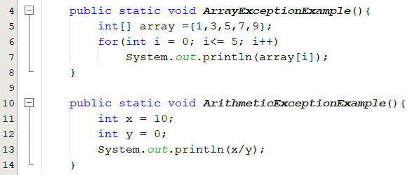

Motivation
What would happen?
The program terminates abnormally.
How can you handle the runtime error so that the program can continue to run or terminate gracefully?

Slide 3
Objectives
To get an overview of exceptions (§12.1).
To explore exception handling and its advantages (§12.2).
To understand the exception class hierarchy (§12.3).
  To distinguish exception types:
    Error (fatal) vs. Exception (nonfatal).
    checked vs. unchecked.
To declare/ throw/ catch exceptions(§12.4) - (§12.7).
To use finally block(§12.5).
To create user-defined exceptions (§12.9).

Slide 4
Exceptions: Runtime Errors
When a program runs into a runtime error, the program terminates abnormally.
  An exception is an object that represents an error or a condition that prevents execution from proceeding normally.
Exception Causes:
  Operating system: Memory violation, disk full, stack overflow.
  Language: Type conversion, Bound violation, class not found.
  Input/output errors: EOF, file doesn’t exist, socket connection closed, URL doesn’t exits.
How can you handle runtime errors so that the program can continue to run or terminate gracefully?
  Exception handling enables a program to deal with runtime errors and continue its normal execution.
Notes:
Runtime errors occur while a program is running if the JVM detects an operation that is
impossible to carry out. For example, if you access an array using an index that is out of
bounds, you will get a runtime error with an ArrayIndexOutOfBoundsException.
If you enter a double value when your program expects an integer, you will get a runtime error with
an InputMismatchException.
If the exception is not handled, the program will terminate abnormally.
How can you handle the exception so the program can continue to run or else terminate gracefully?
This chapter introduces this subject
An exception is an unwanted or unexpected event, which occurs during the execution of a program i.e at run time, that disrupts the normal flow of the program’s instructions.

Slide 5
Some Exceptions(1/2):
ArithmeticException:
  Java does not allow division by zero in integer arithmetic.
  Java does allow division by zero with floating-point values
    System.out.println(1.0/0); // Infinity or -Infinity
    System.out.println(0.0/0); // NaN
NullPointerException
  Thrown when an application invoke a method or accessing or modifying the field of a null object.
ArrayIndexOutOfBoundsException
StringIndexOutOfBoundsException
ClassCastException:
  Indicate that the code has attempted to cast an object to a subclass of which it is not an instance.
SimpleCircle circle; circle.getArea();
int[] list = {2, 4, 6, 8};
System.out.println(list[4]);
String s = “ICS108";
System.out.println(s.charAt(6));
Object x = new Integer(0);
System.out.println((String) x );

Slide 6
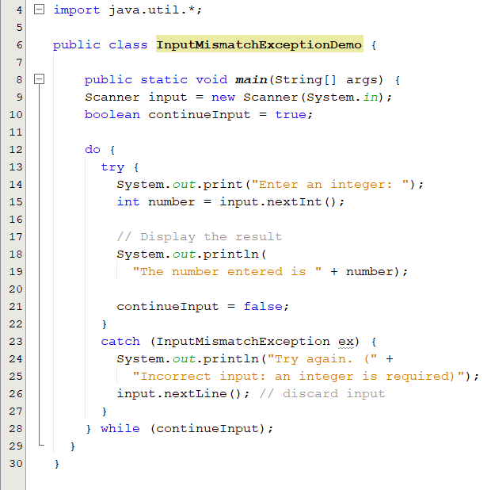
Some Exceptions(2/2):
InputMismatchException
  thrown by a Scanner to indicate that the token retrieved does not match the pattern for the expected type.
NumberFormatException
  Indicates that the application has attempted to convert a string to one of the numeric types, but that the string does not have the appropriate form
String str="1.2r";
Double.parseDouble(str);
What would happen:
If the user enters 5
If the user enters java

Slide 7
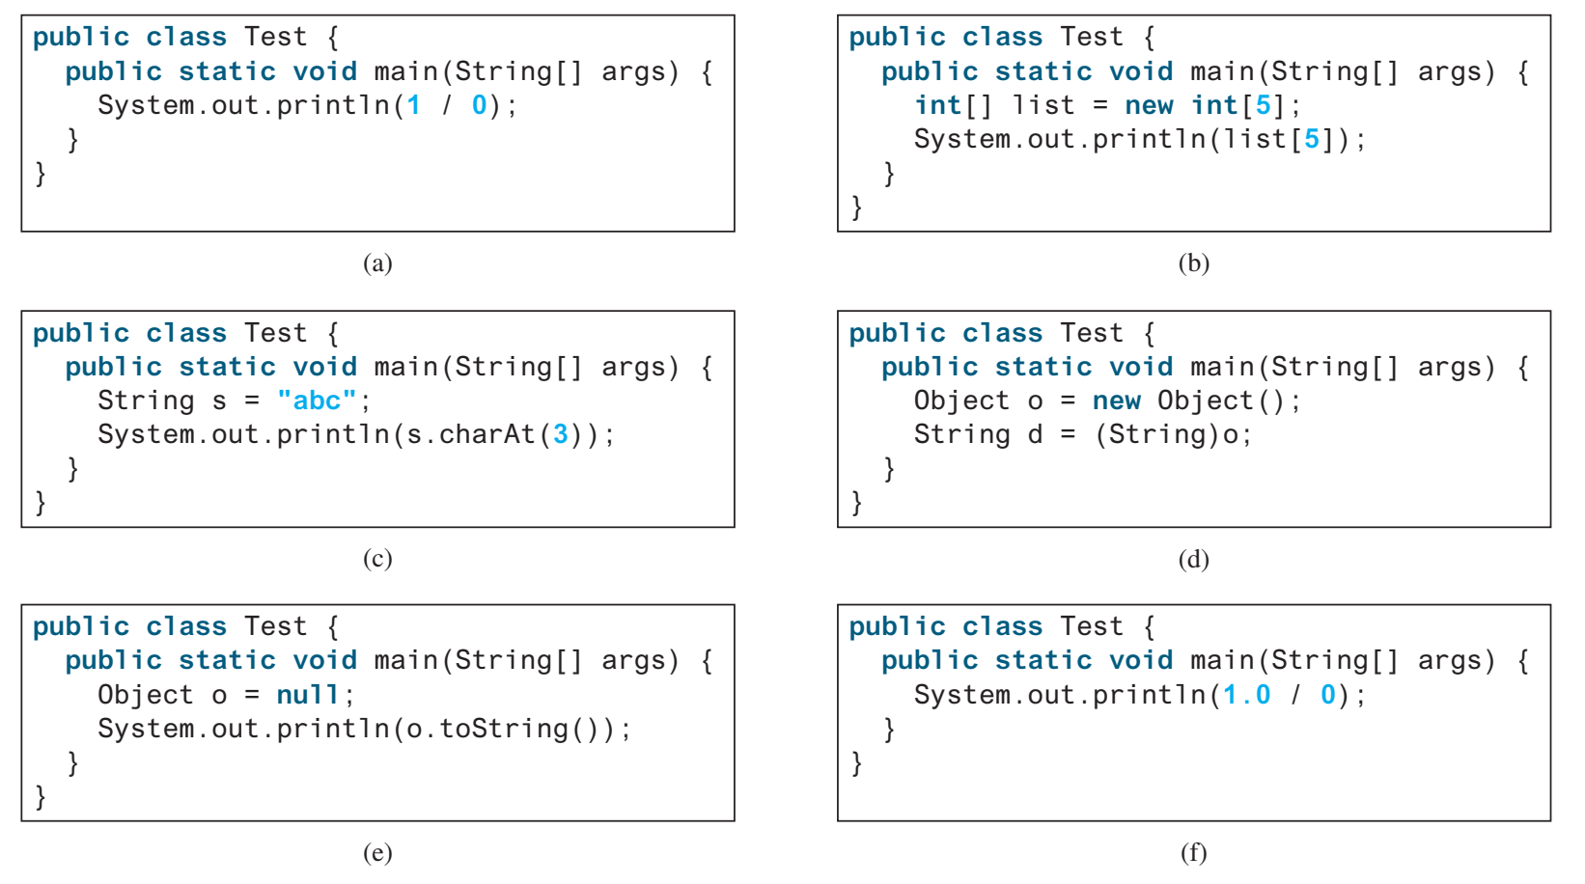
Popup-Question(1)
12.3.2 What RuntimeException will the following programs throw, if any?
a. ArithmeticException b.ArrayIndexOutOfBoundsException
c. StringIndexOutOfBoundsException d. ClassCastException
e. NullPointerException f. No exception

Slide 8
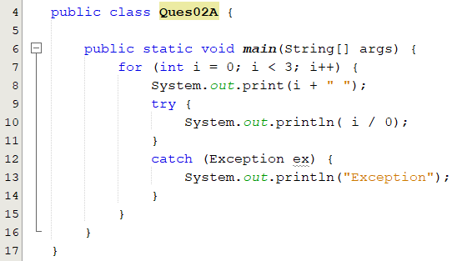
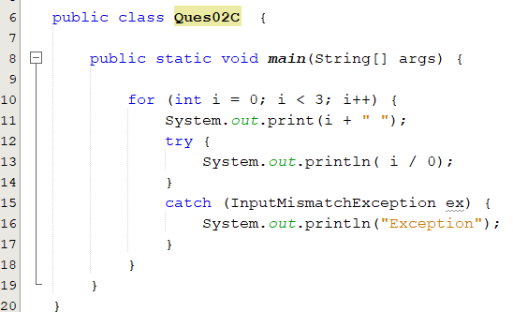
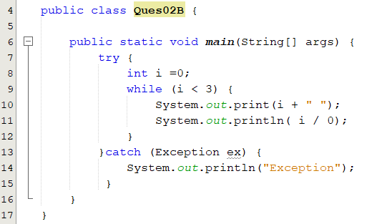
Popup-Question(2)
What is the output of the following code segments?
ArithmeticException: / by zero
0 Exception
1 Exception
2 Exception
0 Exception

Slide 9
Exception Types: System Errors
Represented in the Error class.
Thrown by JVM.
Describes internal system errors, infrequent errors.
Example: VirtualMachineError.
  Run out of memory.
If one does, there is little you can do beyond notifying the user and trying to terminate the program gracefully.
1
Notes:
StackOverflowError
https://blog.fastthread.io/2018/09/24/stackoverflowerror/

Slide 10
Exception Types: Exceptions
Represented in the Exception class.
Thrown by Java program and external circumstances.
Can be caught and handled by Java programs.
2

Slide 11
Exception Types: Runtime Exceptions
Represented in the RuntimeException class.
Can be caught and handled by your program.
Programming errors, such as bad casting and numeric errors.
3

Slide 12
Checked Exceptions vs. Unchecked Exceptions
The compiler forces the programmer to check and deal with them in a try-catch block or declare it in the method header.
Checked exceptions
unchecked exceptions
Notes:
In most cases, unchecked exceptions reflect programming logic errors that are not recoverable.
For example, a NullPointerException is thrown if you access an object through a reference variable before an object is assigned to it; an IndexOutOfBoundsException is thrown if you access an element in an array outside the bounds of the array. These are the logic errors that should be corrected in the program. Unchecked exceptions can occur anywhere in the program. To avoid cumbersome overuse of try-catch blocks, Java does not mandate you to write code to catch unchecked exceptions.

Slide 13
Catching Exceptions(1/2)
When an exception is thrown, it can be caught and handled in a try-catch block.
try block encloses code that might throw an exception.
  Begins with the keyword try followed by a block of code.
catch block
  Allows you to define a block of code to be executed, if an error occurs in the try block.
try {
// statements that may cause an exception
} catch (ExceptionType1 object1) {
//handler for exception2
}
…
…
catch (ExceptionTypeN objectN) {
//handler for exceptionN
}
try {
// statements that may cause an exception
} catch (ExceptionType1 | ExceptionType2 object) {
//error handling code
}
Notes:
If the bodies of several catch blocks are identical, you can use the
multi-catch feature (introduced in Java SE 7) to catch those
exception types in a single catch handler and perform the same
task
Each exception type is separated from the next with a vertical bar (|).
The preceding line of code indicates that any of the types (or their
subclasses) can be caught in the exception handler

Slide 14
Catching Exceptions(2/2)
The process of finding a handler for an exception.
If no exceptions are thrown in a try block
  The try block executes.
  The catch blocks are skipped.
  Statement after the try-catch block executes.
If an exception occurs in a try block
  The try block terminates immediately.
  Program control transfers to the first matching catch block.
When a try or catch block terminates, local variables declared in that block go out of scope.
The local variables of a try or catch block are not accessible in the corresponding catch blocks.
Try block
Catch block
Catch block
Catch block
Next block
Try block
Catch block
Catch block
Catch block
Next block
Notes:
The try block executes.
The catch blocks are skipped.
Control continues with the first statement after the catch block

Slide 15
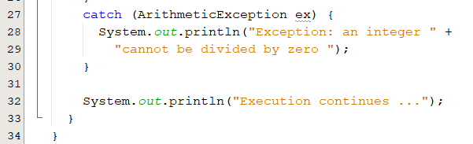
try-catch Statement(1/3)
catch block
  Also called a catch clause or exception handler.
  Begins with the keyword catch followed by exception parameters in parentheses and a block of code enclosed in curly braces.
  Exception parameter identifies the exception type the handler can process.
  The mentioned exception type (or its subclasses) can be caught in the exception handler.
Exception type
catch–block parameter
Handle related exceptions polymorphically
What do we call this feature?

Slide 16
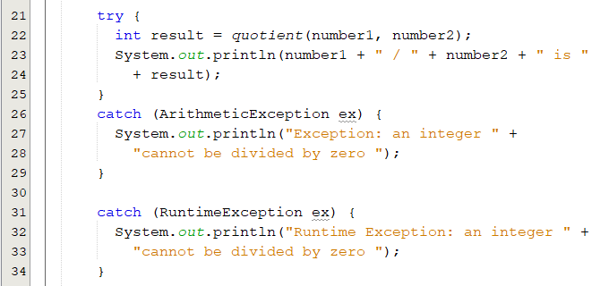
try-catch Statement(2/3)
When an exception occurs in a try block, the catch block that executes is the first one whose type matches the type of the exception that occurred.
  Any remaining catch blocks in the try-catch statement are ignored.
  When a catch block terminates,
    Execution resumes at the first line of code after the t-catch block.
  At least one catch block or a finally must immediately follow the try block.
Which catch block would be execute if we replace ArithmaticException with IOException ?

Slide 17
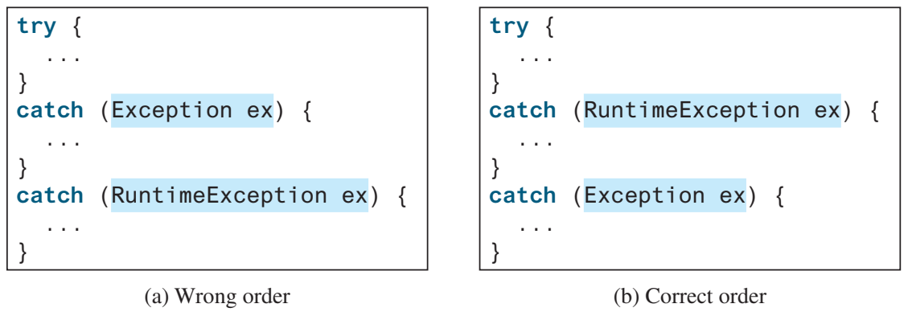
try-catch Statement(3/3)
The order in which exceptions are specified in catch blocks is important.
A compile error will result if a catch block for a superclass type appears before a catch block for a subclass type.
A superclass type appears before a subclass type.
A subclass type appears before a superclass type.
×
√

Slide 18
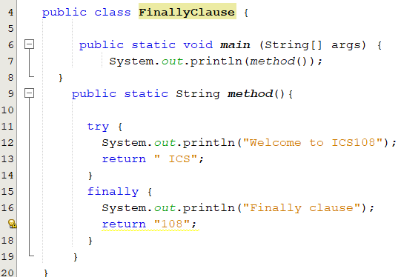
The finally Clause(1/2)
Always executed regardless of whether an exception occurred or not.
Executes if a try-catch block exits by using a return statement.
Overrides the values returned by try-catch clause.
try {
statements;
}
catch(ExceptionType ex) {
handling ex;
}
finally {
finalStatements;
}
try {
statements;
}
finally {
finalStatements;
}
Welcome to ICS108
Finally clause
108
Notes:
Occasionally, you may want some code to be executed regardless of whether an exception
occurs or is caught.
The code in the finally block is executed under all circumstances, regardless of whether an
exception occurs in the try block or is caught .

Slide 19
The finally Clause(2/2)
No exceptions →
statement1
statement2
finalStatement
lastStatement
try {
statement1;
statement2;
}
catch(ExceptionType1 ex1) {
handling ex1;
}
catch(ExceptionType2 ex2) {
handling ex2;
throw ex;
}
finally {
finalStatement;
}
lastStatement;
Exception of type ExceptionType1 is thrown by statement1 →
statement1
handling ex1
finalStatement
lastStatement
Exception of type ExceptionType2 is thrown by statement1 →
statement1
handling ex2;
finalStatement
throw ex;
Exception of type neither ExceptionType1 nor ExceptionType2 is thrown by statement1 →
statement1
finalStatement
and then terminates because of an unhandled exception
Notes:
Occasionally, you may want some code to be executed regardless of whether an exception
occurs or is caught.
The code in the finally block is executed under all circumstances, regardless of whether an
exception occurs in the try block or is caught .

Slide 20
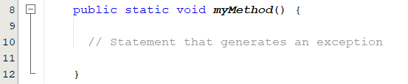
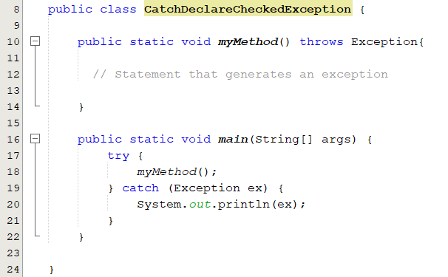
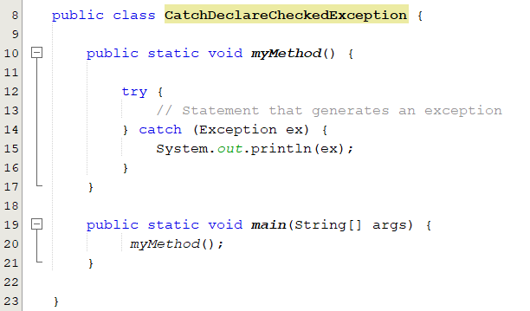
Catch or Declare Checked Exceptions
Compiler enforces a catch-or-declare requirement for checked exceptions.
  Either we will handle it within method.
  Or we can pass it to the caller method to be handled there.
An error is thrown by the compiler
Solution 2
Solution 1

Slide 21
Declaring and Throwing Exceptions
The throws keyword in the method header is used to declare an exception in a method.
throws clause:
  Specifies the exceptions a method might throw if problems occur.
  Must appear after the method’s parameters and before the body.
  May contains a list of exceptions separated by comma.
public void myMethod() throws IOException{}
Indicates myMethod might throw an IOException
public void myMethod() throws IOException, OtherException{}
If a method does not declare exceptions in the superclass, you cannot override it to declare exceptions in a subclass.

Slide 22
Throwing Exceptions
When program detects an error.
  Can create an instance of an appropriate exception type.
  Throw that exception.
ArithmeticException ex = new ArithmeticException(“Divisionby zero”);
throw ex;
throw new ArithmeticException(“Divisionby zero”);
/** Set a new radius */
public void setRadius(double newRadius) throws IllegalArgumentException {
if (newRadius >= 0)
radius = newRadius;
else
throw new IllegalArgumentException("Radius cannot be negative");
}

Slide 23
Popup-Question(3)
What is legal and illegal in the following code?
public static void main(String[] args) {
try {
int[] list = new int[5];
System.out.println("list[5] is " + list[5]);
}
catch (ArithmeticException ex) {
System.out.println("ArithmeticException");
}
catch (Exception ex) {
System.out.println("Exception");
}
catch (Runtime Exception ex) {
System.out.println("Runtime Exception");
}
}

Slide 24
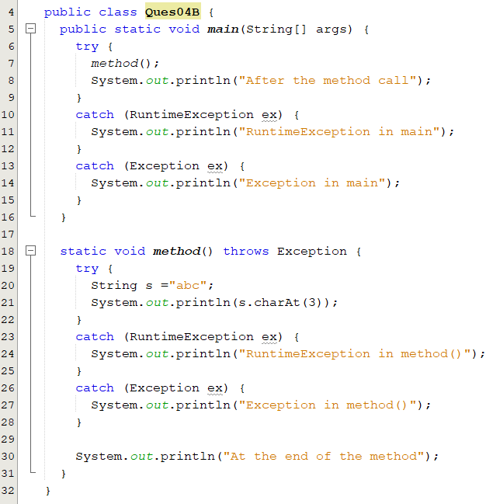
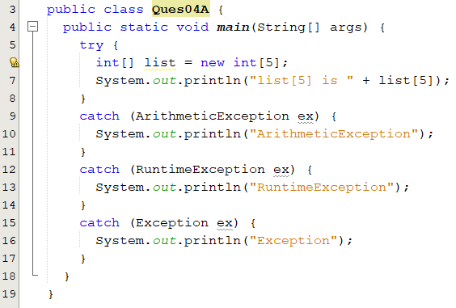
Popup-Question(4)
What is displayed when running the following programs?

Slide 25
Defining Custom Exception Class
Use Java predefined exception classes whenever possible.
You can create your own exception classes.
How two define custom exception:
  Derive it from Exception or from a subclass of Exception.
  Define two constructors, a default constructor and one that has a single String parameter.
  Start each constructor definition with a call to the constructor of the base class, using super.
  It is legal to define other methods, most time you do not need that.
You should not declare an exception that extends Error class.
  When an exception of Error type occurs, your program would terminate.
Notes:
You can define your own exception classes, but they must be derived classes of some already defined exception class.
An exception class can be a derived class of any predefined exception class or of any exception class that you have already successfully defined.
Use the class Exception as the base, if you have no compelling reason to use any other class as the base class.

Slide 26
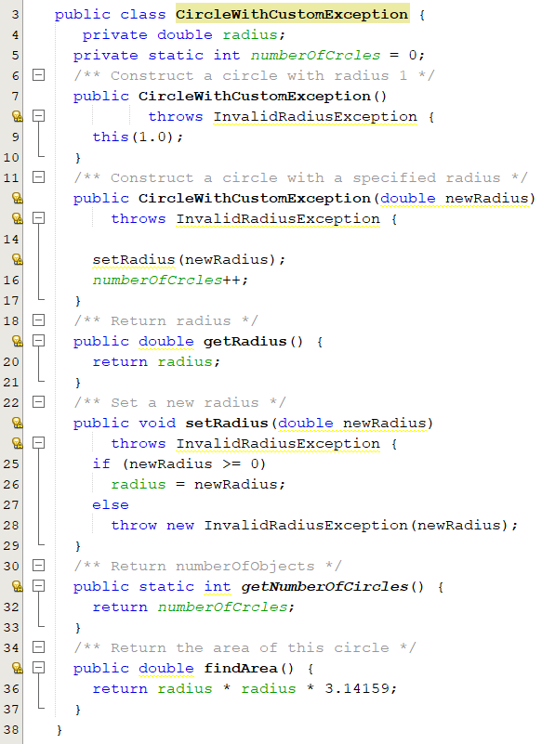
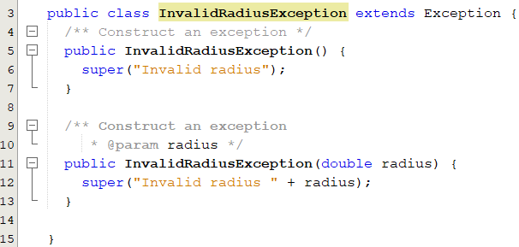
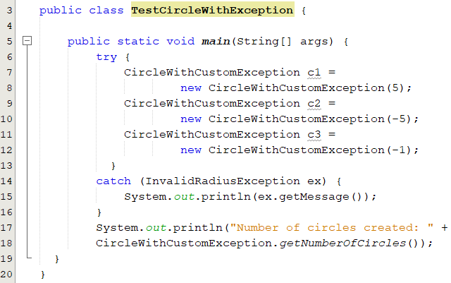
Custom Exception: Example

Slide 27
Text I/O

Slide 28
Motivation
The input and output operation that we have performed so far were done through screen and keyboard only.
  Once we compile and run the program, we have to enter the input and the output is printed on the screen.
  This output is not stored in the form of information anywhere in the system.
  If you terminate the program, the output will be lost.
If we want to get the output of the program, it becomes a tedious task to run the same program multiple times.
What do we have to do if we want to store the output produced for future references?
Notes:
The keyboard input and screen output we have used so far deal with temporary
data. When the program ends, the data typed at the keyboard and left on the
screen go away. Files provide you with a way to store data permanently. The
contents of a file remain until a person or program changes the file.
An input file can be used over and over again by different programs,
without the need to type the data again for each program. Files also provide you
with a convenient way to deal with large quantities of data. When your program
takes its input from a large input file, it receives a lot of data without user effort.
The input and output operation that we have performed so far were done through screen and keyboard only.
After the termination of program all the entered data is lost because primary memory is volatile .
If the data has to be used later ,then it becomes necessary to keep it in permanent storage device. so the Java language provide the concept of file through which data can be stored on the disk or secondary storage device.
The stored data can be read whenever required.
This is where file handling comes into play.

Slide 29
Motivation
Java language provides the concept of file through which data can be stored on the disk or secondary storage devices.
The stored data can be read/written whenever required.
A computer file is used to store data in digital format.
  Plain text, image data, or any other content.
Computer files can be organized inside different directories.
Files are used to keep digital data, whereas directories are used to keep files.

Slide 30
Objectives
To use the File class to discover file/directory properties, to delete and rename files/directories, and to create directories (§12.10).
To write data to a file using the PrintWriter class (§12.11.1-2).
To read data from a file using the Scanner class. (§12.11.3-4).
To develop programs that manipulate text files. (§12.11.5).
To read data from the Web (§12.12) and (§12.13) .

Slide 31
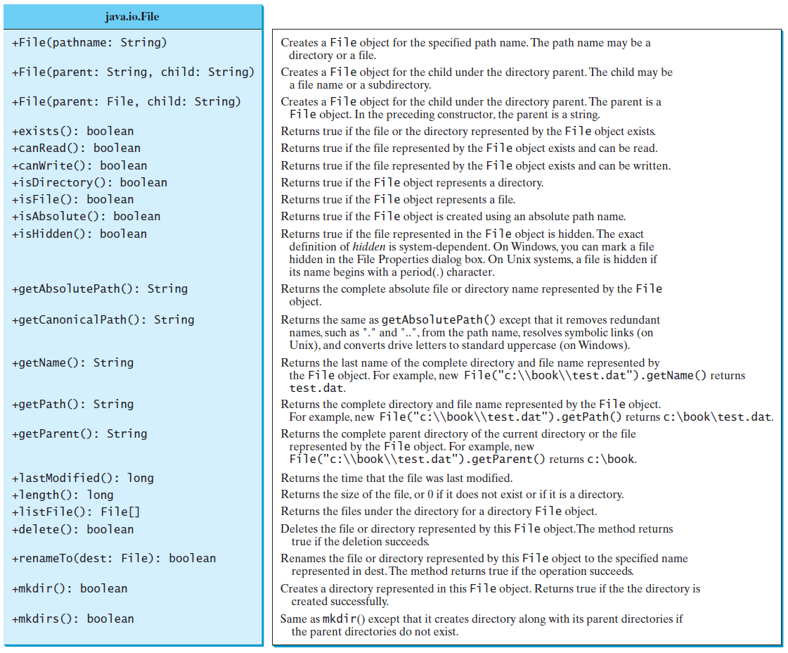
The File Class
The File class from the java.io package, allows us to work with files.
https://docs.oracle.com/javase/9/docs/api/java/io/File.html
It provides an abstraction that deals with files in a machine-independent fashion.
It has methods that operate on files and directories.
  Creating, renaming and deleting files and directories.
It is a wrapper class for the file name and its directory path.

Slide 32
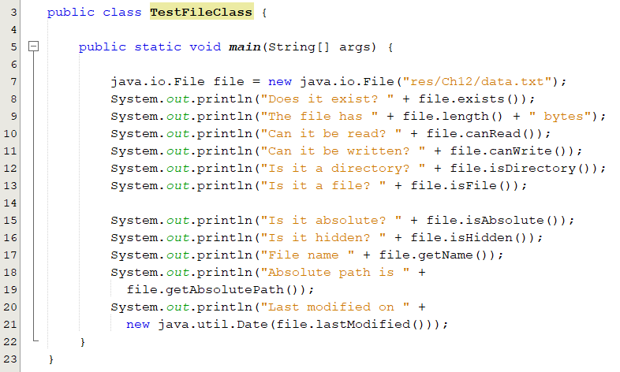
Files Properties: Example
Create a file object.
Creating a File object does not create a file/directory on the disk.
File name is a string.
  Absolute file name:
    A file name with its complete path and drive letter.
    It is machine dependent.
    Examples: c:\\book\\Welcome.java or home/book/Welcome.java.
  Relative name:
    Is in relation to the current working directory.
    Example: Welcome.java
Output:
Does it exist? true
The file has 66 bytes
Can it be read? true
Can it be written? true
Is it a directory? false
Is it a file? true
Is it absolute? false
Is it hidden? false
File name data.txt
Absolute path is C:\Users\othmanr\Documents\NetBeansProjects\ICS108\res\Ch12\data.txt
Last modified on Fri Nov 05 19:44:15 AST 2021

Slide 33
How Is Text I/O Handled in Java?
File object encapsulates the properties of a file.
  Does not have methods for reading/writing data from/to a file.
To perform I/O, you need to create objects using appropriate Java I/O classes.
  Use their methods for reading/writing data from/to a file.
There are many I/O classes for various purposes.
Input Classes
Contain methods to read data. e.g. Scanner
Output Classes
Contain methods to write data. e.g. PrintWriter

Slide 34
Input and Output Classes
Scanner input = new Scanner(new File("temp.txt"));
System.out.println( input.nextLine() );
Input stream
An object reads a stream of data from a file.
PrintWriter output = new PrintWriter("temp.txt");
output.println("Java 101");
output.close();
Output stream
An object writes a stream of data to a file
Notes:
f temp.txt contains the text Java 101, input.nextLine() returns the string "Java 101".
Figure 17.1 illustrates Java I/O programming. An input object reads a stream of data from
a file, and an output object writes a stream of data to a file. An input object is also called an
input stream and an output object an output stream

Slide 35
Steams
Java performs I/O operation through streams
Java defines two types of streams Byte Stream and Character stream.
Byte streams provide a convenient means for handling input and output of bytes. Byte streams are used when reading or writing binary data.
Character streams provide a convenient means for handling input and output of characters. They use Unicode and, therefore, can be internationalized.
At the lowest level, all I/O are byte oriented. Java implements streams within class hierarchies defined in the java.io package.

Slide 36
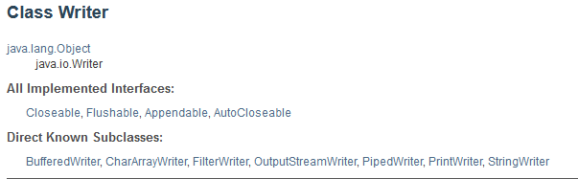
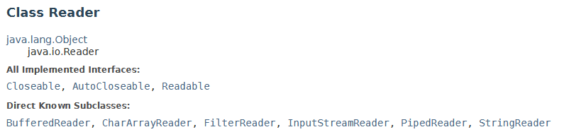
Writer and Reader Classes
https://docs.oracle.com/javase/8/docs/api/java/io/Writer.html
https://docs.oracle.com/javase/8/docs/api/java/io/Reader.html

Slide 37
PrintWriter Class
The java.io.PrintWriter class can be used to create a file and write data to a text file.
PrintWriter
+PrintWriter(filename: String) +PrintWriter(file: File) +print(s: String): void +print(c: char): void +print(cArray: char[]): void +print(i: int): void +print(l: long): void +print(f: float): void +print(d: double): void +print(b: boolean): void Also contains the overloaded println methods. Also contains the overloaded printf methods.
Creates a PrintWriter for the specified file name. Creates a PrintWriter for the specified file. Writes a string. Writes a character. Writes an array of character. Writes an int value. Writes a long value. Writes a float value. Writes a double value. Writes a boolean value. A println method acts like a print method; additionally it prints a line separator. The line separator string is defined by the system. It is \r\n on Windows and \n on Unix. The printf method was introduced in §4.6, “Formatting Console Output and Strings.”
https://docs.oracle.com/javase/9/docs/api/java/io/PrintWriter.html

Slide 38
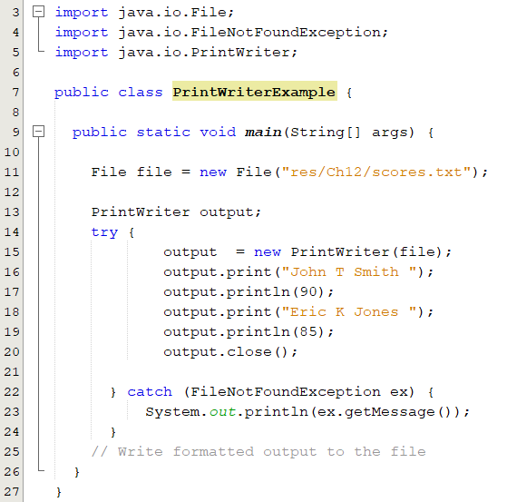
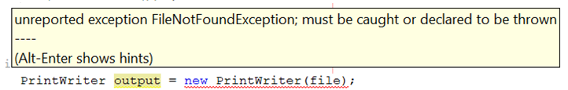
Writing Data Using PrintWriter
Create a PrintWriter object for a text file
PrintWriter output = new PrintWriter(filename);
Invoke the print, println and printf methods on the PrintWriter.
scores.txt
John T Smith 90
Eric K Jones 85
Notes:
Lines 4–7 check whether the file scores.txt exists. If so, exit the program (line 6).
Invoking the constructor of PrintWriter will create a new file if the file does not exist. If the
file already exists, the current content in the file will be discarded without verifying with the user.
Invoking the constructor of PrintWriter may throw an I/O exception. Java forces you to
write the code to deal with this type of exception. For simplicity, we declare throws
IOException in the main method header (line 2).

Slide 39
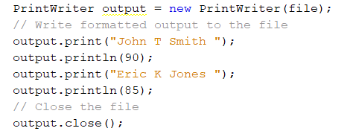
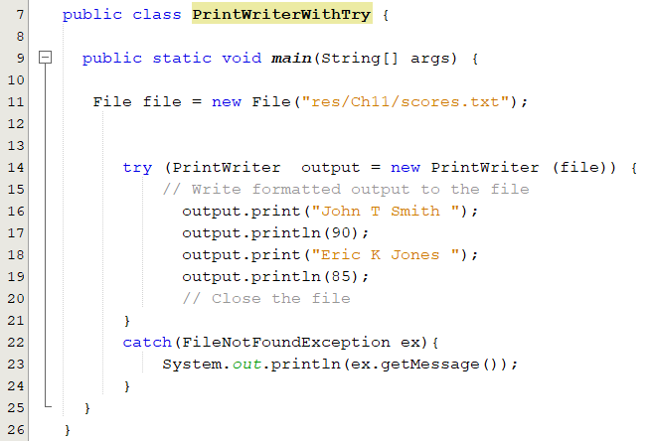
Using try-with-resources
Used to automatically close files.
declare/create a resource →
use the resource →
The printerWriter close() method is automatically invoked to close the resource
→
Closing a stream ensures that:
  Data will be written to the file.
  Resource acquired by the stream object are releases.
Two ways to close a stream:
  Invoking the close() method.
  Using the try-catch-resource to automatically close the stream.
Notes:
Programmers often forget to close the file. JDK 7 provides the followings new try-withresources syntax that automatically closes the files.
A resource is declared and created followed by the keyword try. Note the resources are
enclosed in the parentheses.
he statements in the block (lines 12–18) immediately following the resource
declaration use the resource. After the block is finished, the resource’s close()method is
automatically invoked to close the resource

Slide 40
Reading Data Using Scanner
Used to read string and primitive values from the console.
  Scanner input = new Scanner (System.in);
To read from a file, create a Scanner for a file.
  Scanner input = new Scanner( new File (filename) );
It breaks its input into tokens delimited by whitespace characters.
If the token does not match the expected type, a runtime exception java.util.InputMismatchException will be thrown.
You can use the useDelimiter(String regex) method to set a new pattern for delimiters.

Slide 41
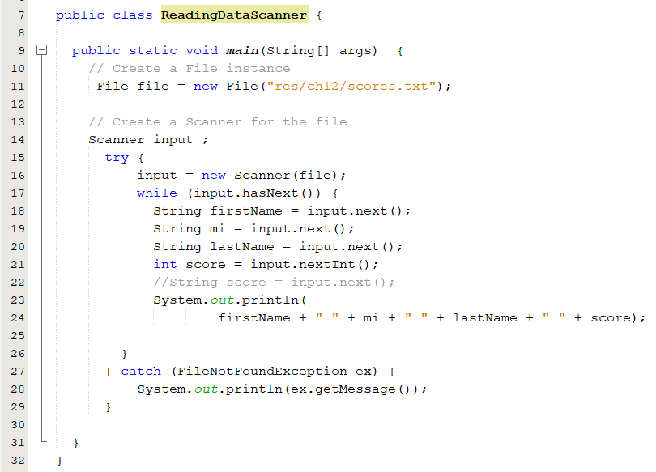
Reading Data Using Scanner
Create a Scanner for the file
Create a file object
May throw an I/O exception
John T Smith 90
Eric K Jones 85
Notes:
o create an instance of the
File using the constructor new File(filename) (line 6) and use new Scanner(File) to
create a Scanner for the file

Slide 42
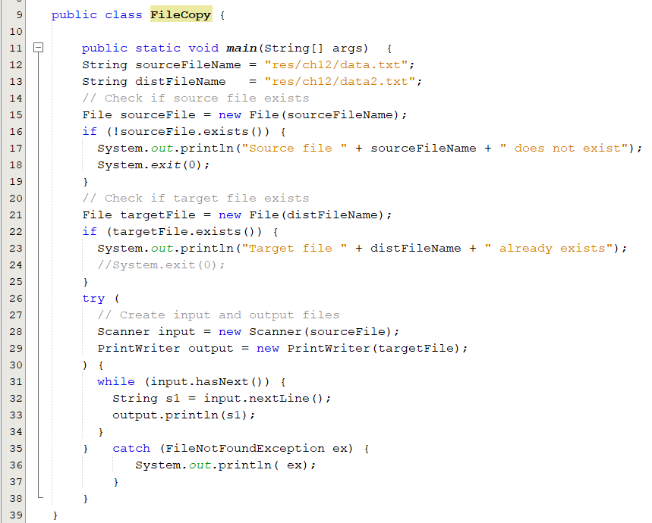
Case Study: File Copy
Case Study: Replacing Text
s1 = s1.replaceAll(oldString, nesString);

Slide 43
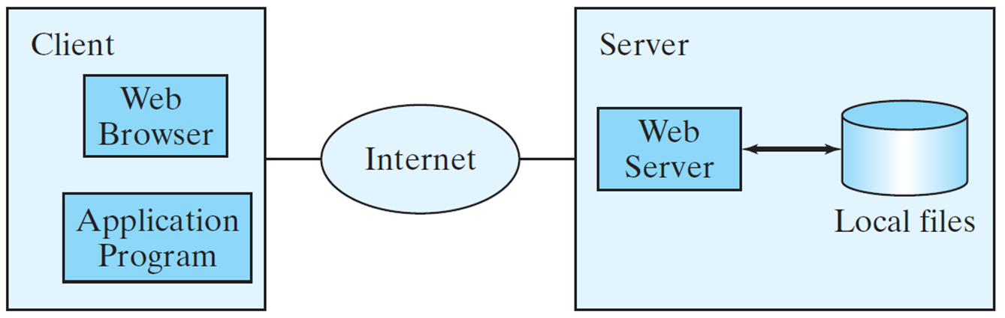
Reading Data from the Web
Java programs can read data from a file that is on the Web .
Create a URL object using the java.net.URL class:
  URL(String spec) throws MalformedURLException
Use the openStream() method defined in the URL class to open an input stream.
  Use this stream to create a Scanner
Read data from the input stream just like from a local file.
try {
URL url = new URL("http://www.google.com/index.html");
} catch (MalformedURLException ex) {
ex.printStackTrace();
}
Scanner input = new Scanner(url.openStream());
Notes:
In addition to reading data from a local file on a computer or file server, you can also access
data from a file that is on the Web if you know the file’s URL

Slide 44
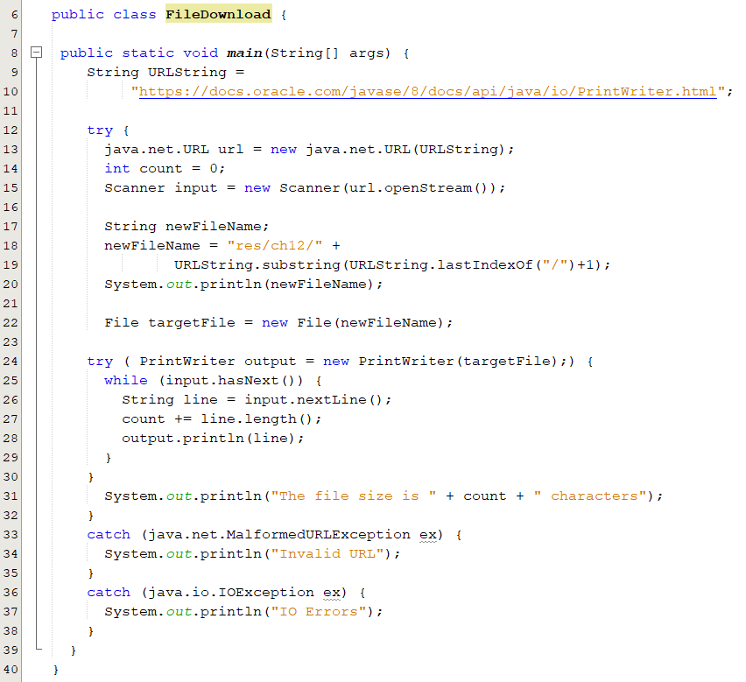
File Download
Create a URL object using the java.net.URL class.
Use the openStream() method defined in the URL class to open an input stream.
3. Read data from the input stream just like from a local file.

Slide 45
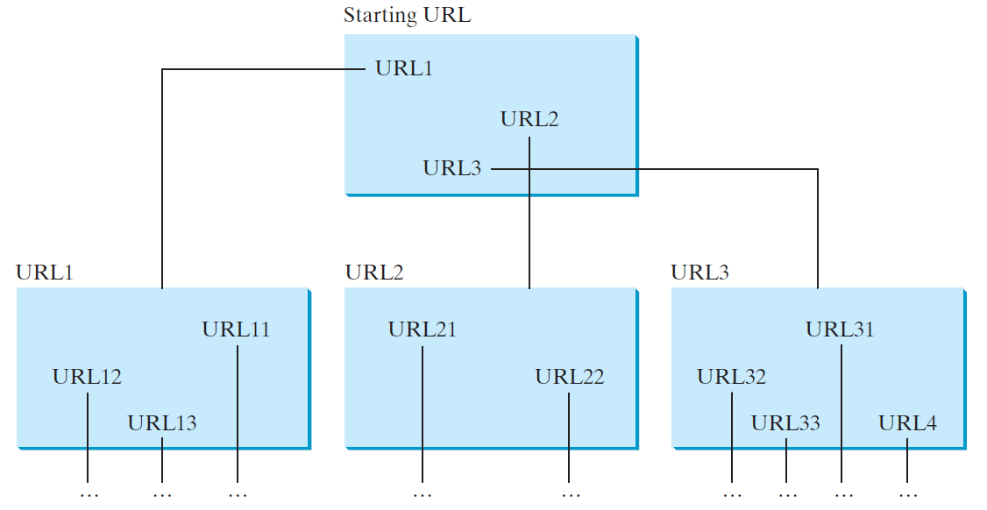
Case Study: Web Crawler
This case study develops a program that travels the Web by following hyperlinks.

Slide 46
Binary I/O

Slide 47
Objectives
To distinguish between text I/O and binary I/O (§17.3).
Describe the concept of an I/O streams.
To read and write data using
  FileInputStream and FileOutputStream(§17.4.1).
  ObjectInputStream and ObjectOutputStream (§17.6).
To Serializable objects (§17.6.1)-(§17.6.2).

Slide 48
The Concept of a Stream
File, simple keyboard and screen I/O are handled by streams.
A stream is a flow of data.
  The data might be characters, numbers, or bytes.
Java implements streams as objects of special stream classes.
  Scanner class
data flow into your program
data flow out of your program
Notes:
ou are already using files to store your Java classes and programs, your music,
your pictures, and your videos. You can also use files to store input for a
program or to hold output from a program. In Java, file I/O, as well as simple
keyboard and screen I/O, is handled by streams. A stream is a flow of data. The
data might be characters, numbers, or bytes consisting of binary digits. If the
data flows into your program, the stream is called an input stream. If the data
flows out of your program, the stream is called an output stream. For example, if
an input stream is connected to the keyboard, the data flows from the keyboard
into your program. If an input stream is connected to a file, the data flows
from the file into your program.

Slide 49
File Types
Files that can be processed (read, created, or modified) using a text editor, human-readable format.
Encoded using a character-encoding scheme such as ASCII or Unicode (represented as 1 or 2 byte ).
199 is stored as a sequence of three characters 199.
Usually appear the same on all computers.
e.g. Java source programs.
Text Files
Binary Files
Cannot read binary files using a text editor, binary files.
Reading and writing must normally be done by a special program.
Store all values of the same primitive data in the same format.
199 is stored as a byte-type value C7 in a binary file.
The structure of some binary files is standardized.
They can also be used on a variety of platforms.
e.g. Java class files, Music and picture files.
010010010100100010100110010000001101010
ICS 108
All of the data in any file is stored as binary digits (bits) sequence of 0s and 1s.
We do not think of a file’s contents as a sequence of binary digits.
we think of them as a sequence of characters
Notes:
Files can be classified as either text or binary. A file that can be processed (read, created,
or modified) using a text editor such as Notepad on Windows or vi on UNIX is called a
text file. All other files are called binary files. You cannot read binary files using a text
editor—they are designed to be read by programs. For example, Java source programs are
text files and can be read by a text editor, but Java class files are binary files and are read
by the JVM.
Each character in a text file is represented as 1 or 2 bytes, depending on
whether the system uses ASCII or Unicode. When a program writes a value to
a text file, the number of characters written is the same as if they were written
to a display using System.out.println

Slide 50
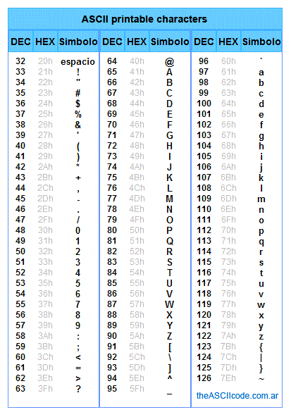
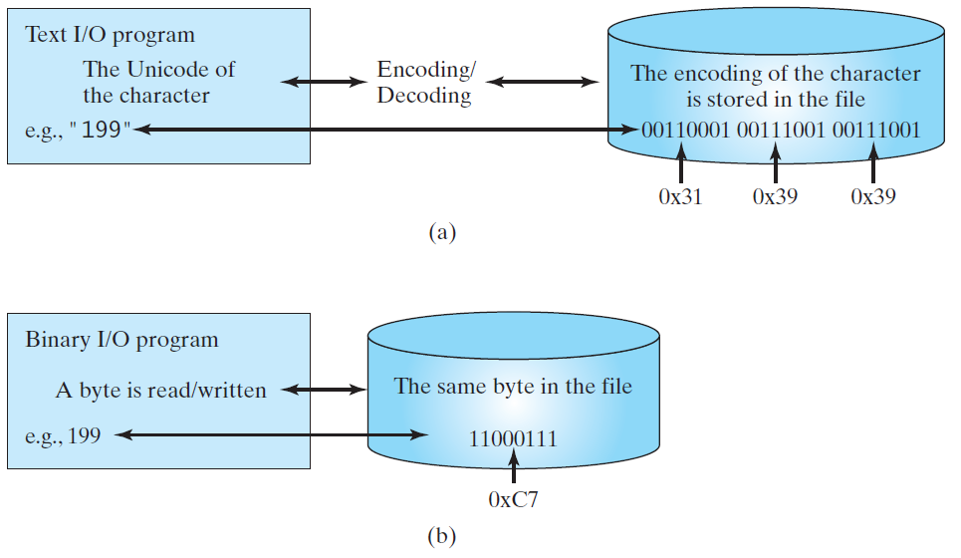
Text I/O vs. Binary I/O
The encoding scheme for representing a character in a Java program is the Unicode.
By default, a text file is encoded using ASCII in Windows. The JVM:
  Converts Unicode to a file specific encoding when writing a character.
  Converts a file-specific encoding to Unicode when reading a character.
Binary is efficient as it does not require conversions.
Text I/O requires encoding and decoding
Characters are encoded/decoded when written/read to/from the file.
The original byte is read/written from/to the file.
Notes:
Encoding and decoding are automatically performed for text I/O. The JVM converts Unicode to a file specific encoding when writing a character, and converts a file-specific encoding to Unicode
when reading a character. For example, suppose you write the string "199" using text I/O to
a file, each character is written to the file. Since the Unicode for character 1 is 0x0031, the
Unicode 0x0031 is converted to a code that depends on the encoding scheme for the file. (Note
the prefix 0x denotes a hex number.) In the United States, the default encoding for text files on
Windows is ASCII. The ASCII code for character 1 is 49 (0x31 in hex) and for character 9 is
57 (0x39 in hex). Thus, to write the characters 199, three bytes—0x31, 0x39, and 0x39—are
sent to the output.
Binary I/O does not require conversions. If you write a numeric value to a file using binary
I/O, the exact value in the memory is copied into the file. For example, a byte-type value 199
is represented as 0xC7 (1 9 9 = 1 2 * 1 6 1 + 7 ) in the memory and appears exactly as 0xC7
in the file, as shown in Figure 17.2b. When you read a byte using binary I/O, one byte value
is read from the input

Slide 51
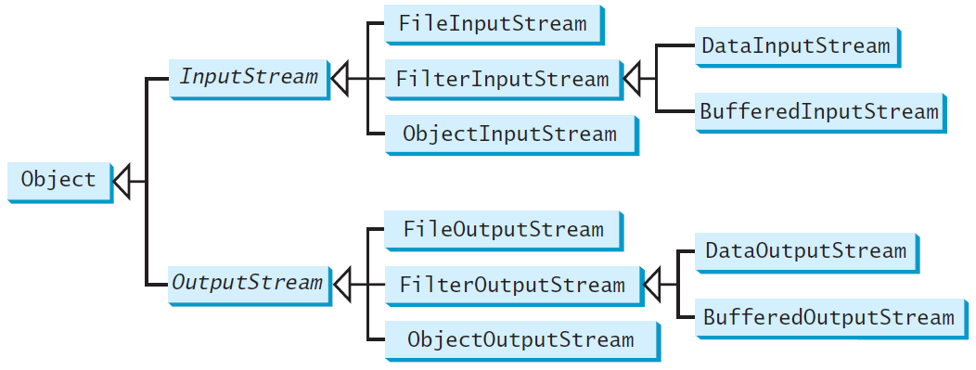
Binary I/O Classes
InputStream and OutputSream are abstract classes.
The design of the Java I/O classes is a good example of applying inheritance.
InputStream is the root for binary input classes.
OutputStream is the root for binary output classes.
Common operations are generalized in superclasses
Subclasses provide specialized operations
Notes:
The design of the Java I/O classes is a good example of applying inheritance, where common operations are generalized in superclasses, and subclasses provide specialized operations.

Slide 52
InputStream
The value returned is a byte as an int type.
java.io.InputStream
+read(): int +read(b: byte[]): int +read(b: byte[], off: int, len: int): int +available(): int +close(): void +skip(n: long): long +markSupported(): boolean +mark(readlimit: int): void +reset(): void
Reads the next byte of data from the input stream. The value byte is returned as an int value in the range 0 to 255. If no byte is available because the end of the stream has been reached, the value –1 is returned.
Reads up to b.length bytes into array b from the input stream and returns the actual number of bytes read. Returns -1 at the end of the stream.
Reads bytes from the input stream and stores into b[off], b[off+1], …, b[off+len-1]. The actual number of bytes read is returned. Returns -1 at the end of the stream.
Returns the number of bytes that can be read from the input stream.
Closes this input stream and releases any system resources associated with the stream.
Skips over and discards n bytes of data from this input stream. The actual number of bytes skipped is returned.
Tests if this input stream supports the mark and reset methods.
Marks the current position in this input stream.
Repositions this stream to the position at the time the mark method was last called on this input stream.
All the methods in the binary I/O classes are declared to throw IOException or a subclass of IOException.
Notes:
read(): reads one byte of data, returns the byte as an integer value. Return -1 if the end of the file is reached.
read(byte[]): reads a chunk of bytes to the specified byte array, up to the size of the array. This method returns -1 if there’s no more data or the end of the file is reached.
If an InputStream subclass supports the mark() and reset() methods, then that subclass should override the markSupported() to return true. If the markSupported() method returns false then mark() and reset() are not supported.

Slide 53
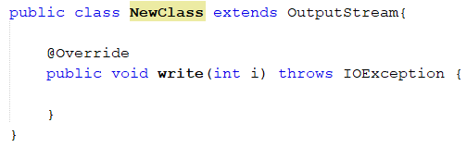
OutputStream
An output stream accepts output bytes and sends them to some sink.
Subclasses of OutputStream must provide an implementation for the write​(int b) method.
The byte to be written is the eight low-order bits of the argument b. The 24 high-order bits of b are ignored.
java.io.OutputStream
+write(int b): void +write(b: byte[]): void +write(b: byte[], off: int, len: int): void +close(): void +flush(): void
Writes the specified byte to this output stream. The parameter b is an int value. (byte) b is written to the output stream.
Writes all the bytes in array b to the output stream.
Writes b[off], b[off+1], …, b[off+len-1] into the output stream.
Closes this output stream and releases any system resources associated with the stream.
Flushes this output stream and forces any buffered output bytes to be written out.
Notes:
imilarly, the abstract class OutputStream defines two primary methods for writing bytes to an output stream:
write(int): writes the specified byte to the output stream.
write(byte[]): writes the specified array of bytes to the output stream.

Slide 54
FileInputStream/FileOutputStream
Reading/writing bytes from/to files.
All the methods in these classes are inherited from their super classes.
Notes:
All the methods in these classes are inherited from InputStream and OutputStream.
FileInputStream/FileOutputStream do not introduce new methods. To construct a
FileInputStream, use the constructo

Slide 55
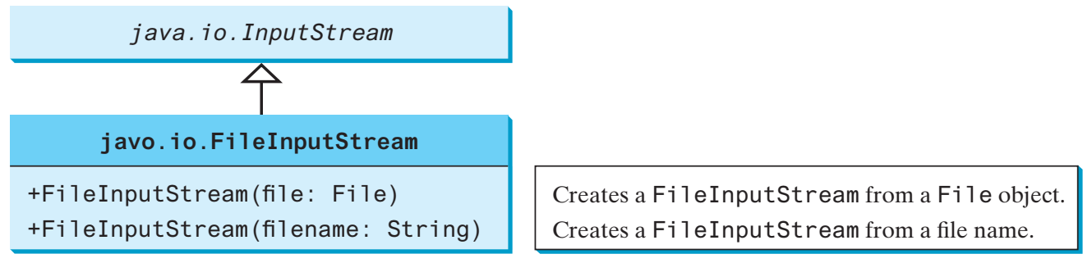
FileInputStream
A FileInputStream obtains input bytes from a file in a file system.
  FileInputStream is meant for reading streams of raw bytes such as image data.
  FileNotFoundException would occur if you attempt to create a FileInputStream with a nonexistent file.
To construct a FileInputStream, use one of the above constructors
Notes:
To construct a FileInputStream, use the following constructors:
public FileInputStream(String filename)
public FileInputStream(File file)

Slide 56
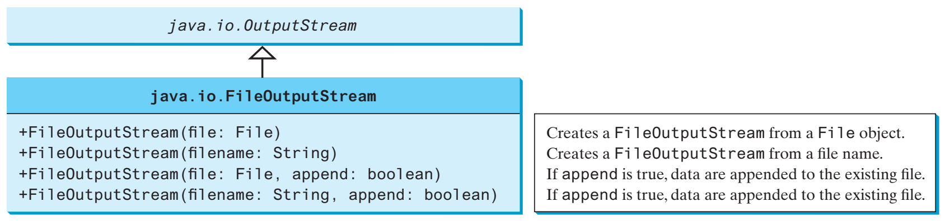
FileOutputStream
A FileOutputStream is meant for writing streams of raw bytes such as image data.
  If the file does not exist, a new file would be created.
  If the file already exists, the first two constructors would delete the current contents in the file.
  To append new data into the file, use the last two constructors by passing true to the append parameter.
To construct a FileOutputStream, use the one of the above constructors:
Notes:
If the file does not exist, a new file would be created.
If the file already exists, the first two constructors would delete the current contents in the file.
To retain the current content and append new data into the file, use the last two constructors by passing true to the append parameter.

Slide 57
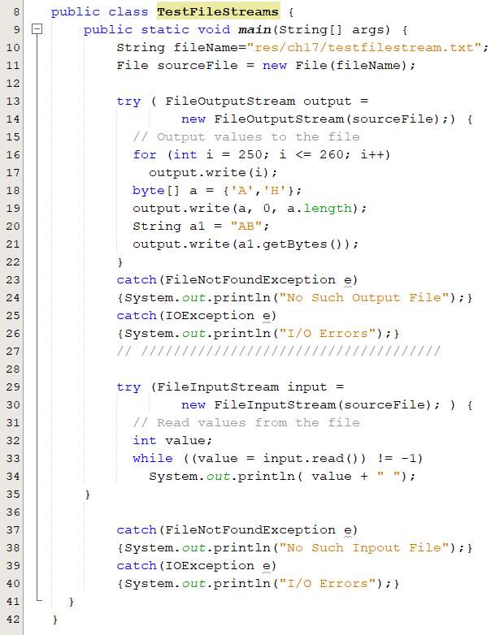
FileOutputStream: Example
Output
250
251
252
253
254
255
0
1
2
3
4
65
72
65
66
Notes:
If the file does not exist, a new file would be created.
If the file already exists, the first two constructors would delete the current contents in the file.
To retain the current content and append new data into the file, use the last two constructors by passing true to the append parameter.

Slide 58
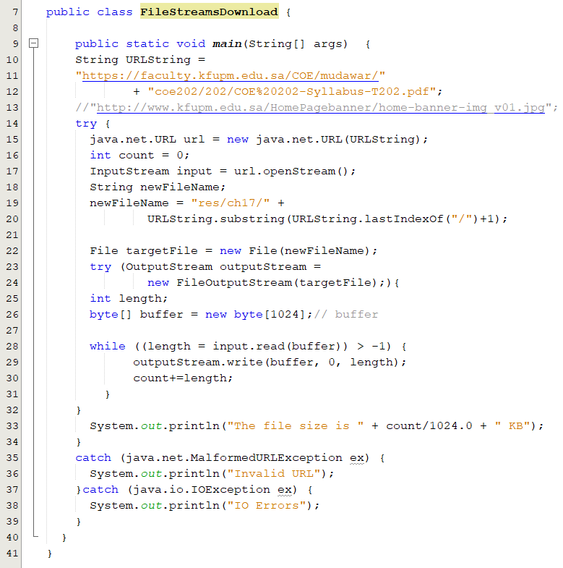
File Download
OUT OF THE BOOK

Slide 59
Object I/O Streams
Enables you to perform I/O for objects in addition for primitive type values and strings.

Slide 60
ObjectInputStream
Allows to read Java objects from an InputStream instead of just raw bytes.
You wrap an InputStream in a ObjectInputStream and then you can read objects from it.
  ObjectInputStream obj = new ObjectInputStream(new FileInputStream(“file"));
The readObject() method may throw java.lang.ClassNotFoundException
Notes:
ObjectInputStream extends InputStream and implements ObjectInput and ObjectStreamConstants.

Slide 61
ObjectOutputStream
Write Java objects to an OutputStream instead of just raw bytes.
  The method writeObject is used to write an object to the stream
Primitive data types can also be written to the stream.
  .writeInt(12345); .writeUTF("John"); .writeDouble(85.5);
Only objects that support the Serializable interface can be written to streams.
  Class MyClass implements Serializable. a marker interface
You wrap an OutputStream in a ObjectOutputStream and then you can read objects from it.
  ObjectOutputStream obj = new ObjectOutputStream(new FileOutputStream(“file"));
Notes:
The Java ObjectOutputStream class (java.io.ObjectOutputStream) enables you to write Java objects to an OutputStream instead of just raw bytes. You wrap an OutputStream in a ObjectOutputStream and then you can write objects to it.

Slide 62
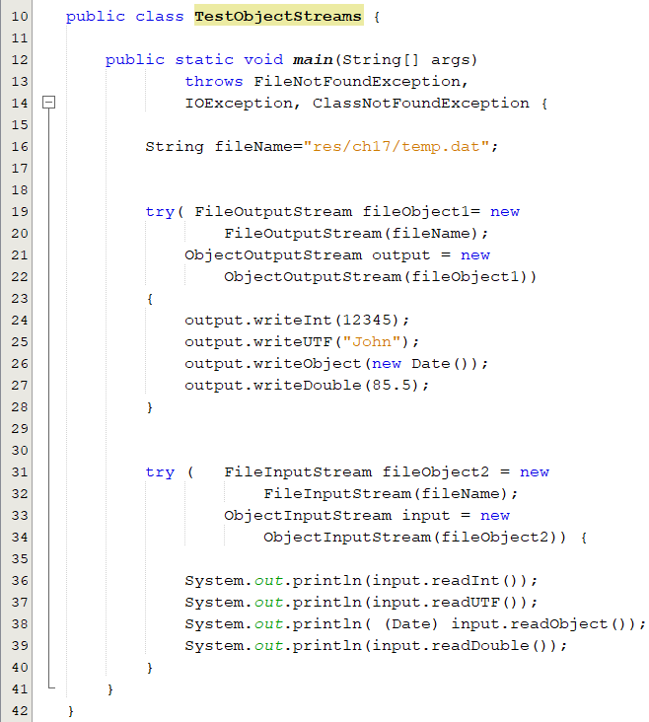
Object I/O Streams: Example(1)
The objects must be read back from the corresponding ObjectInputstream with the same types and in the same order as they were written.

Slide 63
The Serializable Interface
Not all objects can be written to an object stream.
  Must implement the Serializable interface.
  A serializable object is an instance of the java.io.Serializable interface
The Serializable interface is a marker interface.
  It has no methods, so you don't need to add additional code in your class that implements Serializable.
Implementing this interface enables the Java serialization mechanism to automate the process of storing the objects and arrays.
When an object is written for the first time, a serial number is created for it.
  Only the serial number is stored if the same object is written again.
Notes:
When an object of the Foo class is serialized, only variable v1 is serialized. Variable v2 is not serialized because it is a static variable, and variable v3 is not serialized because it is marked transient. If v3 were not marked transient, a java.io.NotSerializableException would occur.

Slide 64
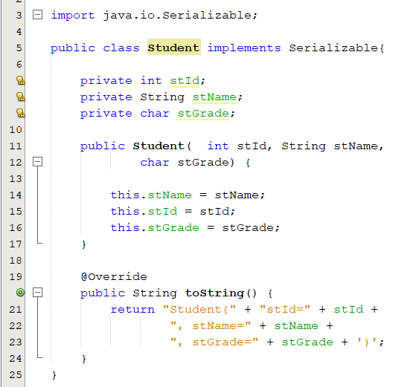
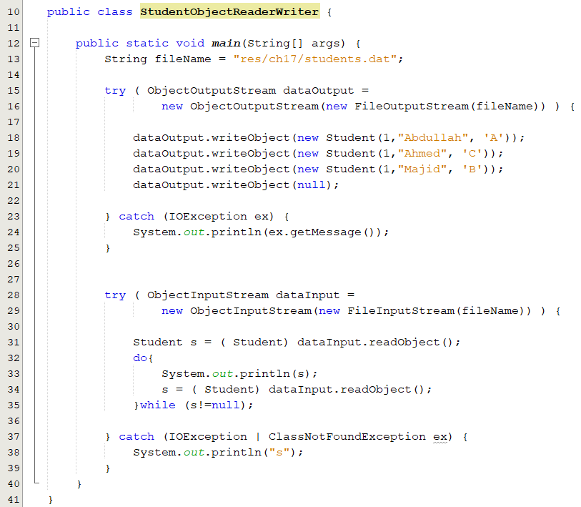
Example

Slide 65
The transient Keyword
If an object is an instance of Serializable, but it contains non-serializable instance data fields, can the object be serialized? No.
  To enable the object to be serialized, mark these data fields with the transient keyword to tell the JVM to ignore these fields when writing the object to an object stream.
public class Foo implements java.io.Serializable {
private int v1;
private static double v2;
private transient A v3 = new A();
}
class A { } // A is not serializable
When an object of the Foo class is serialized.
  variable v1 is serialized.
  Variable v2 is not serialized because it is a static variable.
  variable v3 is not serialized because it is marked transient.
If v3 were not marked transient, a NotSerializableException would occur.
Notes:
When an object of the Foo class is serialized, only variable v1 is serialized. Variable v2 is not serialized because it is a static variable, and variable v3 is not serialized because it is marked transient. If v3 were not marked transient, a java.io.NotSerializableException would occur.

Slide 66
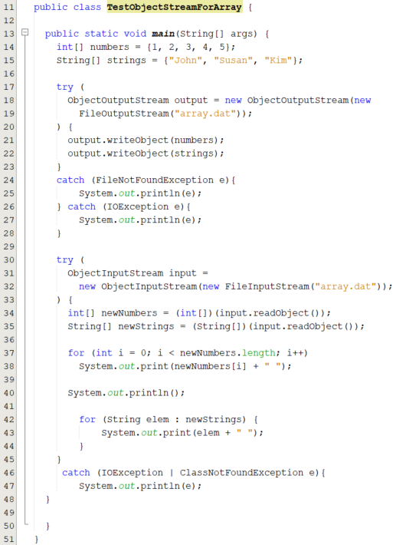
Serializing Arrays
An array is a serializable if all its elements are serializable.
So an entire array can be saved using writeObject into a file and later restored using readObject.
Here is an example that stores an array of five int values and an array of three strings, and reads them back to display on the console.

