Slide 1
Module 09: Recursion
Chapter 18

Slide 2
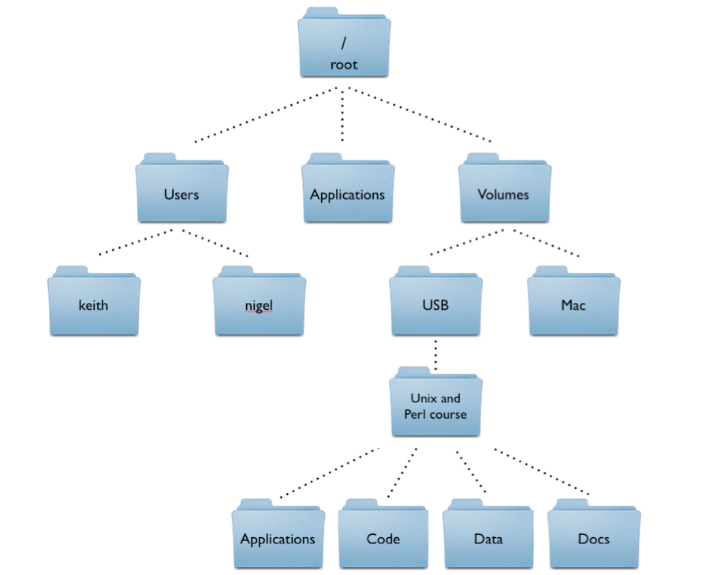
Motivation
How do you compute the size of the root directory?

Slide 3
Objectives
To describe what a recursive method is and the benefits of using recursion (§18.1).
To develop recursive methods for recursive mathematical functions (§§18.2–18.3).
To explain how recursive method calls are handled in a call stack (§§18.2–18.3).
To solve problems using recursion (§18.4).
To use an overloaded helper method to derive a recursive method (§18.5).

Slide 4
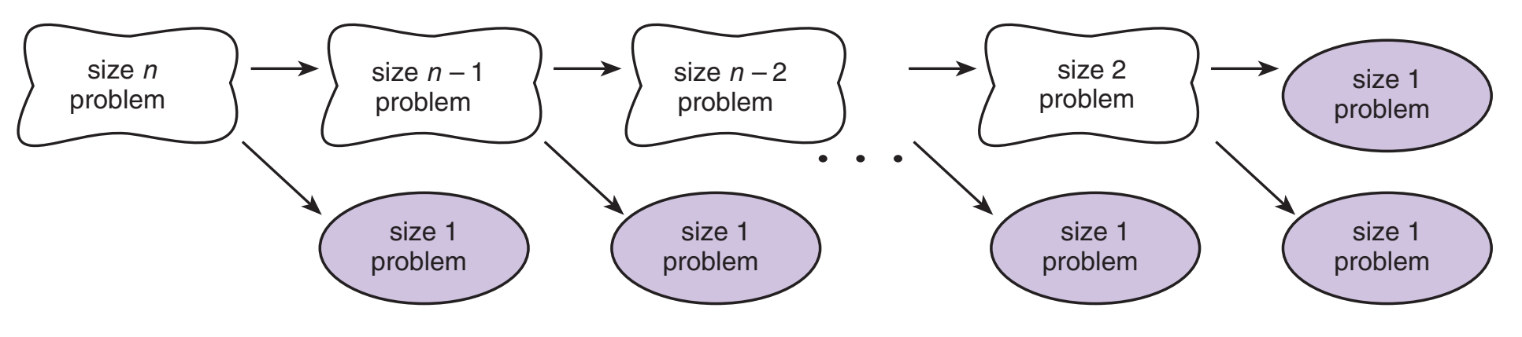
Recursion
A recursive method is one that invokes itself
Directly: a method f1 calls itself.
Indirectly: a method f1 calls a method f2 and f2 calls f1.
Recursion enables a recursive function to be repeated with different parameter value.
Recursion is based on the general problem solving technique of breaking down a task into subtasks
In particular, recursion can be used whenever one subtask is a smaller version of the original task.
Notes:
A method that calls itself is said to be recursive
Allows us to specify a very natural, simple solution to a problem that would otherwise be very difficult

Slide 5

Characteristics of Recursion
Problems that lend themselves to a recursive solution have the following characteristics:
One or more simple cases of the problem:
Have a straightforward, non-recursive solution.
They are used to stop the recursion.
The other cases can be redefined in terms of problems that are closer to the simple cases.
Every recursive call reduces the original problem, bringing it increasingly closer to a base case until it becomes that case.
n! = n * (n-1)!
0! = 1
$$f\left(n\right)= \left\{\begin{matrix}1 n=0 \\ \begin{aligned} \\ \\ \end{aligned} \\ n ∗ f\left(n−1\right) otherwise\end{matrix}\right\}$$
a simple/base/stopping case already solved.
a complex case redefined in terms of the original problem but less complex than the original.
Notes:
a case containing no recursive case.
when this case occurs recursion will end

Slide 6
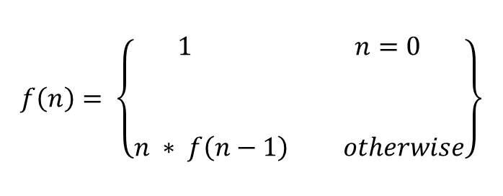
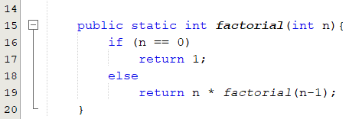
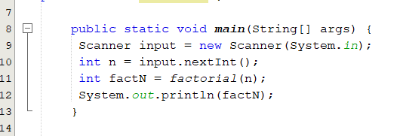
Implementing Recursive Methods
Recursive methods are implemented with if-else statement.
if (this is a base case)
solve it directly
else
redefine the problem using recursion

Slide 7
How Recursive Methods are Executed?
factorial(4) = 4 * factorial(3)
= 4 * (3 * factorial(2))
= 4 * (3 * (2 * factorial(1)))
= 4 * (3 * ( 2 * (1 * factorial(0))))
= 4 * (3 * ( 2 * ( 1 * 1))))
= 4 * (3 * ( 2 * 1))
= 4 * (3 * 2)
= 4 * (6)
= 24
Expansion in which the recursive step is applied until hitting the base step
Substitution in which the solution is constructed backwards starting with the
base step

Slide 8
factorial(4) Stack Trace

Slide 9
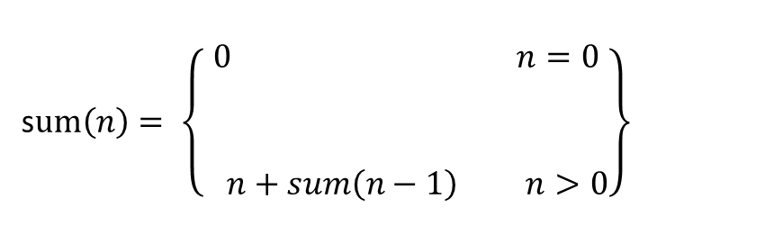
Recursive Methods: Example 1 ( sum 1..n)
Write a recursive method to find the sum of integer numbers between 1 and n
if (this is a base case)
solve it directly
else
redefine the problem using recursion
static int sum( int n){
if (n == 0)
return 0;
else
return n + sum(n-1);
}
s$um\left(n\right)= \left\{\begin{matrix}0 n=0 \\ \begin{aligned} \\ \\ \end{aligned} \\ n+sum\left(n−1\right) n>0\end{matrix}\right\}$

Slide 10
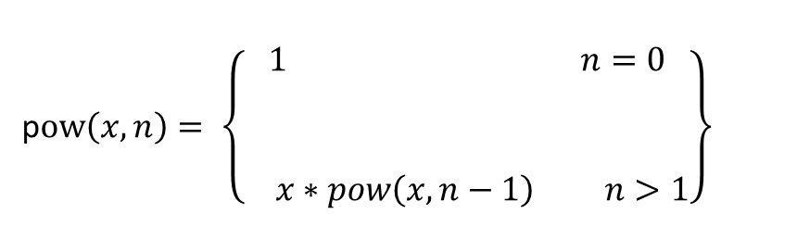
Recursive Methods: Example 2 ( x^{n})
Write a recursive method to find x^{n}.
if (this is a base case)
solve it directly
else
redefine the problem using recursion
static int pow( int x, int n){
if (n == 0)
return 1;
else
return x * pow(x,n-1);
}
p$ow\left(x,n\right)= \left\{\begin{matrix}1 n=0 \\ \begin{aligned} \\ \\ \end{aligned} \\ x∗pow\left(x,n−1\right) n>1\end{matrix}\right\}$

Slide 11
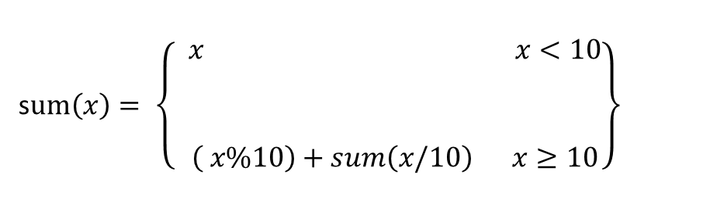
Recursive Methods: Example 3 (sum of digits)
Write a recursive method to find out the sum of all the digits of a given integer x.
if (this is a base case)
solve it directly
else
redefine the problem using recursion
s$um\left(x\right)= \left\{\begin{matrix} x x<10 \\ \begin{aligned} \\ \\ \end{aligned} \\ \left( x\%10\right)+sum\left(x/10\right) x≥10\end{matrix}\right\}$
static int sum( int x){
if (x < 10)
return x;
else
return (x%10) + sum(x/10);
}

Slide 12
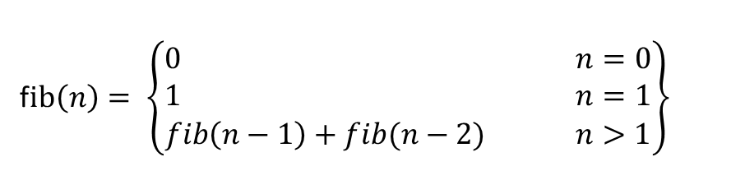
Recursive Methods: Example 4 (Fibonacci Numbers)
A recursive method to compute the n^{th} Fibonacci number.
Index | 0 | 1 | 2 | 3 | 4 | 5 | 6 | 7 | 8 | 9 | 10 | 11
value | 0 | 1 | 1 | 2 | 3 | 5 | 8 | 13 | 21 | 34 | 55 | 89
if (this is a base case)
solve it directly
else
redefine the problem using recursion
static int fib( int n){
if (n == 0 )
return 0;
if ( n == 1 )
return 1;
else
return fib(n-1)+fib(n-2);
}
f$ib\left(n\right)= \left\{\begin{matrix}\begin{matrix}0 & \begin{matrix} & \begin{matrix} & & \end{matrix} & \end{matrix} & n=0\end{matrix} \\ \begin{matrix}1 & \begin{matrix} & \begin{matrix} & & \end{matrix} & \end{matrix} & n=1\end{matrix} \\ \begin{matrix}fib\left(n−1\right)+fib(n−2) & & n>1\end{matrix}\end{matrix}\right\}$

Slide 13
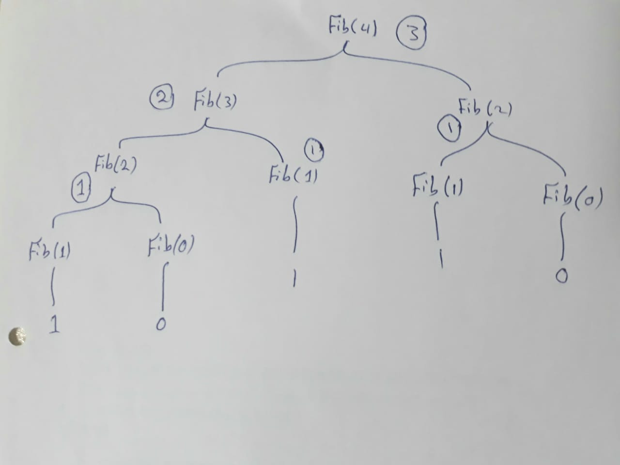
Fibonacci Numbers
static int fib( int n){
if (n == 0 )
return 0;
if ( n == 1 )
return 1;
else
return fib(n-1)+fib(n-2);
}
fib(4) = fib(3) + fib(2)
= (fib(2)+fib(1)) + fib(2)
= ((fib(1)+fib(0))+fib(1)) + fib(2)
= ((1+fib(0))+fib(1))+ fib(2)
= ((1+0)+fib(1))+ fib(2)
= (1+fib(1))+ fib(2)
= (1+1) + fib(2)
= 2 + fib(2)
= 2 + fib(1)+fib(0)
= 2 + 1 + fib(0)
= 3 + fib(0)
= 3 + 0

Slide 14
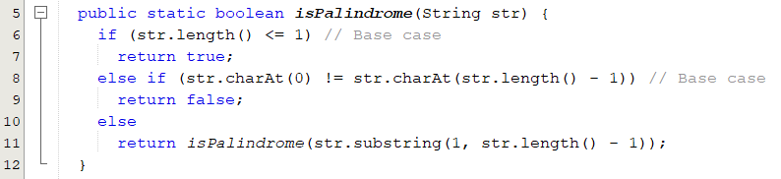
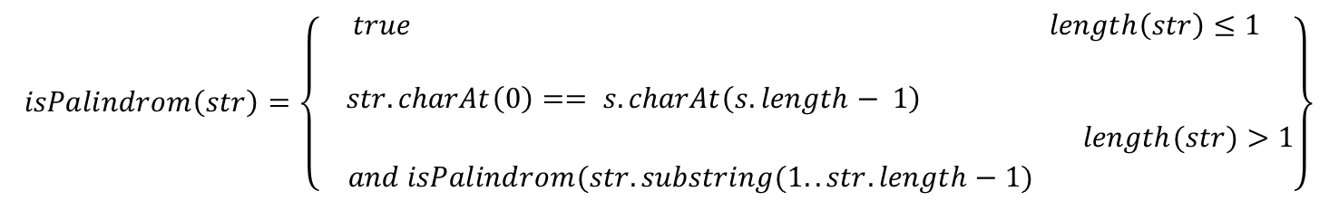
Recursive Methods: Example 5 (Is Palindrome)
Write a recursive method to check whether a given string is palindrome or not.
$$isPalindrom\left(str\right)=\left\{\begin{matrix}\begin{matrix}true & \begin{matrix} & & \end{matrix}\begin{matrix} & & \end{matrix}\begin{matrix} & & \end{matrix}\begin{matrix} & & \end{matrix} & length\left(str\right)≤1\end{matrix} \\ \\ \begin{matrix}\begin{matrix}str.charAt\left(0\right)== s.charAt\left(s.length− 1\right) & \begin{matrix} & \end{matrix}\begin{matrix} & \end{matrix}\begin{matrix} & \end{matrix} & \end{matrix} \\ \begin{matrix}\begin{matrix} & & length(str)>1\end{matrix} \\ \begin{matrix}and isPalindrom(str.substring(1..str.length−1) & \begin{matrix} & & \end{matrix} & \end{matrix}\end{matrix}\end{matrix}\end{matrix}\right\}$$

Slide 15
Recursive Helper Methods
The preceding recursive isPalindrome method is not efficient, because it creates a new string for every recursive call. To avoid creating new strings, use a helper method:
public static boolean isPalindrome(String s) {
return isPalindrome(s, 0, s.length() - 1);
}
public static boolean isPalindrome(String s, int low, int high) {
if (high <= low) // Base case
return true;
else if (s.charAt(low) != s.charAt(high)) // Base case
return false;
else
return isPalindrome(s, low + 1, high - 1);
}

Slide 16
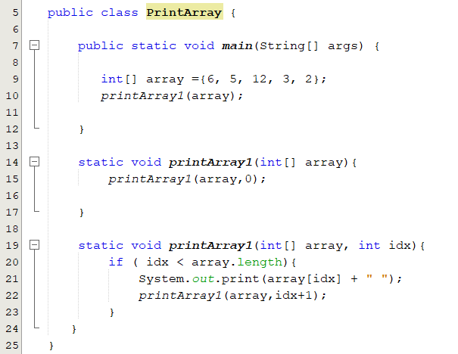
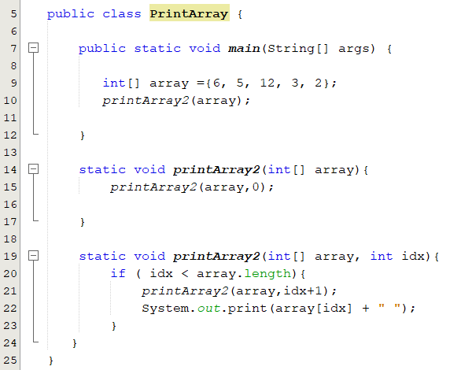
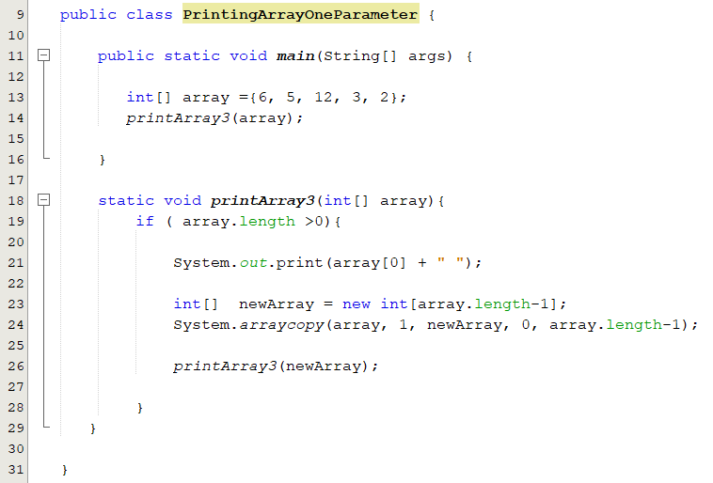
Recursive Helper Methods: Example 1 (Printing Array)

Slide 17
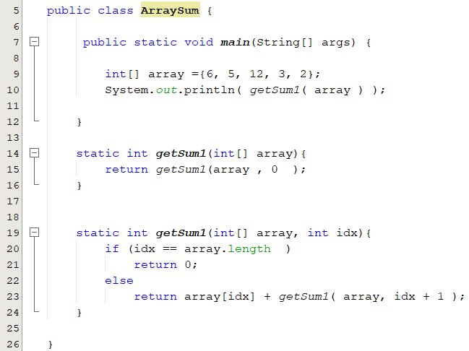
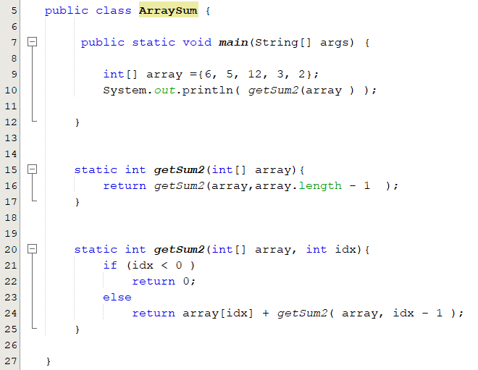
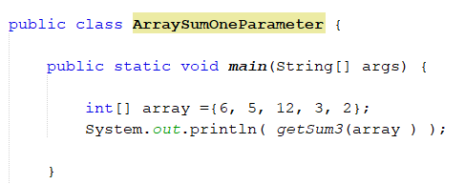
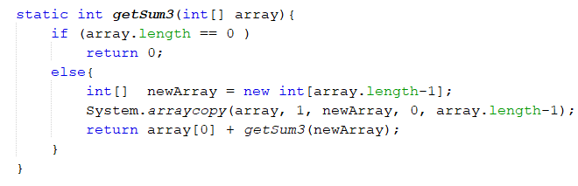
Recursive Helper Methods: Example 2 (Array Sum)

Slide 18
Problem Solving Using Recursion
Let us consider a simple problem of printing a message for n times. You can break the problem into two sub-problems:
one is to print the message one time and the other is to print the message for n-1 times.
The second problem is the same as the original problem with a smaller size. The base case for the problem is n==0.
You can solve this problem using recursion as follows:
public static void nPrintln(String message, int times) {
if (times >= 1) {
System.out.println(message);
nPrintln(message, times - 1);
}
}

Slide 19
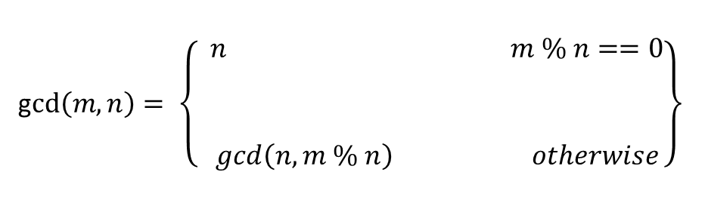
The Greatest Common Divisor (GCD)
The greatest common divisor (GCD) of two integers is the largest number that can evenly divide both integers.
public static int gcd(int m, int n) {
int gcd = 1;
int minNumber = Math.min(m,n);
for (int k = 2; k <= minNumber; k++) {
if (m % k == 0 && n % k == 0)
gcd = k;
}
return gcd;
}
t1 = Math.abs(m); t2 = Math.abs(n);
r = t1 % t2;
while (r != 0) {
t1 = t2;
t2 = r;
r = t1 % t2;
}
static int gcd(int m, int n)
{
if (m % n == 0)
return n;
else
return gcd(n, m % n);
}
g$cd\left(m,n\right)= \left\{\begin{matrix} n m \% n==0 \\ \begin{aligned} \\ \\ \end{aligned} \\ gcd\left(n, m \% n\right) otherwise\end{matrix}\right\}$

Slide 20
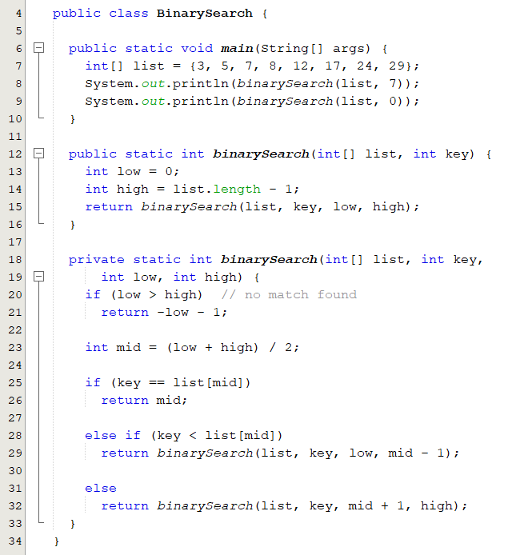
Recursive Binary Search
Case 1: If the key is equal to the middle element, the search ends with a match.
Case 2: If the key is less than the middle element, recursively search the key in the first half of the array.
Case 3: If the key is greater than the middle element, recursively search the key in the second half of the array.

Slide 21
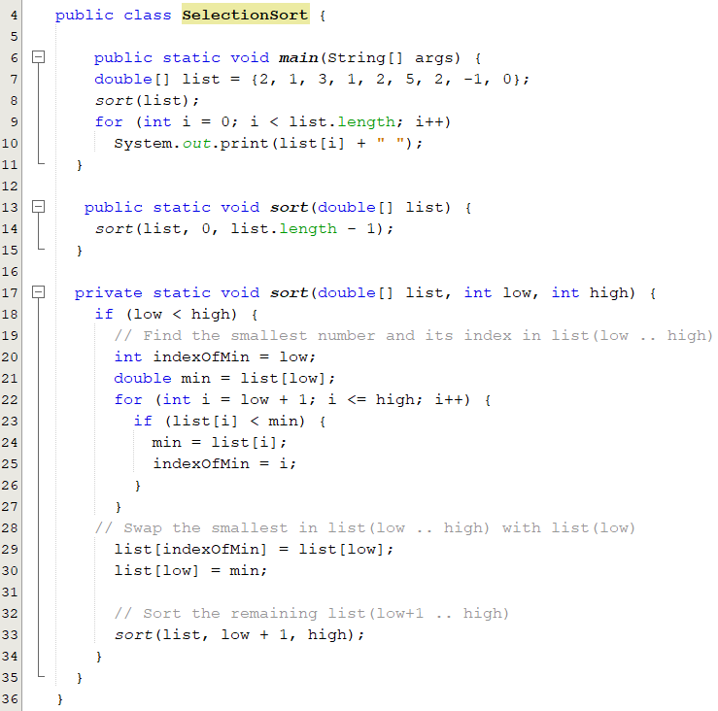
Recursive Selection Sort
Recall that selection sort finds the smallest element in the list and swaps it with the first element.
It then finds the smallest element remaining and swaps it with the first element in the remaining list and so on until the remaining list contains only a single element.

Slide 22
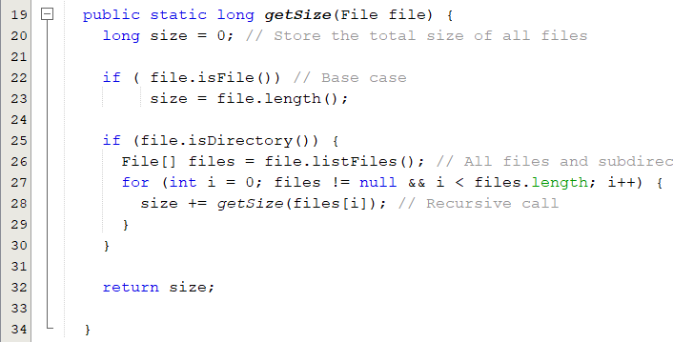
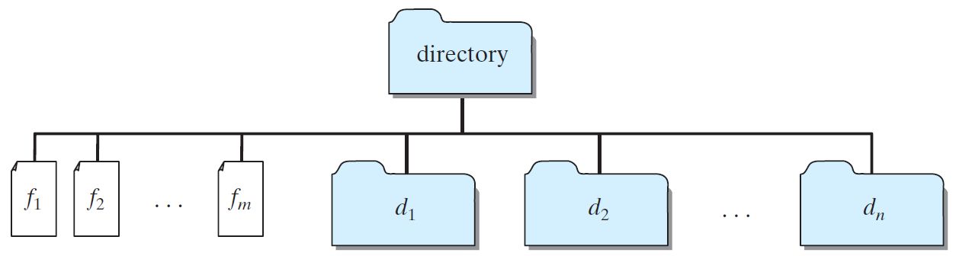
Case Study: Finding the Directory Size
Recursive methods are efficient for solving problems with recursive structures.
The size of the directory can be defined recursively as follows:

Slide 23
Recursion Vs. Iteration
There are two approaches to repeat code: loop and Recursion
Recursive methods are efficient for solving problems with recursive structures.
Iteration
Recursion
The repetition is controlled by the loop control structure.
More efficient in terms of memory and time.
Involves the use of variables to store the intermediate values during computation.
Loop condition determines whether to exit.
The method itself is called repeatedly.
Has substantial overhead, memory for local variables and parameters and time to manage the additional space.
Involves the use of the stack to store the intermediate values.
Condition tests for a base case.
Notes:
These two control flow mechanisms allow a computer to perform the same set of operations repeatedly
It often turns out that a natural way to design an algorithm involves using the same algorithm on one or more subcases.

Slide 24
Popup-Question(1)
How many times is the following method called?
public static long factorial( int n) {
return n * factorial(n − 1);
}
If recursion does not reduce the problem in a manner that allows it to eventually converge into the base case or a base case is not specified, infinite recursion can occur

Slide 25
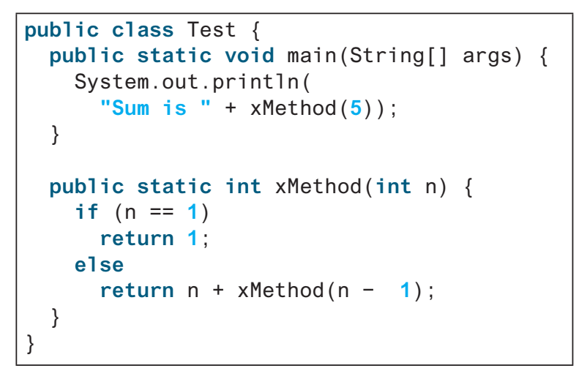
Popup-Question(2)
18.2.3 Show the output of the following programs and identify base cases and recursive calls.

Slide 26
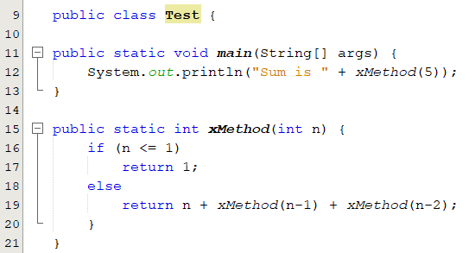
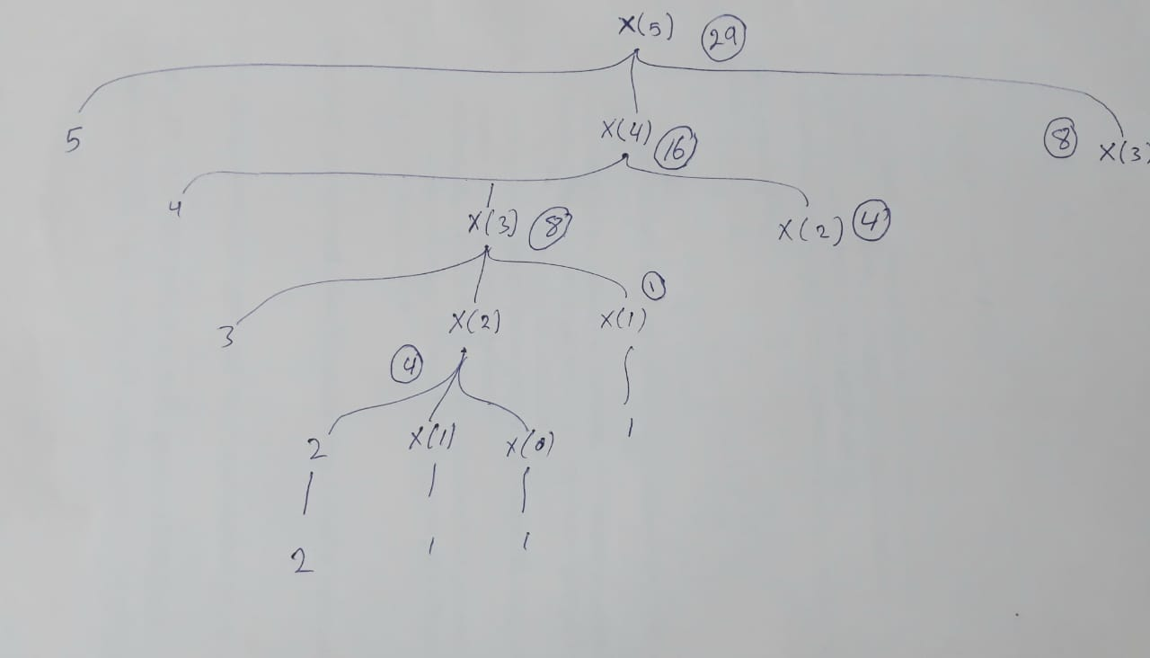
Popup-Question(3)
Show the output of the following programs and identify base cases and recursive calls.

Slide 27
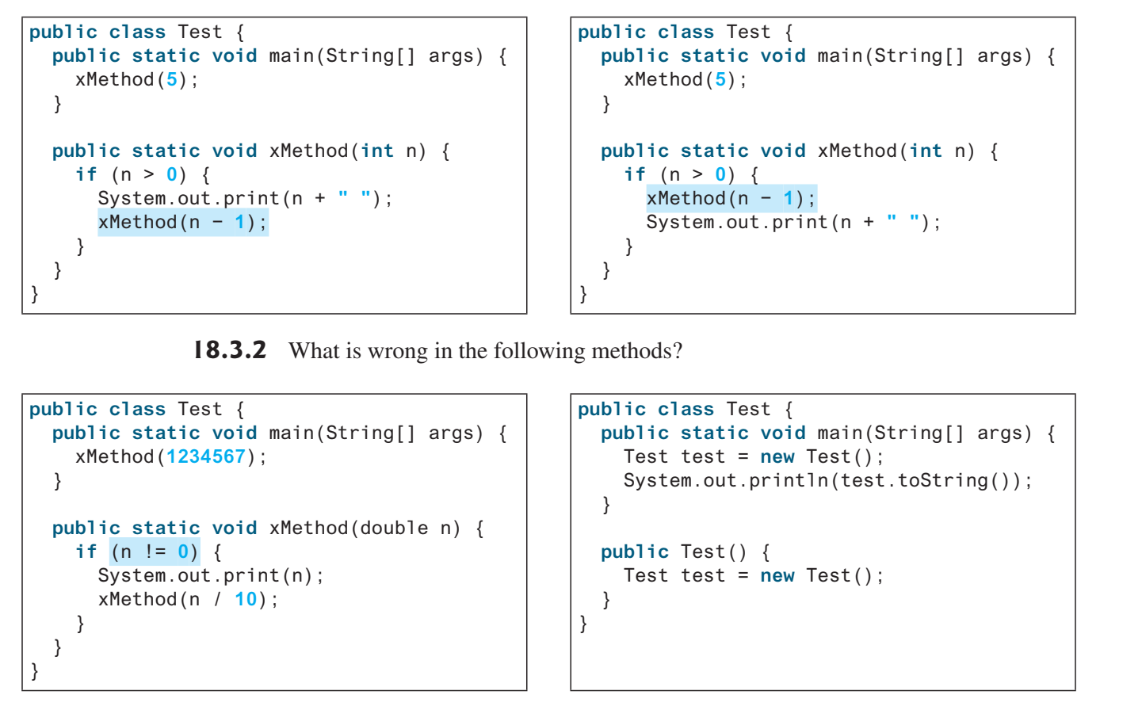
Popup-Question(4)
18.3.1 Show the output of the following two programs:

Slide 28
Popup-Question(5)
Consider the following recursive function.
What are the values of mystery(2, 25) and mystery(3, 11)?
public static int mystery(int a, int b) {
if ( b == 0 )
return 0;
if ( b % 2 == 0 )
return mystery( a+a , b/2 );
return mystery(a+a, b/2) + a;
}

Slide 29
Popup-Question(6)
Consider the following recursive functions.
What is the value of square(5)? cube(5)? cube(123)?
public static int square(int n) {
if (n == 0)
return 0;
return square(n-1) + 2*n - 1;
}
public static int cube(int n) {
if (n == 0)
return 0;
return cube(n-1) + 3*(square(n)) - 3*n + 1;
}

Slide 30
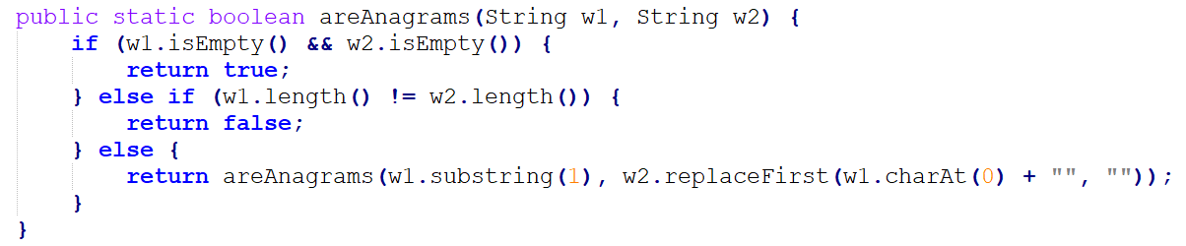
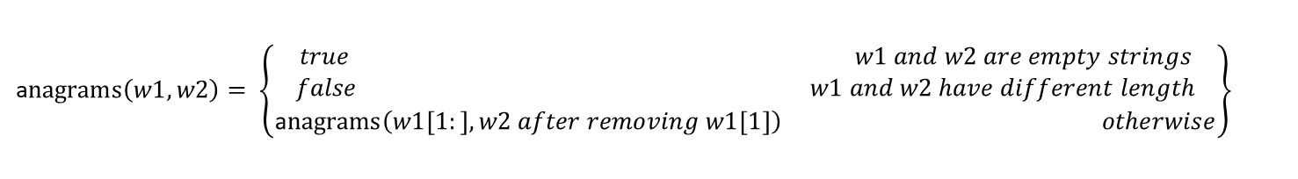
Programming Exercise(1)
*18.1 (Identifying anagrams) Two words are anagrams of each other if they contain the same letters that are arranged in different orders. Write a recursive method that can identify if two given words are anagrams of each other
a$nagrams\left(w1,w2\right)= \left\{\begin{matrix}\begin{matrix}true & \begin{matrix} & \begin{matrix} & & \end{matrix} & \end{matrix} & w1 and w2 are empty strings\end{matrix} \\ \begin{matrix}false & \begin{matrix} & & \end{matrix} & w1 and w2 have different length\end{matrix} \\ \begin{matrix}\text{a}nagrams\left(w1\left[1:\right],w2 after removing w1[1]\right) & & otherwise\end{matrix}\end{matrix}\right\}$

Slide 31
Programming Exercise(2)
18.4 Combinations refer to the combination of n things taken p at a time without repetition.
A recursive definition of C(n, p) is C(n, 0) = C(n, n) = 1, otherwise C(n, p) = C(n- 1, p) + C(n- 1, p-1).
public static long C(long n, long p) {
if ( n == p ) || ( p == 0 )
return 1;
else
return C(n - 1, p - 1);
}

Slide 32
Programming Exercise(3)
*18.10 (Occurrences of a specified character in a string) Write a recursive method that finds the number of occurrences of a specified letter in a string using the following method header
public static int count (String str, char a) {
if (str.length() == 0)
return 0;
else if (str.charAt(0) == a)
return 1 + count (str.substring(1), a) ;
else
return count (str.substring(1), a) ;
}
Rewrite Programming Exercise 18.10 using a helper method to pass the substring high index to the method.
The helper method header is
public static int count(String str, char a, int high)

Slide 33
Programming Exercise(4)
*18.21 (Decimal to binary) Write a recursive method that converts a decimal number into a binary number as a string. The method header is public static String dec2Bin(int value)
public static String dec2Bin(int value) {
if (value == 0)
return "";
else
return dec2Bin(value / 2) + value % 2;
}

