Slide 1
Module 10: Searching and Sorting
Chapter 7

Slide 2
Declaration
Please note that information in this lecture is mainly taken from:
Liang, Y. Daniel - Introduction to Java programming and data structures, comprehensive version (2019, Pearson).

Slide 3
Objectives
To search elements using the linear or binary search algorithm (§7.10).
To sort an array using different approaches (§7.11).
To design, implement, and analyze insertion sort (§23.2).
To design, implement, and analyze bubble sort (§23.3).
To use the methods in the java.util.Arrays class (§7.12).
To design, implement, and analyze merge sort (§23.4).
To design, implement, and analyze quick sort (§23.5).

Slide 4
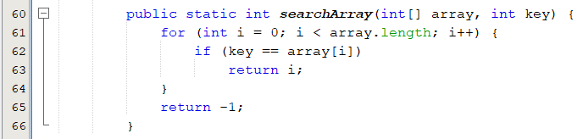
Searching Arrays: The Linear Search Approach
The process of looking for a specific element in an array.
discovering whether a certain value is included in a array.
The Linear Search Approach:
Compares the key sequentially with each element in the array.
It continues to do so until the key matches an element in the array, or the array is exhausted without a match being found.
If a match is made, the linear search returns the index of the element in the array that matches the key.
If no match is found, the search returns -1.

Slide 5
Searching Arrays: The Linear Search Approach
3
6 | 4 | 1 | 9 | 7 | 3 | 2 | 8
Key
array
3
6 | 4 | 1 | 9 | 7 | 3 | 2 | 8
3
6 | 4 | 1 | 9 | 7 | 3 | 2 | 8
3
6 | 4 | 1 | 9 | 7 | 3 | 2 | 8
3
6 | 4 | 1 | 9 | 7 | 3 | 2 | 8
3
6 | 4 | 1 | 9 | 7 | 3 | 2 | 8
Live example
3
6 | 4 | 1 | 9 | 7 | 3 | 2 | 8

Slide 6
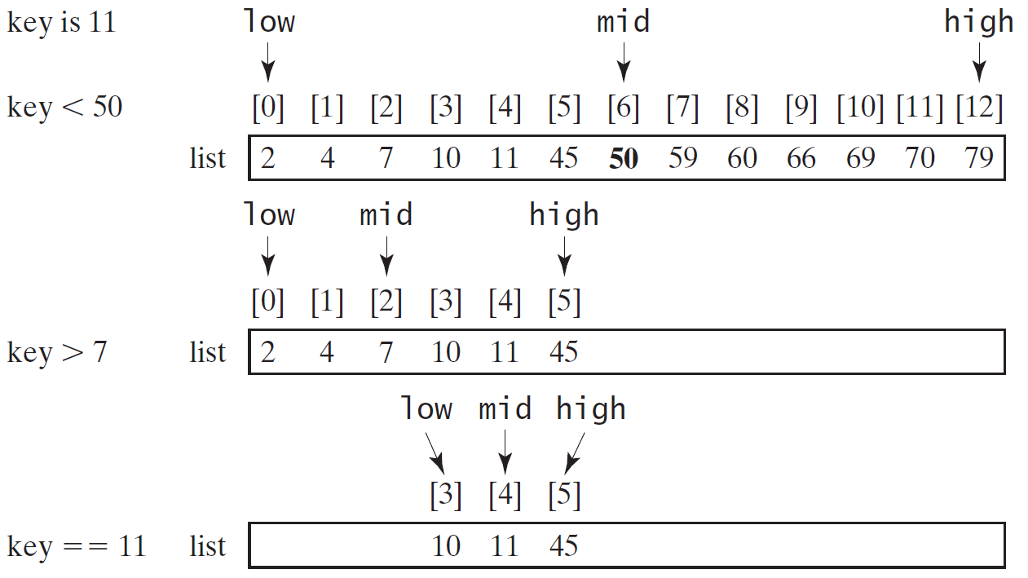
The Binary Search Approach(1/4)
For binary search to work, the elements in the array must already be ordered.
Live example

Slide 7
The Binary Search Approach(2/4)

Slide 8
The Binary Search Approach(3/4)
Elements in the array must already be ordered.
2 4 7 10 11 45 50 59 60 66 69 70 79
The binary search first compares the key with the element in the middle of the array.
If the key is equal to the middle element, the search ends with a match.
If the key is less than the middle element, you only need to search the key in the first half of the array.
If the key is greater than the middle element, you only need to search the key in the second half of the array

Slide 9
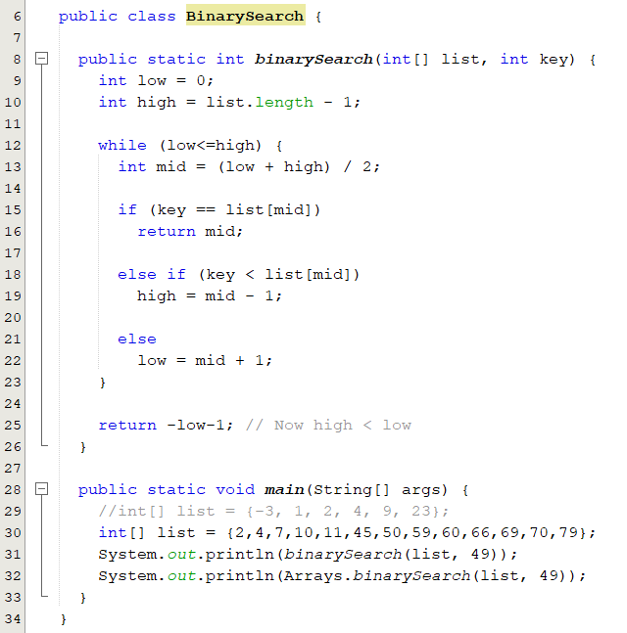
The Binary Search Approach(4/4)
The binarySearch method returns the index of the element in the list that matches the search key if it is contained in the list.
Otherwise, it returns
-insertion point - 1.
The insertion point is the point at which the key would be inserted into the list.
BinarySearch.java

Slide 10
Sorting
Sorting is a common task in computer programming.
There are three reasons for studying sorting algorithms.
They illustrate many creative approaches to problem solving.
Can be applied to solve other problems.
A good for practicing fundamental programming techniques using selection statements, loops, methods, and arrays.
Excellent examples to demonstrate algorithm performance.
The data to be sorted might be integers, doubles, characters, or objects.
Data are stored in an array.
Data are sorted in ascending order.

Slide 11
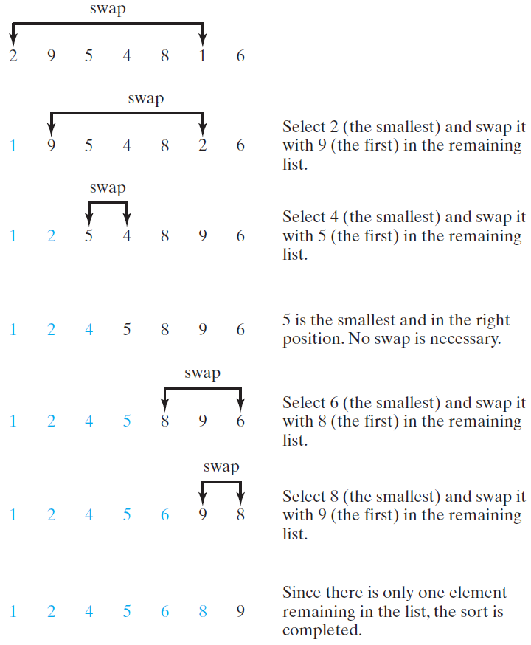
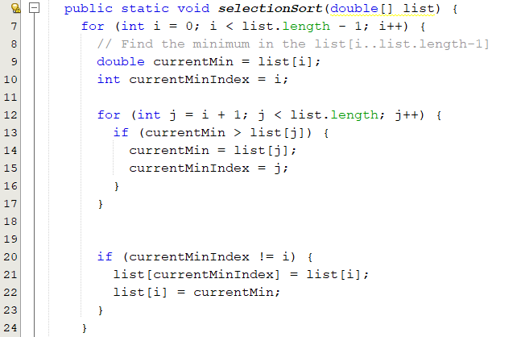
Selection Sort
Finds the smallest number in the list and places it first.
It then finds the smallest number remaining and places it second, and so on until the list contains only a single number.
SelectionSort.java

Slide 12
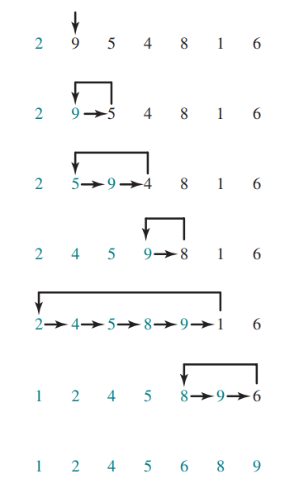
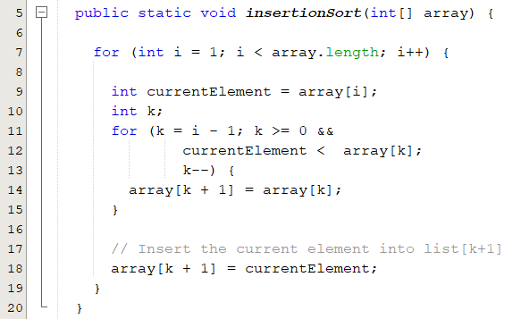
Insertion Sort
The insertion-sort algorithm sorts a list of values by repeatedly inserting a new element into a sorted sublist until the whole list is sorted
InsertionSort.java

Slide 13
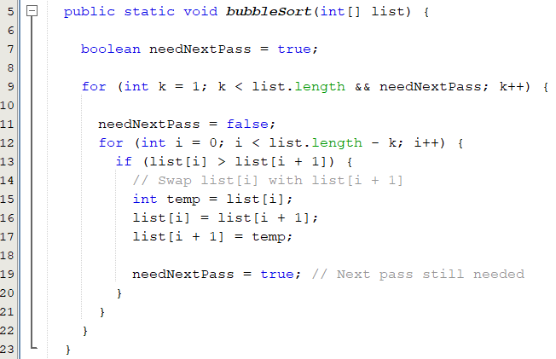
Bubble Sort
A bubble sort sorts the array in multiple passes.
Each pass successively swaps the neighboring elements if the elements are not in order
BubbleSort.java

Slide 14
The Arrays Class
The java.util.Arrays class contains various static methods for
Sorting and searching arrays
Arrays.sort(array);
Arrays.binarySearch(array,15);
Comparing arrays
Arrays.equals(array1, array2);
Filling array elements
Arrays.fill(array, 1);
Returning a string representation of the array.
Arrays.toString(array);
These methods are overloaded for all primitive types.

Slide 15
Merge Sort
mergeSort(list):
firstHalf = mergeSort(firstHalf);
secondHalf = mergeSort(secondHalf);
list = merge(firstHalf, secondHalf);

Slide 16
Merging Two Sorted Lists
Merging Two Sorted Lists

Slide 17
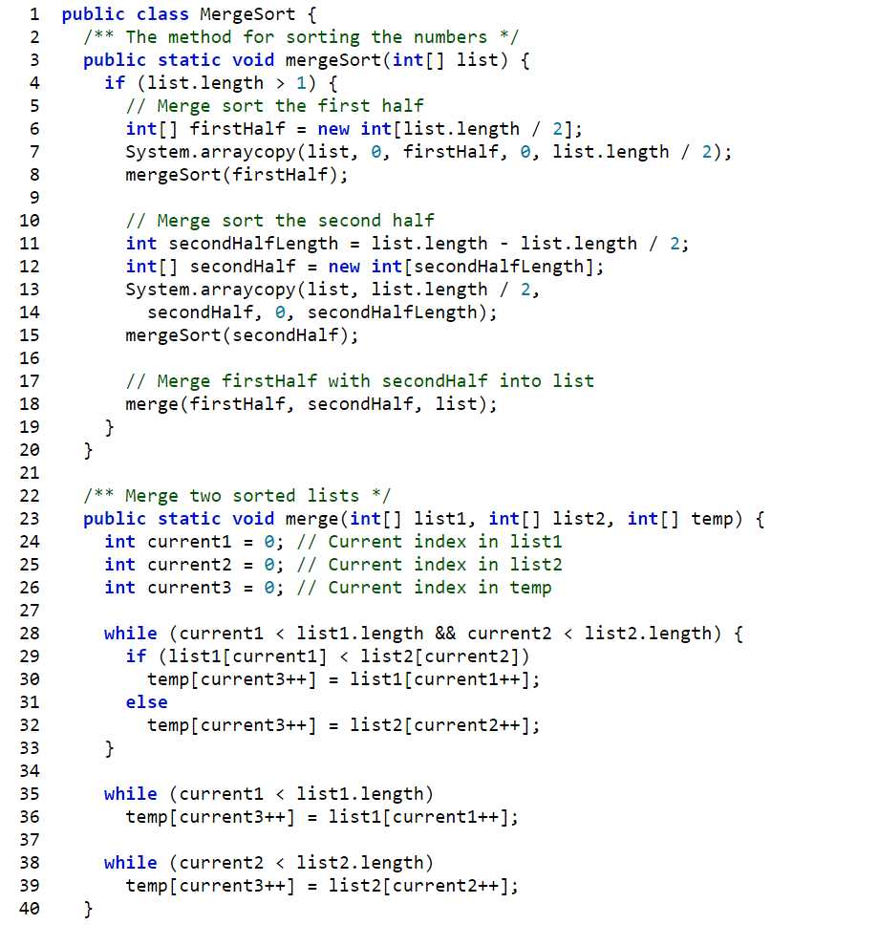
Merge Sort

Slide 18
Quick Sort
Quick sort, developed by C. A. R. Hoare (1962), works as follows: The algorithm selects an element, called the pivot, in the array. Divide the array into two parts such that all the elements in the first part are less than or equal to the pivot and all the elements in the second part are greater than the pivot. Recursively apply the quick sort algorithm to the first part and then the second part.

Slide 19
Quick Sort

Slide 20
Partition
Partition

Slide 21
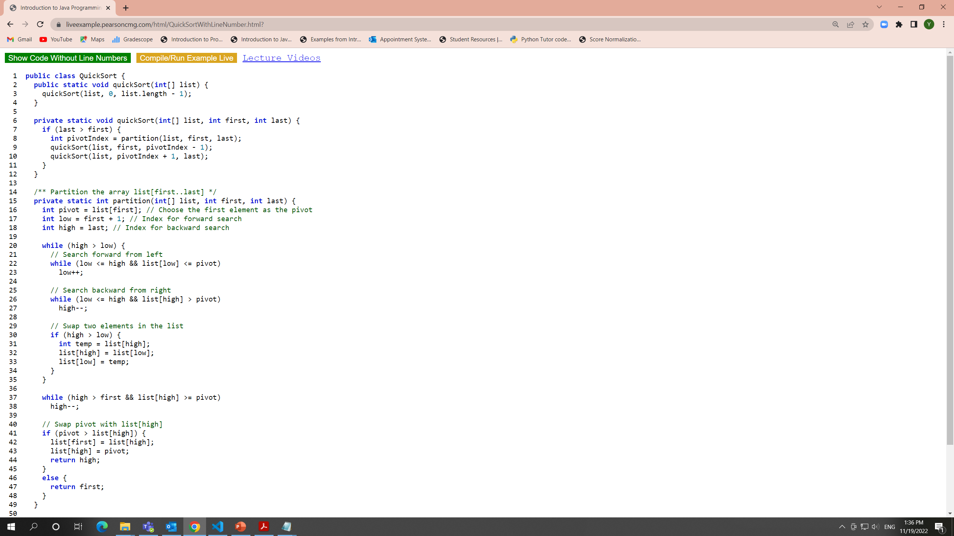
Quick Sort

